Slide 1

SAMSUNG PRISM
Generative AI
Hackathon
3rd Edition 2026 – 27
Theme ID - 1
Team Name - Mozimo
College Name - Thapar Institute of Engineering & Technology
Member Name & Email 1- Jasleen Kaur & jkaur2_be23@thapar.edu
Member Name & Email 2- NA
Member Name & Email 3- NA
Member Name & Email 4- NA
Submission Github link - https://github.com/jasleenkdev/agentic_code_intelligence

Slide 2
Theme
Theme: Agentic Code Intelligence — Code Retrieval
Given a query in natural language and a large library of code snippets, rank the snippets by relevance.
Constraints: CPU-only (minimal GPU); generation/explanation out of scope — retrieval only.
Goals: P0 Retrieval Accuracy → P1 Retrieval Across Versions → Bonus Evolutionary Retrieval.

Slide 3
Existing Solutions & Gaps
Feeding the whole codebase to an LLM: breaks on real-world scale (thousands of snippets), and LLM inference is far slower than a retrieval step should be.
Plain keyword/BM25 search: fast, but blind to intent — fails on natural-language queries with no shared vocabulary.
Generic sentence embeddings: not trained on code, weak at matching problem descriptions to implementations.
Most retrieval demos assume a static codebase — no support for versioning or near-duplicate code across commits.

Slide 4
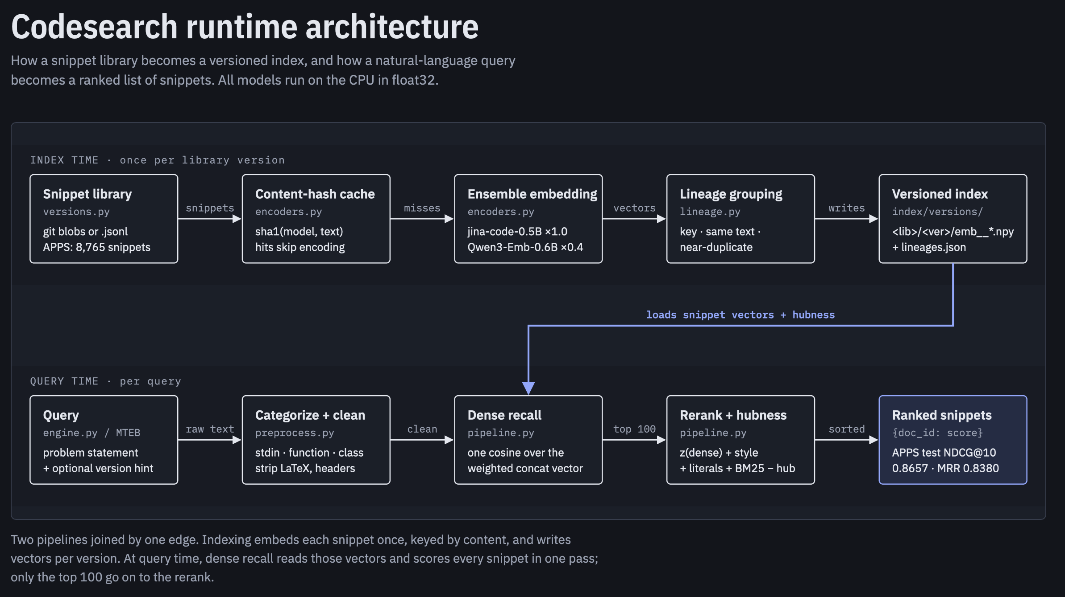
Our Solutions & Architecture Diagram
Two pipelines joined by one edge: index once per version, then serve any query in milliseconds.

Slide 5
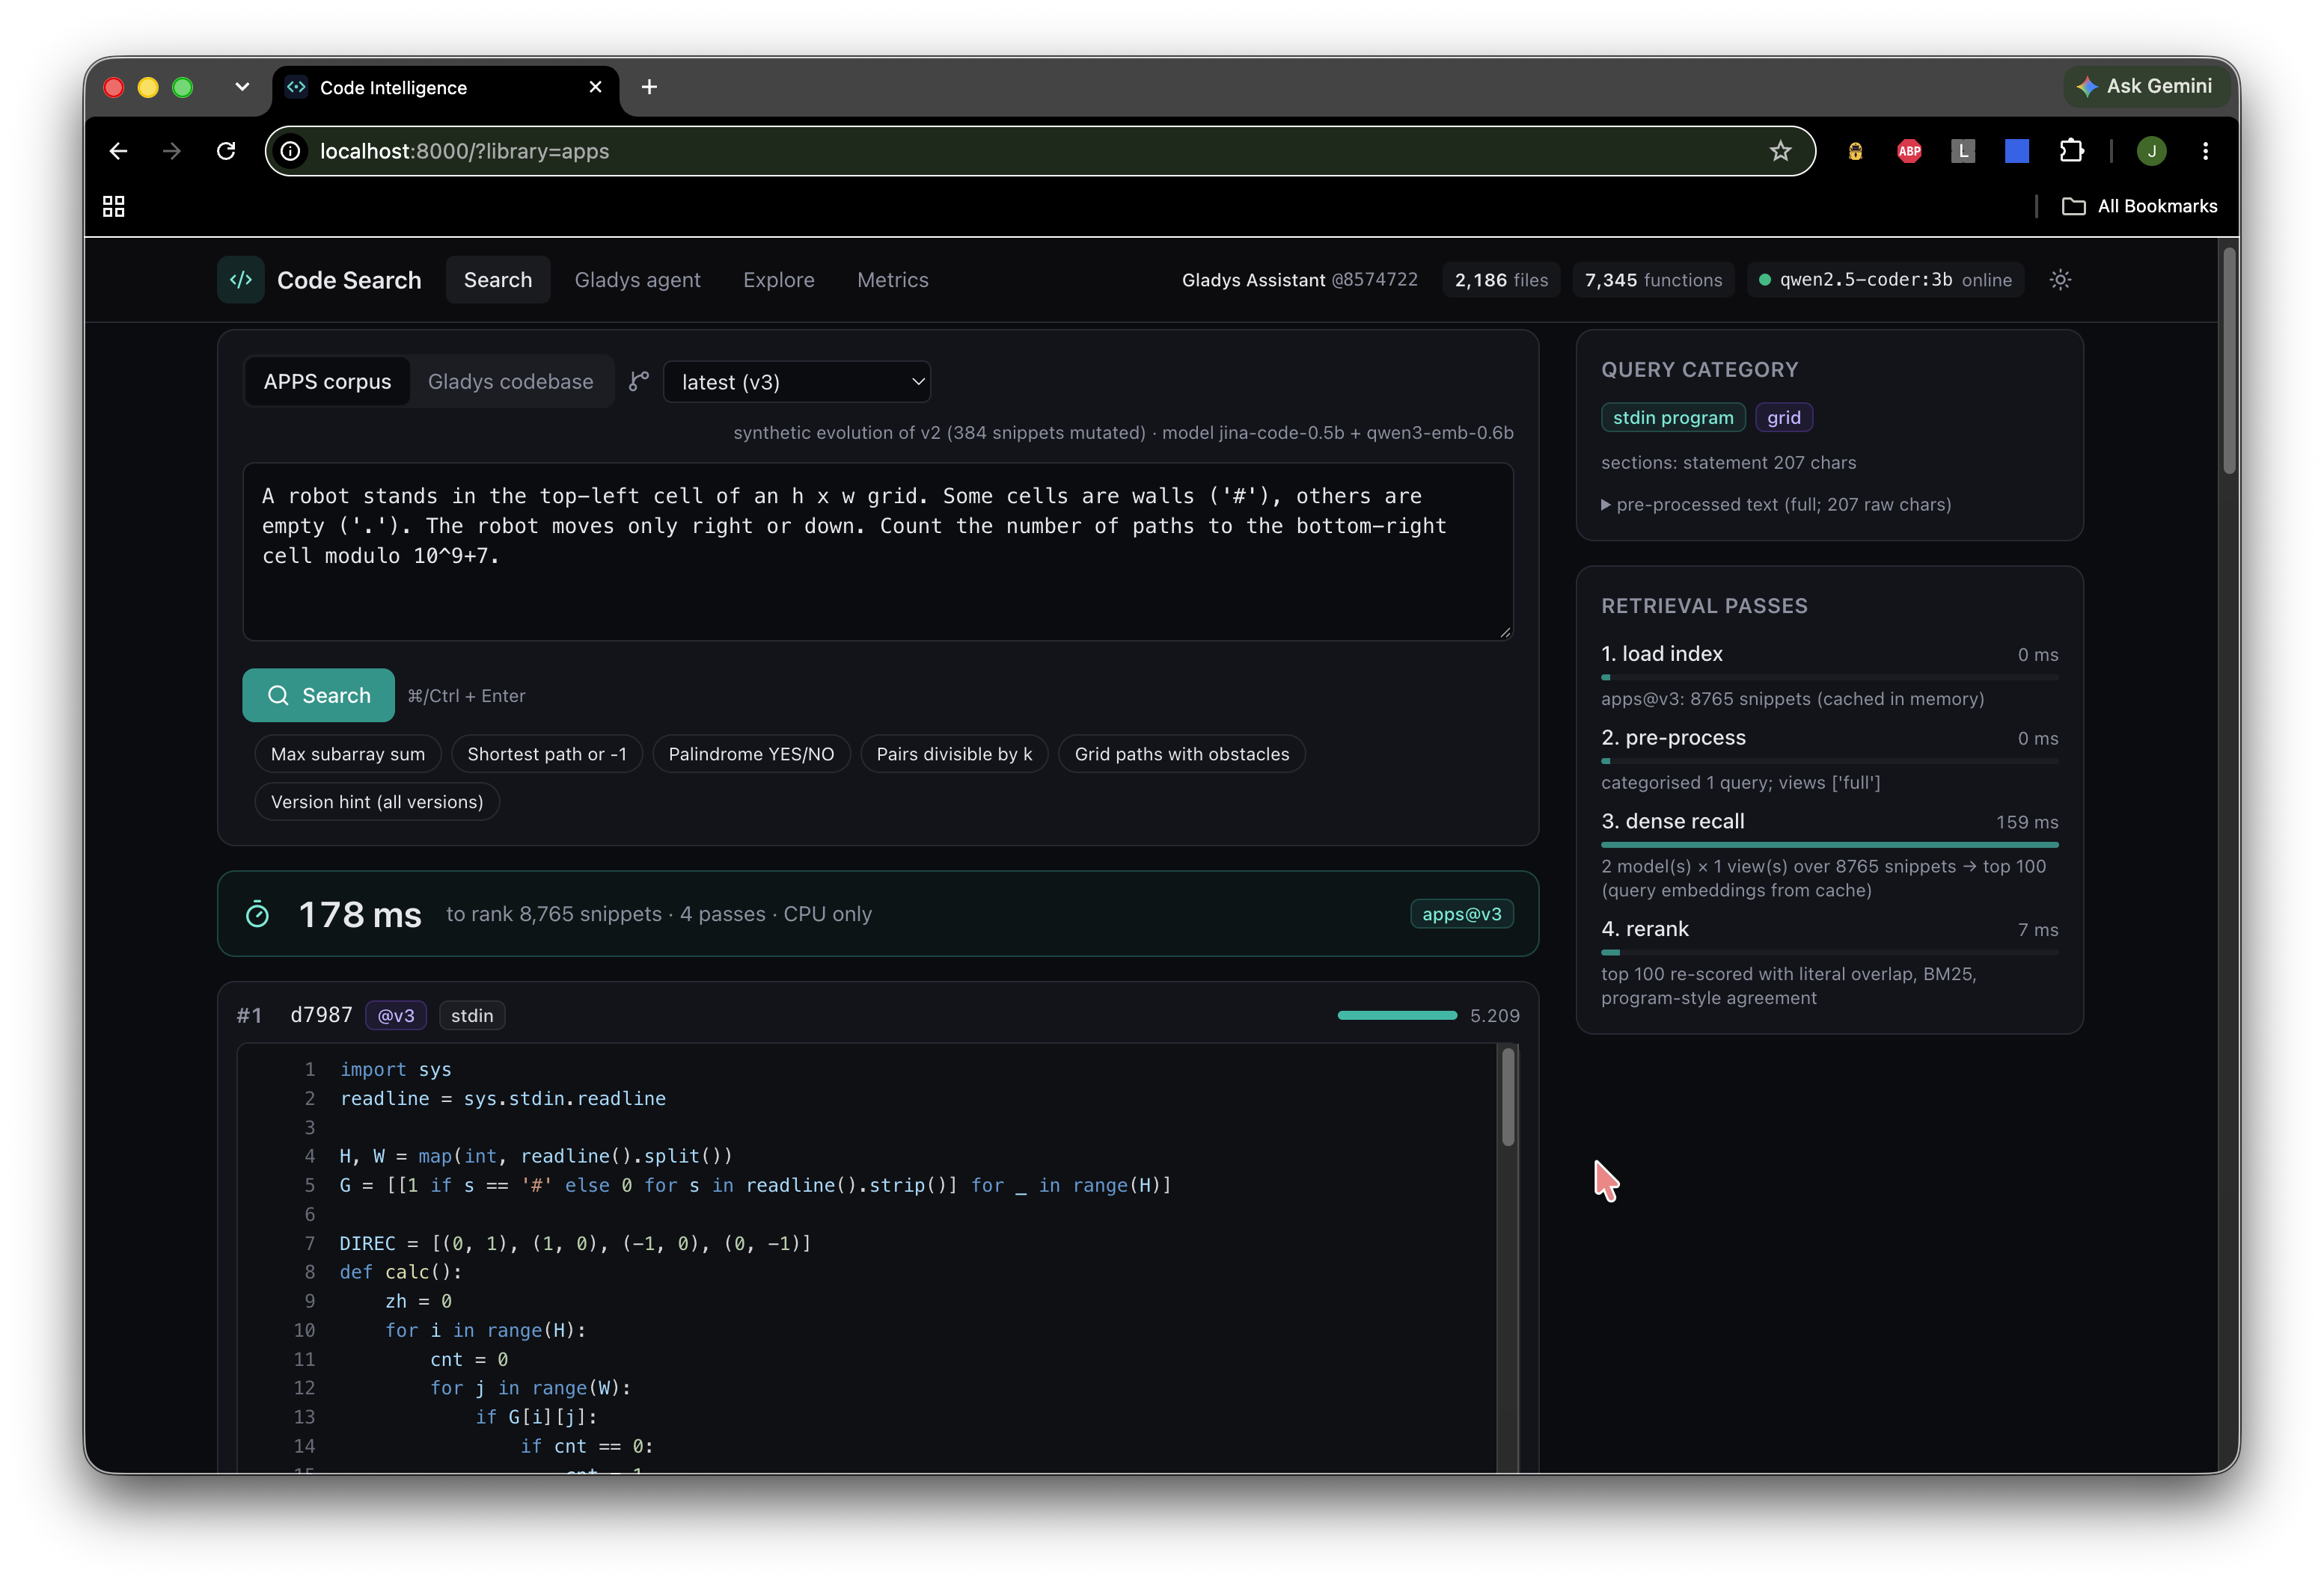
Demo & Product Walkthrough

Slide 6
Tools and tech stack used
Embeddings & evaluation: jina-code-embeddings-0.5B, Qwen3-Embedding-0.6B, SentenceTransformers, MTEB (official evaluation)
Backend: Python, FastAPI, SQLite
Frontend: React, TypeScript, Vite, Tailwind
Testing: Playwright, pytest
Optional: Ollama (secondary demo only)
Constraint: 100% CPU inference, no paid APIs

Slide 7
Impact & Use case
Faster bug fixing and onboarding in large codebases
Drop-in retrieval stage for any RAG/code-assistant pipeline
Codebase search that keeps working as the code evolves across versions

Slide 8
Innovation highlights, results and limitations
HIGHLIGHTS:
CALLOUT | NUMBER
NDCG@10 | 0.8657 on official CoIR APPS test split — matches a model 3× larger
+0.027 NDCG@10 | Gain over the same base model, from pre/post-processing alone
470s → 0.8s | Full rebuild vs. incremental update for a 1-file change
0.56 → 0.74 | De-duplicated NDCG@10, before vs. after lineage grouping
LIMITATION:- Base model's dev-split scores are contaminated by training overlap — only test-split numbers are used for comparison. Cold start ≈1h51m; all figures above are warm-cache.

Slide 9
What’s next
Stronger/larger code-embedding models as they become CPU-viable; git-hook-triggered incremental re-indexing
distillation to cut cold-start time
evaluation on additional code-retrieval benchmarks beyond APPS.

Slide 10
Brownie points slide( differentiation)
P1 and Bonus goals fully implemented and benchmarked, not just P0
Rigorous tuning discipline: test split touched exactly once, documented decision log for every design choice
Honest negative-results reporting (what was tried and rejected, and why)
Full working demo UI with live latency, not just a results file
Reproducible: 87 unit tests + 8 e2e tests, verified via independent clean-copy and cold-clone runs

Slide 11
Checklist- Updated on Public GitHub
Working prototype code — Y
README with reproducible setup instructions Y
Drive link: https://drive.google.com/file/d/15vH87EHcXKu_cyzX0yF3EVYZnRCamuJE/view?usp=sharing
Presentation file (PPT or PDF) Y

Slide 12
Thank you
Organised by the Language AI Team and the PRISM Team, Samsung R&D Institute India
Notes:
Closing slide. Add the Google Form URL and a contact email before sharing. Edition 2 organising team for reference: Language AI - Sourabh Tiwari, Gaurav, Sanjeeth Pothireddy, Gorang Maniar; PRISM - Binny Lakra, Prakhar Chandrakar, Vishu Kumar; Kick-off and mentors - Giridhar Jakki, Deepraj Prabhakar Patkar (Language AI), Srimanu Prasad Nagaraju, Ashish Kumar (Tech Strategy).

