Slide 1

MEDICAL COST ANALYSIS

Slide 2
PROJECT DESCRIPTION
This Excel data analysis project aims to uncover key insights into healthcare costs by examining demographic and medical factors. The study involves calculating basic statistics such as average, median, and standard deviation for medical charges, BMI, and age. Gender-based comparisons analyze variations in medical costs and BMI using pivot tables. The impact of smoking on costs is assessed through average medical charges for smokers versus non-smokers. Dependents analysis evaluates whether having more children correlates with higher medical expenses using correlation and scatter plots. Geographical insights identify regional variations in costs and BMI through pivot tables and bar charts. A cost distribution analysis visualizes the most common medical charge brackets using histograms.

Slide 3
PROBLEM STATEMENTS

Slide 4
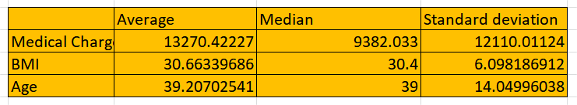
Statistical Analysis of Medical Charges, BMI, and Age: Average, Median, and Standard Deviation

Slide 5
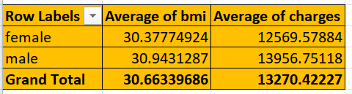
Gender-Based Comparison of Average Medical Charges and BMI
Males Have Higher Average Medical Charges:The average medical charge for males is $13,956.75, which is higher than that for females ($12,569.58).This suggests that male beneficiaries tend to incur higher healthcare costs on average compared to females.
BMI is Slightly Higher for Males:The average BMI for males is 30.94, compared to 30.38 for females.Although both genders have an average BMI in the obese category (BMI ≥ 30), males have a slightly higher BMI.

Slide 6
Impact of Smoking Status on Medical Costs: Average Cost Comparison for Smokers vs. Non-Smokers
The average medical charge for smokers is $32,050.23, which is almost 3.8 times higher than that of non-smokers ($8,434.27).
This suggests a strong correlation between smoking and higher healthcare expenses.

Slide 7
Relationship Between Number of Dependents and Medical Charges: Impact on Cost
The relationship between the number of children/dependents and medical charges appears to be inverse. In other words, beneficiaries with more dependents tend to incur lower medical costs, at least on average.

Slide 8
Regional Comparison of Average Medical Costs and BMI
The southeast region exhibits the highest average medical charges, significantly exceeding the other three regions.
It also has the highest average BMI. This suggests a potential correlation between higher BMI and higher medical costs in this region.

Slide 9
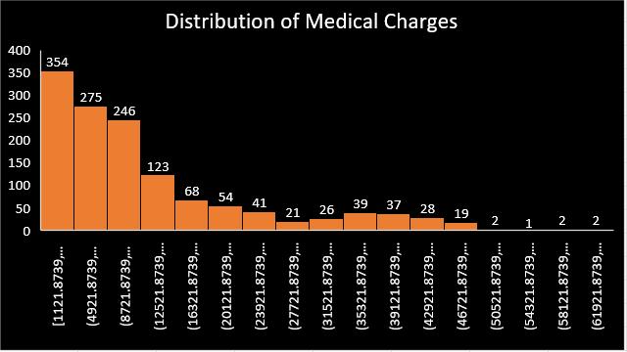
Histogram of Medical Charges Distribution
The data is strongly right-skewed. This means that the tail of the distribution extends further to the right, indicating that a larger proportion of individuals have lower medical charges, while a smaller percentage has significantly higher charges.

Slide 10
BMI Classification of Beneficiaries: Count by Category (Underweight, Normal, Overweight, Obese)
The "Obese" category has the highest number of individuals (716), significantly outnumbering all other categories. This indicates a major health concern and suggests that obesity is a widespread issue within the represented population.
The "Overweight" category (380 individuals) is also substantial and notably higher than the "Normal" category (222 individuals). This suggests a large portion of the population is at risk of or already experiencing health issues related to excess
The "Underweight" category has the fewest individuals (20). While being underweight can also pose health risks, it's clearly less prevalent in this data set compared to overweight and obesity.

Slide 11
Scatter Plot Analysis of BMI and Medical Charges with Trend Line
Positive Correlation: Upward Trend: The data points generally exhibit an upward trend, suggesting a positive correlation between BMI and medical charges. This implies that as BMI increases, medical charges tend to increase as well.
Line of Best Fit: The yellow line represents the line of best fit, visually confirming the positive correlation. Its upward slope indicates the general direction of the relationship.

Slide 12
Interaction Effect Between Smoking and Region on Medical Charges
Smokers Incur Higher Costs: In all four regions, the "yes" bars (representing smokers) are significantly taller than the "no" bars (non-smokers). This clearly indicates that smokers incur substantially higher medical costs than non-smokers across all regions.
Southeast Highest for Smokers: The southeast region shows the highest medical costs for smokers, with a notably taller bar compared to the other regions.

Slide 13
DASHBOARD

Slide 14
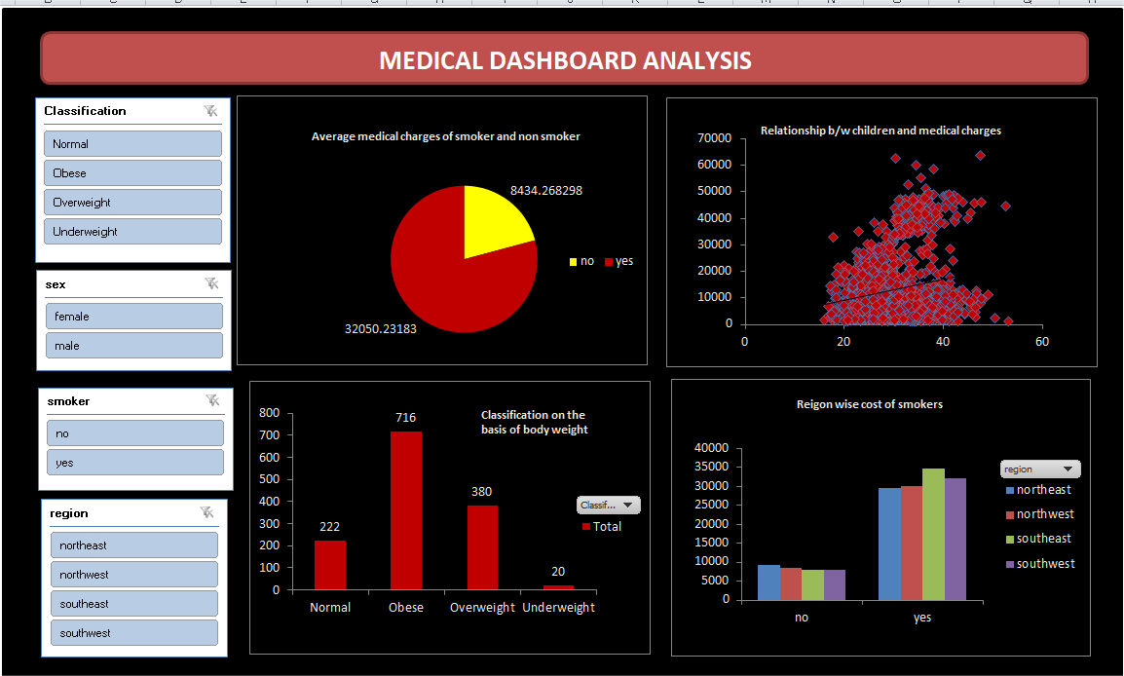

Slide 15
INSIGHTS
Smokers have significantly higher medical charges (~32,050) compared to non-smokers (~8,434) So, we should implement anti-smoking awareness programs and incentivize individuals to quit smoking through reduced insurance premiums or wellness programs.
We can introduce family health plans or preventive care packages to support families in managing medical expenses effectively.
The majority of individuals are classified as Obese (716), Overweight (380), Normal (222), and Underweight (20). This suggests obesity is a major health concern in the dataset. We can Launch weight management programs, promote healthy lifestyle initiatives, and encourage physical activity through corporate wellness programs.
We should provide discounted check-ups, health screenings, and wellness packages.

Slide 16
YOU TUBE LINK
https://youtu.be/RxIIfSIJxo0

Slide 17
THANKYOU

