Slide 1
AI-Powered Study Buddy
CAPSTONE PROJECT
Presented By:
Student Name- Jasmeet Kaur
College Name- Kalinga Institute Of Industrial Technology
Department- CSE
AICTE ID- STU69e78ab4edf191776782004

Slide 2
OUTLINE
Problem Statement (Should not include solution)
Proposed System/Solution
System Development Approach (Technology Used)
Algorithm & Deployment
Result
Conclusion
Future Scope
References

Slide 3
Problem Statement
Students often struggle to understand complex concepts while studying independently. Searching online gives long or irrelevant results and teachers are not always available to resolve doubts instantly. The problem consists of the following challenges:
■ Difficulty in Understanding Topics:
■ Students cannot grasp complex concepts without proper explanation or guidance
■ Online resources provide lengthy content that is hard to understand at student level
■ Lack of Personalized Study Tools:
■ No free tool exists that explains topics according to student's own learning level
■ Generic study apps do not adapt to individual student needs or syllabus
■ Manual Note-Making is Time Consuming:
■ Students spend hours writing summaries and notes from lengthy textbook chapters
■ There is no automated way to convert lecture notes into concise revision material
■ No Self-Assessment Tool Available:
■ Students have no easy way to test their knowledge on specific topics instantly
■ Creating practice MCQ questions manually is difficult and time consuming
■ Lack of Quick Revision Material:
■ Students struggle to find or create flashcards for last-minute exam preparation
■ No tool generates ready-made Q&A revision cards automatically on demand

Slide 4
Proposed Solution
The proposed system "AI Study Buddy" aims to address the challenge of helping students learn independently using Generative AI. The solution will consist of the following components:
■ Explain Topic:
■ Accepts any topic as input and explains it at Beginner, Class 10-12 or College level
■ Provides simple definition, analogy, key points and a real-life example
■ Summarize Notes:
■ Accepts pasted study notes and converts them into concise bullet points or paragraphs
■ Helps students revise faster without reading lengthy textbook content
■ Generate Quiz:
■ Generates 5 MCQ questions with correct answers and explanations on any topic
■ Supports Easy, Medium and Hard difficulty levels for self-assessment
■ Flashcards:
■ Creates Q&A format revision cards on any subject automatically
■ Helps students memorize key concepts quickly before exams
■ Deployment:
■ Built using Python and Streamlit framework for a clean web interface
■ Powered by LLaMA 3.1 model via Groq API and deployed on Streamlit Cloud

Slide 5
System Approach
The System Approach outlines the technology and methodology used to build the AI Study Buddy application:
■ System Requirements:
■ Python 3.12 — Core programming language
■ Streamlit — Web framework for building the UI
■ Groq API — Fast AI inference platform
■ Google Colab — Development and testing environment
■ Libraries Used:
■ streamlit — Interactive web application
■ groq — Connect with Groq API and LLaMA model
■ AI Model:
■ LLaMA 3.1 (8B Instant) by Meta AI via Groq API
■ Used for explaining topics, summarizing, quiz and flashcard generation
■ System Architecture:
■ User Input → Streamlit UI → Groq API → LLaMA 3.1 → Response displayed to User
■ Deployment:
■ Code hosted on GitHub
■ App deployed live on Streamlit Cloud

Slide 6
Algorithm & Deployment
The following algorithm and deployment approach was used to build and launch the AI Study Buddy application:
■ Algorithm Selection:
■ Generative AI approach using Large Language Model (LLaMA 3.1 8B Instant)
■ Prompt Engineering used to structure outputs for each feature
■ Input Processing:
■ User enters topic, notes or subject in the Streamlit web interface
■ Input is combined with a structured prompt and sent to Groq API
■ AI Processing:
■ Groq API receives the prompt and passes it to LLaMA 3.1 model
■ Model generates explanation, summary, quiz or flashcards as response
■ Output Display:
■ Response is received from API and displayed on screen using st.markdown()
■ Results are formatted as structured text with headings and bullet points
■ Deployment:
■ Source code pushed to GitHub repository (version control)
■ Application deployed on Streamlit Cloud — free and publicly accessible
■ Groq API key stored securely in Streamlit Secrets — no key needed from users

Slide 7
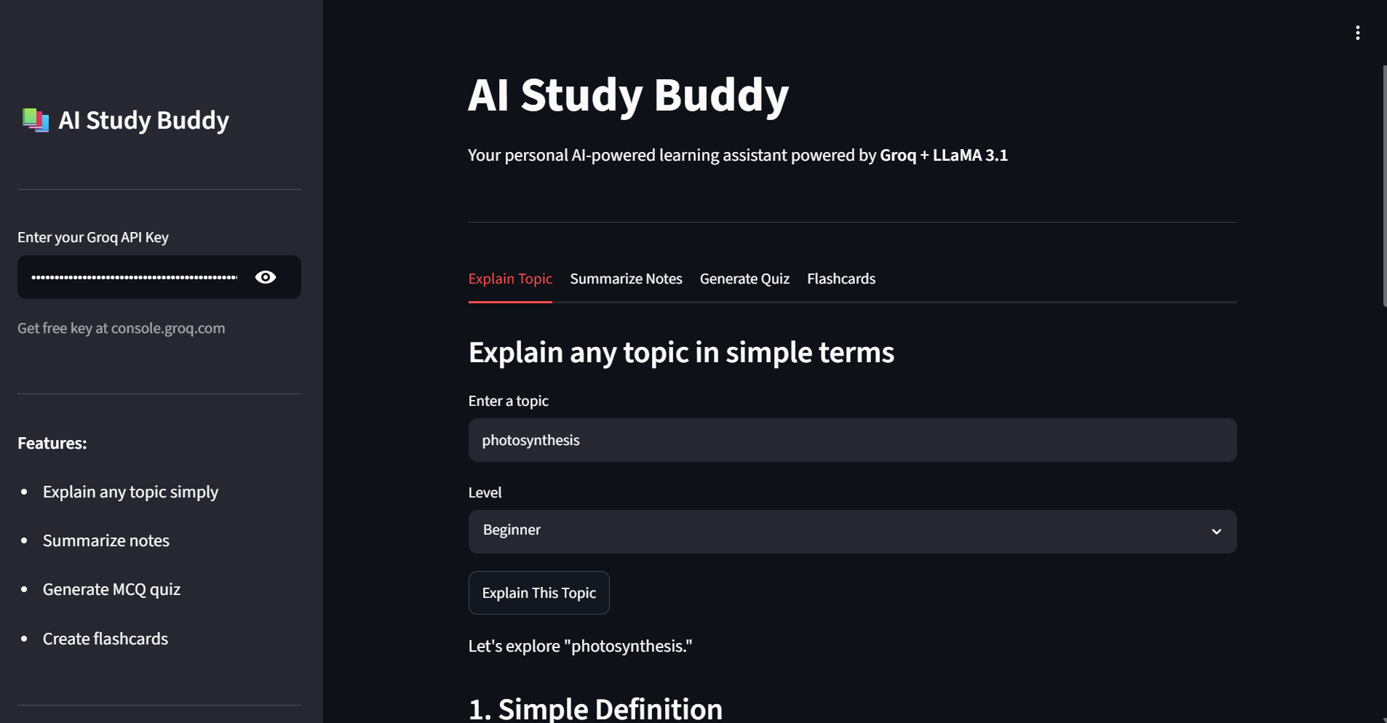
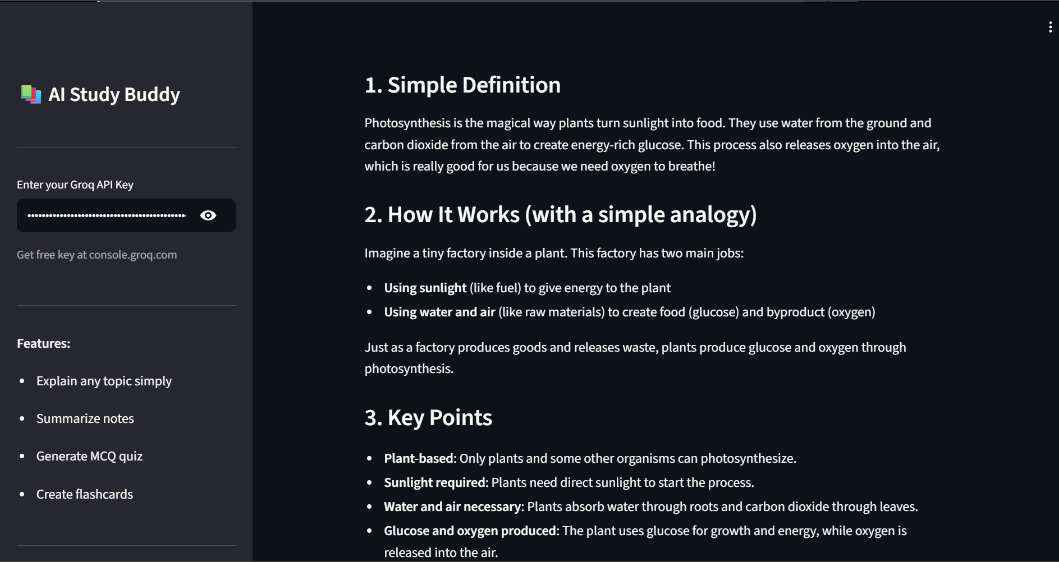
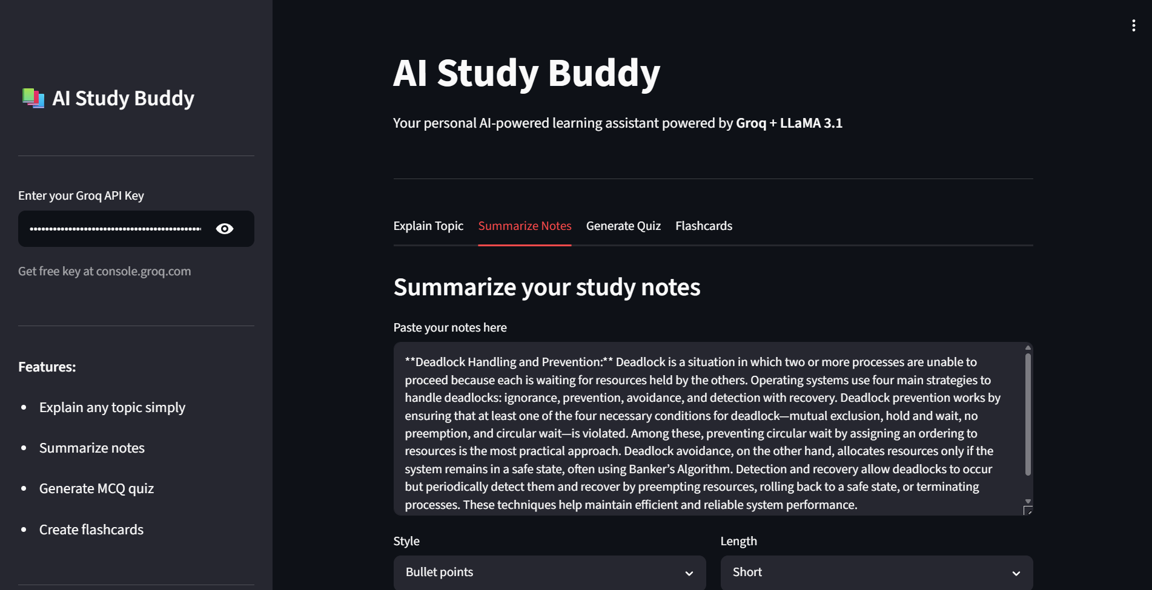
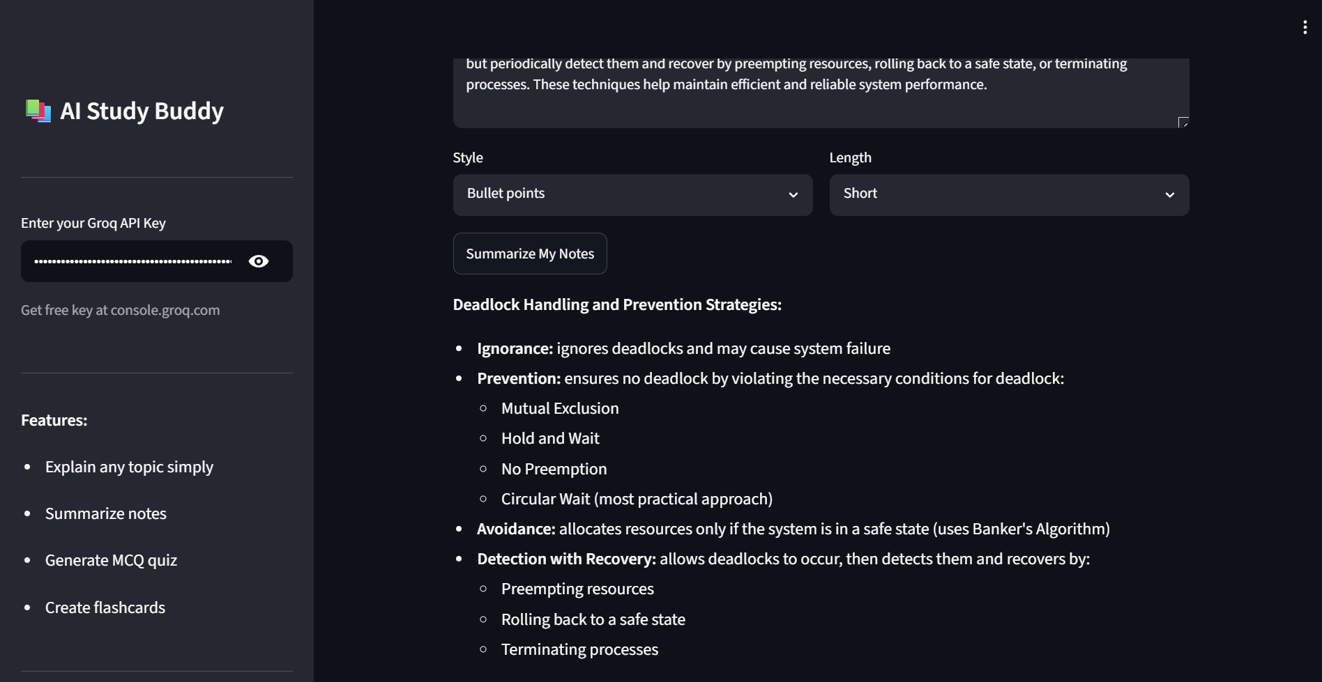
Result

Slide 8
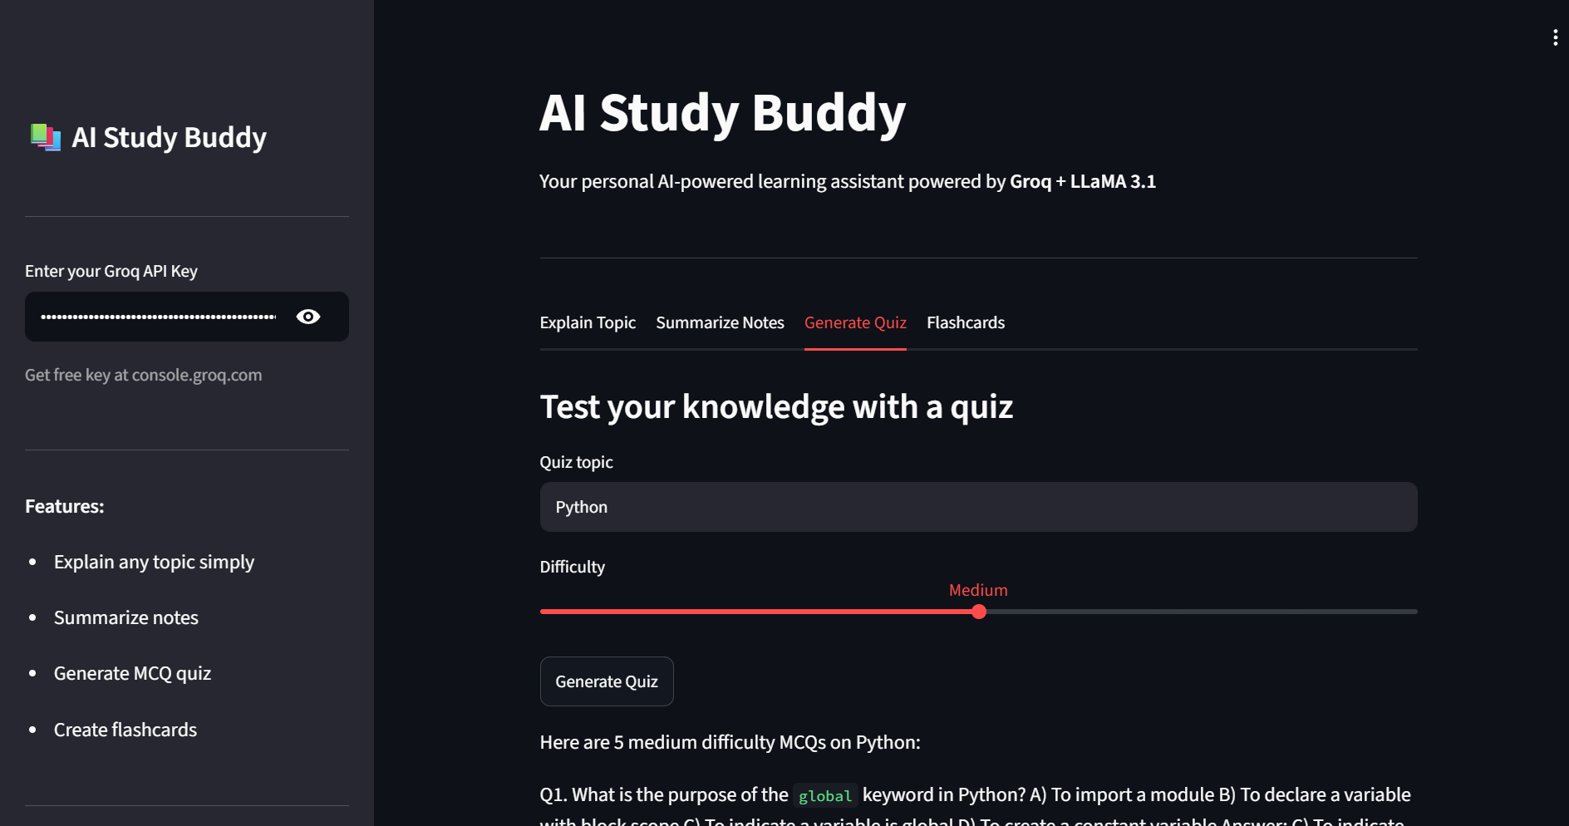
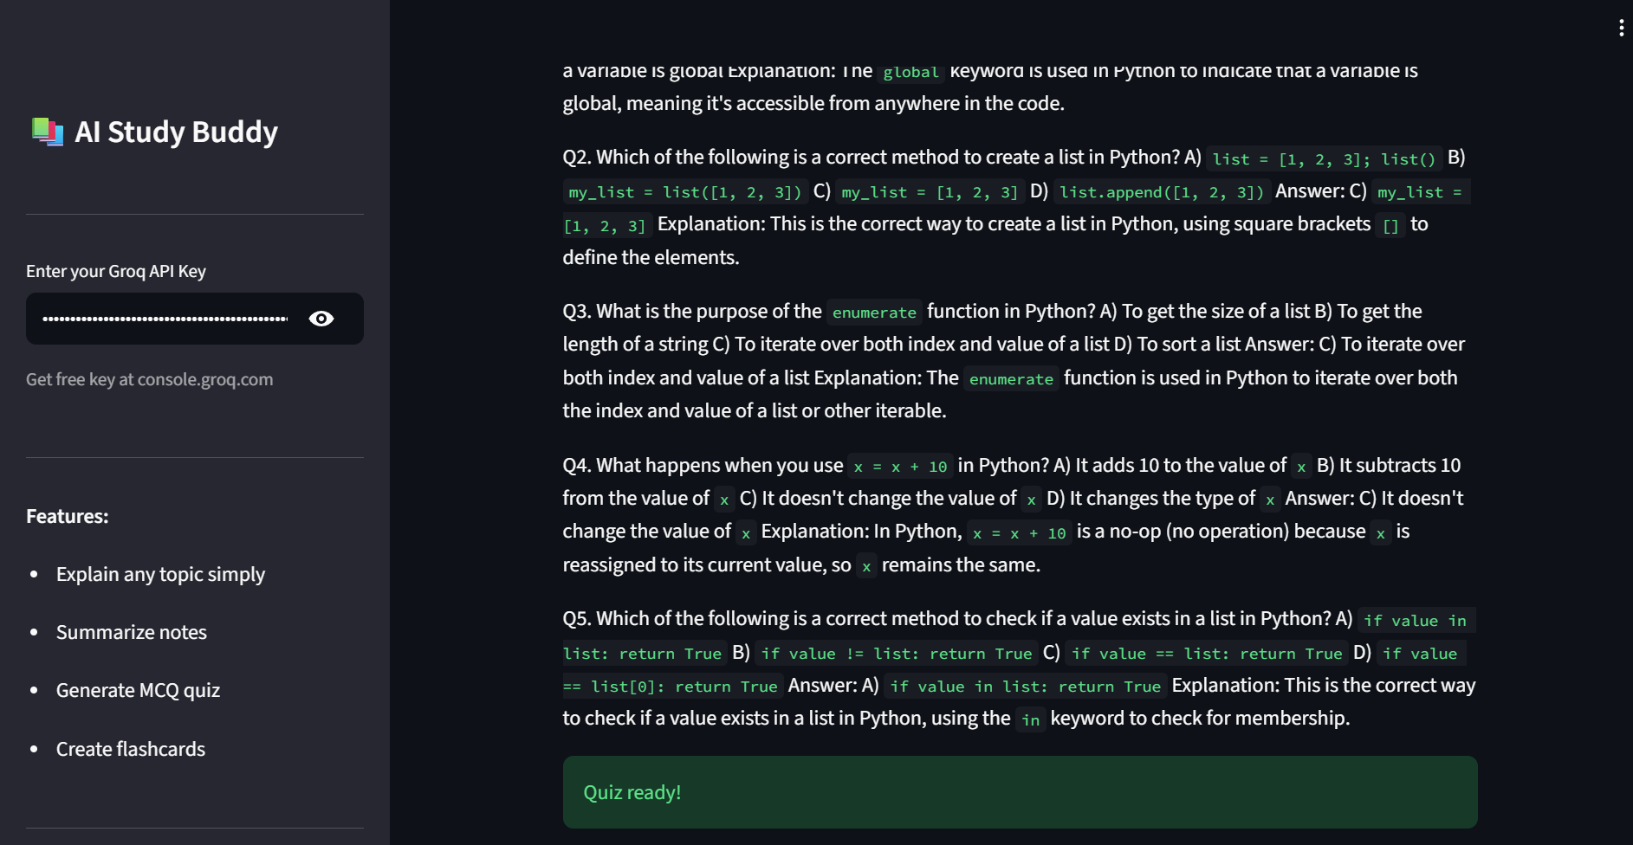
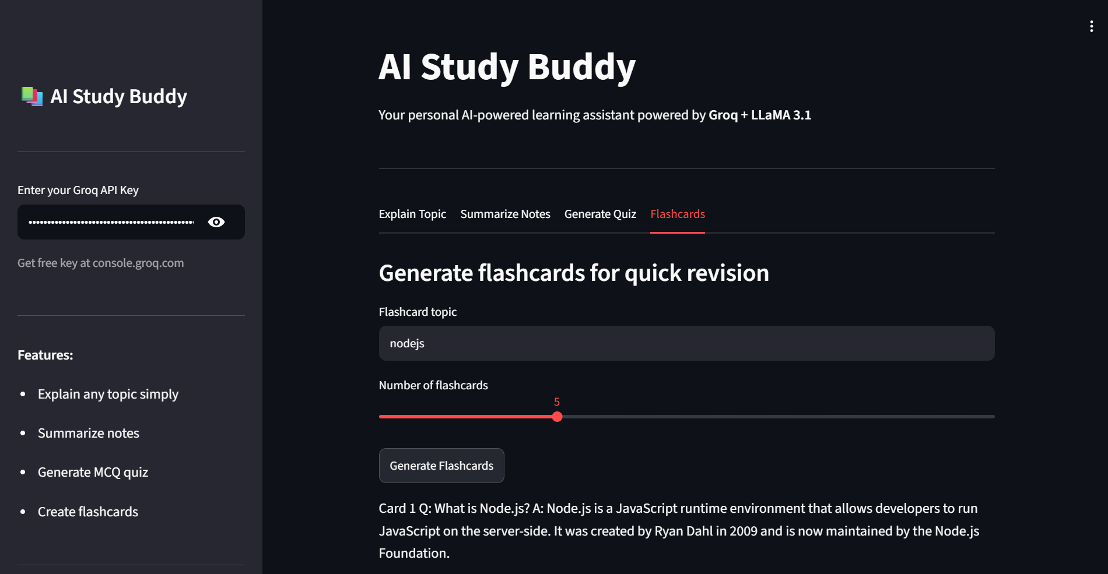
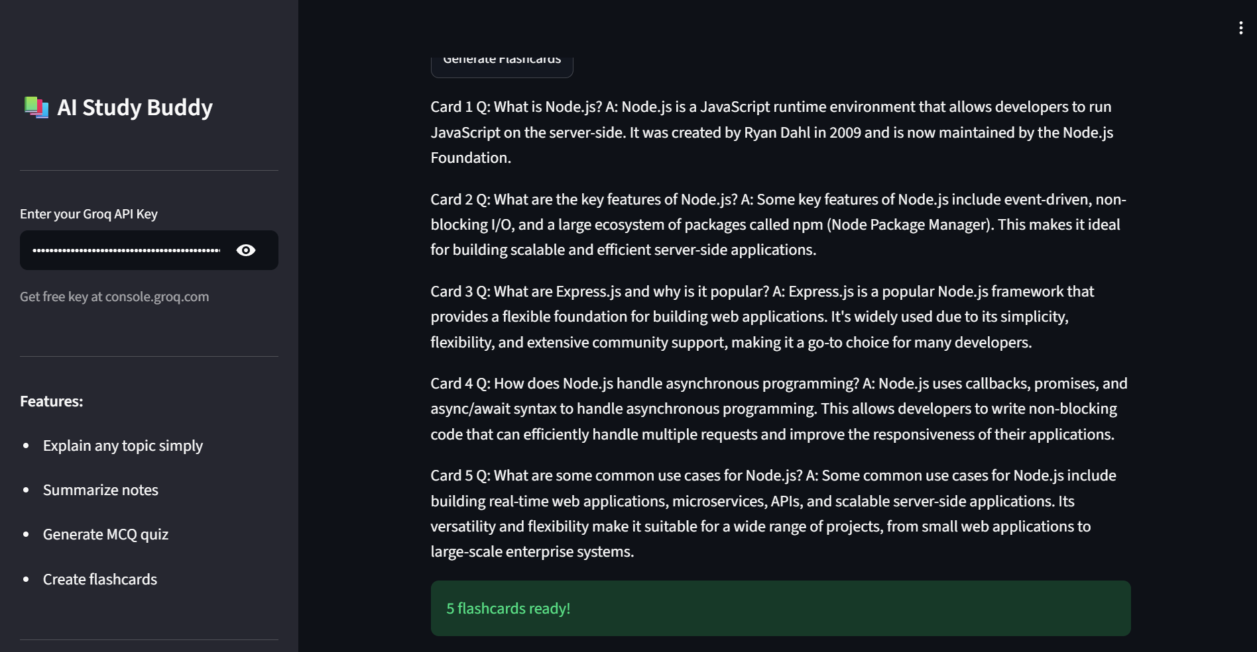

Slide 9
Conclusion
The AI Study Buddy project was successfully built and deployed as a live web application using Generative AI technology. The project has the following social impact and conclusions:
■ Impact on Students:
■ Provides 24/7 free access to AI-powered learning assistance for all students
■ Helps students from rural and underprivileged areas who lack access to tutors
■ Impact on Education:
■ Makes quality education more accessible, personalized and interactive
■ Reduces dependency on expensive coaching classes and tuition centers
■ Impact on Self-Learning:
■ Encourages independent study habits by giving instant answers and explanations
■ Students can revise, practice and test themselves anytime without a teacher
■ Technical Achievement:
■ Successfully integrated Generative AI (LLaMA 3.1) into a real-world student tool
■ Demonstrated practical use of Groq API, Streamlit and Python in one project
■ Overall Conclusion:
■ The AI Study Buddy proves that Generative AI can transform the way students learn
■ The project is live, functional and ready for real-world use by students globally

Slide 10
Future scope
The AI Study Buddy can be further enhanced with the following future improvements:
■ Voice Input:
■ Allow students to speak questions using speech-to-text technology
■ PDF Upload:
■ Upload textbook PDFs and get instant AI-generated summaries and quizzes
■ Multilingual Support:
■ Add Hindi and other regional Indian languages for wider accessibility
■ Progress Tracker:
■ Track topics studied and quiz scores to monitor student improvement
■ Personalized Learning Path:
■ AI recommends next topics based on student performance and weak areas
■ Mobile Application:
■ Convert into Android and iOS app for learning on the go

Slide 11
References
Groq API Documentation — console.groq.com
Streamlit Documentation — docs.streamlit.io
Meta LLaMA 3.1 Model — ai.meta.com/llama
Welcome to Python.org — python.org
Google Colab — colab.research.google.com
EduNet IBM SkillsBuild — edunetworld.com

Slide 12
Github link
Github Link : https://github.com/jasmeetkaur06/AICTE-BATCH-1-AI-STUDY-BUDDY-
Deployment Link: https://ai-study-buddy-aicte.streamlit.app/
No API key required — app works directly for all users

Slide 13
THANK YOU

