Slide 1
IBM University Engagement Project Submission
“Exploring the Power of Agentic AI with IBM Granite and LangFlow”

Slide 2

Project Tile – Interview Trainer Agent – AI-Powered Mock Interview Coach
Domain of Project – Education / Career Development
Student Name | Recent Passport Photo | Email ID | Mobile number [WhatsApp]
Jasmeet Kaur |  | jasmeetkaur8206@gmail.com | 9142341110

Slide 3
Problem Statement -
Problem Statement No. 22 : Interview Trainer Agent
The Challenge
Job seekers, especially students and fresh graduates, struggle to prepare for interviews. They lack personalized coaching, role-specific practice questions, and real-time feedback. Existing tools are either too generic, expensive, or not interactive enough to simulate a real inteoss unreliable sources. Without rview experience. Without personalized guidance, many students miss out on their dream jobs.
The Objective
Build an AI-powered Interview Trainer Agent that prepares users for job interviews through personalized question generation and intelligent feedback. The solution should:
Personalized Questions – Generate role-specific interview questions based on job title and experience level.ls.
Mock Interview Session – Conduct a live one-question-at-a-time mock interview with conversation memory.
Answer Feedback – Evaluate each response and provide what was good, what to improve, and a model answer.
Session Summary – Provide an overall score out of 10 with strengths and improvement areas after all questions.
Agent Capabilities –
Supports technical and behavioral questions for any job role
Adapts to experience level: fresher, mid-level, or senior
Remembers full conversation history for context-aware responses
Built on IBM watsonx.ai
Zero Setup – Users simply open LangFlow chat and start practicing immediately.

Slide 4
Technology Used
Tech Stack (Mandatory)
Use any one of the following approaches:
LangFlow + IBM watsonx.ai + Granite Models
IBM Cloud Agentic Lab with IBM Granite Models
Replicate with LangChain + RAG + IBM Granite Models
I used LangFlow + IBM watsonx.ai + Granite Models

Slide 5
Proposed Solution - Interview Trainer Agent (PS-22)
Proposed Solution: Interview Trainer Agent
The proposed solution is a AI-powered Interview Trainer Agent built using LangFlow and IBM watsonx.ai. It prepares users for job interviews through personalized question generation, mock sessions, and intelligent feedback.
The agent is built on a clean LangFlow workflow: Chat Input → IBM watsonx.ai → Chat Output, with Message History maintaining full conversation context across the entire mock interview session.
The agent performs four key functions in sequence:
1. Greet the user and confirm their job role and experience level.
2. Generate exactly 5 targeted interview questions (technical + behavioral) specific to that role and experience level.
3. Ask one question at a time, evaluate each answer, and give detailed feedback with what was good, what to improve, and a model answer.
4. Deliver a final session summary with overall score out of 10, top 3 strengths, and a personalized improvement roadmap.
The LangFlow Playground serves as the user-friendly chat interface – clean, simple, zero technical setup required for end users.
LangFlow orchestrates the workflow visually. IBM watsonx.ai provides model inference on IBM Cloud Lite (free tier, au-syd region)
Overall, this solution delivers an end-to-end intelligent interview coach that builds confidence, sharpens responses, and increases job success rates for students and freshers.

Slide 6
Langflow component Used -
1) Chat Input – Interface where users type their job role, experience level, and interview answers during the session.
2) IBM watsonx AI – Core LLM component processing input to generate interview questions, feedback, and session summaries.
3) Model Used: IBM Granite (ibm-granite-3-2-8b-instruct intended; Llama 3.3 70B used on IBM watsonx.ai – instructor approved)
4) Chat Output – Displays interview questions, answer feedback, model answers, and the final session summary.
5) Message History – Stores and retrieves full conversation so the agent remembers all previous Q&A in the session.
6) Prompt Template (System Message) – Custom instructions defining agent behavior as expert interview coach

Slide 7
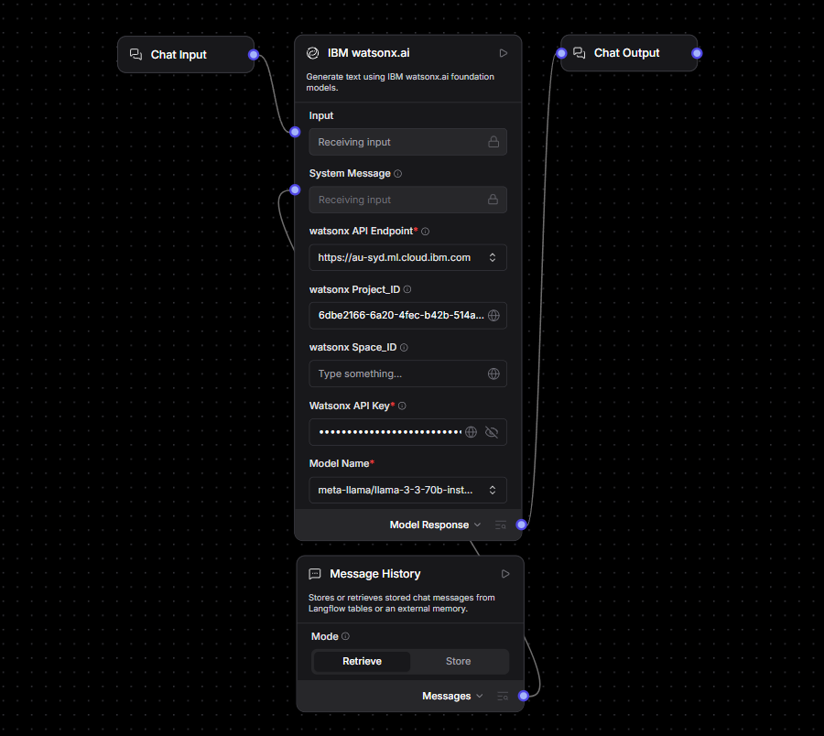
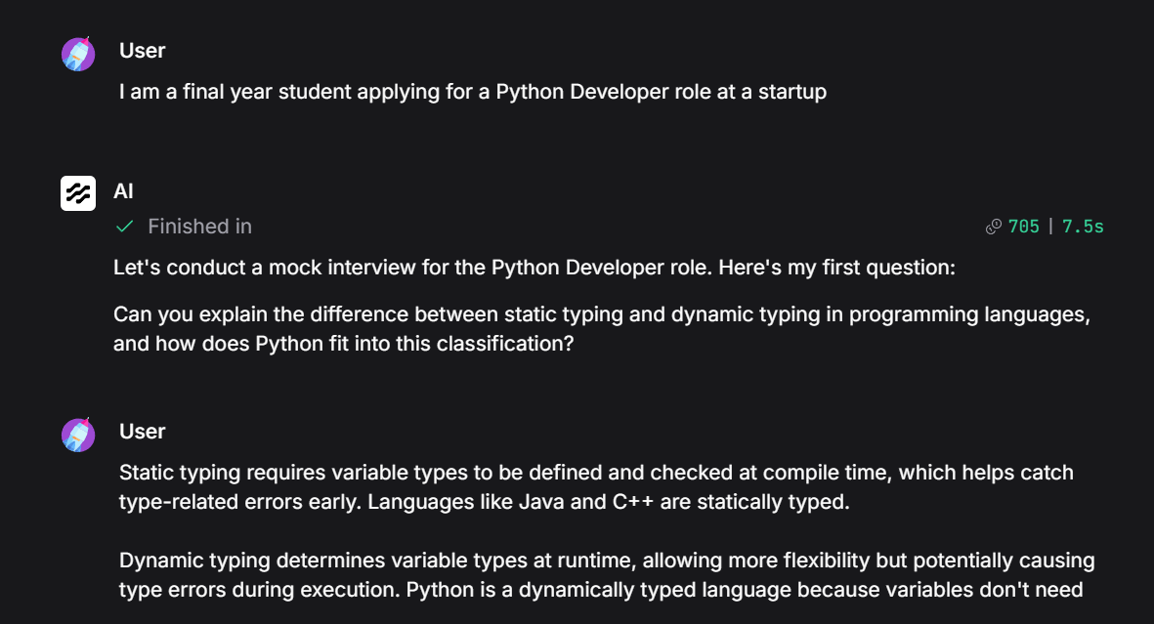
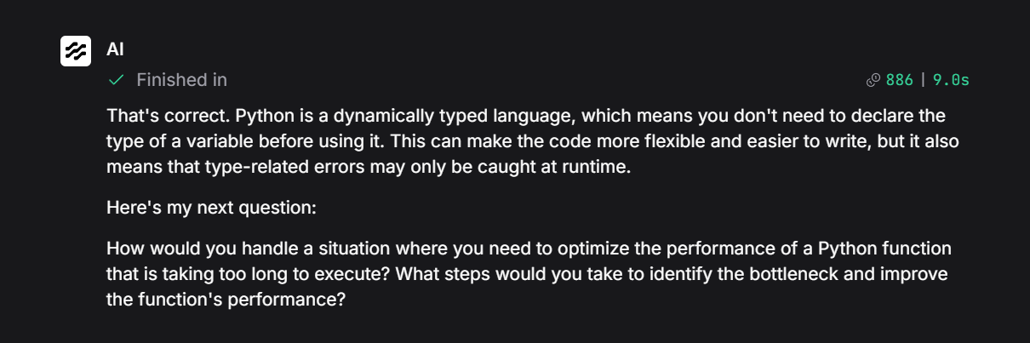
Langflow workflow - Mock Interview Demonstration -

Slide 8
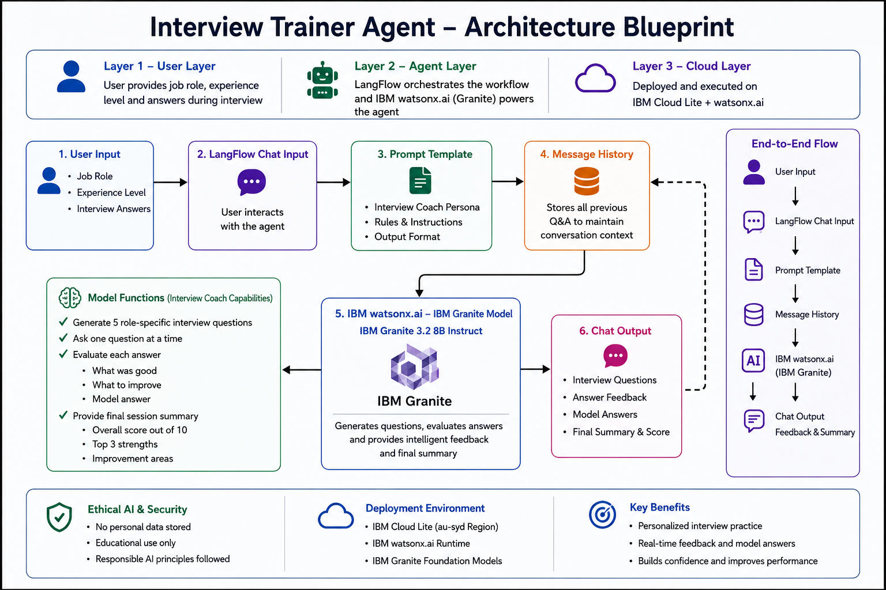

Slide 9
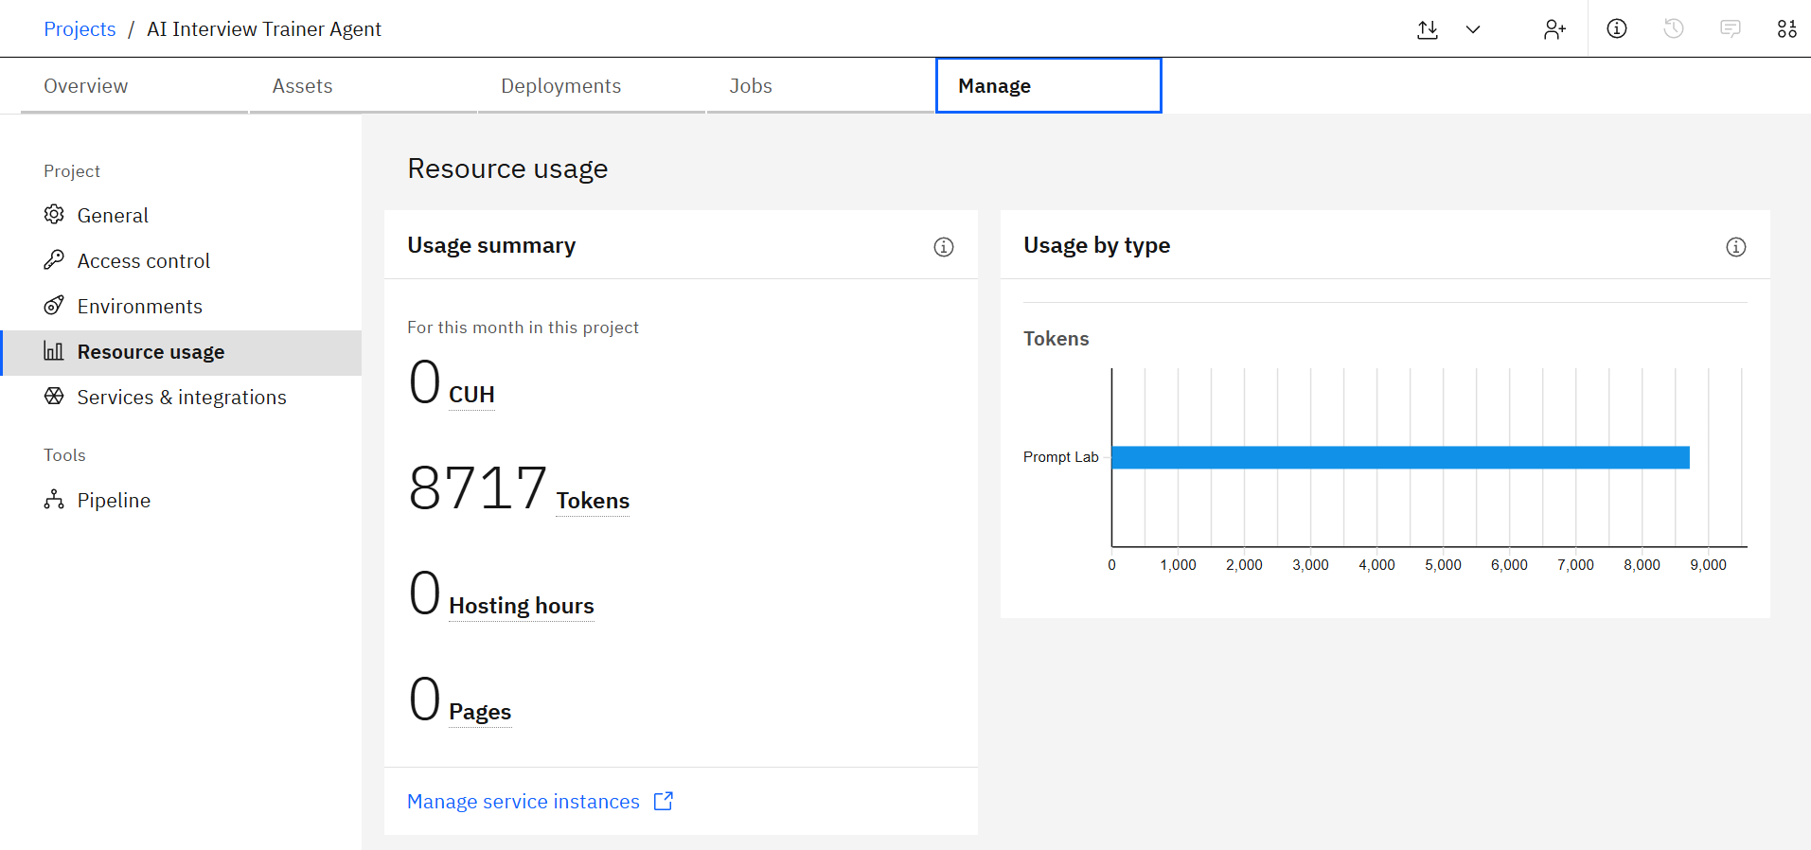
IBM watsonx.ai Resource Usage Dashboard -

Slide 10

Role of Agentic AI in the solution
Role of Agentic AI in the Interview Trainer Agent
Agentic AI enables the Interview Trainer Agent to function as an intelligent, autonomous interview coach rather than a simple chatbot. Using IBM watsonx.ai and IBM Granite models, it independently plans, conducts, and adapts the entire mock interview session without manual scripting.
The agent autonomously generates role-specific questions, evaluates answers in context, and provides personalized feedback. Using Message History, it remembers previous interactions and maintains a coherent multi-turn interview experience.
Its goal-oriented behavior ensures that every interaction contributes toward improving the user's interview readiness, confidence, and communication skills.

Slide 11
Technology Used
LangFlow Platform – Used to design and orchestrate the Interview Trainer Agent workflow through a visual no-code interface.
IBM watsonx.ai – Provides access to foundation models and powers interview question generation, answer evaluation, and feedback.
IBM Grainte model - for eg – ibm-granite-3-2-8b – For natural language understanding, reasoning, and personalization
IBM Cloud Lite – Hosts the watsonx.ai services and provides a secure, scalable cloud environment for the solution.
Message History (LangFlow) – Maintains conversation context throughout the mock interview session for coherent and personalized interactions.
Prompt Engineering – Custom system prompts guide the AI to act as an expert interview coach, ensuring structured interviews and feedback

Slide 12
Novelty and Uniqueness
The Interview Trainer Agent provides a realistic and personalized interview preparation experience by combining Agentic AI, conversation memory, and intelligent feedback into a single solution.
Personalized Interview Experience – Generates role-specific technical and behavioral questions based on the user's job role and experience level.
Adaptive Questioning – Dynamically adjusts interactions and feedback according to the user's responses throughout the session.
Context-Aware Memory – Uses LangFlow Message History to remember previous questions and answers, enabling meaningful multi-turn conversations..
Detailed Answer Evaluation – Analyzes each response and provides strengths, improvement areas, and a model answer for learning.
End-to-End Interview Simulation – Conducts a complete mock interview from introduction to final assessment without manual intervention.
Instant Performance Analysis – Provides an overall score, top strengths, and improvement recommendations at the end of the session.
Accessible and Cost-Effective – Offers free, AI-powered interview practice through IBM watsonx.ai and LangFlow.
Built on IBM Technologies – Developed using IBM watsonx.ai, IBM Cloud Lite, and LangFlow, ensuring reliability and scalability.
This makes the solution a smart, adaptive, and proactive digital interview coach, not just a static question bank or generic chatbot.

Slide 13
Git Hub Link
Interview Trainer Agent Repository
🔗 https://github.com/jasmeetkaur06/interview-trainer-agent
Files Included
README.md
app.json
Problem Statement PDF
Project Presentation
Workflow Screenshots
Public Repository for Project Evaluation & Reproducibility

Slide 14
Future Scope
1. Resume-Based Personalization
Allow users to upload resumes so interview questions can be tailored to their skills, projects, and experience.
2. AI-Powered Voice Interviews
Integrate speech-to-text and text-to-speech to simulate real interview conversations.
3. Multilingual Support
Enable interview practice in multiple languages to make the solution more accessible and inclusive.
·
·
·

Slide 15


