Slide 1

Making Heidelberg & Mannheim bike data AI-ready
Zero bikes or broken sensor?
Data Management, Group 07 · Prof. Dr. Mehrdad Jalali
Jasmeet Kaur · Yash Chinnannavar · Vivek Sawant · Shashank K. Sridhar
& Keshav Sain, 09.11.2026
Notes:
Presenter: Jasmeet Kaur
Welcome. We are Group 07. We took a raw open dataset - daily bike counts from Heidelberg and Mannheim plus DWD weather - and turned it into a FAIR, validated, AI-ready data product. Every slide answers one question: can this data be trusted, reused and fed into an AI model, and how do we prove it?

Slide 2
Agenda
01
Dataset & problem
  Two open sources, one question
04
Profiling
  What is wrong with the raw data?
02
Architecture
  ETL from source to AI-ready table
05
Cleaning & pipeline
  Tableau Prep flow + Python functions
03
FAIR
  How reusable is the original data?
06
Governance & conclusion
  Roles, lineage, AI risks, answer
Notes:
Presenter: Jasmeet Kaur
Six parts, each presented by the person who built it. About 15 minutes.

Slide 3
Dataset: 10,839 bike counts + 365 weather days
Two open sources, joined on site and date
 | Bike counts | Weather
Source | MobiData BW (Eco-Counter) | DWD, station 05906 Mannheim
Licence | DL-DE-BY 2.0 | CC BY 4.0
Scope | 30 sites, Heidelberg + Mannheim, 2025 | Daily values, 2025
Size | 10,839 rows (of 57,341 in BW) | 365 days (of 34,884 rows)
Tables / key | sites + daily counts · site_id | weather per day · date
Date column | iso_timestamp | MESS_DATUM (yyyymmdd)
Problem statement
How strongly do weather and calendar effects drive daily bike traffic in Heidelberg and Mannheim?
For whom
Mobility departments of both cities: bike lanes, winter service, events.
Our question
Can this data be trusted, reused and fed into an AI model?
Sources: mobidata-bw.de · opendata.dwd.de · downloaded 2 Nov 2026
Notes:
Presenter: Jasmeet Kaur
Two open sources. Bike counts from MobiData BW: 12 monthly files for 2025, we keep Heidelberg and Mannheim - 10,839 rows from 30 counter sites. Weather from the German Weather Service, station Mannheim. Both have open licences that require attribution. Our problem statement: how much do weather and calendar drive bike traffic, and can the data be trusted enough to train a forecasting model? Users: the mobility departments of both cities.

Slide 4
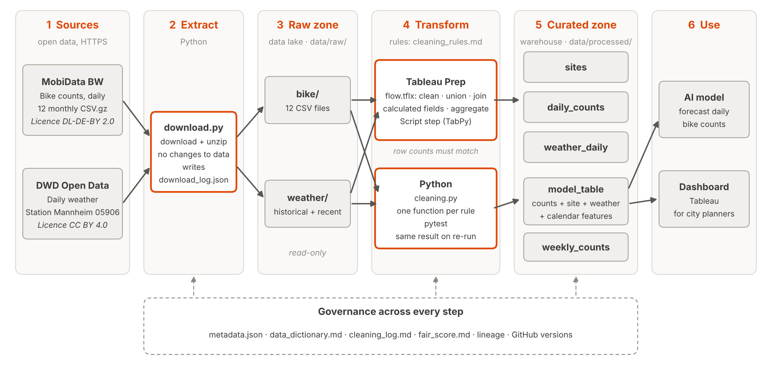
Architecture: clean first, then store (ETL)
Tableau Prep and Python apply the same rules
Notes:
Presenter: Jasmeet Kaur
ETL, not ELT: we clean before we store. download.py pulls the raw files into a read-only raw zone (our data lake). Tableau Prep and Python apply the same cleaning rules and write five curated tables (our warehouse zone). The model table feeds the AI model and a dashboard. Governance documents sit across every step.

Slide 5
FAIR: 18/30 before, 29/30 now
Easy to find, hard to reuse: we fixed I and R
FAIR score per letter
points; 15 GO FAIR sub-principles, each scored 0, 1 or 2
01
Before: every column is text, with no units, no column meanings and no link to other data. I and R are weak.
02
After: typed columns with units, data dictionary, keys site_id + date. Metadata record: metadata.json (title, DOI, licence, schema, checksums).
03
Done: Zenodo DOI lifts F1 + F4 → 29/30. Only R1.3 left: no standard for bike count data.
Letter | Original dataset | After cleaning | Final (with DOI)
Findable | 6 / 8 | 6 / 8 | 8 / 8
Accessible | 7 / 8 | 8 / 8 | 8 / 8
Interoperable | 2 / 6 | 6 / 6 | 6 / 6
Reusable | 3 / 8 | 7 / 8 | 7 / 8
Total | 18 / 30 (60 %) | 27 / 30 (90 %) | 29 / 30 (97 %)
*Scored against the MobiData BW dataset page (checked 2 Nov 2026) and our repo · DOI 10.5281/zenodo.24058367 · docs/fair_score.md
Notes:
Presenter: Keshav Sain
We scored the 15 FAIR sub-principles from 0 to 2, with evidence for each. The original data is easy to find and download, but hard to reuse: every column is text, no units, no descriptions, no link to other data - 18 of 30. Our product fixes Interoperable and Reusable: typed columns with units, a data dictionary, keys that link counts, sites and weather, and full lineage. Our metadata record, docs/metadata.json, holds title, DOI, creators, licence, keywords, coverage, schema and checksums. Last step: a release on Zenodo gives a DOI and puts the data in a searchable registry, so F1 and F4 get full points: 29 of 30. The one point left is R1.3 - there is no community standard for bike count data.

Slide 6
Profiling: the KPIs say 100 %
The values tell a different story
Quality KPIs on the raw data
Heidelberg + Mannheim · 10,839 rows · 30 sites · 365 days of 2025
01
Column profile: 17 text columns; 3.4 % of direction counts are "na"; site names with typos and trailing dots.
02
Weather (DWD): 365 of 365 days, -999 in < 1 %, two files overlap 245 days, identical.
03
Lesson: a KPI only checks what you ask. Look at the values.
Dimension | KPI (raw) | Value | What the values show
Completeness | key fields filled | 100 % | 12,225 cells say "na"
Coverage | site-days present | 98.99 % | 111 days missing at 7 sites
Uniqueness | one row per site + day | 100 % | really clean
Validity | count ≥ 0, valid date | 100 % | 97 zero days, 77 = outages
Consistency | IN + OUT = ALL | 100 % | really clean
Type conformity | numeric type | 0 % | all 17 columns are text
*Measured on the raw files (never edited) by src/profiling.py. Full column profile: backup slide and docs/profiling_report.md
Notes:
Before cleaning anything we profiled the raw files with src/profiling.py. The raw files are never changed. The scope is 10,839 rows: 30 counters in Heidelberg and Mannheim, every day of 2025. If you only look at the classic KPIs, this data looks perfect: 100 % complete, 100 % unique, 100 % valid, and IN plus OUT always equals ALL. But look at the right column. Completeness is 100 % because 12,225 cells contain the text 'na' instead of being empty, so a simple null check does not see them. Validity is 100 % because zero is a valid number, but 97 days have zero bikes, and 77 of them come in runs of three days or more, for example Liebermannstrasse, which normally counts 4,500 bikes a day, shows zero for the first 29 days of January. That is a broken sensor, not empty streets. Coverage is 98.99 %: 111 site-days have no row at all, 76 of them because three counters only start in late January. And type conformity is 0 %: every one of the 17 columns arrives as text, so nothing can be computed before we cast types. The weather data from DWD is in good shape: all 365 days, under 1 % of -999 codes, and the two files overlap on 245 days with identical values. The lesson for us: a KPI only checks what you ask it. You have to look at the values. [about 75 seconds]

Slide 7
Key issue: counts that are not real
One counter change at B38, seen twice
77 zero days in runs of ≥ 3 = sensor outage. Rule B7: NULL + is_outage, never "0 bikes".
22 Sep 2025: IN drops to about 1 bike/day, AUS jumps from about 10 to 1,300. The sum stays normal.
So 44 "outages" and all 10 "outliers" are ONE change. Proposal B11: sum the B38 pair, flag the break.
Notes:
The most important issue is that some counts look real but are not. First, zeros. A single zero day can be real, for example a closed road. But three or more zero days in a row at a busy counter is a sensor outage. If we kept those as zero, an AI model would learn that nobody cycles on those days. So rule B7 sets them to NULL and adds the flag is_outage: 77 days. Second, while checking the outliers we found something bigger. All 10 outliers are at one counter, B38 RI. AUS in Mannheim. Look at the chart: until 21 September, B38 Ri. IN counts about 1,200 bikes a day and B38 AUS about 10. On 22 September they swap: IN drops to about one bike a day, AUS jumps to about 1,300. The dashed line is the sum of both, and it follows the normal seasonal curve. So the cyclists did not disappear: the traffic was counted by the other sensor. That means 44 outage days on IN and all 10 outliers on AUS are the same real-world change. Worse, after the switch IN shows 1 or 2 bikes, not 0, so the zero rule does not even catch most of those days. Our proposal is rule B11: treat the two B38 counters as one site by summing them, and flag the date of the break. We do not know the cause yet: a swapped sensor, a relabelled direction or a construction detour. We would confirm that with the city of Mannheim. The lesson: rules flag, a human decides. [about 80 seconds]

Slide 8
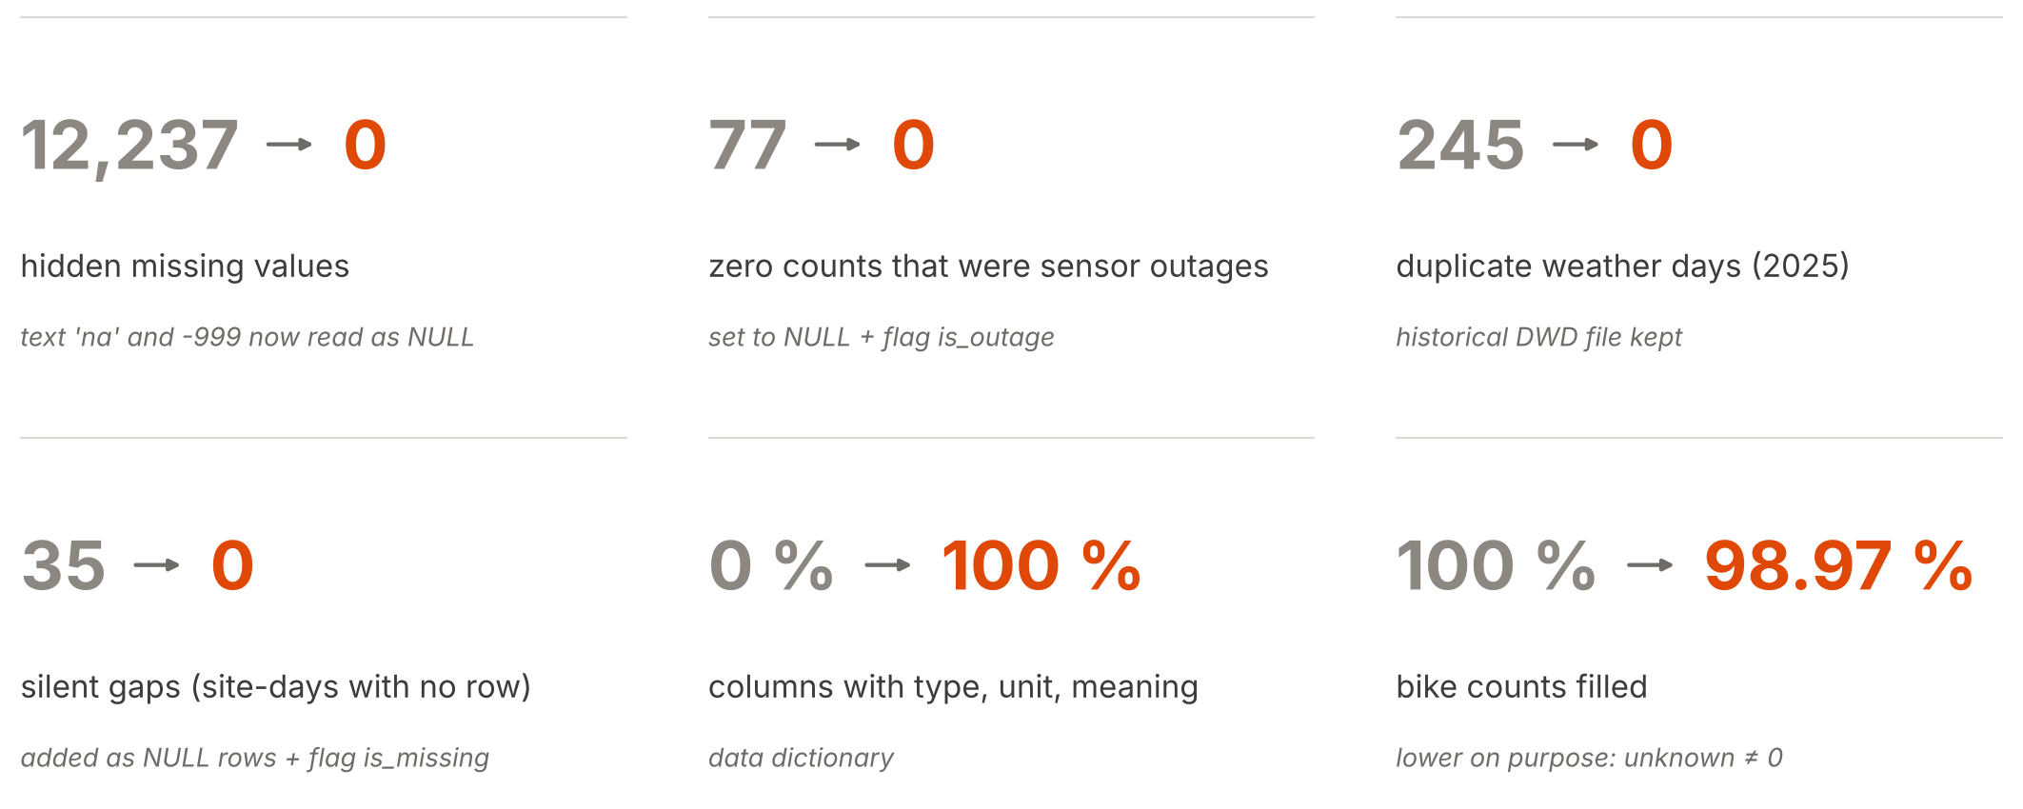
Every issue is now fixed or flagged
Quality KPIs: raw data → cleaned data
Notes:
Presenter: Yash Chinnannavar
Same KPI definitions on raw and cleaned data (src/quality_kpis.py). Every profiling issue is now fixed or flagged. One number goes down on purpose: bike counts filled, from 100 to 98.97 percent. Before cleaning, a broken sensor looked like zero bikes; now it is marked as unknown. Complete is not the same as correct - and for an AI model, correct matters more.

Slide 9
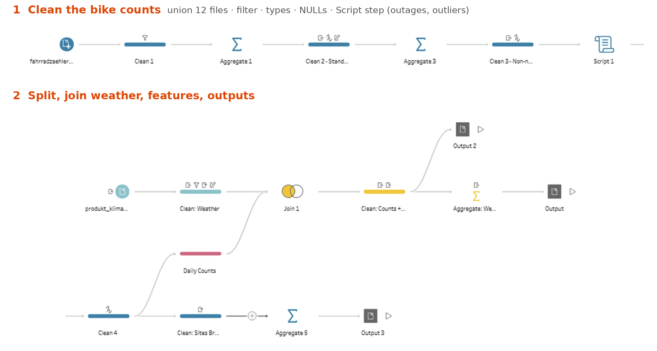
Tableau Prep: 13 raw files → 3 outputs
One flow, same rules and same result as Python
1
Input + Union
12 bike files + 1 DWD file
2
Clean
scope, types, NULLs
3
Script step
outages + outliers (Python)
4
Join
missing days + weather
5
Calculated fields
weekday, holiday, rain
6
Aggregate + Output
weekly totals, 3 Hyper files
Notes:
Presenter: Vivek Sawant
This is the full Tableau Prep flow, tableau/flow.tflx. The twelve monthly bike files come in as one union. They pass through clean steps, a Script step that runs the same Python functions for outages and outliers, and a small branch that adds the missing days. Then the counts are joined with DWD weather, calendar fields are added, and three outputs are written: daily counts with weather, weekly totals and the sites table. The rules are the same as in the Python pipeline, written in docs/cleaning_rules.md.

Slide 10
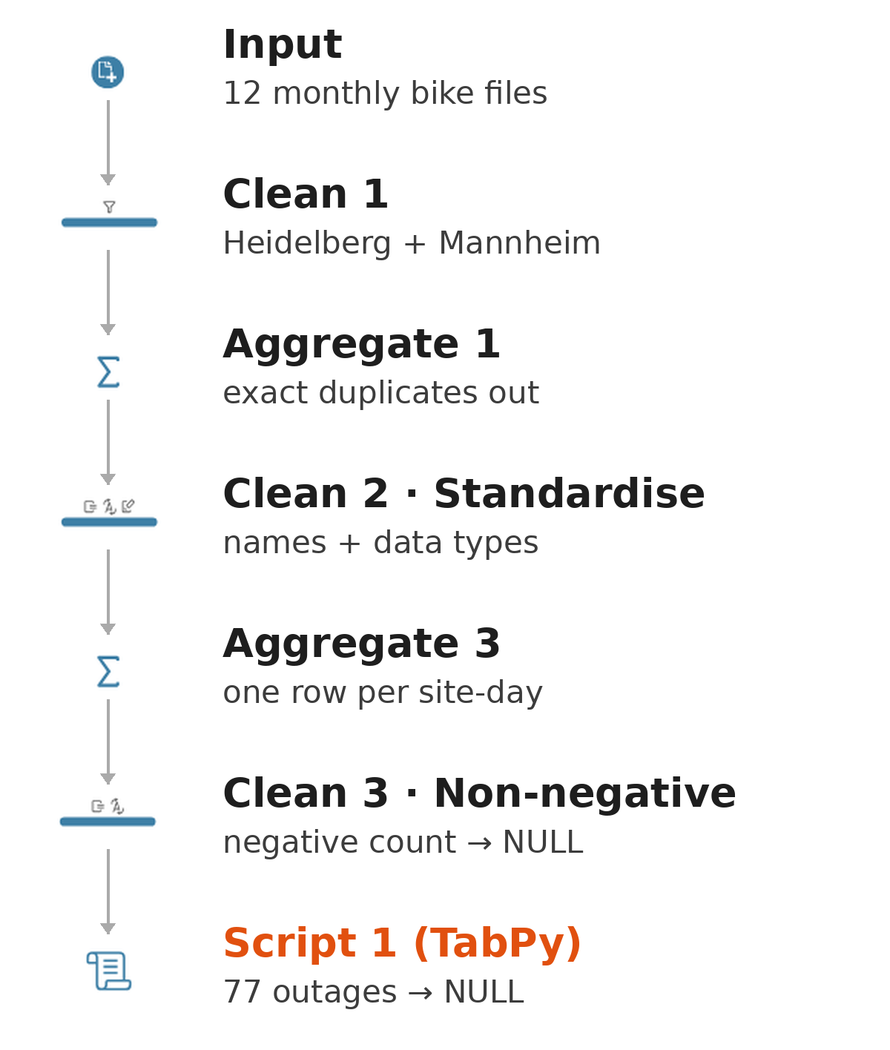
Clean: scope, types, honest NULLs
57,341 → 10,839 rows
Filter to Heidelberg + Mannheim
  CONTAINS([domain_name], "Heidelberg") OR … → 57,341 → 10,839 rows
Types and names
  Text → whole number / decimal / date; English column names
Missing values
  'na' → NULL; negative counts → NULL (0 found)
Outages (Script step)
  ≥ 3 zero days in a row → NULL + is_outage: 77 days
Notes:
Presenter: Vivek Sawant
First we keep only Heidelberg and Mannheim: 57,341 rows become 10,839. Then we remove exact duplicates, give every column an English name and a real type, and keep one row per site and day. The text 'na' becomes NULL; negative counts would become NULL too - we found none. Outages need to compare a row with the days before it, so they run in a Script step that calls the same Python function as cleaning.py: 77 outage days become NULL with the flag is_outage.

Slide 11
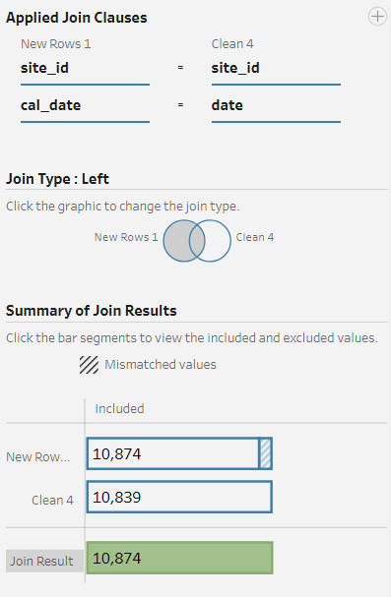
Union and join: two sources, one table
Row count stays 10,874 through the join
Union
  12 monthly bike files → one table (10,839 rows)
  DWD: historical file only (the recent file repeats 245 of its days) → 365 days
New rows
  calendar per site (New Rows) + left join on site_id and date → 35 missing site-days as NULL rows → 10,874
  Join (left)
  daily counts + weather on date
  10,874 rows in → 10,874 rows out
Notes:
Presenter: Vivek Sawant
The twelve monthly files become one union: 10,839 rows. For weather we use the quality-checked DWD historical file, which covers all of 2025; the recent file only repeats 245 of its days. Then the missing days: we build a calendar per site with a New Rows step and left-join the counts onto it. The 35 days without a count become NULL rows with the flag is_missing - never zero. The join with weather is a left join on date: 10,874 rows in, 10,874 rows out, no row lost or doubled.

Slide 12
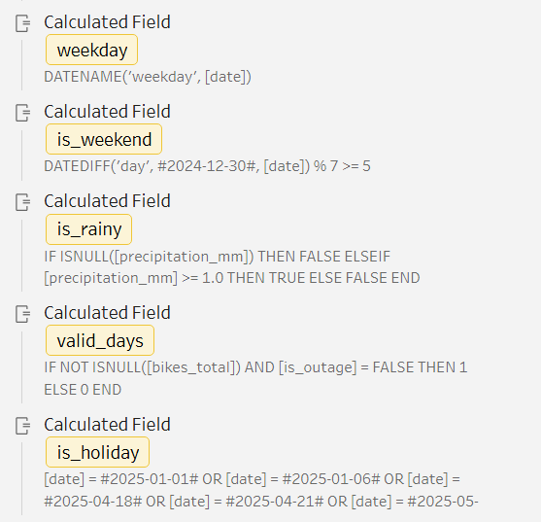
Calculated fields: features for the model
Calendar, weather and quality flags
weekday DATENAME('weekday', [date])
is_weekend DATEDIFF('day', #2024-12-30#, [date]) % 7 >= 5
is_holiday 12 Baden-Württemberg holidays of 2025 in one formula
is_rainy [precipitation_mm] >= 1
is_outlier > Q3 + 3 × IQR per site (Script step)
is_missing no count for that site-day (Fill Missing Days step)
Flags keep problem rows visible instead of deleting them
Notes:
Presenter: Vivek Sawant
Calculated fields add the features a model needs: weekday, weekend, public holiday and rainy day. The weekend formula counts days from a known Monday, so it gives the same result on every computer, whatever its week settings. Holidays are the twelve Baden-Württemberg holidays of 2025, rainy means at least 1 mm. In 2025 that is 104 weekend days, 12 holidays and 94 rainy days. The quality flags - missing, outage, zero, outlier - keep problem rows visible so users can filter them instead of losing them.

Slide 13
Aggregate and output: 5 AI-ready tables
Rows before → after · Tableau = Python
Step | Rule | Rows before | Rows after | Result
Filter Heidelberg + Mannheim | B1 | 57,341 | 10,839 | project scope
Duplicates (exact, site + day) | B2, B5 | 10,839 | 10,839 | 0 found
Outages → NULL | B7 | 10,839 | 10,839 | 77 days flagged
Add missing site-days | B9 | 10,839 | 10,874 | +35 NULL rows
Weather: dedupe + 2025 | W1, W2 | 34,884 | 365 | one row per day
Join → model_table | J1 | 10,874 | 10,874 | 24 columns
Aggregate weekly | J3 | 10,874 | 1,580 | site × ISO week
Outputs (CSV, UTF-8): sites · daily_counts · weather_daily · model_table · weekly_counts
Tableau = Python: 10,874 daily + 1,580 weekly rows, 0 different values (checked row by row)
Notes:
Presenter: Vivek Sawant
Rows before and after every step, from docs/cleaning_log_2025.md. The weekly aggregate groups each site by Monday-to-Sunday weeks: 1,580 rows, and a week with no valid day has a NULL total, not zero. Most important: we compared the Tableau output with the Python output row by row - 10,874 daily rows and 1,580 weekly rows, zero differences in any value. Two tools, same rules, same result.

Slide 14
Reproducible pipeline: one function per rule run_pipeline() calls each rule in order
def run_pipeline(year=2025, months=None):
log = CleaningLog()
bike = load_bike_raw(year, months)
bike = filter_cities(bike, log)
bike = remove_exact_duplicates(bike, log)
bike = standardise_types(bike, log)
bike = filter_period(bike, log, year, months)
bike = deduplicate_site_day(bike, log)
bike = invalid_counts_to_null(bike, log)
bike = flag_outages(bike, log)
bike = flag_outliers(bike, log)
bike = complete_calendar(bike, log)
sites, counts = split_tables(bike)
... # weather W1-W3, join J1-J3
1 rule = 1 function
takes a table, returns a table
@logged decorator
rows before → after into cleaning_log_2025.md
Raw stays read-only
outputs go to data/processed/<year>/
Notes:
Presenter: Shashank Kenkere Sridhar
Every cleaning rule is one Python function in src/cleaning.py. Each takes a table and returns a table. run_pipeline() calls them in a fixed order. A small decorator logs rows before and after every step, which writes the cleaning log automatically. The same functions run inside Tableau Prep's Script step.

Slide 15
Same input, same output: proven 3 ways
Tests, checksums and a re-run on new data
15 / 15
= SHA-256
Jan 2026
tests passed
identical on re-run
new month, same rules
pytest: one test per rule + edge cases ('na', Berlin date, outliers per site, join row count) + one on the real data
checksums of all 5 output files match between runs and on 2 computers (Windows + Linux), see docs/cleaning_log_2025.md
--year 2026 --months 1: 5,103 → 930 rows, 23 outages, 0 missing days. Same code, no changes
Notes:
Presenter: Shashank Kenkere Sridhar
Three proofs. One: pytest runs fifteen tests - one per rule, edge cases like the text 'na', the Berlin date and outliers per site, and one on the real data. Two: re-running the pipeline gives byte-identical files; the SHA-256 checksums in the cleaning log stay the same, also on a second computer. Three: new data. We ran January 2026 with one command each: 5,103 rows, 930 for our two cities, 23 outage days, no missing days - same code, no changes. The weather even came from a different DWD file, because the historical file ends in December, and the rule handled it on its own.

Slide 16
Governance: roles, lineage, AI risks
Who is responsible – and what can go wrong
Roles
Owner (source): MobiData BW / NVBW (bikes), DWD (weather)
Owner (product): Group 07, lead Jasmeet (merges every change)
Steward: Keshav (metadata, dictionary, licences)
Custodians: Jasmeet, Shashank, Vivek (pipeline + Tableau)
Users: city mobility departments · quality analyst: Yash
Lineage
download_log.json
URL + SHA-256 per file
data/raw
read-only, never edited
Same 16 rules in Python and Tableau Prep
cleaning_log
rows before → after
metadata.json
output checksums
Data dictionary
every column: type, unit, meaning
AI risks → action
Missing read as 0
NULL + flags
1 weather station
documented
1 year of data
re-run on Jan 2026
Busy sites dominate
model per site
B38 sensor swap (Sep)
flagged + documented
Review found bug
weekly 0 → NULL, fixed
Notes:
Presenter: Keshav Sain
Roles: the sources stay owned by MobiData BW and DWD; our group owns the product; Keshav is the data steward. Lineage: every file can be traced from its download URL and checksum to the final table. Every change goes through a branch and a pull request on a protected main branch. AI risks: the biggest is missing data read as zero, which we prevent with NULLs and flags. Our governance review even found a bug - weekly totals showed 0 instead of unknown - which we fixed and covered with a test. We also documented the B38 sensor swap from September as an AI risk: it is flagged, and we would confirm the cause with the city before merging the two counters.

Slide 17
Conclusion: yes – after cleaning, with flags
Trusted, reusable, AI-ready – with proof
Trusted
every profiling issue fixed or flagged · 15 tests pass · Tableau = Python
Reusable
FAIR 18 → 29 / 30 with DOI · metadata + data dictionary
AI-ready
model_table: 10,874 rows × 24 columns · unknown = NULL, never 0
Calendar beats weather
holiday −52 % · weekend −40 % · cold −35 % · heavy rain −23 % · rain −14 % (median, 29 sites) · R² 0.57
Lessons learned
Complete ≠ correct
77 'zero bike' days were broken sensors
Two tools, one rule set
forces precise, written rules
Reviews find bugs
governance review caught weekly 0 → NULL
Not fixed yet
one weather station for two cities; B38 sensor swap only flagged (needs the city)
Notes:
Presenter: Jasmeet Kaur
Our answer: yes - after cleaning, and only with the flags. Trusted: every profiling issue is fixed or flagged, fifteen tests pass, and Tableau and Python give exactly the same result. Reusable: FAIR from 18 to 29 out of 30, with a DOI. AI-ready: one model table where unknown is NULL, never zero. And the data answers our question: calendar beats weather. Public holidays cut bike traffic by about half, weekends by 40 percent, cold days by a third; rain matters less. Together these explain 57 percent of the daily variation. Lessons: complete is not correct; one rule set in two tools forces precise rules; reviews find bugs. Not fixed: one weather station for two cities, and the B38 sensor swap is only flagged until the city confirms the cause.

Slide 18
Group 07 · Data Management · SRH University Heidelberg
Jasmeet Kaur · Yash Chinnannavar · Vivek Sawant
Shashank Kenkere Sridhar · Keshav Sain
github.com/jasmeetkaurpelia/dm-project-group-07
DOI 10.5281/zenodo.24058367
Data: MobiData BW / NVBW (DL-DE-BY 2.0) · DWD (CC BY 4.0)
Notes:
Presenter: Jasmeet Kaur
Thank you. We are happy to take questions - each of us answers for their own part.

Slide 19
Backup: column profile
Raw bike data, 17 columns, all text
Column | Missing % | Distinct | Min | Max | Note → cleaning
operator_name | 0.0 | 1 | – | – | 1 value, no information
domain_name | 0.0 | 2 | – | – | "Stadt " prefix → city
domain_id | 0.0 | 2 | 4,197 | 4,206 | 2 values (cities)
counter_site | 0.0 | 30 | – | – | typos, trailing dots
counter_site_id | 0.0 | 30 | 100,012,161 | 300,040,059 | key (site_id)
counter_serial | 0.0 | 30 | – | – | device ID
longitude | 0.0 | 30 | 8.4566 | 8.726 | 1 position per site
latitude | 0.0 | 30 | 49.3886 | 49.5144 | 1 position per site
timezone | 0.0 | 1 | – | – | label says Europe/Paris
iso_timestamp | 0.0 | 365 | – | – | → date, Europe/Berlin
channels_in | 3.38 | 2978 | 0 | 9,045 | "na" for 2 sites
channels_out | 3.37 | 3053 | 0 | 7,837 | "na" for 2 sites
channels_unknown | 96.63 | 292 | 78 | 1,341 | only where no direction
channels_all | 0.0 | 4450 | 0 | 16,792 | target: 97 zeros
site_temperature | 3.14 | 63 | -0.5 | 30 | dropped: DWD instead
site_rain_accumulation | 3.14 | 103 | 0 | 43 | dropped: DWD instead
site_snow_accumulation | 3.14 | 15 | 0 | 6.6 | dropped: DWD instead
*"Missing" counts empty cells and the text "na". Source: docs/column_profile_bike.csv, generated by src/profiling.py
Notes:
Backup slide for questions. The full column profile of the raw bike data. Orange = columns with hidden missing values: the text 'na' in the direction columns for the 2 sites that only report a total. channels_unknown is 96.6 % 'missing' because it is only filled when there is no direction. The counter-side weather columns are dropped because DWD is our single, quality-checked weather source.

