Slide 1
AHCS (automatic Heating and Cooling System)
Jasmeet Singh 1710991350
Karandeep sahni 1710991381

Slide 2
Why do we need it?
In recent times, weather around the world has become unpredictable and extreme due to which heating and cooling appliances are used more frequently.
But, in the fast pace of life people usually forget to turn off the appliances.
So what we need is a system that automatically triggers the heating/cooling system to keep the house temperature at a normal level and making a smart living.

Slide 3
Tools and Technologies Used
To making this type of system we need sensors for sensing the temperature and humidity. So, we will use DHT22 sensor i.e. Digital Temperature and Humidity Sensor.
For processing how the data should be compared, type of decision making and saving the data, we need microcontroller. So, we will use Arduino Uno. As Arduino Uno is based upon the special language similar to C language.
For storing data we will use Data Logger Shield which saves the data in the SD Card in form of CSV file.

Slide 4
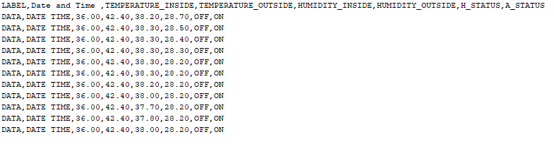
Sensing
In the above image we can see the data will be sensed of temp of Inside, Temp of Outside, Humidity of Inside, Humidity of Outside and other data will be stored in the database.

Slide 5
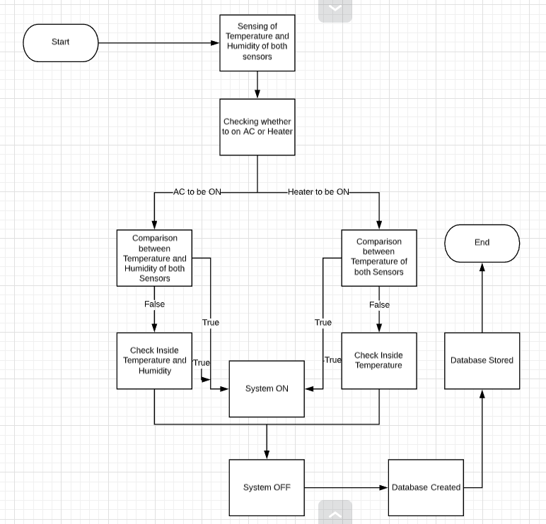
Thinking

Slide 6

Act of the system

Slide 7
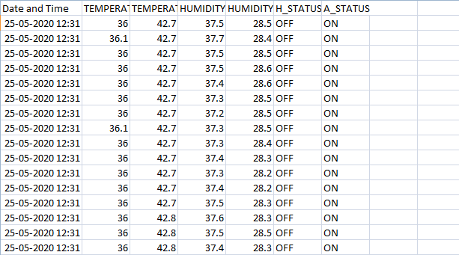
Database of ahcs
This is how the data will be stored and for the data file link is :
https://github.com/jasmeetsi4/AHCS/blob/master/MGL001.xlsx

Slide 8
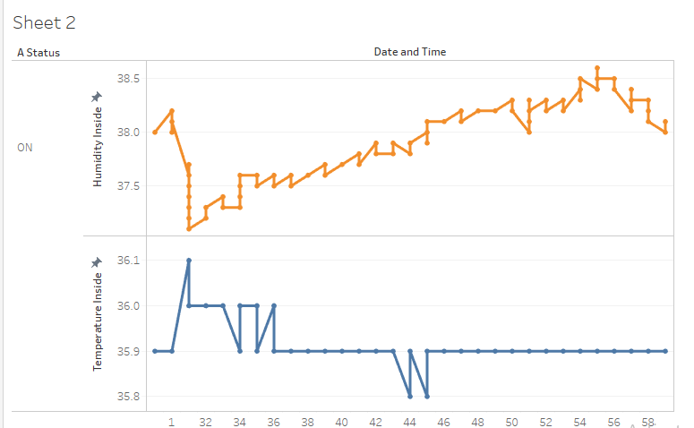
Visualization of database

Slide 9
Group Members Roles
Name | Role
Jasmeet Singh | Developer
Karandeep Sahni | Project Researcher and Tester

Slide 10
Work done and leftover
AHCS is completely function able for the heating process and for the cooling process with the database of the two datasets of the temperature and humidity.
AHCS real time testing is still left with 100%assurance.

