Slide 1
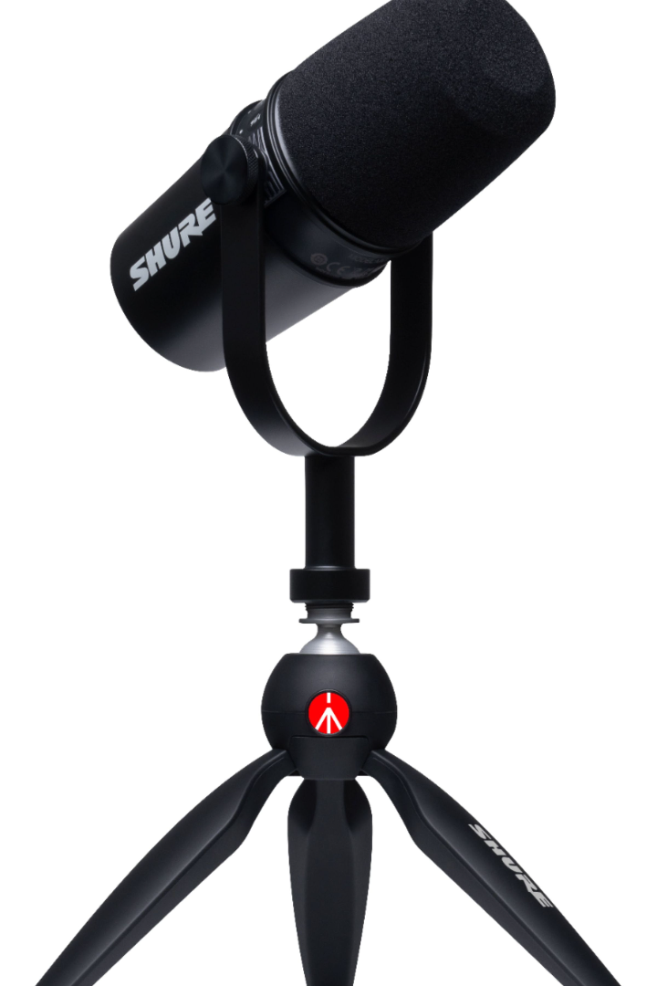


Podcasting: The Gateway to a World of Knowledge
Podcasting is one of the fastest-growing mediums of today, allowing anyone to share their knowledge, insights and stories with a worldwide audience. In this presentation, we will discuss the benefits, process, and monetization strategies of podcasting.
by Jasmeet Singh

Slide 2
The Rise of Podcasting
2004
The term "podcasting" is coined and Apple integrates podcasts into iTunes
1
2
3
2000
2021
Adam Curry and Dave Winer develop the first podcasting tools
Over 1.5 million podcasts available worldwide, with over 34 million episodes

Slide 3
The Benefits of Podcasting
Unleash Your Creativity
Built-in Audience
Low Cost & High ROI
Podcasts have a loyal and growing audience, giving you the opportunity to connect with people from all over the world.
All you need to get started is a microphone and editing software. Podcasting can also be a lucrative source of income.
Podcasting allows you to express yourself freely and creatively, without the limitations of traditional media.

Slide 4



Planning & Recording Your Podcast
Establish Your Theme & Format
Invest in Quality Audio Equipment
Interview Techniques
Prepare your questions and research your guest. Listen carefully and be responsive during the interview to make it engaging.
Choose a topic that you're passionate and knowledgeable about, then decide on the format that best suits your content.
Your podcast's audio quality can make or break its success, so invest in a high-quality microphone and soundproofing gear.

Slide 5
Publishing & Promoting Your Podcast
Choose a Platform and Host
Create an Eye-Catching Cover Art & Description
Promote Your Podcast on Social Media & Other Channels
There are many podcast hosting platforms to choose from. Pick one that matches your budget and technical needs.
Your cover art and description are your podcast's first impression. Make it stand out by being unique and engaging.
Use social media, email marketing and other channels to promote your podcast. Collaborate with other podcasters and invite guests to share your episodes.

Slide 6
Monetizing Your Podcast
1
Sponsorship & Advertising
As your podcast grows, you can monetize it using sponsorships and advertising. Ask brands that you believe in, and who align with your audience and topics, to sponsor your show.
2
Premium Content & Donation-Based Programs
Create premium content for loyal listeners, such as early access or bonus content, and set up a donation-based program via platforms such as Patreon.
3
Live Shows & Merchandise
Host live shows and/or sell merchandise. Live shows can take different forms, from Q&A sessions to full-fledge live recordings.

Slide 7

Embrace the Power of Podcasting
Podcasting opens doors for those who want to share their expertise, experiences, and knowledge with others. Aspiring podcasters, start with your unique voice and perspective, and let us guide you through the entire process.

