Slide 1
Multi-Agent SVG Generation System
基于多智能体的自然语言到 SVG 信息图生成系统
Phase 3: 知识增强 + 渲染验证 + 反馈闭环
2026-07-10

Slide 2
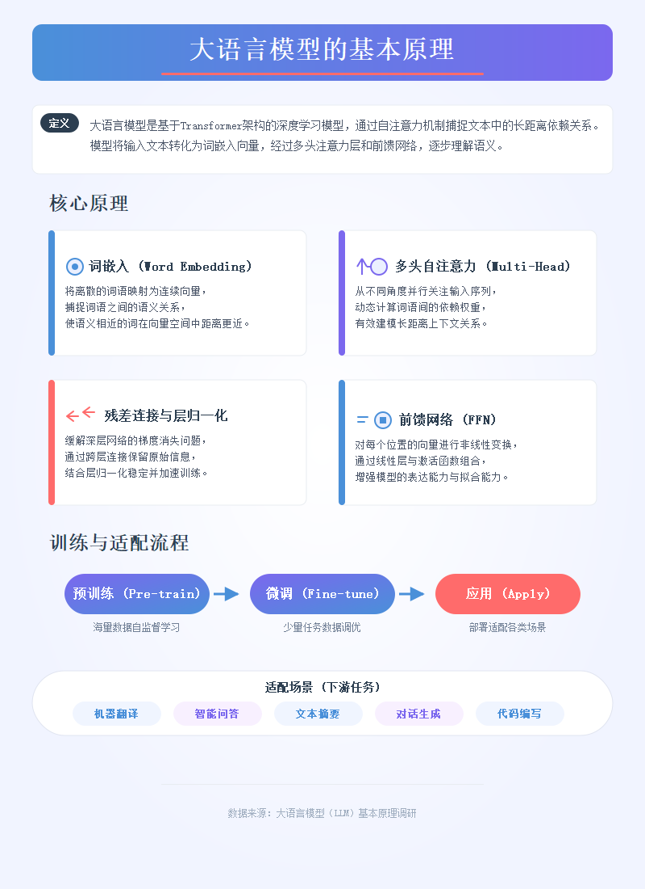
Sample: sample1_llm_principles
Prompt: 大语言模型的基本原理
Intent: concept_explanation | Chart: concept_map | Confidence: 0.9 Score: 9 | Passed: True | Rounds: 1 | Duration: 327s

Slide 3
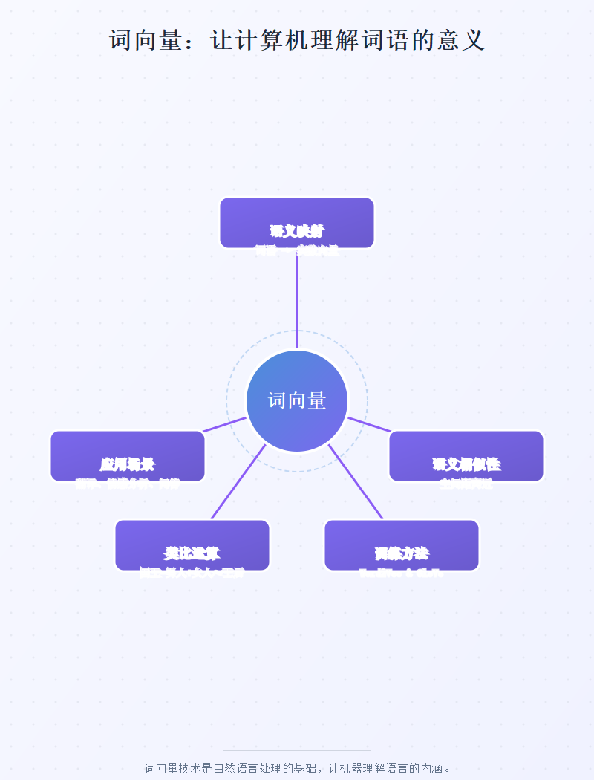
Sample: sample2_word_embedding
Prompt: 词向量：让计算机理解词语的意义
Intent: concept_explanation | Chart: concept_map | Confidence: 0.95 Score: 9 | Passed: True | Rounds: 1 | Duration: 296s

Slide 4
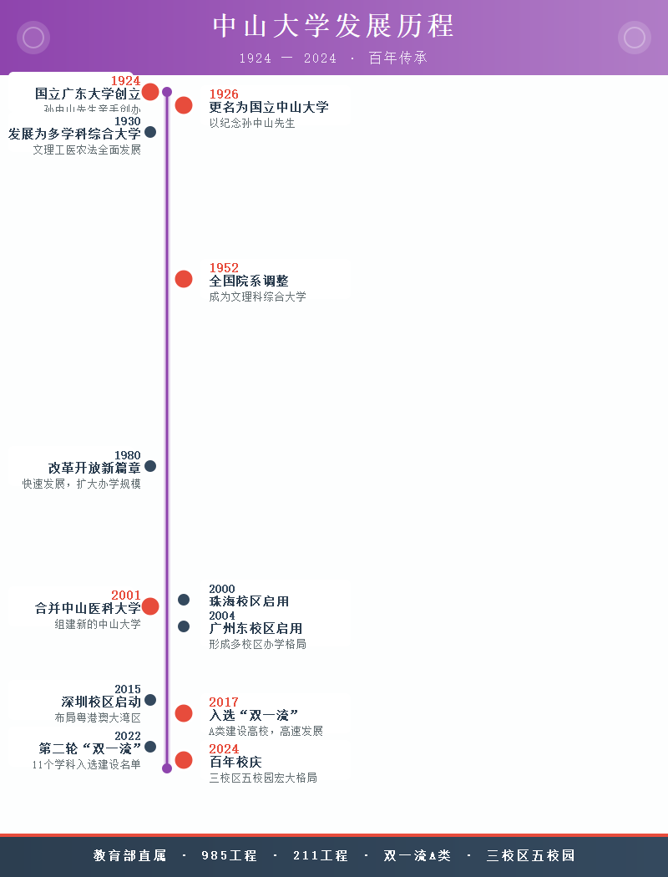
Sample: sample3_sysu_history
Prompt: 中山大学发展历程
Intent: timeline | Chart: timeline | Confidence: 0.95 Score: 9.2 | Passed: True | Rounds: 1 | Duration: 327s

Slide 5
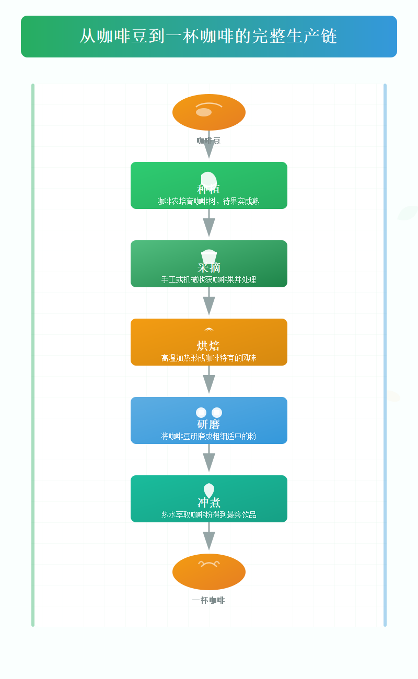
Sample: sample4_coffee_chain
Prompt: 从咖啡豆到一杯咖啡的完整生产链
Intent: process_flow | Chart: process_diagram | Confidence: 0.98 Score: 9 | Passed: True | Rounds: 1 | Duration: 268s

Slide 6
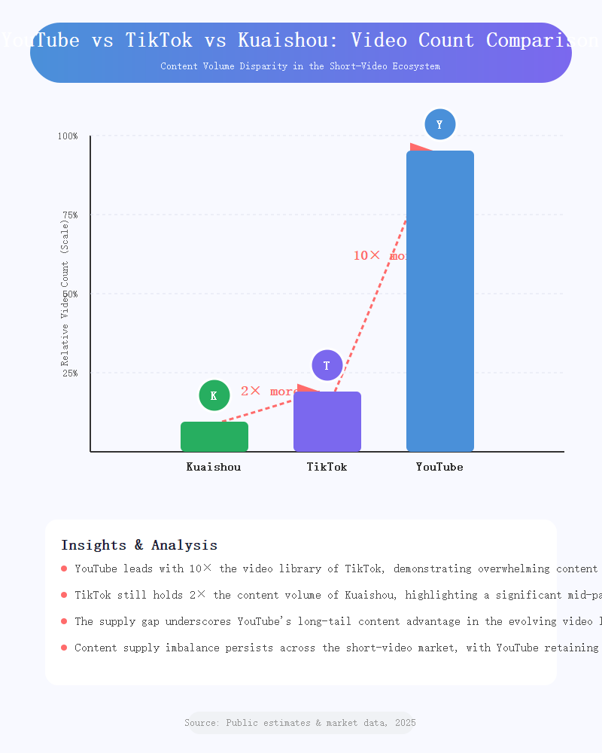
Sample: sample5_video_comparison
Prompt: YouTube vs TikTok vs Kuaishou: Video Count Comparison
Intent: data_comparison | Chart: bar_chart | Confidence: 0.95 Score: 9 | Passed: True | Rounds: 1 | Duration: 187s

Slide 7

Sample: test_sample
Prompt: test_sample
Intent: ? | Chart: ? | Confidence: ? Score: ? | Passed: False | Rounds: 0 | Duration: 0s

Slide 8
Generation Summary
sample1_llm_principles: 9/10 [PASS] — concept_explanation
sample2_word_embedding: 9/10 [PASS] — concept_explanation
sample3_sysu_history: 9.2/10 [PASS] — timeline
sample4_coffee_chain: 9/10 [PASS] — process_flow
sample5_video_comparison: 9/10 [PASS] — data_comparison

