Slide 1
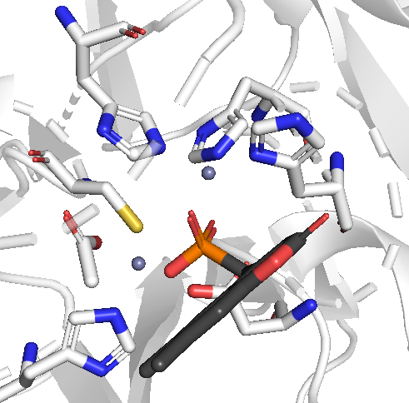
H189
H120
H122
C208
acetate
Ligand 1
H250

