Slide 1
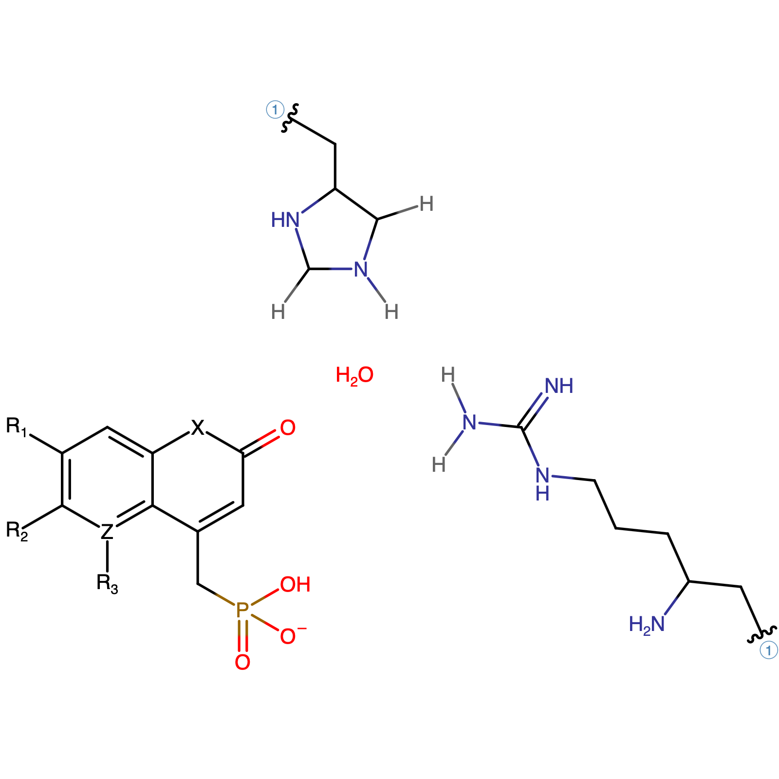
HIS
𝛆₁
𝛆₂
η₂₂
Ligand
ARG
η₂₁

