Slide 1
CARDIO-VASCULAR DISEASE DETECTION
CHITKARA UNIVERISTY,PUNJAB
SUBMITTED BY:
JASMINE SINGH(2210991703)
KAMYA JINDAL(2210991730)
KANUSHI GUPTA(2210991743)
SUBMITTED TO:
MR. ANIMESH OJHA

Slide 2
INDEX
INTRODUCTION 3
ABSTRACT 4
PROJECT DETAILS 5
EVALUATION 14
CONCLUSION 16
MEET OUR TEAM 17
THANK YOU

Slide 3
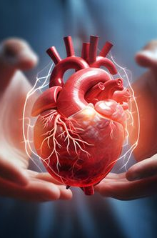
Introduction
Cardiovascular diseases (CVDs) are the leading cause of death globally, responsible for approximately 17.9 million deaths in 2019, accounting for 32% of all global deaths. Heart attacks and strokes, which result from blockages in blood vessels supplying the heart or brain, constitute the majority of CVD-related fatalities.
While some risk factors are beyond our control (such as age and family history), many are modifiable through lifestyle changes. Unhealthy diet, physical inactivity, tobacco use, and excessive alcohol consumption contribute to raised blood pressure, glucose, and lipids, increasing the risk of heart attack, stroke, and other complications. Encouraging healthy behaviors, such as quitting smoking, reducing salt intake, eating more fruits and vegetables, and staying physically active, can significantly lower the risk of cardiovascular disease
Leveraging machine learning and predictive models, we can enhance early detection, improve diagnosis, and recommend tailored interventions for high-risk individuals, ultimately reducing fatality rates and promoting better health outcomes.

Slide 4
ABSTRACT
PROBLEM:
In today's world, cardiovascular disease (CVD) is the leading cause of death . This field has seen numerous studies, many of which are still ongoing . The research is now more focused on data analysis and machine learning models, like many others. What causes heart disease and how can we prevent it are the questions at hand.
SOLUTION:
In order to fit the outputs of a predictive model to the observations in our dataset, we performed a straightforward exploratory data analysis to obtain a slightly more comprehensive view. We wanted to know which factors have a greater impact on the diagnosis of heart disease.

Slide 5
Dataset Description
slope_of_peak_exercise_st_segment (type: int): the slope of the peak exercise ST segment, an electrocardiography read out indicating quality of blood flow to the heart.
thal (type: categorical): results of thallium stress test measuring blood flow to the heart, with possible values normal, fixed_defect, reversible_defect
resting_blood_pressure (type: int): resting blood pressure
chest_pain_type (type: int): chest pain type (4 values)
num_major_vessels (type: int): number of major vessels (0-3) colored by flourosopy
fasting_blood_sugar_gt_120_mg_per_dl (type: binary): fasting blood sugar > 120 mg/dl
resting_ekg_results (type: int): resting electrocardiographic results (values 0,1,2)
serum_cholesterol_mg_per_dl (type: int): serum cholestoral in mg/dl
oldpeak_eq_st_depression (type: float): oldpeak = ST depression induced by exercise relative to rest, a measure of abnormality in electrocardiograms
sex (type: binary): 0: female, 1: male
age (type: int): age in years
max_heart_rate_achieved (type: int): maximum heart rate achieved (beats per minute)
exercise_induced_angina (type: binary): exercise-induced chest pain (0: False, 1: True)

Slide 6
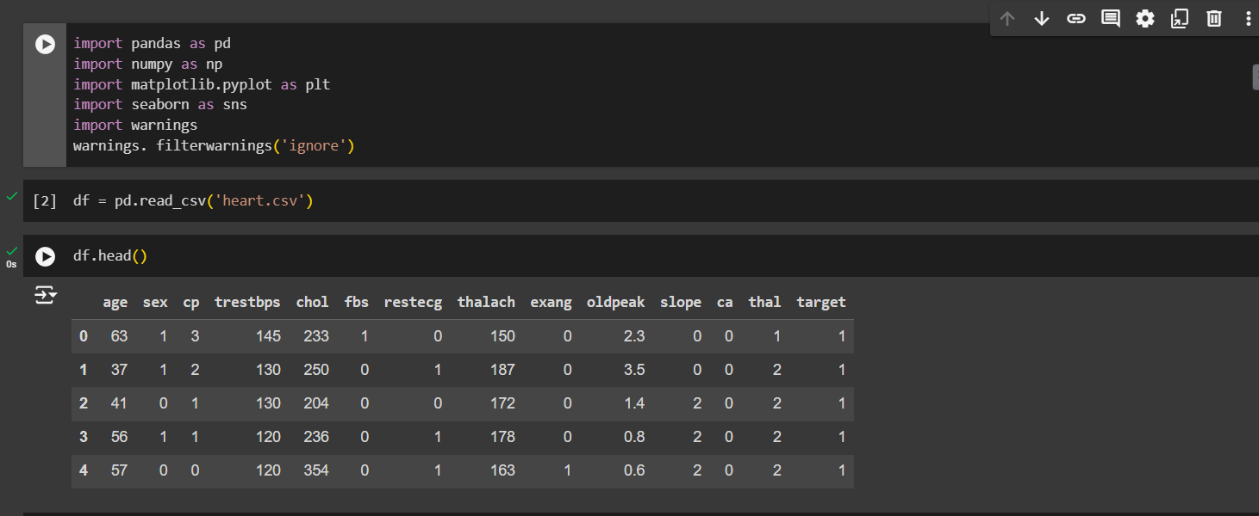
Data Loading

Slide 7
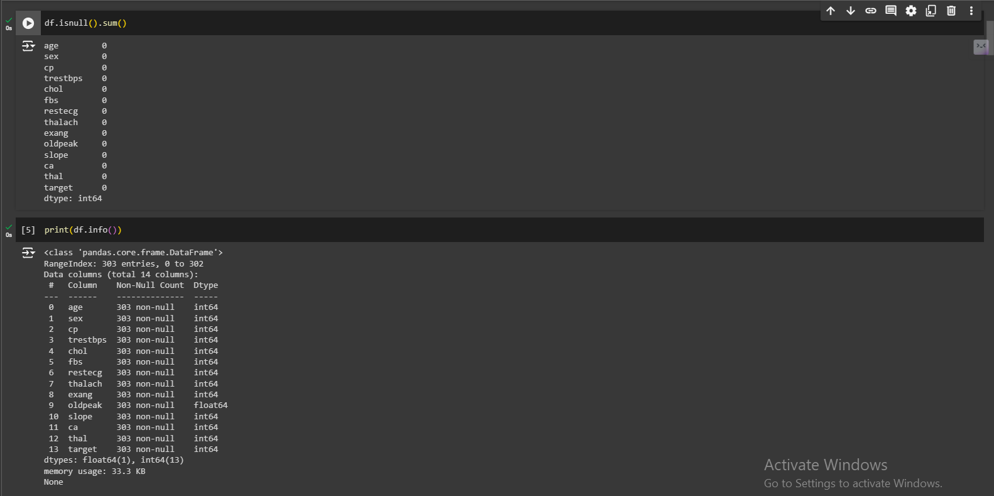

Slide 8
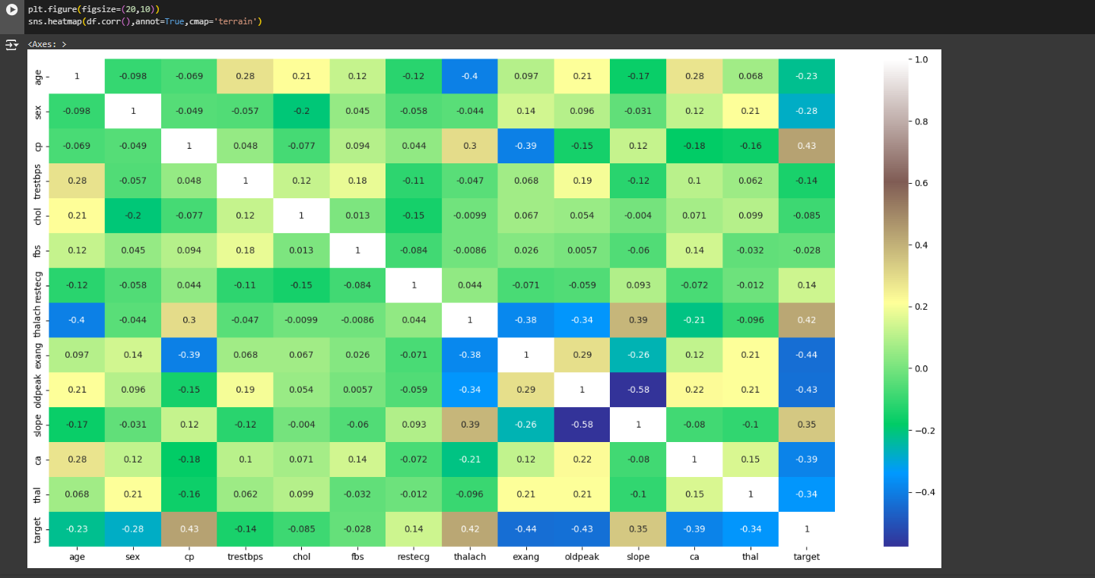
Data Visualization and Analysis

Slide 9
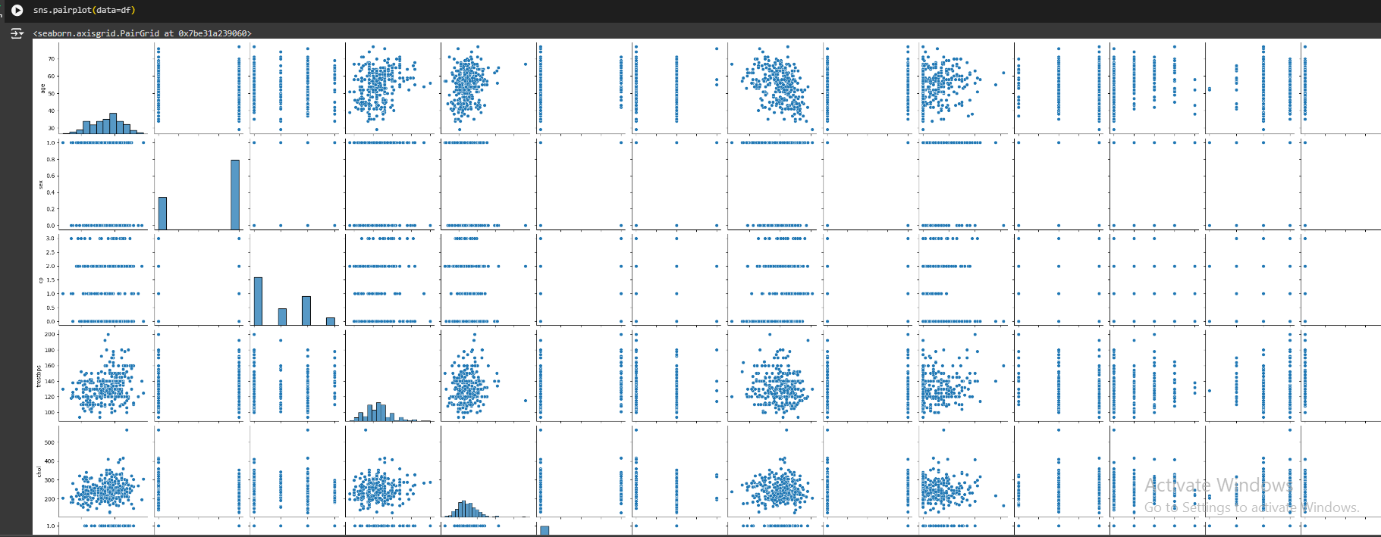

Slide 10
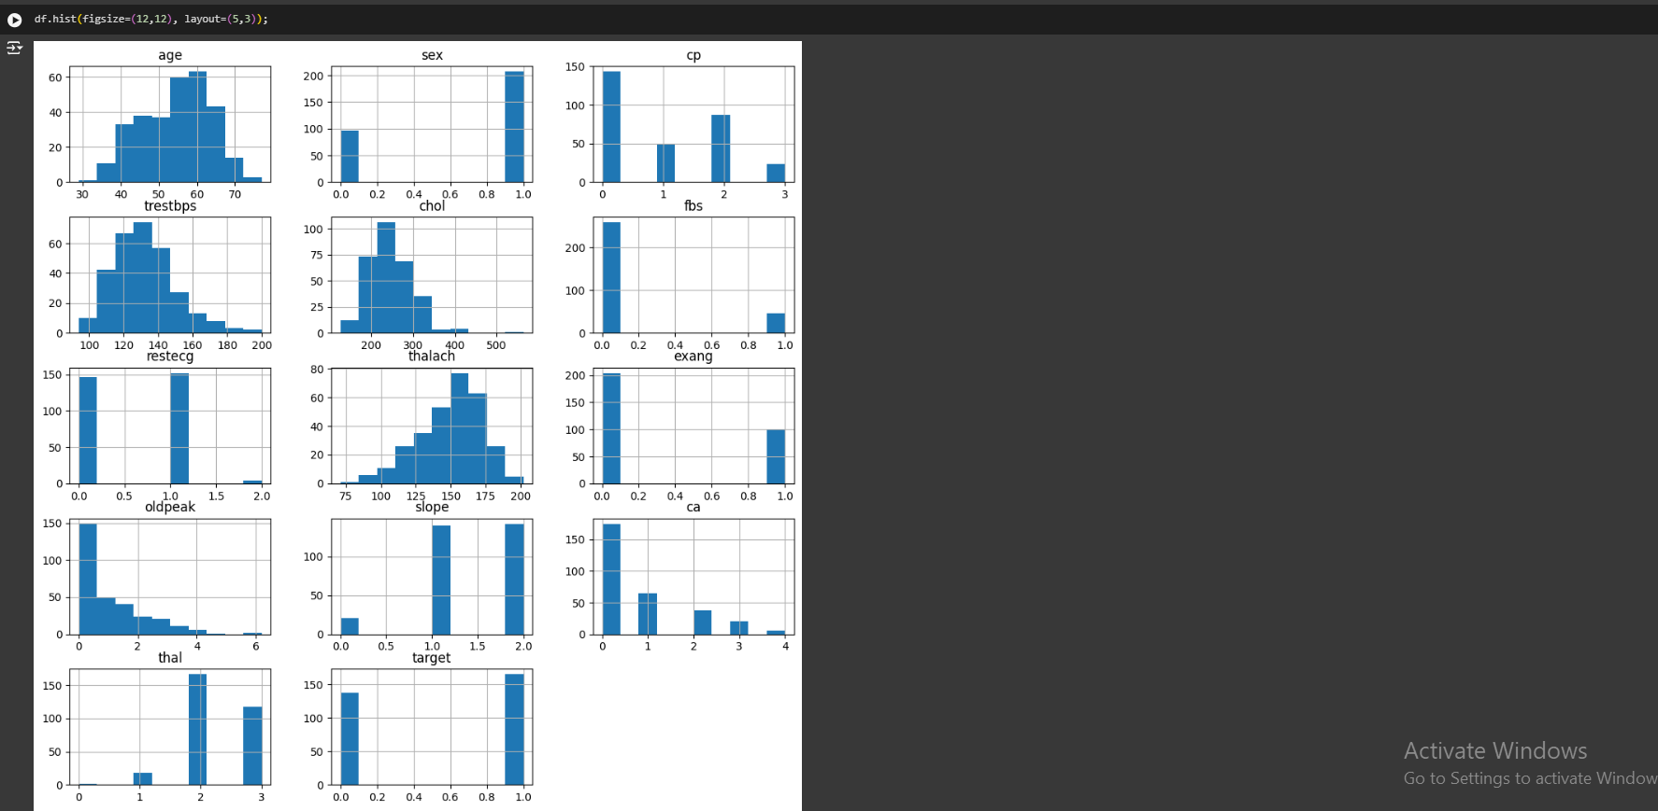

Slide 11
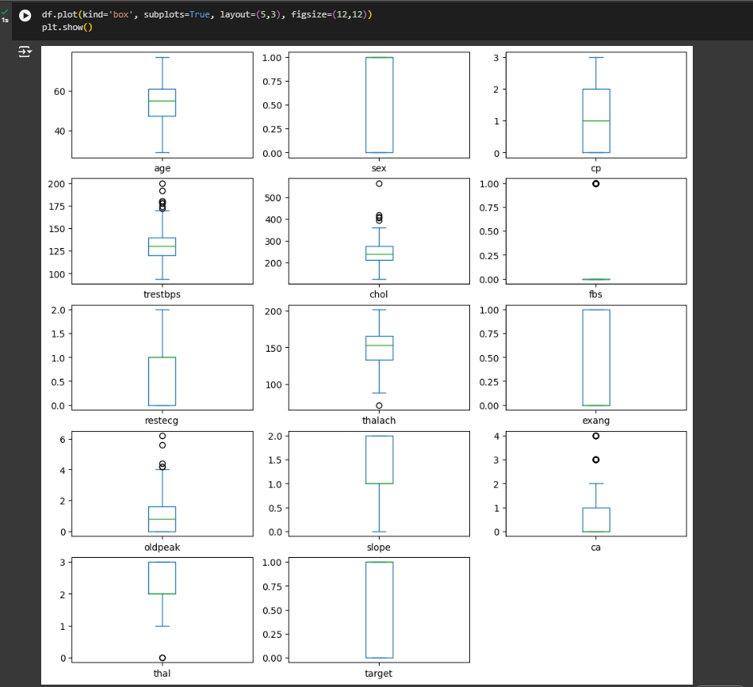
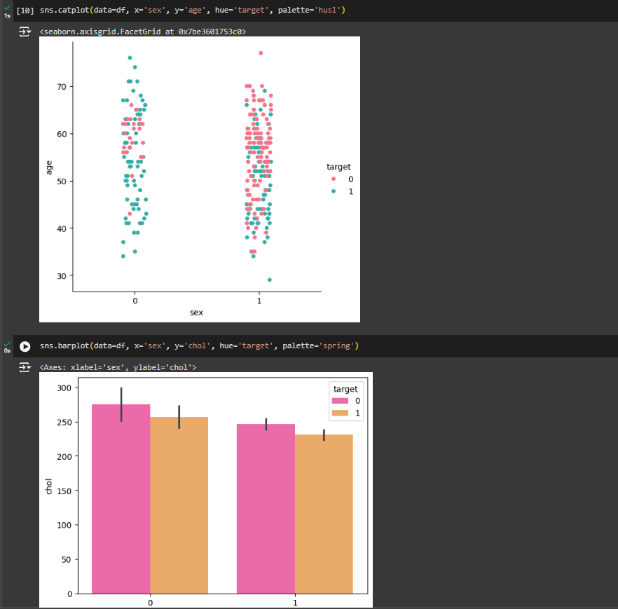

Slide 12
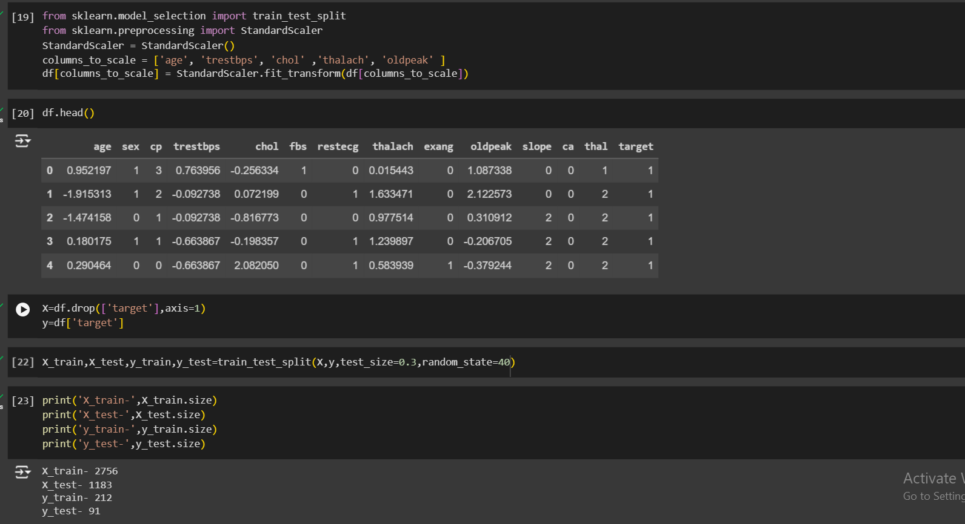
Preparing The Data for Model

Slide 13
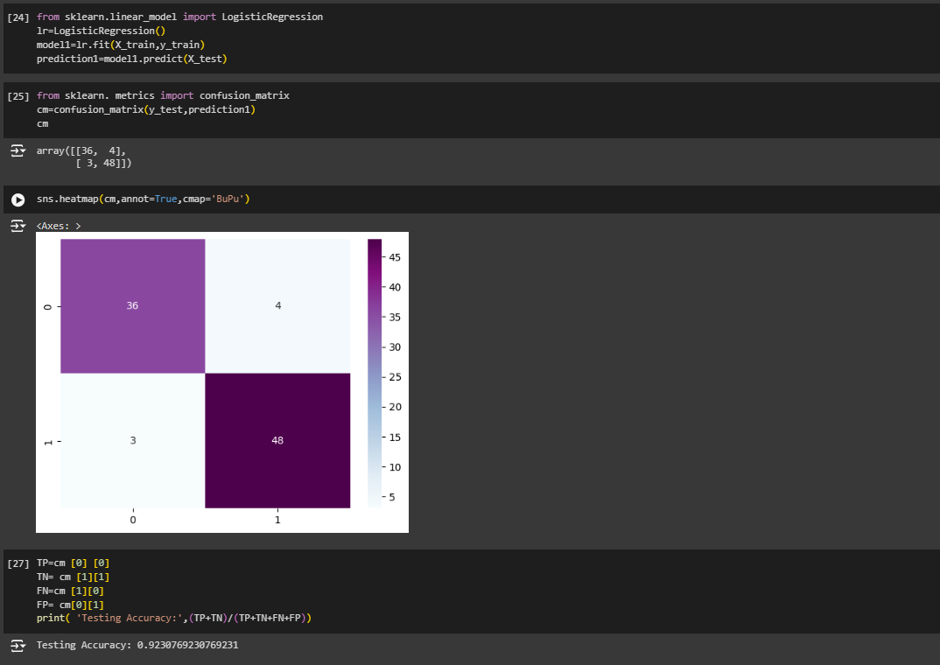
Logistic Regression

Slide 14
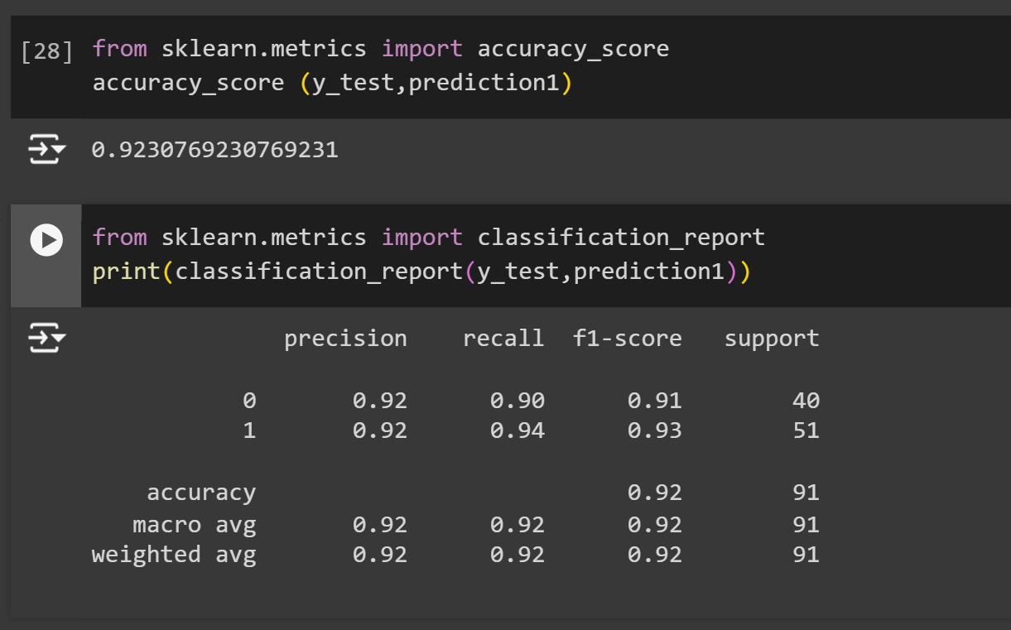
Evaluation

Slide 15
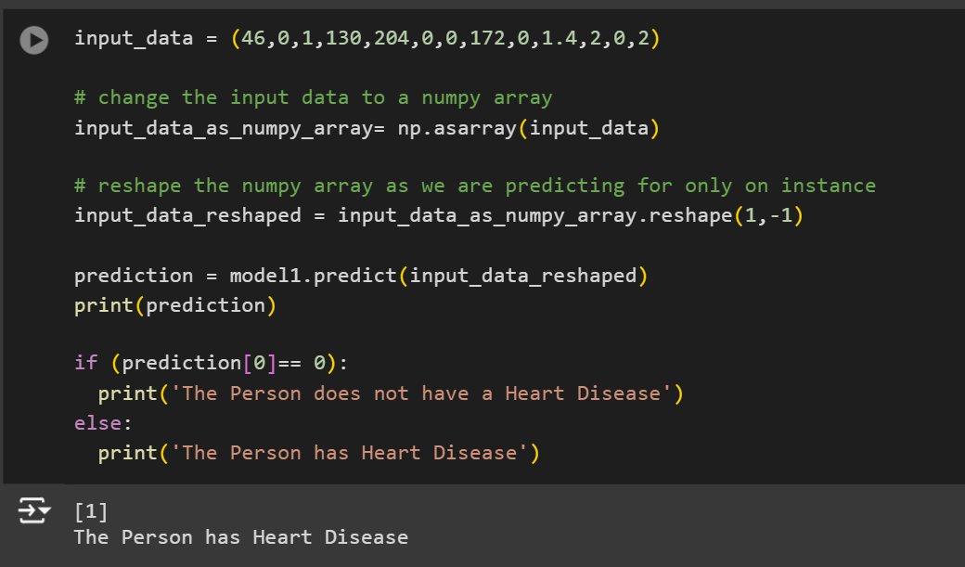

Slide 16
CONCLUSION
This extensive article emphasizes the significance of computer science, particularly data science, in the early detection and treatment of cardiovascular disease. By utilizing each dataset variable to represent a biological indicator of cardiac disease,
existing datasets present a comprehensive picture, as we note. Next, we see how these datasets can be used in a machine learning approach to train various models to predict a target variable, such as determining the severity of heart disease risk or the presence of an illness. We also show how various models are put into action from beginning to end and compare how well they work with the well known UCI heart disease prediction dataset. Last but not least, we take a look at current initiatives that, after extensive feature engineering and selection, construct robust ensemble models by utilizing either all or some of the features of various datasets. Given all of this work, it's reasonable to believe that machine learning is the future of healthcare. In its current form, machine learning can be useful for detecting extremities like the confident absence of risk or, on the other hand, sudden cardiac death.

Slide 17



meet our team
KANUSHI GUPTA
TEAM MEMBER
KAMYA JINDAL​
JASMINE SINGH
TEAM MEMBER​
TEAM MEMBER
CVD DETECTION

Slide 18
Thank you

