Slide 1
Artificial Intelligence and Machine Learning Project
[ Team -1 ]
Jaivardhan Khanna : 2210990429
Jashan Jot Kaur Gill : 2210990436
Jasmeet Singh : 2210990449
Jasmine Rathor : 2210990450
Faculty Coordinator: Shagun Sharma
Chitkara University Institute of Engineering and Technology,
Chitkara University, Punjab

Slide 2
Table of Contents
Introduction
Problem Statement
Technical Details
Key Features
Conclusion
References/Links used

Slide 3
Introduction
In the era of overwhelming choices, recommending personalized content has become crucial in enhancing user experience. The film industry is no exception, with countless movies released each year, users often find it challenging to discover films aligned with their preferences. To address this issue, we present a Movie Recommender System leveraging Python and scikit-learn.

Slide 4
Problem Statement
The problem statement revolves around developing an intelligent movie recommendation system utilizing artificial intelligence and machine learning techniques. The objective is to create a system that can analyze user preferences and recommend movies based on their characteristics and features. The system should be capable of providing personalized suggestions to enhance the user experience and facilitate seamless content discovery.

Slide 5
Technical Details
Software Requirements:
The software requirements for the movie recommendation system encompass the following components:
Programming Language: Python for implementing algorithms, data processing, and system logic.
Libraries/Frameworks:
scikit-learn: For machine learning algorithms and feature extraction (Countvectorizer, cosine_similarity).
Pandas: For data manipulation and analysis, particularly for handling datasets.
PorterStemmer(): For finding close matches between movie titles.
Integrated Development Environment (IDE): Any Python-compatible IDE such as Jupyter Notebook, PyCharm, or VS Code for development and testing.
Version Control: Git for managing codebase and collaboration among team members.

Slide 6
Technical Details
Hardware Requirements:
The hardware requirements for the movie recommendation system are relatively modest and can vary based on factors such as dataset size and user traffic. The basic hardware setup includes:
Processor: A multi-core processor (e.g., Intel Core i5 or higher) to handle data processing tasks efficiently.
Memory (RAM): At least 8 GB of RAM to accommodate dataset loading, feature extraction, and algorithm execution.
Storage: Sufficient storage space for storing datasets, codebase, and any additional resources required by the system.
Network Connectivity: Stable internet connectivity for accessing external datasets (if applicable) and deploying web-based components (if included).

Slide 7
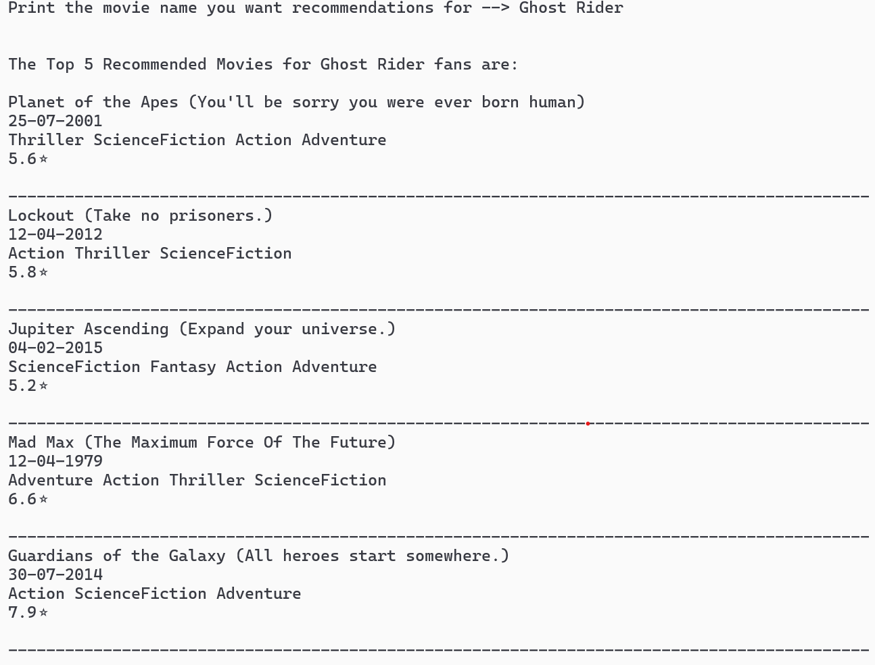
Project Highlights
Name of Recommended Movie
Name of the User input Movie
Release date of Recommended Movies
Genre of Recommended Movies
Ratings of Recommended Movies

Slide 8
Conclusion
The primary objective of this project has been to design and implement a movie recommendation system based on artificial intelligence and machine learning.
The system aims to provide users with personalized movie suggestions by analyzing the characteristics and features of films.
By leveraging techniques such as content-based filtering, the system can understand user preferences and recommend movies that are similar to those the user has enjoyed in the past.

Slide 9
References/Links used
W3 Schools- https://www.w3schools.com/ai/ai_machine_learning.asp
Medium - https://medium.com/
Data Camp - https://datacamp.com/
Towards Data Science - https://towardsdatascience.com/
Stack Overflow - https://stackoverflow.com/

Slide 10


