Slide 1
Graph Neural Networks and Transformers Workshop
ENCCS and RISE
Erik Ylipää and Leon Sütfeld

Slide 2
Workshop outline
Thursday October 21
Friday October 22
09:00 - 09:20 | Workshop intro
09:20 - 10:00 | Intro for session 1 notebooks: Graphs and what to do with them
10:00 - 12:00 | Work on notebooks
12:00 - 13:00 | Lunch break
13:00 - 13:30 | Intro for session 2 notebooks: From graphs to tensors
13:30 - 15:50 | Work on notebooks
15:50 - 16:00 | Recap of the day
09:00 - 09:30 | Intro to session 3, Inner workings of Graph Neural Networks
09:30 - 12:00 | Work on notebooks
12:00 - 13:00 | Lunch break
13:00 - 13:30 | Intro for session 4 notebooks: From GNNs to Transformers
13:30 - 15:40 | Work on notebooks
15:40 - 16:00 | Recap of the workshop

Slide 3
From graphs to tensors
SESSION 1

Slide 4
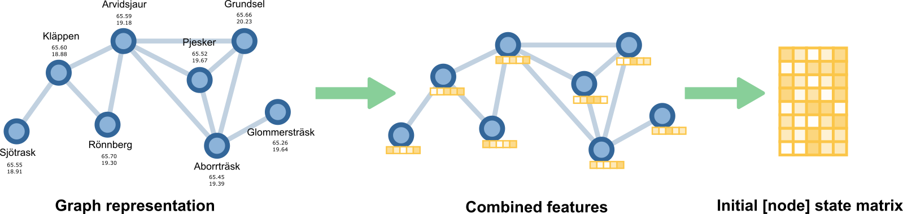
From graphs to arrays
SESSION 1

Slide 5
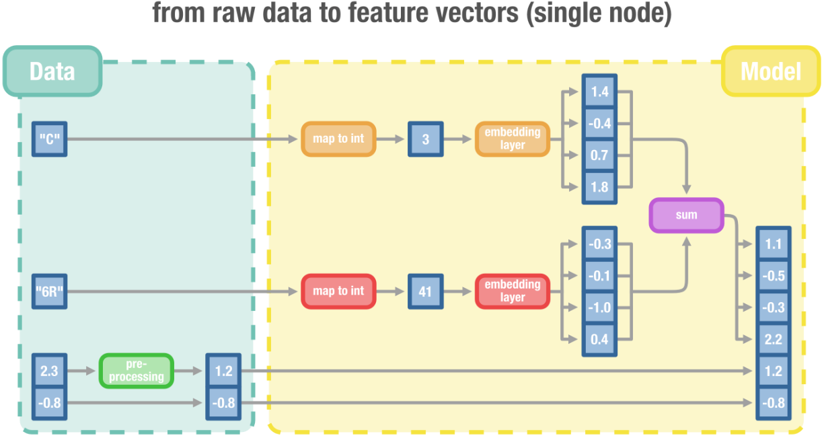
From graphs to arrays
SESSION 1

Slide 6
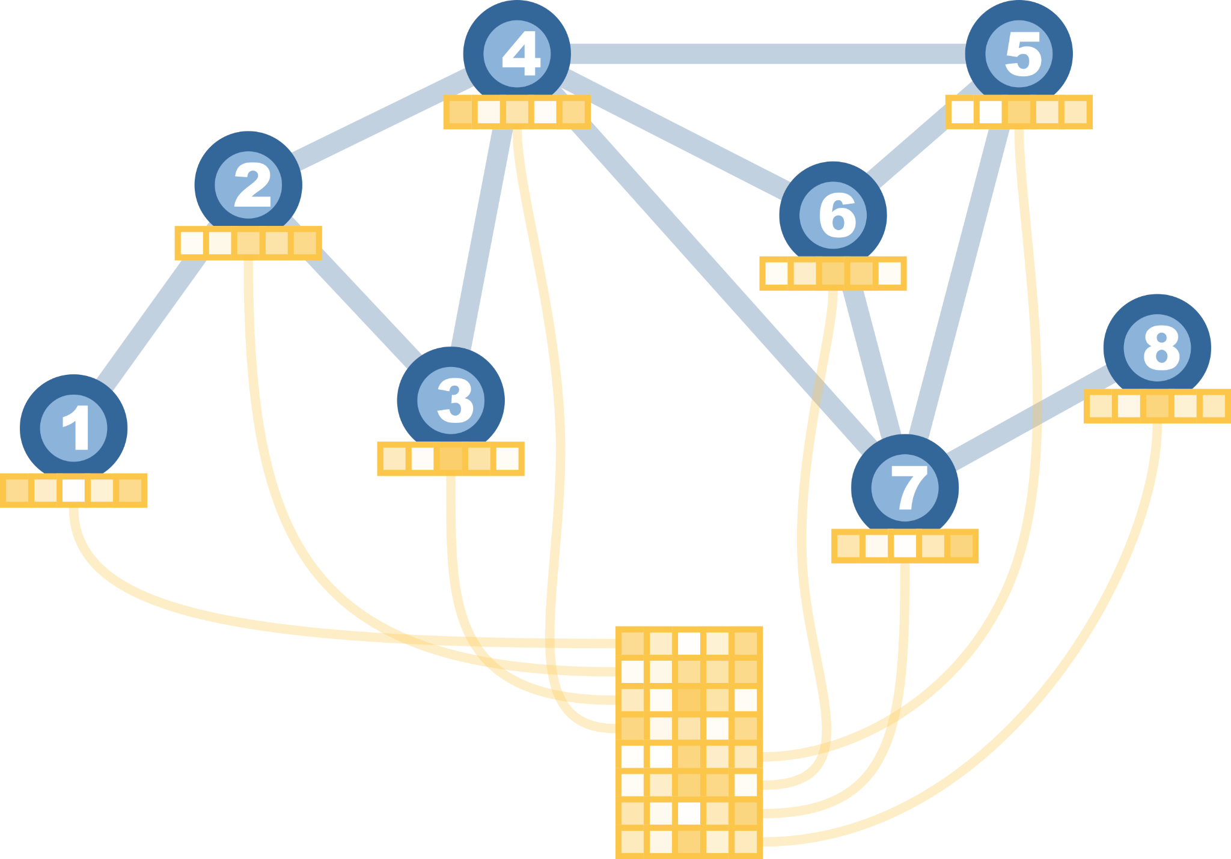
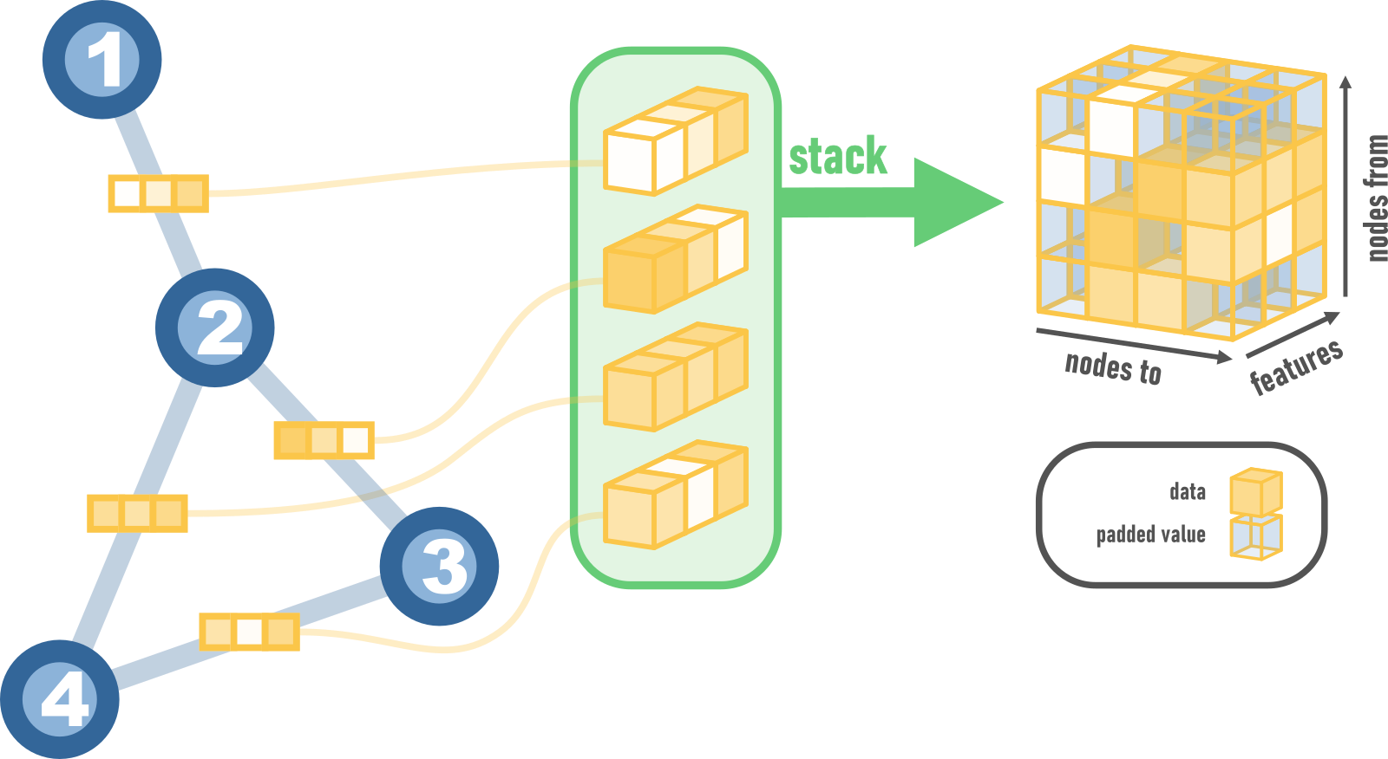
From graphs to arrays
SESSION 2
Node features
Edge features

Slide 7
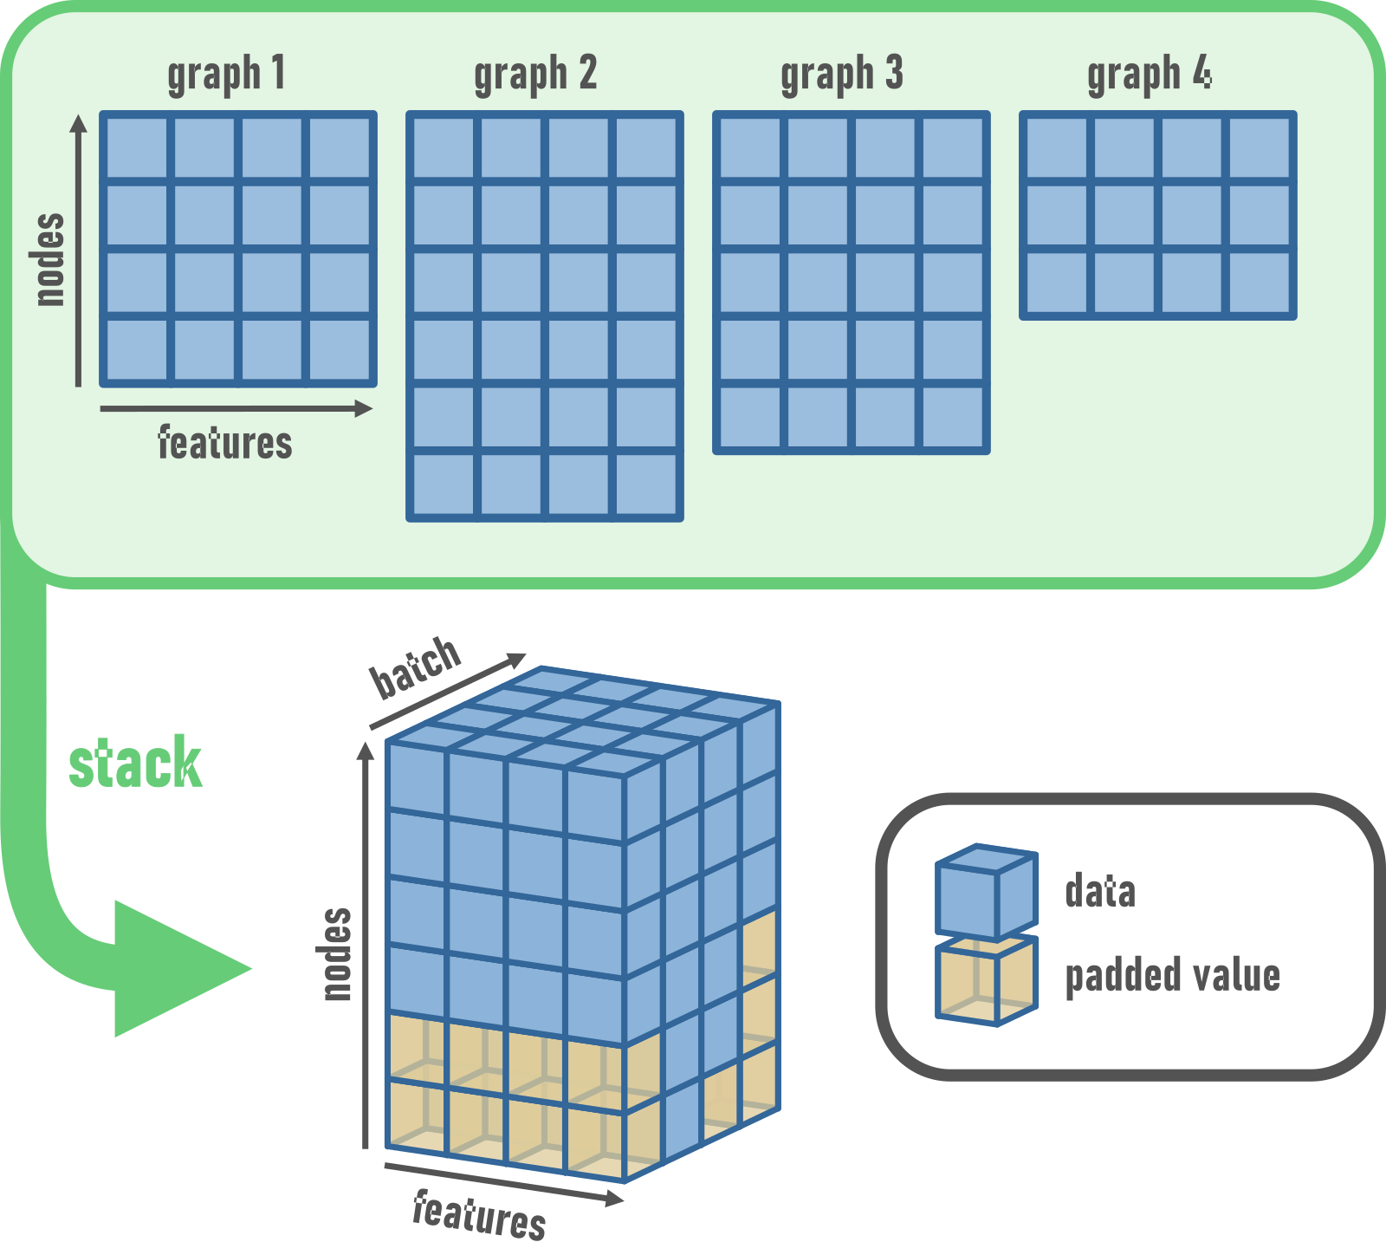
Batching graphs
SESSION 2

Slide 8
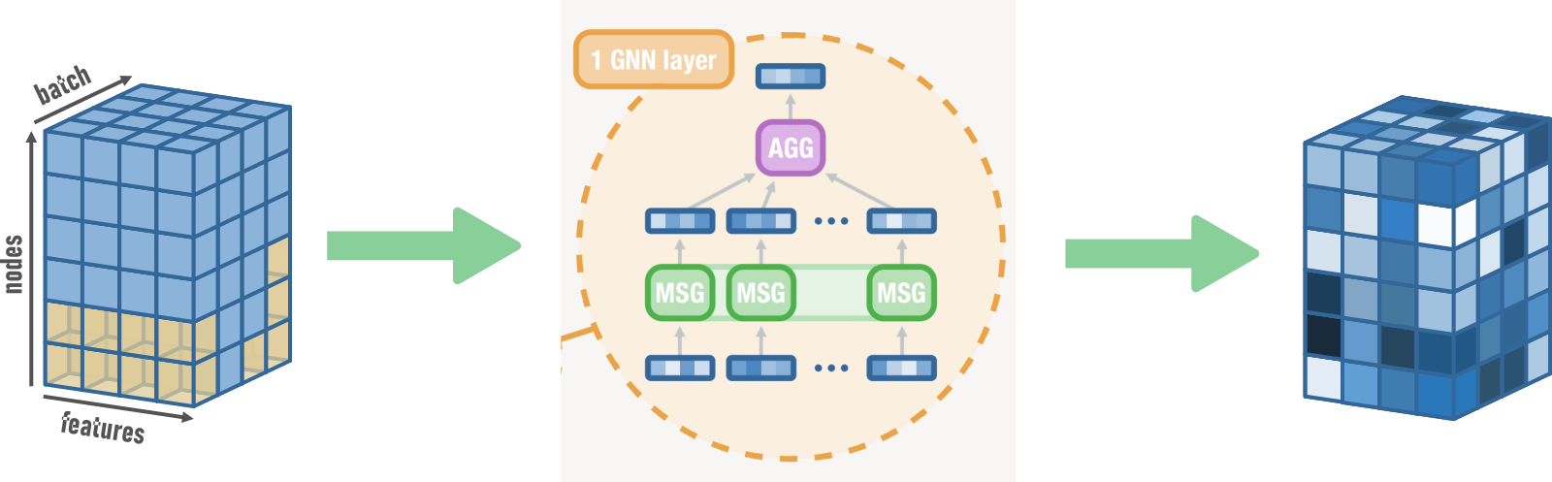
Dealing with differently sized graphs
SESSION 2
Notes:
Focus more on producing the batches and the masks not on producing the neural network which is the circle in the middle.

Slide 9
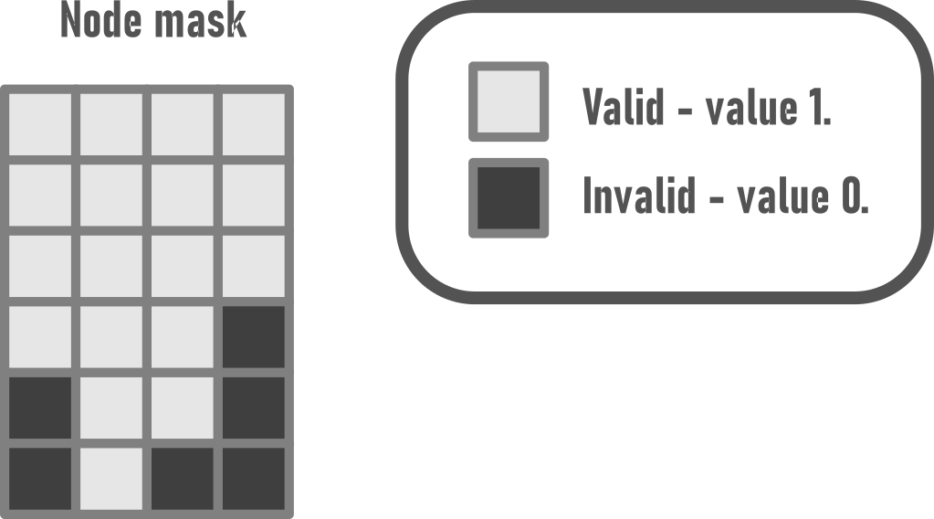
Masks
SESSION 2

Slide 10
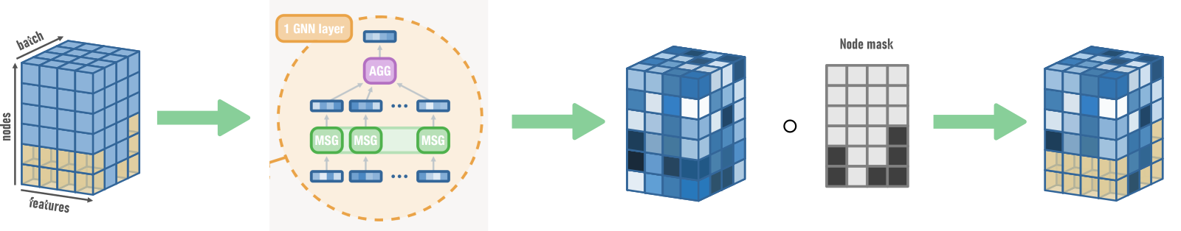
Masking tensors
SESSION 2
Broadcasting

Slide 11
Thank you!
enccs.se

