Slide 1

Iot-Noise pollution Monitoring project Guide, Mr.R.M.Senthil kumar,AP/ece
9238-Mangayarkarasi College of Engineering
(Approved by AICTE, New Delhi & Affiliated to Anna University, Chennai ) MANGAYARKARASI NAGAR,PARAVAI,MADURAI-625 402 Website: http://mce-madurai.ac.in E-Mail: mangai.enggcoll@gmail.com
Project Team Members
Aarthi Murugan(923821106001)
N.Aruna Shree(923821106007)
K.Saranya(923821106045)
A.Sujitha Jasmine (923821106051)
S.Shabira(923821106049)
R.Priyadharshini(923821106037)

Slide 2
Abstract
The increasing sound pollution is one of the significant issue now days. As the pollution increasing it is giving rise number of diseases. so, it has become essential to control the pollution for better future and healthy life.Here we propose the sound pollution monitoring system that allows us to monitor and check live sound pollution monitoring in particular areas through IOT . System keeps measure sound level and report it to the online server over IOT. The user friendly and easy handling of the system technology is such that it can be installed in houses, schools and in small places.

Slide 3

Introduction
The main objective of IOT based noise pollution monitoring system is that the noise pollution is a rising issue these days. Noise pollution means how many pollution level in atmosphere in three different levels. We use Internet Of Things (IOT). In this we use thing speak we can analyze previous data also using this platform in graphical form.
An effective natural observing framework is essential to screen and estimate the conditions in the event of surpassing endorsed level of parameter . At the point when the items like condition furnished with sensor gadgets, smaller scale controller and different programming application turn into a self-securing and self-observing condition.

Slide 4
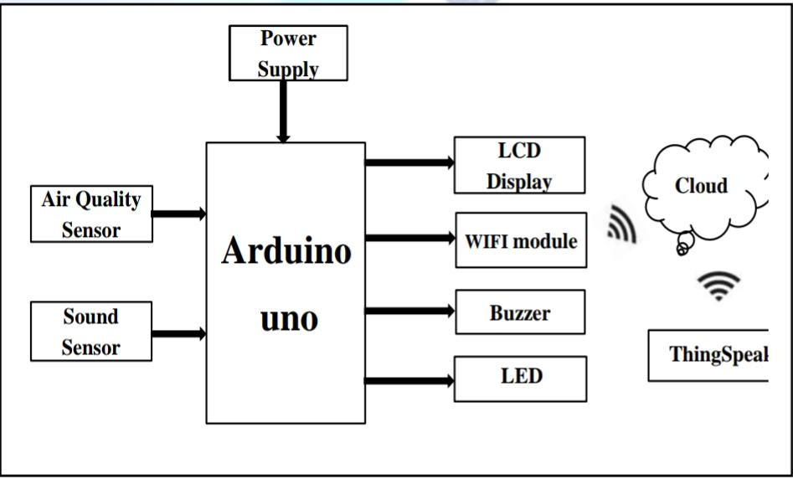

Objectives
1. To study the existing system.
2. To design the block diagram.
3. To decide the components specification &device in system.
4. To design the circuit diagram and simulate it using suitable software.
5. To design the PCB and implement hardware.
6. To test the circuit and observe the result.
7. To prepare report.

Slide 5
Components Required
Arduino UNO LM393 (Noisesensor) ESP8266 WIFIModule 16*2 LCDDisplay
LED
Buzzer

Slide 6
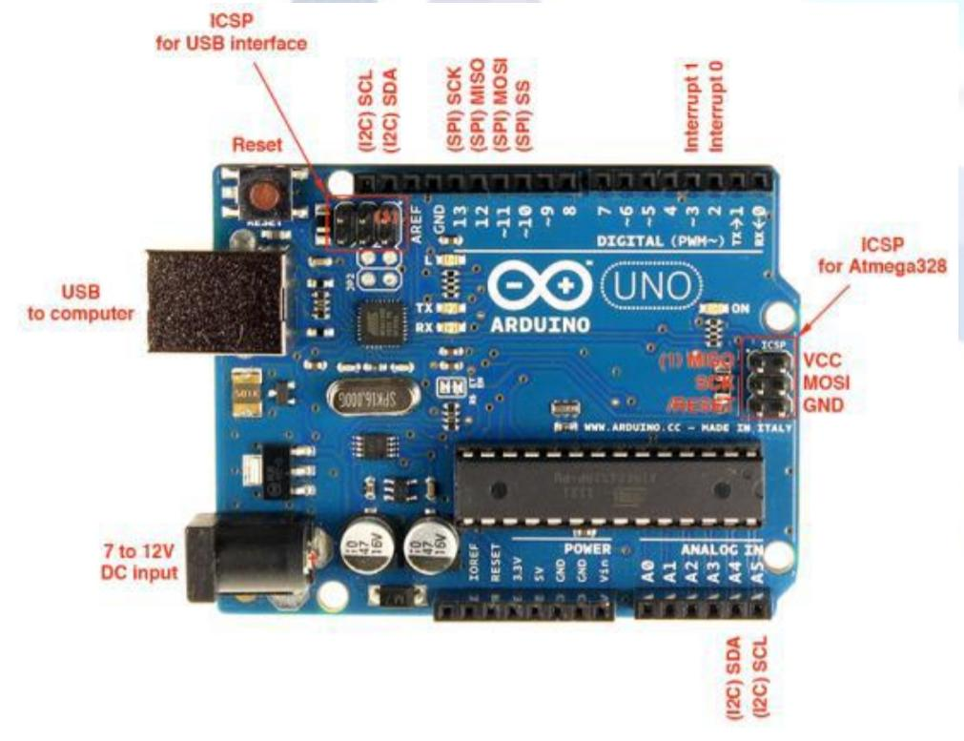
Arduino UNO
Arduino is 8 bit microcontroller board based on the ATmega328P. The operating voltage is 5V. It has 14 pins digital input output pins (Of which can be used 6 as PWM output)Oscillator frequency is 16 MHz It contains everything needed to support the microcontroller simply connect it to a computer with USB cable. It has 6 analog input pins.
Features
• Operating voltage is5v.
• DC current per input pin is 40mA.
• Clock speed16MHz.• DC current for 3.3v pin is 50mA.
• SPAM 2 KB
• EEPROM 1KB

Slide 7
Advantages
1 Sensors are easily available.
2. Sensors are effortlessly accessible.
3.Simple, compact and easy to handle.
4. Sensors have long life time.
5. Low cost
6. Data can be used to control pollution
Applications
1. To estimate the pollution.
2. To design server and upload data on that server with date and time.
3. We can use it at industrial area as there is lot of noise pollution
4. In city roads traffic noise
.5. Activities like shooting, open events, football and cricket matches.
6. At small level, in schools and colleges we can use this device
.7. Automation.

Slide 8

Future scope
In future we modify the system to notify a user about the noise level it reaches beyond permissible level through sms or app. We can monitor sound pollution level at any place of the world.

Slide 9

Conclusion
By using this project each and every variation we can analyze and inform nearby people in time. We can also analyze data form home using thing speak. The most important factor of this system is that it is small, cost efficient and portable. Sensors are available easily anywhere. This system fully helpful to save the lives and overcome all the problem related to environment.

