Slide 1





TEAM #45
PreDICTING CLAIMS & LOSSES FOR SMARTER AUTO INSURANCE PRICING
BAHREMAND, JASMINE
LEE, HANNAH
WU, ALAN
FAN, TIANJUN,
MCNEW, NICHOLAS
Notes:
“Hi, we’re Team 45.
Our project focused on using predictive modeling to estimate customer-level insurance risk.
Specifically, we built models to predict both loss cost and claim likelihood based on historical policy data.
In the next section, we’ll explain why solving this problem is critical for insurers today.”

Slide 2

WHY PREDICT INSURANCE RISK?
FROM DATA TO STRATEGY:
THE RISK PREDICTION PIPELINE
CUSTOMER DATA
Demographics, policy history,
vehicle info
MODELS
Predict LC, HALC (regression) +
CS (classification)
ACCURATE RISK PREDICTION ENABLES
Smarter premium pricing
Targeted retention and underwriting strategies
KEY CHALLENGES
Identifying customers likely to file claims
Estimating financial loss from new policyholders
OUR PROJECT MODELS BOTH
Loss Cost (LC & HALC) — how costly a policyholder might be
Claim Status (CS) — whether they’re likely to file a claim
PREDICTED RISK METRICS
Expected loss,
claim probability
BUSINESS ACTIONS
Price premiums, flag risks,
retain low-HALC customers
Notes:
“Insurance companies face a recurring challenge: setting premiums that accurately reflect individual risk. If pricing is off, the portfolio becomes unbalanced, increasing exposure to loss.
Our team built machine learning models to predict two key outcomes: Loss Cost—the expected financial impact of a customer, and Claim Status—the likelihood they’ll file a claim. These predictions support more informed pricing, risk control, and customer-level strategy.
These insights don’t just improve pricing accuracy — they enable smarter underwriting, more strategic retention, and better risk-adjusted decision making across the business.”

Slide 3

MODELING LOSS EXPOSURE: LC & HALC OBJECTIVES
WHAT WE’RE PREDICTING
Loss Cost (LC): Incurred loss / Exposure units
HALC: LC adjusted using historical correction factor(X.18)
WHY IT MATTERS
Helps set fair and profitable premiums for each customer
Especially important when historical claims data is sparse
MODELING CHALLENGE
Metric | LC (Train) | LC (Predicted) | HALC (Train) | HALC (Predicted)
Mean | 629.84 | 233.25 | 1156.17 | 325.79
Standard Deviation | 2448.34 | 78.55 | 4883.63 | 144.85
LC and HALC are heavily skewed due to rare but large claims
Many customers have zero claims, making prediction harder
APPROACH
Applied log-transformation to stabilize data
Tested GLM (Tweedie), MLP, XGBoost, and LightGBM
Notes:
“Our first task focused on predicting two cost-related outcomes: Loss Cost, or LC, and Historically Adjusted Loss Cost, HALC. LC is calculated as incurred loss divided by exposure units, while HALC adjusts that cost based on historical correction factors.
One challenge in modeling these targets is that insurance losses are heavily skewed — most customers have zero claims, but a few incur very large losses. This creates a distribution that’s difficult for standard models to handle.
To address this, we applied a log transformation to both LC and HALC and, in early testing, also evaluated models that support Tweedie distributions, which are commonly used in insurance for their ability to model zero-inflated, non-negative data.
As a sanity check, we compared predicted outputs to the training data.
In the training set, the mean LC was 629.84, and the predicted mean was 233.25. For HALC, the training mean was 1,156.17, while the predicted mean was 325.79.
The predicted values are more conservative, but the spread and trend direction align well, indicating our models captured meaningful structure without overfitting to extreme outliers.”

Slide 4
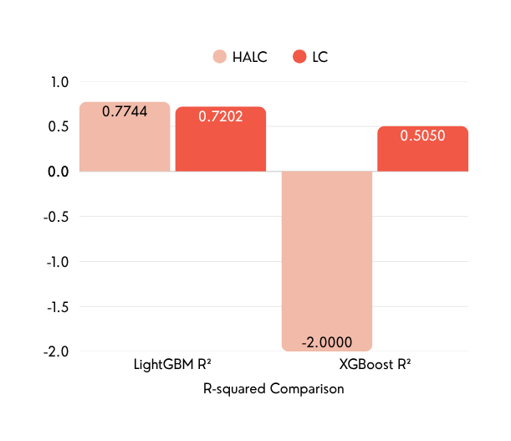

WHY WE CHOSE LIGHTGBM
Model | R-squared | Target | MSE | MAE
LightGBM | 0.7744 | HALC | 300.22 | 14.14
LightGBM | 0.7202 | LC | 0.0459 | 0.1996
XGBoost | -2.000 | HALC | 3992.37 | 59.55
XGBoost | 0.5050 | LC | 0.0812 | 0.2750
We tested multiple models to predict LC and HALC
Outperformed especially on HALC, which directly affects premium setting
GLM (Tweedie), MLP, XGBoost, and LightGBM
LIGHTGBM CONSISTENTLY OUTPERFORMED OTHERS ACROSS KEY METRICS
Chosen as the final model for generating loss cost predictions
Highest R² → better explanation of cost variation
Lowest MAE → most accurate predictions
Notes:
“After transforming the data, we evaluated several models for predicting LC and HALC, including GLM with Tweedie loss, Multilayer Perceptron, XGBoost, and LightGBM.
As shown in the table, LightGBM consistently delivered the strongest results.
For HALC, it achieved an R² of 0.7744 with a Mean Absolute Error of 14.14.
For LC, it reached an R² of 0.7202 with a MAE of 0.1996.
In contrast, XGBoost, for example, had much lower R² values and significantly higher error.
The bar chart on the slide highlights this clearly — LightGBM achieved the highest R² scores across both targets, meaning it explained the most variance in the loss outcomes.
Based on this consistent performance, and its particularly strong results on HALC, we selected LightGBM as our final model for generating loss cost predictions.”

Slide 5
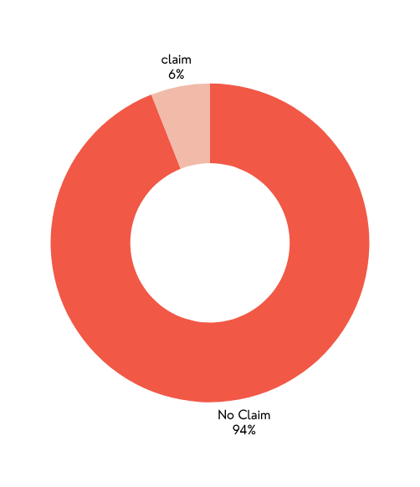
Modeling Claim Risk:
Predicting Claim Status (CS)
WHAT WE’RE PREDICTING
Model | Test ROC-AUC | Rank
Boosting | 0.7889 | 1
Boosting (Weighted) | 0.7833 | 2
Random Forest | 0.7698 | 3
MLP | 0.7659 | 4
Logistic Regression | 0.7505 | 5
LR (Lasso) | 0.7457 | 6
LR (Ridge) | 0.7449 | 7
Class Distribution:
Claim vs. No Claim
Whether a customer will file a claim (CS = 1) or not (CS = 0)
Binary classification problem using policyholder data
WHY IT MATTERS
Helps identify high-risk individuals before they file
Supports underwriting and risk-based pricing decisions
MODELING STRATEGY
Tried 7 models: Boosting, Random Forest, MLP, Logistic Regression (and regularized versions)
Used 5-fold cross-validation and ROC-AUC to evaluate performance
Boosting achieved highest ROC-AUC: 0.7889
Highly imbalanced data — most customers don’t file claims
Notes:
“For our second task, we built a classification model to predict claim status—specifically, whether a customer would file a claim.
As shown in the chart on the right, the dataset was heavily imbalanced, with far fewer customers filing claims than not.
To account for that, we explored both standard and weighted approaches during modeling.
We tested seven models, including logistic regression, neural networks, random forest, and gradient boosting.
The models were evaluated using ROC-AUC, which measures how well each model separates the two classes.
Gradient Boosting achieved the highest performance, with a ROC-AUC of 0.7889.
We also tested a version that applied sample weights to give more emphasis to the positive class, which scored slightly lower at 0.7833.
Although the weighted version slightly increased recall, it reduced overall ROC-AUC.
Because our goal was to maximize overall model performance, we selected the unweighted Gradient Boosting model for our final claim status predictions.”

Slide 6

Final CLASSIFIER OUTPUT–PRECISION, RECALL & RISK PATTERNS
CLASSIFICATION REPORT
Confusion matrix
Metric | Class 0 (No) | Class 1 (Yes)
Precision | 0.89 | 0.58
Recall | 0.99 | 0.06
F1-Score | 0.94 | 0.11
 | Predicted No | Predicted Yes
Actual No | 6622 | 39
Actual Yes | 777 | 53
KEY BUSINESS INSIGHT
Model is highly precise when predicting claims
Low recall means only a small subset of actual claimants are flagged
Useful for identifying high-risk customers for manual review
Reduces false positives, supports efficient underwriting focus
Notes:
“After selecting the final model, we evaluated its performance using the confusion matrix and classification report.
The model had a precision of 58 percent for predicting claims. This means that when it flagged a customer as likely to file, it was correct more than half the time.
However, the recall was only 6 percent, meaning it identified just a small portion of the actual claimants.
This trade-off reflects a precision-focused model. While it doesn’t catch every claimant, it does reliably identify a targeted group of higher-risk policyholders.
In practice, this helps insurers focus attention and resources on reviewing the customers who are most likely to file, without creating unnecessary noise or over-flagging.”

Slide 7





WHAT DRIVES RISK? INTERPRETING KEY PREDICTORS
NUMBER OF DRIVERS
CONTRACT DURATION
CONTRACT DURATION (X.14)
longer contracts linked to higher loss
NUMBER OF DRIVERS (X.8)
more drivers, more exposure
REGION TYPE (X.13)
Suggests geographic risk differences
VEHICLE AGE & LICENSE TENURE (X.22)
proxies for experience and responsibility
REGION TYPE
VEHICLE AGE & LICENSE TENTURE
These insights help refine pricing tiers, risk scoring, and marketing segmentation
Notes:
“To understand what was influencing our models, we looked at the most important features contributing to predictions of loss cost and claim likelihood.
Several variables consistently stood out.
Contract duration - longer contracts leads to higher loss
The number of drivers was also important, as more drivers increase overall exposure.
and Region type and viechale age.
and we wanted to further analyze how these risk signals will play out across different customer segments—specifically by tenure and premium tier.”

Slide 8
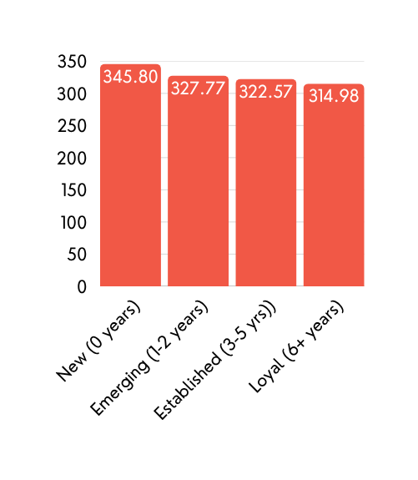
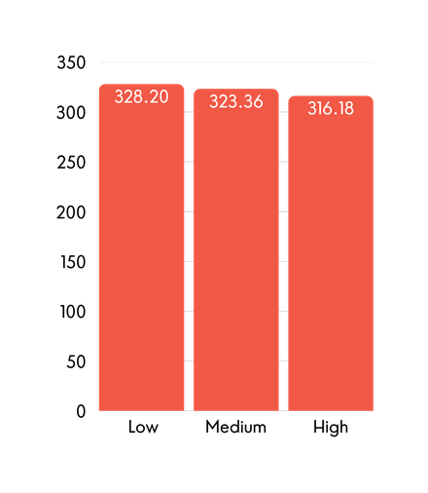
CUSTOMER SEGMENTS WORTH WATCHING
AVERAGE HALC BY INSURANCE TENURE SEGMENT
AVERAGE HALC BY NET PREMIUM TIER
WE SEGMENTED CUSTOMERS BY
Insurance Tenure: New, Emerging, Established, Loyal
Net Premium Tiers: Low, Medium, High
FINDINGS
New customers had the highest average HALC — likely due to limited history
Low premium customers carried the highest risk relative to cost
Loyal customers had the lowest HALC, indicating potential for profitable retention
BUSINESS IMPLICATION
Prioritize monitoring new/low-tier customers
Incentivize retention of low-HALC loyal customers
Low-paying customers actually cost more → not always more profitable
HALC decreases with tenure → loyal customers are less risk
Notes:
“When we segmented customers by insurance tenure, we saw a clear relationship between loyalty and risk.
for new customers—those with zero years of history—had the highest average HALC,
As tenure increased, HALC decreased, for the more loyal customers.
and then we segmented by net premium tier. and we found out
customers in the lowest premium tier had the highest predicted loss cost at 328.20, while those in the highest tier averaged lower.
with the data, we suggest monitoring new and low-tier customers more closely and carefully.
as higher HALC score will result in more risk exposure, and without proper oversight, they will drive up the loss ratios.
secondly we suggest to Invest more in retaining customers with longer tenure as these customers are not only lower risk but can be potentially more profitable over time, especially if incentivized through loyalty programs,

Slide 9




ACTIONABLE RECOMMENDATIONS FOR PRICING & RETENTION
PRICING STRATEGY
Charge higher premiums for new or low-tier customers with high predicted HALC
Adjust pricing tiers using key drivers like contract duration and number of drivers
Use HALC predictions to flag underpriced policies for review
RETENTION STRATEGY
Incentivize loyal, low-HALC customers (e.g., discounts, long-term benefits)
Monitor medium-risk segments for churn risk and target with tailored offers
RISK FLAGGING
Use Claim Status predictions (CS) to identify high-risk policyholders
Flag for manual underwriting or restricted coverage
Combine claim likelihood + HALC to build a comprehensive risk score
Notes:
“We structured our recommendations around three core strategies: pricing, retention, and risk flagging.
Under pricing strategy, we recommend charging higher premiums for new or low-tier customers with high predicted HALC.
Premium tiers can also be adjusted using predictive drivers like contract duration and number of drivers, both of which were strongly associated with higher risk.
In addition, HALC predictions can help flag underpriced policies for review, ensuring pricing reflects true exposure.
For retention, we suggest incentivizing loyal, low-HALC customers—this group is consistently less risky and more profitable.
We also recommend monitoring medium-risk segments for potential churn and targeting them with tailored offers to improve retention and margin.
And for risk flagging, Claim Status predictions can be used to identify high-risk policyholders before a claim is filed.
These customers can be flagged for manual underwriting or restricted coverage, and combining claim probability with HALC can help insurers build a more complete view of customer-level risk.”

Slide 10



Key Takeaways & Business Impact
PREDICTIVE OUTPUTS
Predicted Loss Cost (LC and HALC)
Predicted Claim Status (CS)
STATEGIC APPLICATIONS
Aligned pricing with individual risk
Flagged high-risk policies for manual review
Identified high-value segments for retention
BUSINESS VALUE
Supports more targeted, data-driven portfolio decisions
Notes:
To close, we built models to predict loss cost and claim likelihood, giving us two distinct views of customer risk.
We identified the key features driving those predictions and linked them to customer segments and pricing challenges.
Based on those insights, we outlined strategies across pricing, underwriting, and retention—each directly tied to measurable model outputs.
Our models performed consistently across test data and are structured for deployment within existing decision workflows, helping insurers make smarter, data-driven decisions across the customer lifecycle.
That concludes our analysis and recommendations. Thank you.

Slide 11
TEAM #45
THANKS FOR
WATCHING!
BAHREMAND, JASMINE
LEE, HANNAH
WU, ALAN
FAN, TIANJUN,
MCNEW, NICHOLAS
Notes:
“Thank you for watching our presentation.”

