Slide 1


ACQUISITION ANALYSIS: PARCH & POSEY

Slide 2


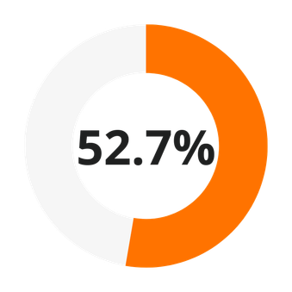
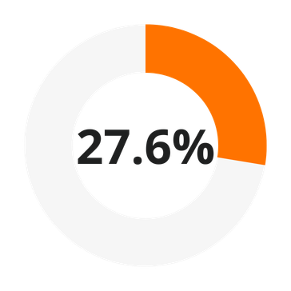
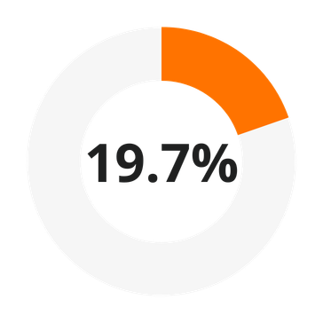

Current State of the Company
STANDARD PAPER
GLOSS PAPER
POSTER PAPER
$23,141,511.83 Lifetime Revenue

Slide 3





















Global Customer Network

Slide 4
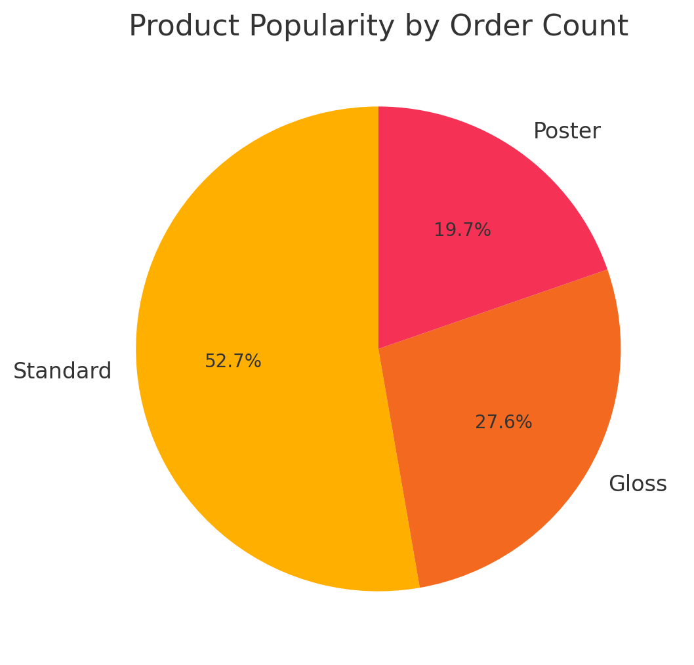
Product Popularity by Order Count
01
To determine product popularity, count the number of unique orders where the product quantity is greater than zero. This reveals how often each product is ordered, helping to identify high-demand items.
02
Product Type | Units Sold
Standard | 1,938,346
Gloss | 1,013,773
Poster | 723,646

Slide 5
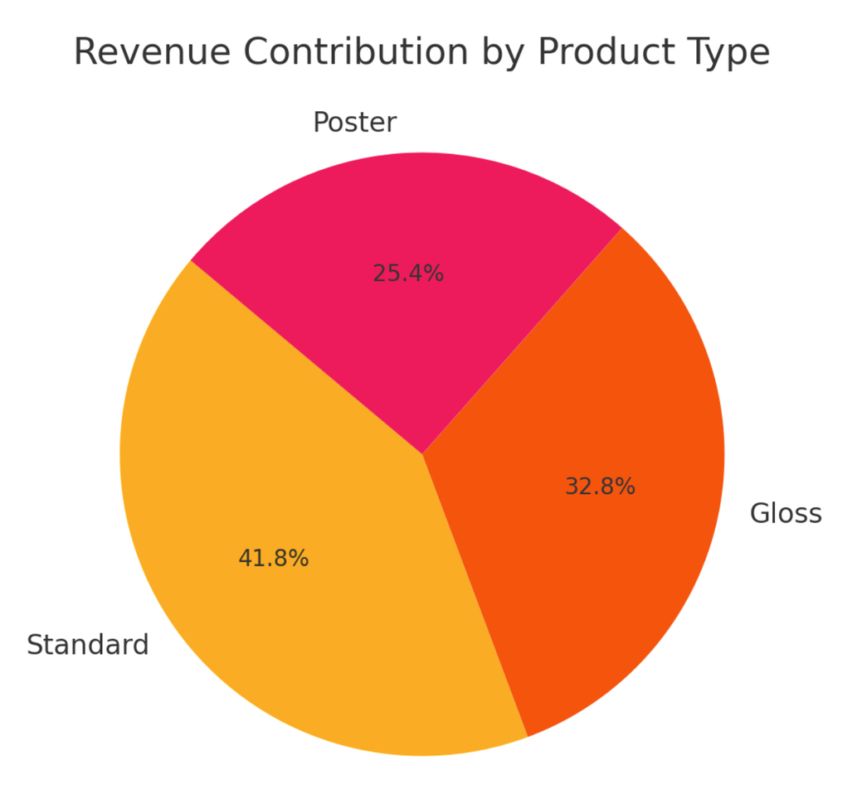
Revenue Contribution by Product Type
01
The pie chart shows the revenue share of each product type.
This highlights which products are the primary contributors to total revenue.
02
Product Type | Total Revenue
Standard | 9,672,346.54
Gloss | 7,593,159.77
Poster | 5,876,005.52

Slide 6
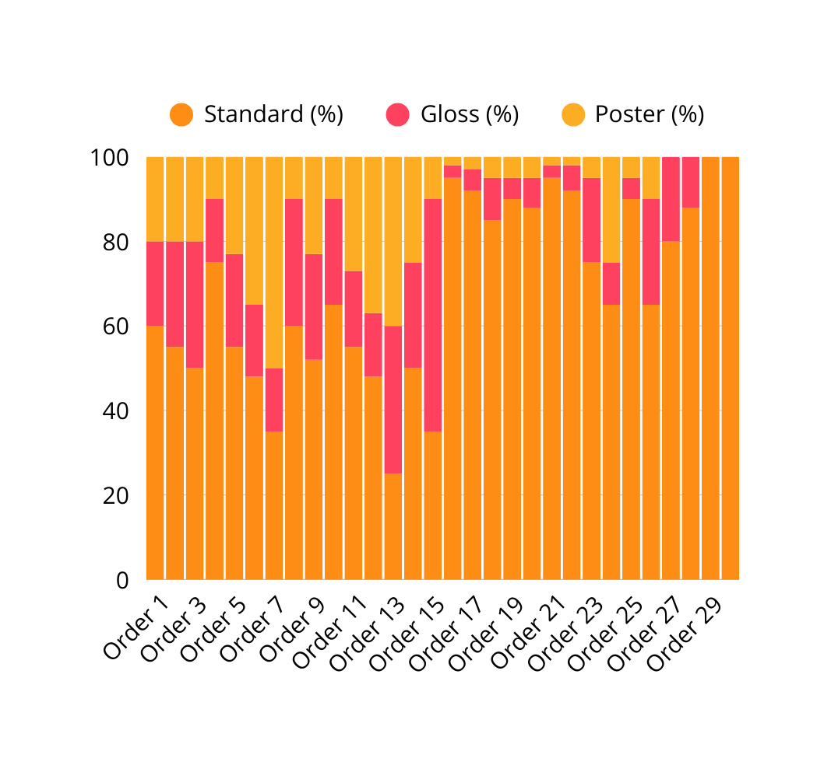
Revenue Contribution by Product Type for Sample Orders
01
This stacked bar chart shows how each product (Standard, Gloss, Poster) contributes to the revenue of individual orders. It highlights the varying revenue contributions, illustrating that some orders are more focused on certain products.
02

Slide 7
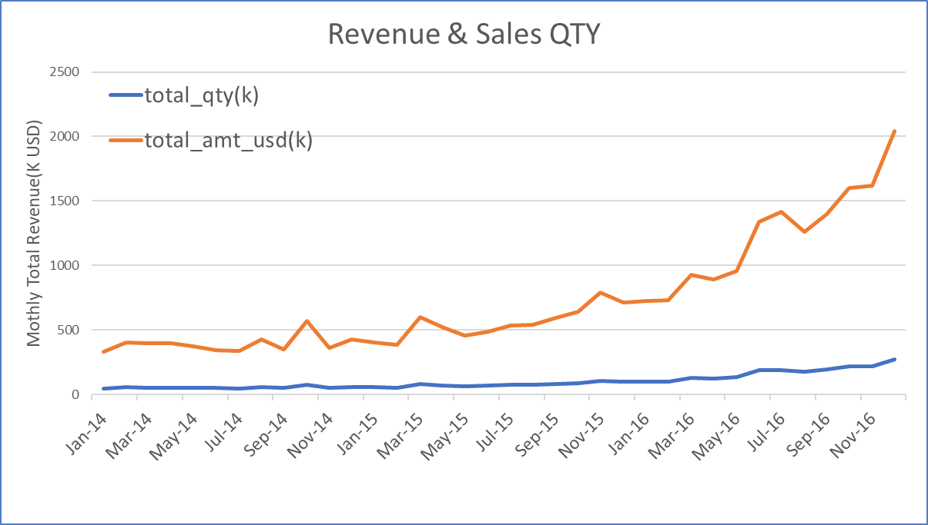
Parch & Posey is growing
Yearly Revenue & Sales QTY
(2014 - 2016)
01
Year | Total Quantity | Total USD
2014 | 651 | $4,069
2015 | 913 | $5752
2016 | 2042 | $12865
02
Yearly growth(USD) rate :
2014 - 2015 : 41.4%
2015 - 2016 : 123.7%
03
Total growth rate from
2014 - 2016 : 216%

Slide 8
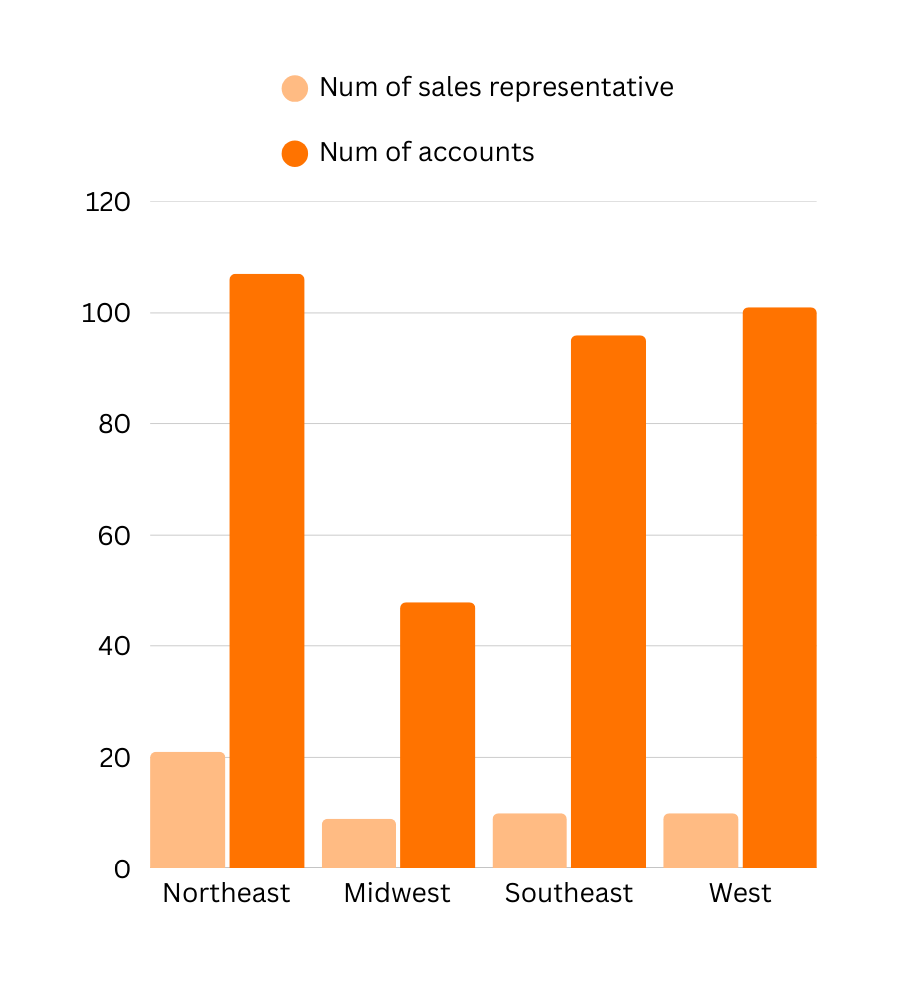
Sales Representatives Allocation By Accounts
Region | Num of Accounts | Sales Representative | Avg of accounts per person
Northeast | 107 | 21 | 5
Midwest | 48 | 9 | 5
Southeast | 96 | 10 | 10
West | 101 | 10 | 10

Slide 9
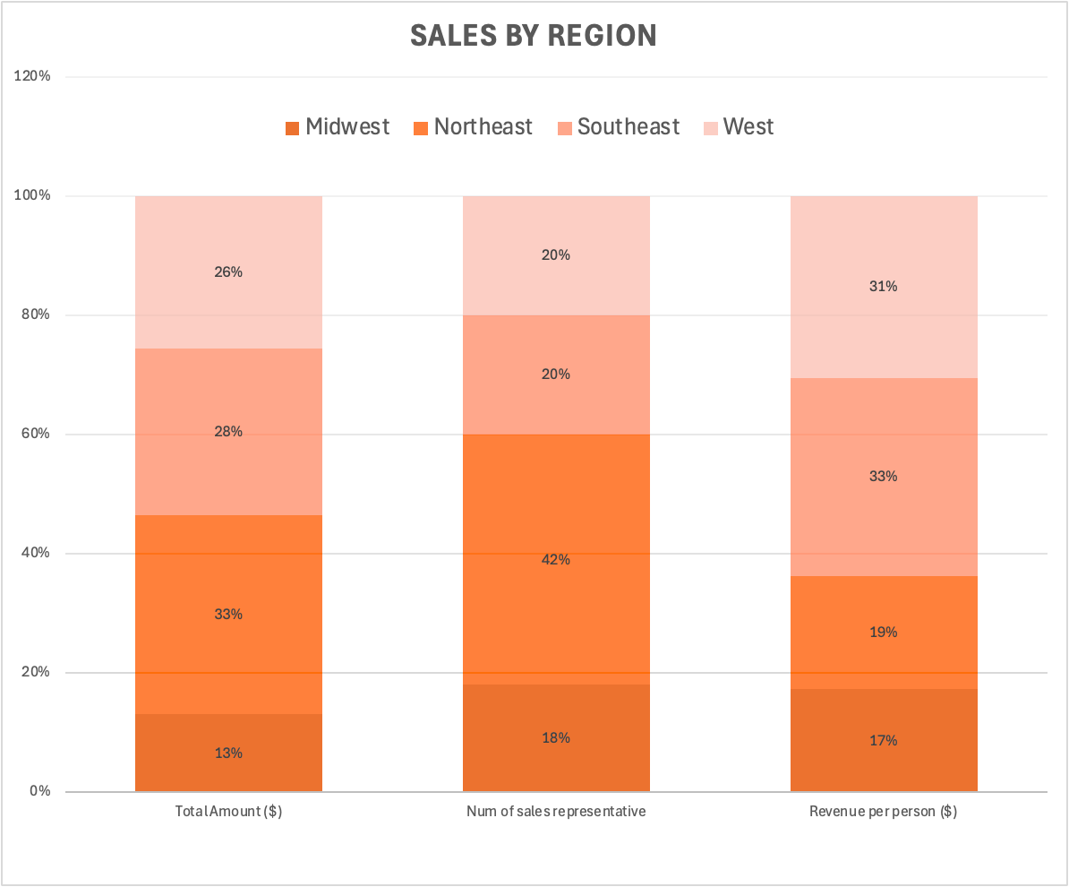
Sales Representatives Allocation By Sales
01
Over-Allocation of sales representatives in the Northeast
02
Under-Allocation in the Southeast and West
Regions | Total Amount ($) | Sales Proportion | Revenue per person
Northeast | 7,744,405 | 33.47% | 368,781
Southeast | 6,458,497 | 27.91% | 645,850
West | 5,925,123 | 25.60% | 592,512
Midwest | 3,013,487 | 13.02% | 334,832
TOTAL | 23,141,512 | 100%
02

Slide 10
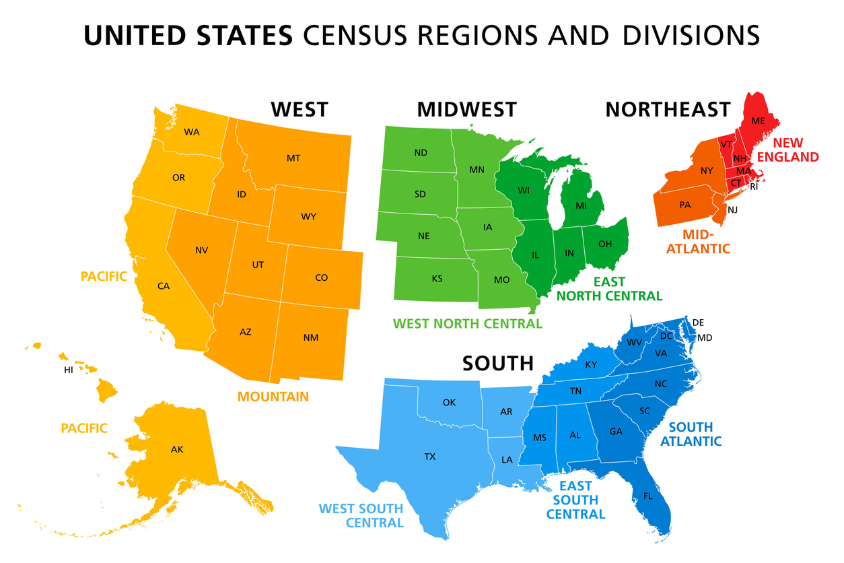
Additional Regions
Adding North and South regions means redistributing sales representatives. Population distribution may be the key.
Regions | Current Distribution | Proposed Distribution (based on region pop)
Northeast | 21 | 5
Southeast | 10 | 9
West | 10 | 7
Midwest | 9 | 6
International | 1 | 1
North | - | 11
South | - | 12
TOTAL | 51 | 51

Slide 11
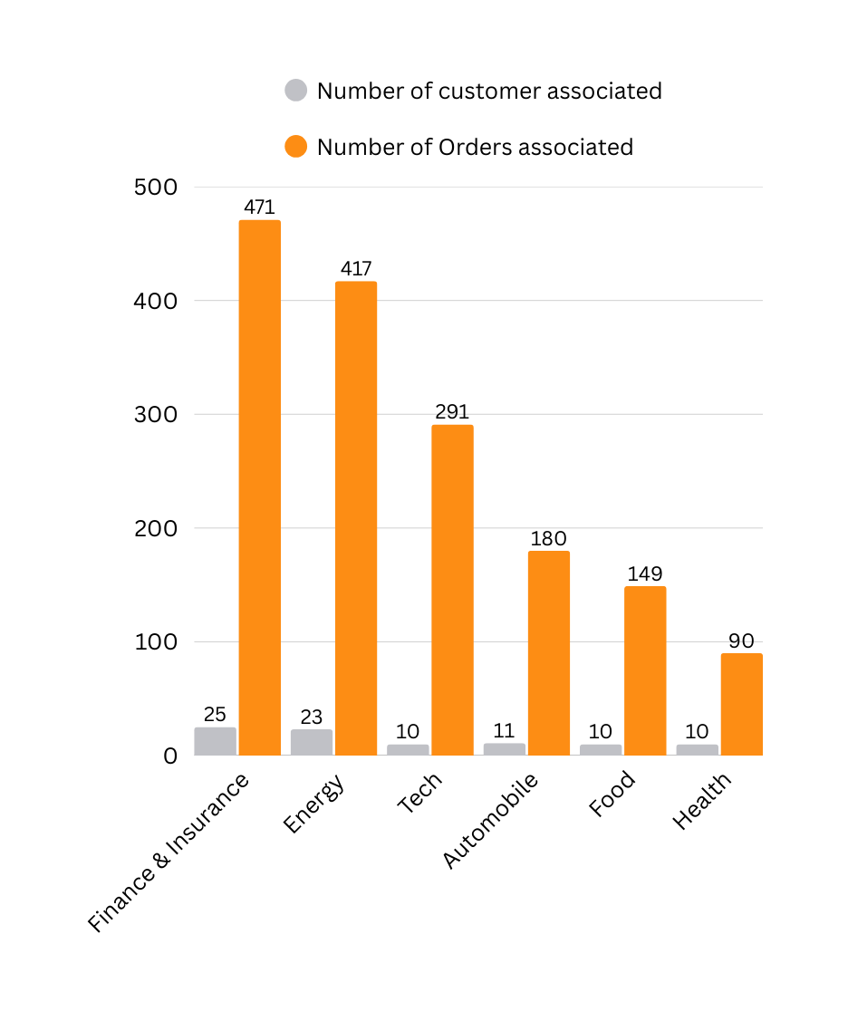
Industries Most Popular Among Customers
Industry Category | Customer Count | Orders Associated
Finance & Insurance | 25 | 471
Energy | 23 | 417
Tech | 10 | 291
Automobile | 11 | 180
Food | 10 | 149
Health | 10 | 90

Slide 12
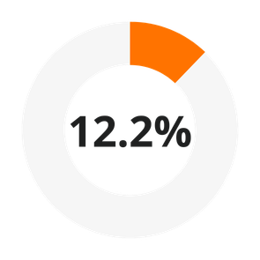
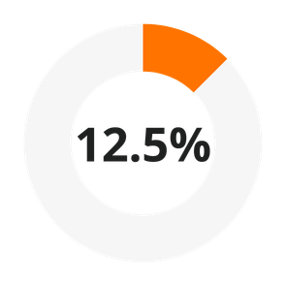
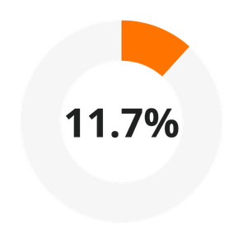

Least Used Channels
The marketing team aims to invest on popular web channels in new regions
Regions | Channel Name | Least Usage count
Northeast | Twitter | 154
Southeast | Banner | 59
West | Twitter | 127
Midwest | Banner | 116
NORTHEAST
SOUTHEAST
WEST
MIDWEST

Slide 13
More Areas to Explore
Recommendations
01
Internal & external competitors
02
Customer retention & satisfaction
Not to Proceed
03
Financial status
Notes:
need to know:
- profit not just revenue
- market competition
etc.

Slide 14

THANK YOU

