Slide 1


ACQUISITION ANALYSIS: PARCH & POSEY

Slide 2







TEAM D9
Jasmine Bahremand
Xinyan Yin
Roger Ren
Kaveri Verma
Yixiao Shen
Nicolas Lopez
Jong Hoon Park

Slide 3

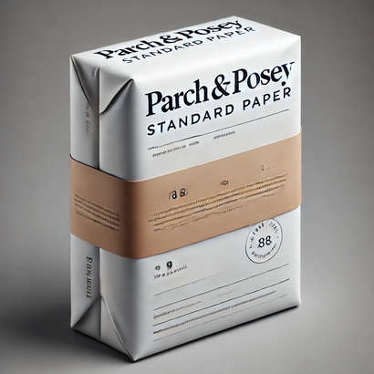

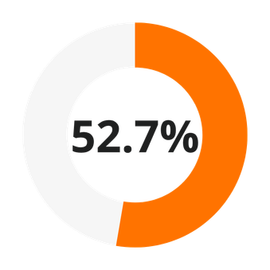
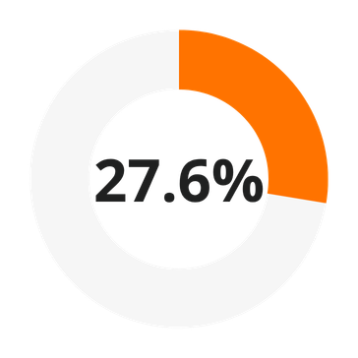
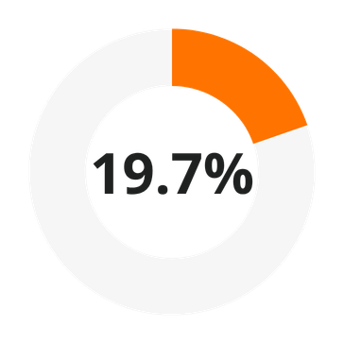

Current State of the Company
STANDARD PAPER
GLOSS PAPER
POSTER PAPER
$23,141,511.83 Lifetime Revenue
Notes:
Parch & Posey was founded in April of 2013 and has since established itself as a reliable name within the paper industry.
The company specializes in 3 types of paper: standard (which is their most popular), gloss, and poster. With operations spanning across the US and internationally, Parch & Posey is supported by a team of 52 employees who have been able to generate over 23 million dollars in revenue since they started, just 4 years ago.

Slide 4





















Global Customer Network
Notes:
And really, their products are in demand across a wide range of industries.
With a customer base of over 352 accounts, Parch & Posey serves many sectors like healthcare, retail, and entertainment, with big name customers like Disney, Walmart, and Chase.
now pass roger

Slide 5
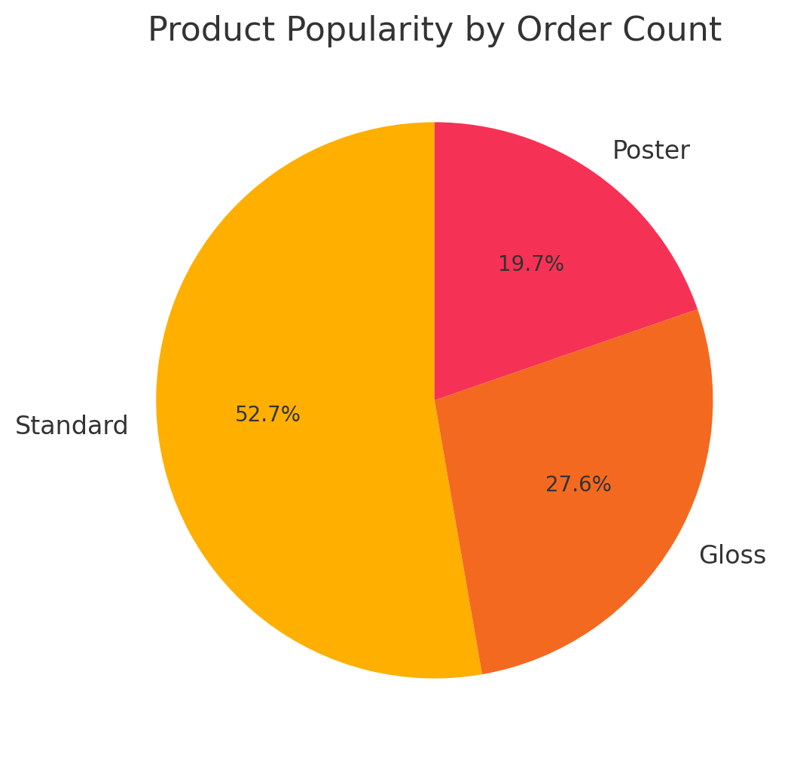
Product Popularity by Order Count
01
To determine product popularity, count the number of unique orders where the product quantity is greater than zero. This reveals how often each product is ordered, helping to identify high-demand items.
02
Product Type | Order Count
Standard | 1,938,346
Gloss | 1,013,773
Poster | 723,646
Notes:
Let’s start with product popularity. This pie chart shows how often each product is ordered. As we can see, Standard is the most popular product, accounting for over 50% of the orders, followed by Gloss and Poster, which represent a smaller share of the total order count.

Slide 6
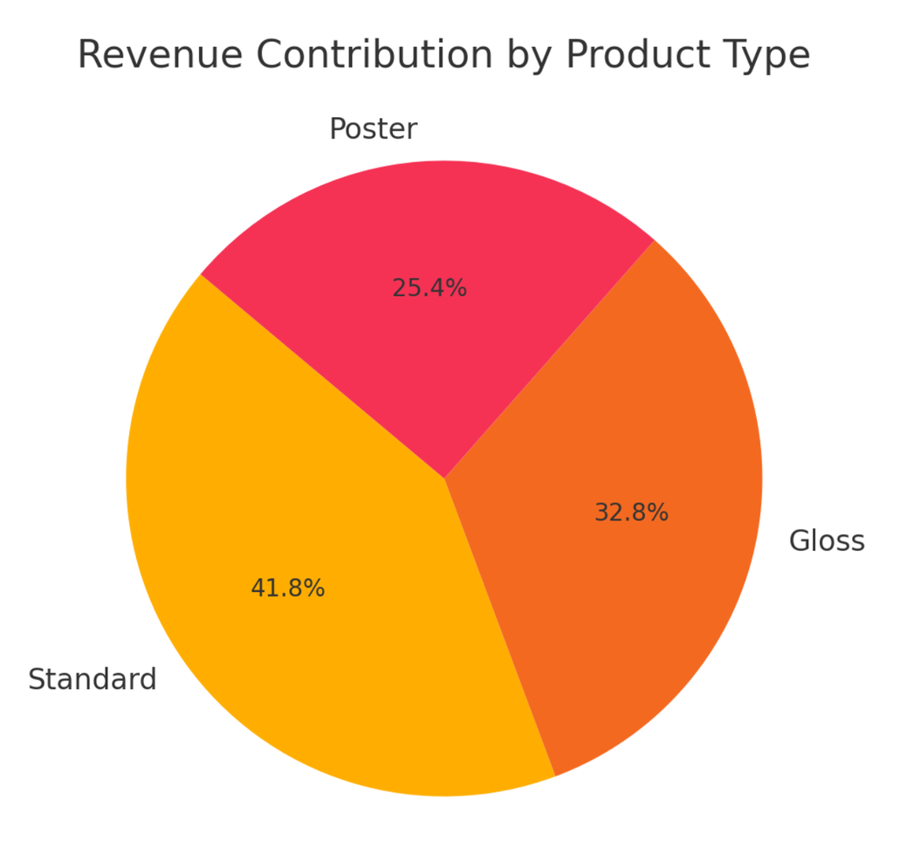
Revenue Contribution by Product Type
01
The pie chart shows the revenue share of each product type.
This highlights which products are the primary contributors to total revenue.
02
Product Type | Total Revenue
Standard | 9,672,346.54
Gloss | 7,593,159.77
Poster | 5,876,005.52
Notes:
Moving on to revenue, this second chart shows the contribution of each product type to total revenue. While Standard still leads in popularity, Gloss contributes a higher percentage to revenue than Poster. This indicates that even though Poster is less frequently ordered, it might have a higher price or generate more revenue per sale.

Slide 7
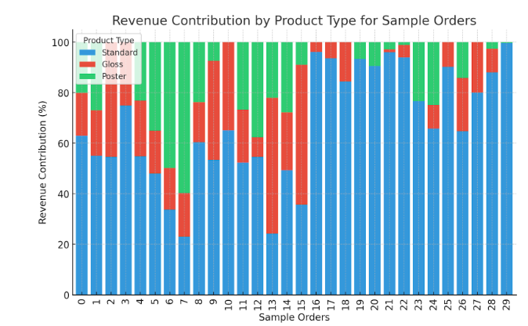
Revenue Contribution by Product Type for Sample Orders
01
This stacked bar chart shows how each product (Standard, Gloss, Poster) contributes to the revenue of individual orders. It highlights the varying revenue contributions, illustrating that some orders are more focused on certain products.
02
Notes:
Finally, we have a stacked bar chart showing the revenue contribution of each product across individual sample orders. This chart reveals that some orders are more heavily focused on certain products, with Standard dominating most orders, but there are variations across different orders in terms of how much each product contributes to revenue.

Slide 8
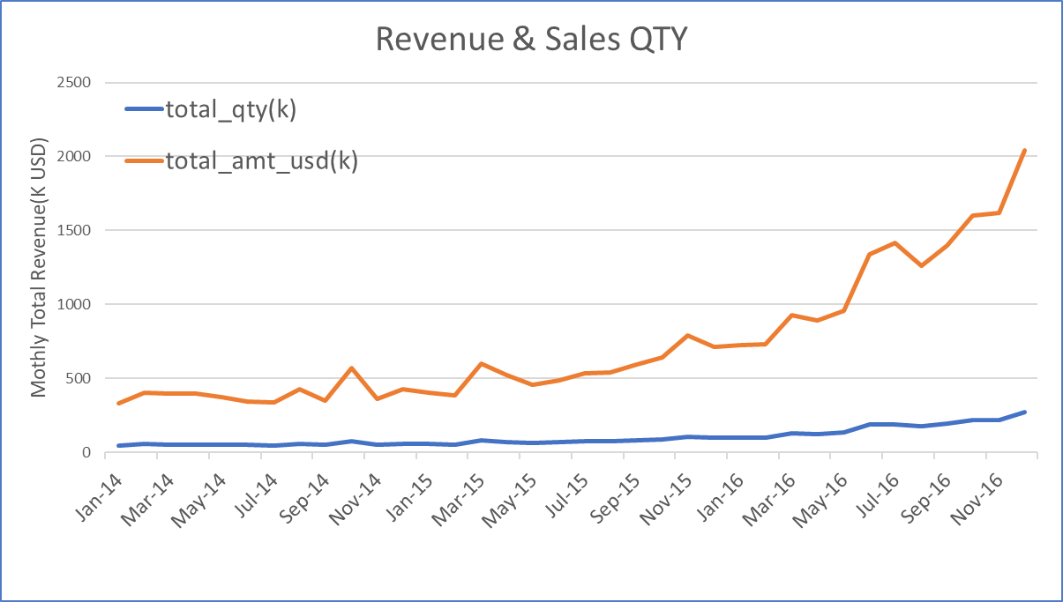
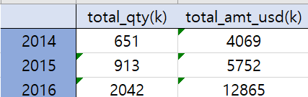
Parch & Posey is growing
Yearly Revenue & Sales QTY
(2014 - 2016)
01
02
Yearly growth(USD) rate :
2014 - 2015 : 41.4%
2015 - 2016 : 123.7%
03
Total growth rate from
2014 - 2016 : 216%

Slide 9
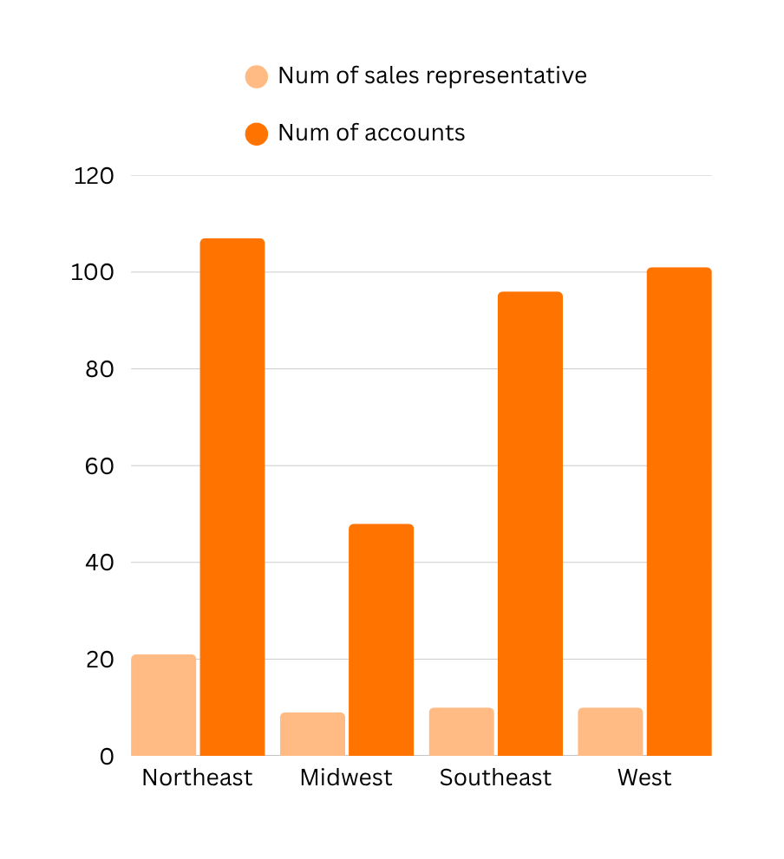
Sales Representatives Allocation By Accounts
Region | Num of Accounts | Sales Representative | Avg of accounts per person
Northeast | 107 | 21 | 5
Midwest | 48 | 9 | 5
Southeast | 96 | 10 | 10
West | 101 | 10 | 10

Slide 10
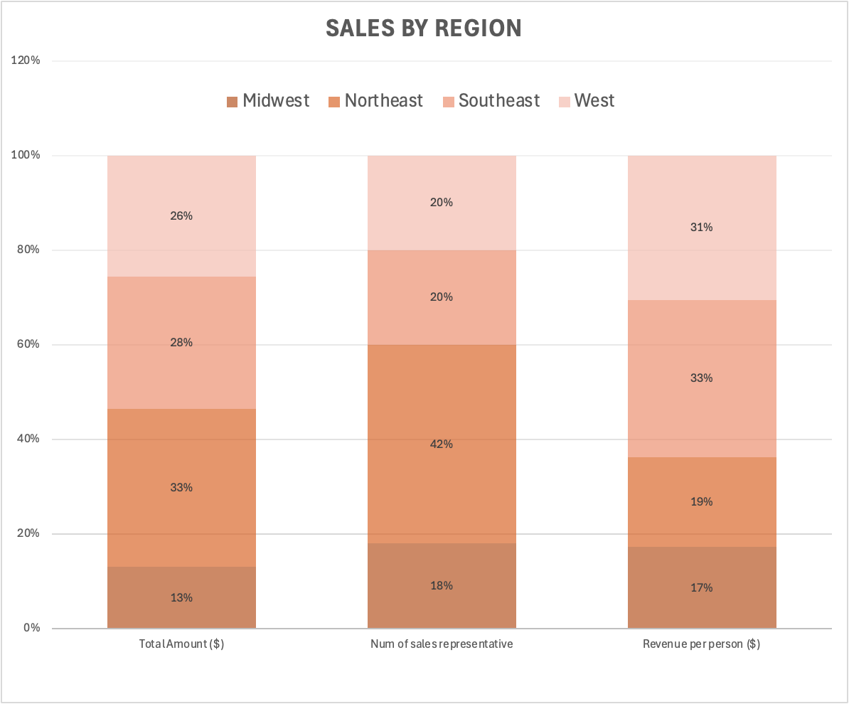
Sales Representatives Allocation By Sales
01
Over-Allocation of sales representatives in the Northeast
02
Under-Allocation in the Southeast and West
Regions | Total Amount ($) | Sales Proportion | Revenue per person
Northeast | 7,744,405 | 33.47% | 368,781
Southeast | 6,458,497 | 27.91% | 645,850
West | 5,925,123 | 25.60% | 592,512
Midwest | 3,013,487 | 13.02% | 334,832
TOTAL | 23,141,512 | 100%
02

Slide 11
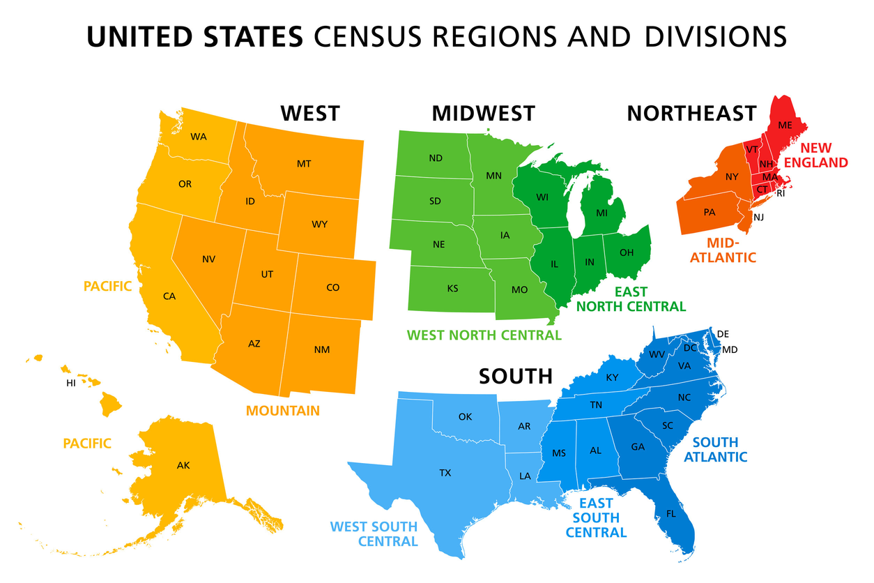
Additional Regions
Adding North and South regions means redistributing sales representatives. Population distribution may be the key.
Regions | Current Distribution | Proposed Distribution (based on region pop)
Northeast | 21 | 5
Southeast | 10 | 9
West | 10 | 7
Midwest | 9 | 6
International | 1 | 1
North | - | 11
South | - | 12
TOTAL | 51 | 51

Slide 12
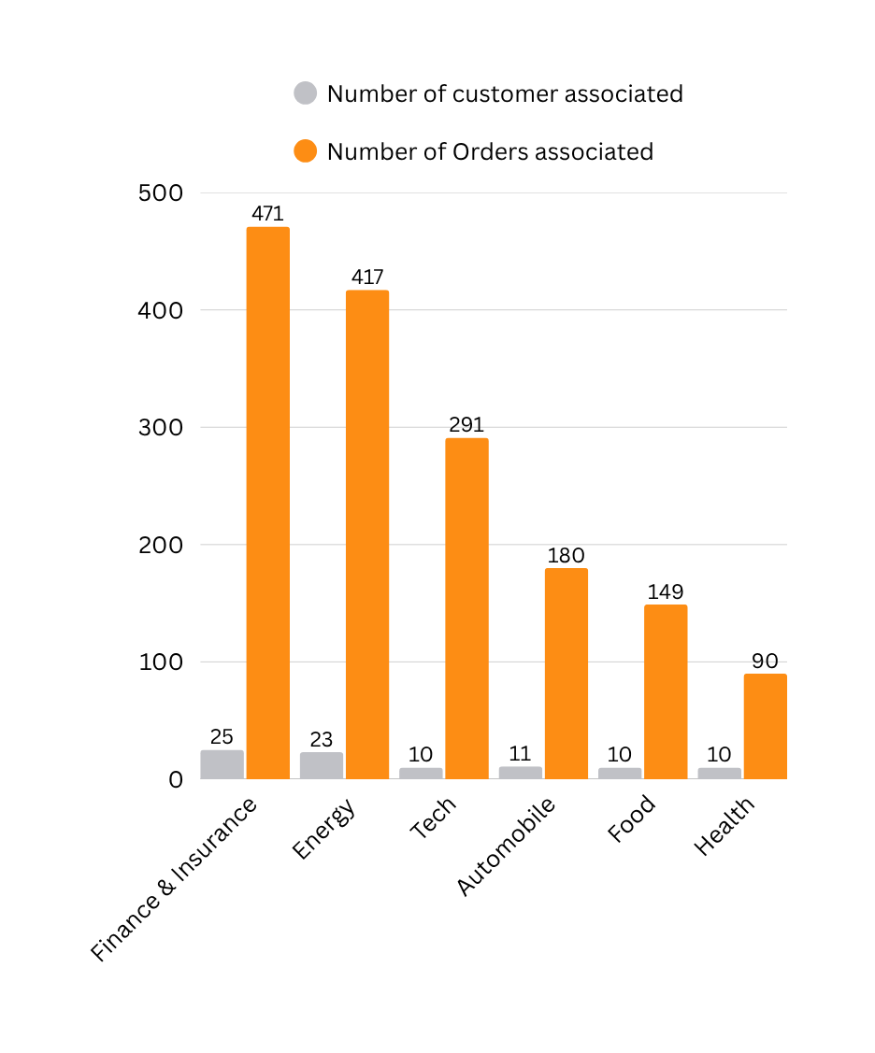
Industries Most Famous Among Customers
Industry Category | Customer Count | Orders Associated
Finance & Insurance | 25 | 471
Energy | 23 | 417
Tech | 10 | 291
Automobile | 11 | 180
Food | 10 | 149
Health | 10 | 90

Slide 13
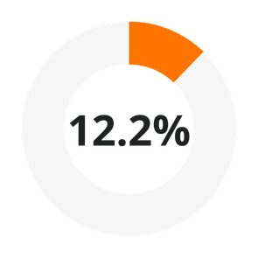

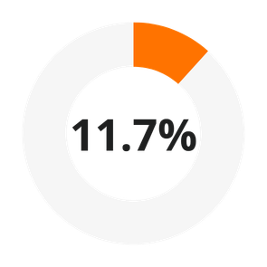

Least Used Channels
The marketing team aims to invest on popular web channels in new regions
Regions | Channel Name | Least Usage count
Northeast | Twitter | 154
Southeast | Banner | 59
West | Twitter | 127
Midwest | Banner | 116
NORTHEAST
SOUTHEAST
WEST
MIDWEST

Slide 14


More Areas to Explore
Recommendations
01
Internal & external competitors
02
Customer retention & satisfaction
Not to Proceed
03
Financial status
Notes:
need to know:
- profit not just revenue
- market competition
etc.

Slide 15

THANK YOU

