Slide 1
SPRING WEB MVC

Slide 2
Content
Introduction to Spring
Overview about Spring MVC
DEMO

Slide 3
Overview
1

Slide 4

Spring framework
- Spring is the most popular application development framework
- Spring is an open source java platform

Slide 5
Spring framework
Make application easier and less complex to develop
Easier to test and maintain

Slide 6
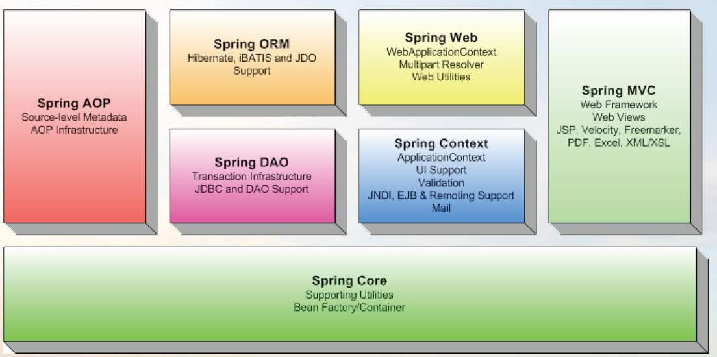
Spring module

Slide 7
What is Spring MVC?
A robust, flexible and well-designed framework for developing web application
Help building flexible and loosely coupled web applications

Slide 8

Spring MVC Concepts
This design pattern helps in seperating the business logic, presentation logic and navigation logic
Model: encapsulating the application data
View : response to the user with the help of the model object
Controller: receiving the request from the user and calling the back-end services

Slide 9
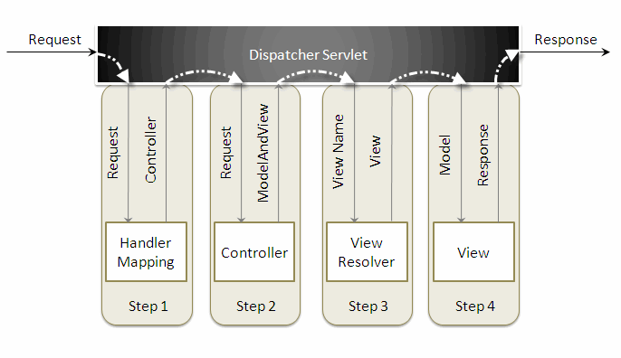
Spring MVC Concepts

Slide 10
2

Slide 11
3
DEMO

Slide 12


