Slide 1
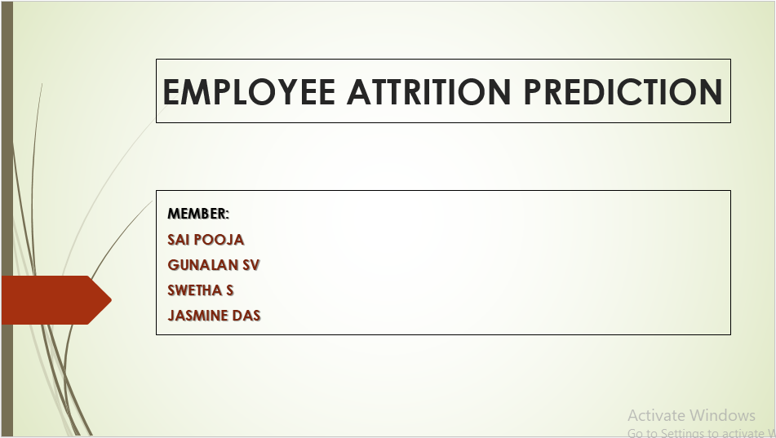

Slide 2
PROBLEM STATEMENT:
The main problem that exists across all businesses irrespective of geography or type of industry is employee attrition. Some of the problems faced are :
Expensive in terms of both money and time to train new employees
Loss of experienced employees
Impact on productivity
Impact on profit

Slide 3
DATA DESCRIPTION:
AGE :Numerical Value
ATTRITION: Employee leaving the company (0=no, 1=yes)
BUSINESS TRAVEL: nominal (1=No Travel, 2=Travel Frequently, 3=Tavel Rarely)
DEPARTMENT: nominal (1=HR, 2=R&D, 3=Sales)
DISTANCE FROM HOME: Numerical Value - THE DISTANCE FROM WORK TO HOME
EDUCATION: nominal - 1 'Below College' 2 'College' 3 'Bachelor' 4 'Master' 5 'Doctor'
EDUCATION FIELD: nominal- (1=HR, 2=LIFE SCIENCES, 3=MARKETING, 4=MEDICAL SCIENCES,
5=OTHERS, 6= TEHCNICAL)
EMPLOYEE COUNT: Numerical Value
EMPLOYEE NUMBER: Numerical Value - EMPLOYEE ID
ENVIROMENT SATISFACTION: Ordinal(ranked category) - SATISFACTION WITH THE JOB ENVIROMENT
- 1 'Low' 2 'Medium' 3 'High' 4 'Very High'
GENDER: Nominal- (1=FEMALE, 2=MALE)
JOB INVOLVEMENT: Numerical Value - how much involved in their job - 1 'Low' 2 'Medium' 3 'High' 4 'Very High'
JOB LEVEL: Ordinal- JOB LEVEL FOR EACH JOB ROLE
JOB ROLE: Nominal- (1=Health Care REP, 2=HR, 3=LAB TECHNICIAN, 4=MANAGER, 5= MANAGING DIRECTOR,
6= REASEARCH DIRECTOR, 7= RESEARCH SCIENTIST, 8=SALES EXECUTIEVE, 9= SALES REPRESENTATIVE)

Slide 4
JOB SATISFACTION: Ordinal- SATISFACTION WITH THE JOB -1 'Low' 2 'Medium' 3 'High' 4 'Very High'
MARITAL STATUS: Nominal- (1=DIVORCED, 2=MARRIED, 3=SINGLE)
MONTHLY INCOME: Numerical Value - MONTHLY SALARY
NUMCOMPANIES WORKED: Numerical Value - NO. OF COMPANIES WORKED AT
OVER 18: Nominal-(1=YES, 2=NO)
OVERTIME: Nominal-(1=NO, 2=YES) -whether they have worked extra hours
PERCENT SALARY HIKE: Numerical Value - PERCENTAGE INCREASE IN SALARY (%)
PERFORMANCE RATING: Ordinal - PERFORMANCE RATING given - 1 'Low' 2 'Good' 3 'Excellent' 4 'Outstanding'
RELATIONS SATISFACTION: Ordinal - RelationshipSatisfaction 1 'Low' 2 'Medium' 3 'High' 4 'Very High'
STANDARD HOURS: Numerical Value - STANDARD HOURS
STOCK OPTIONS LEVEL: Numerical Value - STOCK OPTIONS GIVEN TO EMPLOYEE
TOTAL WORKING YEARS: Numerical Value - TOTAL YEARS WORKED
TRAINING TIMES LAST YEAR: Numerical Value - HOURS SPENT TRAINING
WORK LIFE BALANCE: Ordinal - TIME SPENT BEWTWEEN WORK AND OUTSIDE-1 'Bad' 2 'Good' 3 'Better' 4 'Best'
YEARS AT COMPANY: Numerical Value - TOTAL NUMBER OF YEARS AT THE COMPNAY
YEARS IN CURRENT ROLE: Numerical Value -YEARS IN CURRENT ROLE
YEARS SINCE LAST PROMOTION: Numerical Value - NO OF YEARS SINCE LAST PROMOTION
YEARS WITH CURRENT MANAGER: Numerical Value - YEARS SPENT WITH CURRENT MANAGER
There are 1470 rows and 35 features in the dataset.

Slide 5
DATA PREPARATION:
1.The following features which are categorical were appearing as numerical(int):
Education ,Environment satisfaction, Job involvement, job level, job satisfaction, PerformanceRating,
RelationshipSatisfaction, StockOptionLevel, work life
NOTE: We changed the types of these features to object and rechecked the data types to confirm.
2.Dropped the following features:
EmployeeCount- It was constant (1) for all the rows
EmployeeNumber- insignificant feature
StandardHours- It was constant (80) for all the rows
Over18- It was constant (Y) for all the rows
3.There are no missing values.
4.There were outliers for few features and few of the features were skewed.
In order to treat the skewness, we did a log transformation. It treated the skewness, as well as the outliers also were treated.
A very few amount of outliers remained.

Slide 6
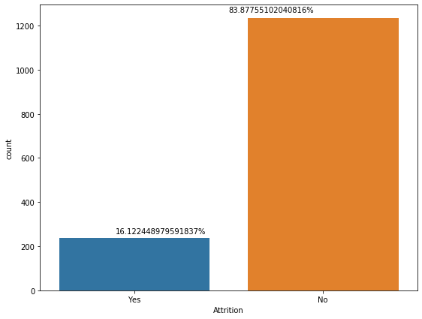
EDA:
distribution of dependent variable
From this we see, the no. of people who left the company is 237(16%) and no of people who stay is 1233 (83%).
We can see that the data is imbalanced.
So we need to apply some techniques: sampling(upsampling/smote), varying the ratio of train test split, crossvalidation etc.. So that the model can perform better.

Slide 7
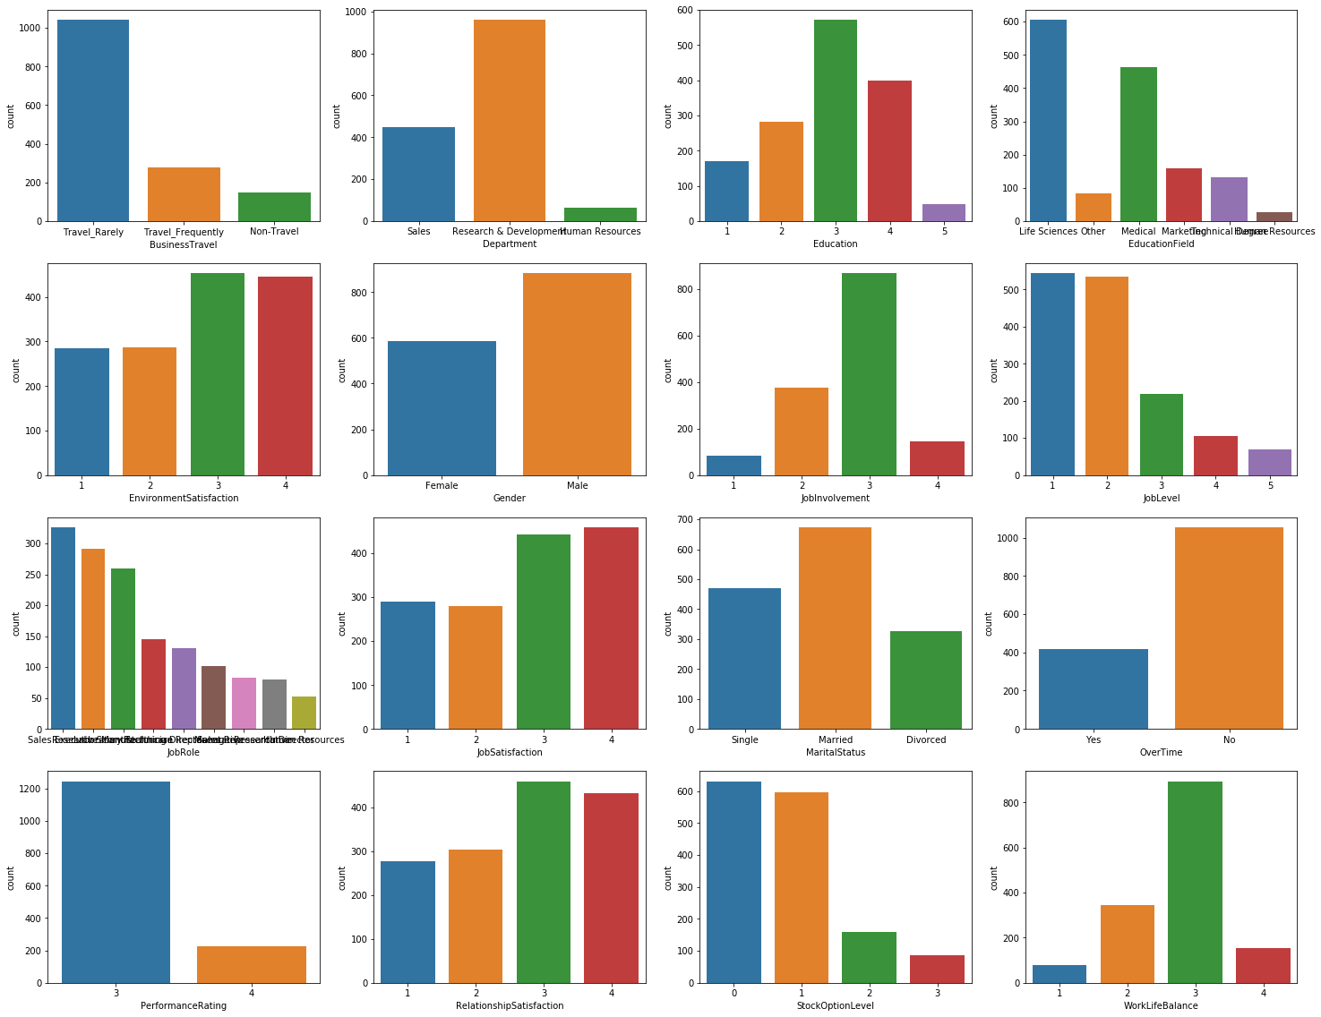
distribution of categorical dependent variables
From the plots, we see 'over 18' column has only 1 value, so it is not having any impact on the attrition , hence we can drop that column.
In business travel, the no of people who travel rarely is more than other categories.
More no of people are in R&D compared to sales and HR.
Most of the employess have life sciences/ medical background

Slide 8
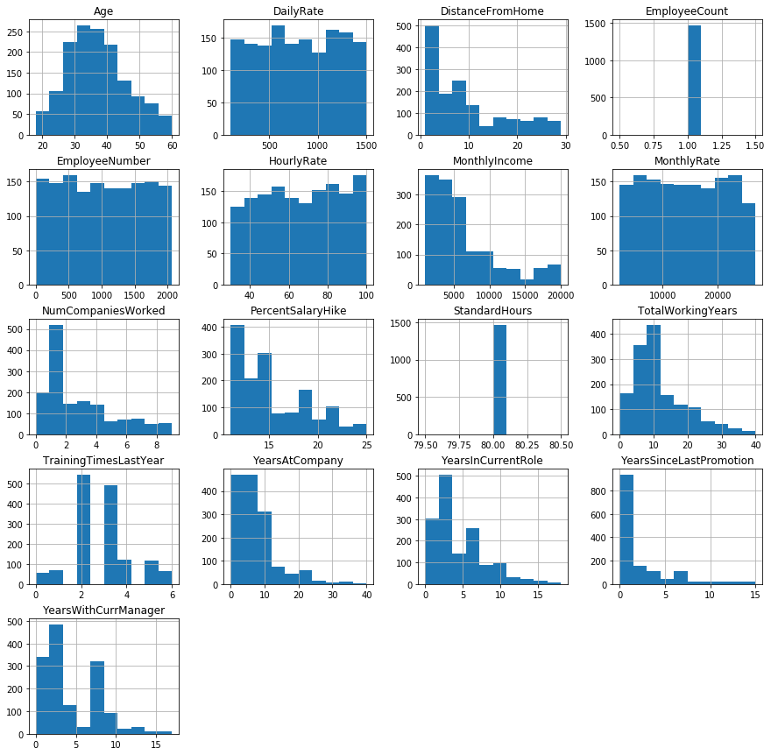
distribution of independent numerical variables
From this we see 'employee count','standard hours' can be dropped as they have one value for all rows. Also 'employee number' is not useful
From the plots we see that some variables are skewed and we need to apply transformations
From plots we see that monthly income is skewed, reason could be most of the employees are in lower level and there are few people in higher levels
Also percent salary hike is skewed, which indicates mean salary hike % is low.
Age is normally distributed, the average age of employee is 35yrs.

Slide 9
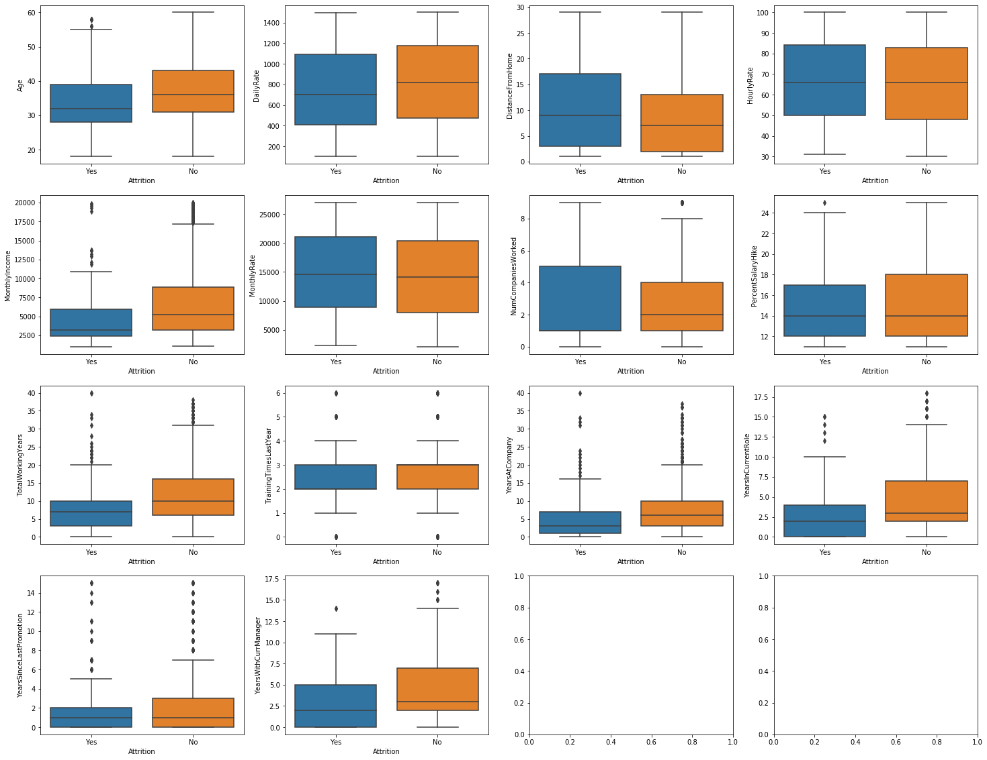
bivariate analysis
From this we see how the variables are changing with respect to the target column.
eg : For age, the average age of people who leave the company is less than the average age of people who stay, which might mean older employees tend to stay in the company and younger people might search for new opportunities.

Slide 10
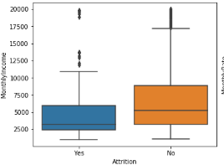
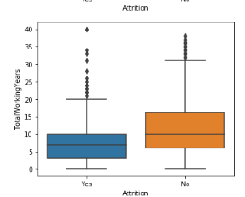
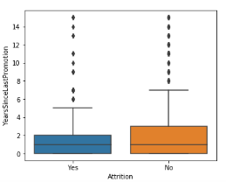
We can visually see that , the below features can explain the target variable better .
Monthly Income
Total working years
Years since last promotion
Employees tend to leave when their monthly income is less
Less experienced people (i.e) people of younger age tend to look for more opportunity than the experienced ones
Employess tend to leave the company if they are not promoted for a longer time

Slide 11
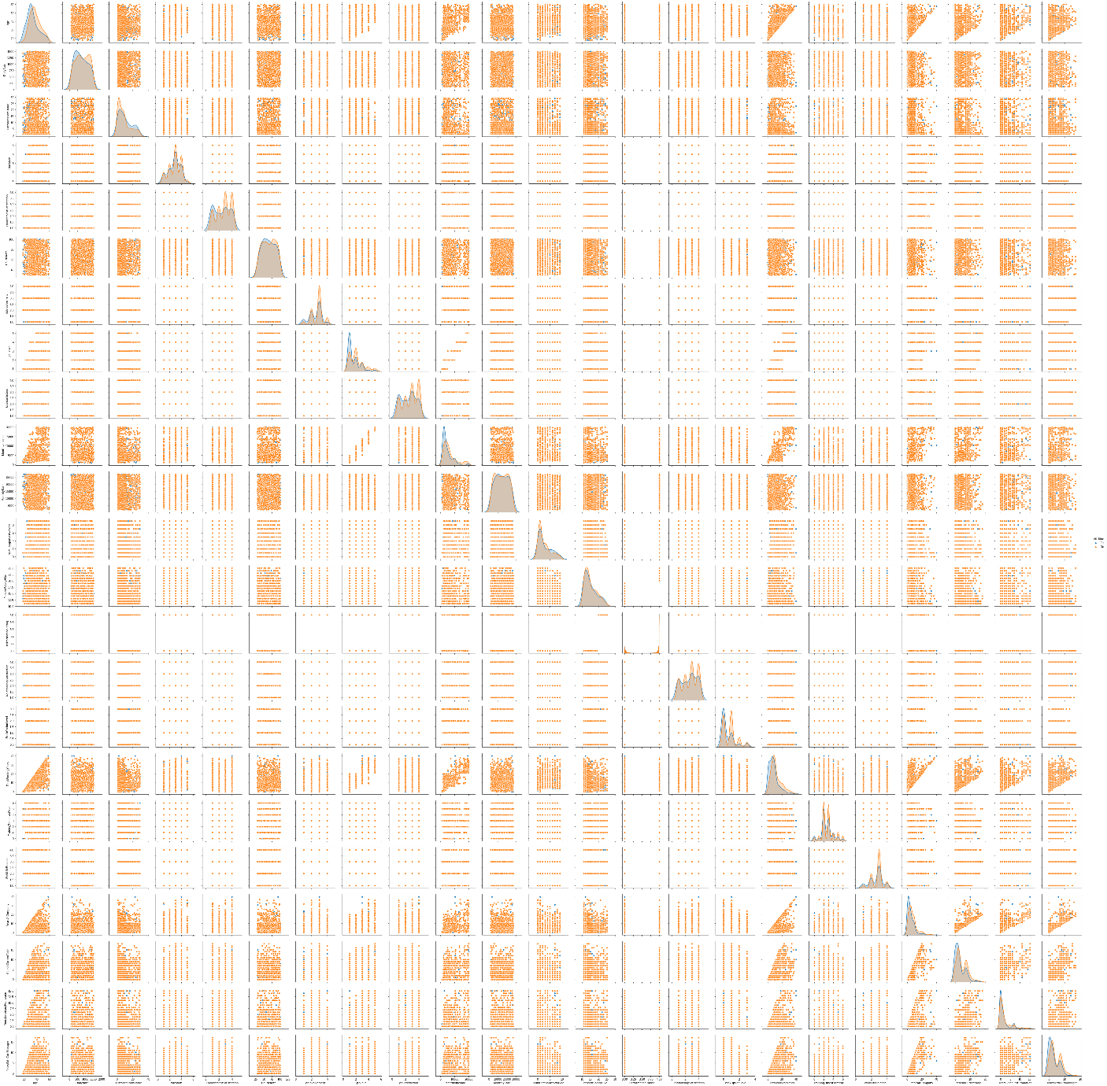
multivariate analysis
From this we see some parameters are having overlaps, so there are lots of noisy features which might pose difficulty in classification.
Also there is less multicollinearity among variables

Slide 12
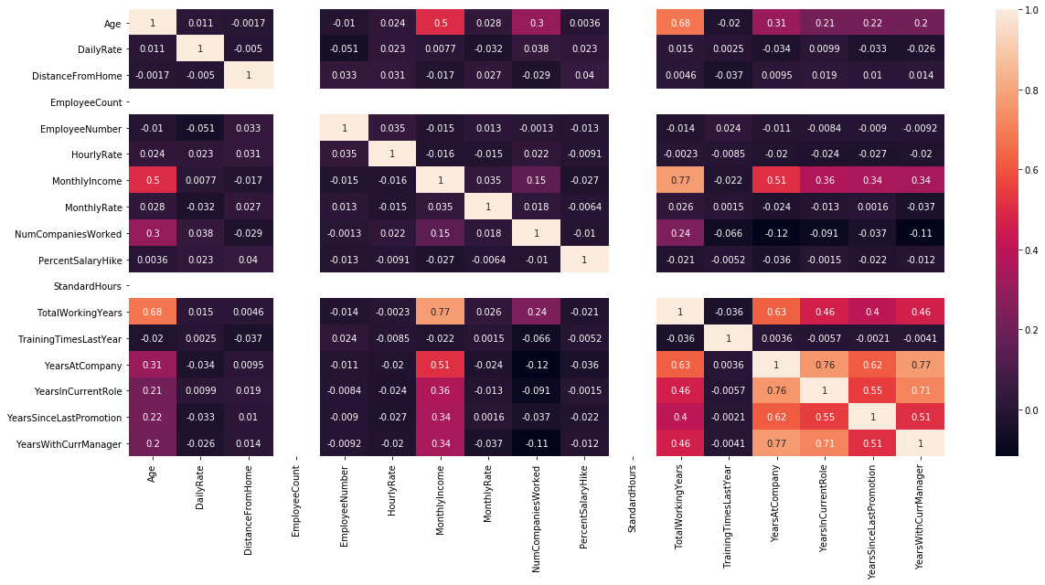
HEATMAP

Slide 13
Algorithms opted :
Logistic Regression
Decision tree
Random Forest
4. K-NN
5. Ada boost
Of the above , Logistic regression model gave better outputs

Slide 14
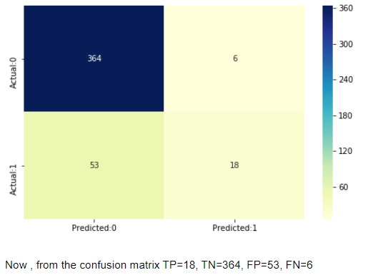
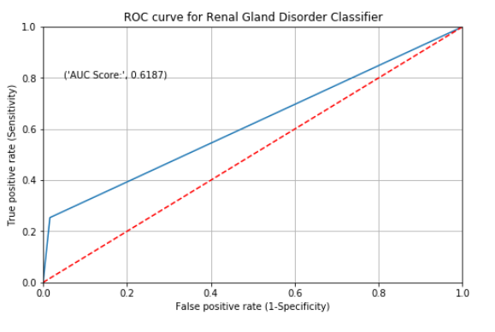
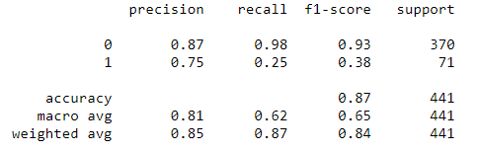
Model building:
LOGISTIC REGRESSION

Slide 15
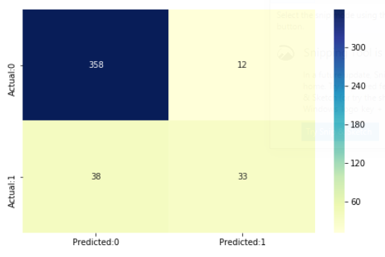
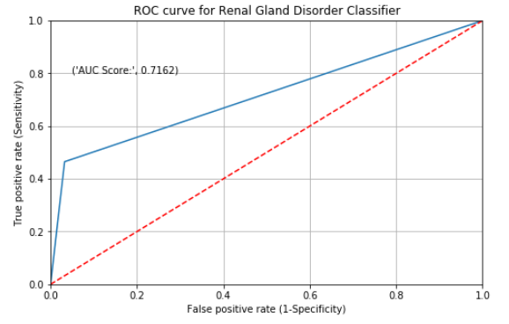
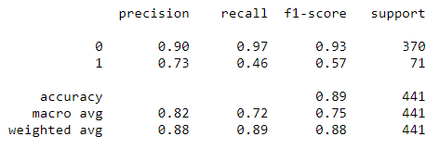

Model building:
Logistic Regression (MLE with Scaled Features)

Slide 16
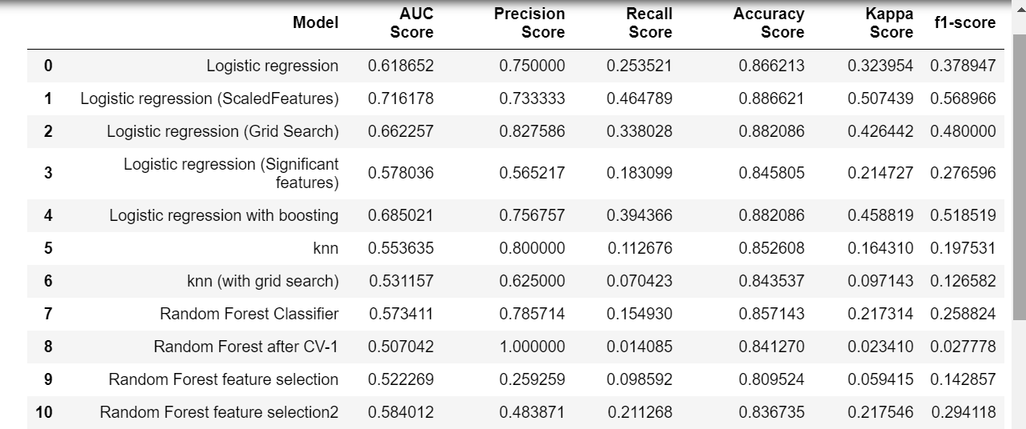

Slide 17
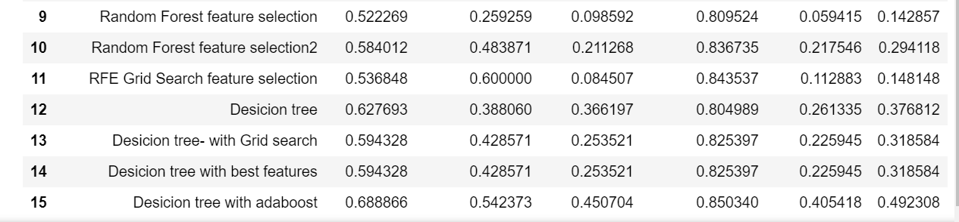

Slide 18
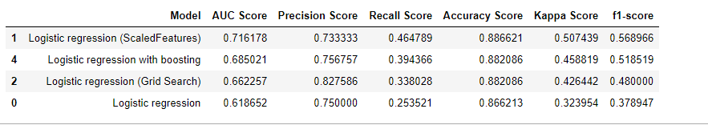
Final Result :
Model is biased towards predicting non attrition.
Log Regression is the best model, as it always predict a higher area under the curve and a better confusion matrix
our algorithm identifies about 46% of them accurately.

Slide 19
Benefit :
Our model is build such that it focuses on the problems faced due to employee attrition .
Focusing on the features causing the employee attrition can help business
Reduce the expense in terms and time to train new employees
Avoid the loss of experienced employees
To reduce impact on productivity
To reduce impact on profit

