Slide 1
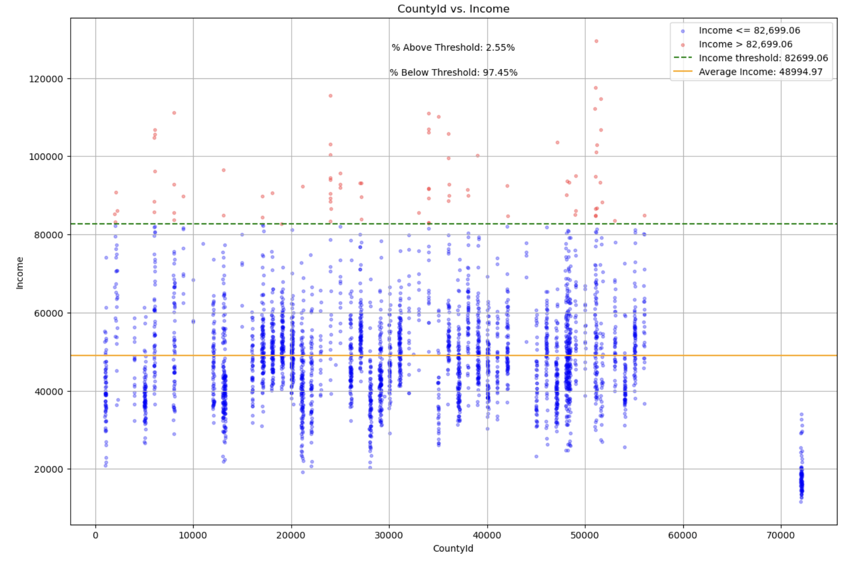
Notes:
Use 2017 scatter plot and draw a line that shows what the 50k would look like
Average up how many below and above that line and see if you can divide it up visually - transparent area to show under 50k adjustment to be a different shade
→ add what countyids are associated with which states

Slide 2
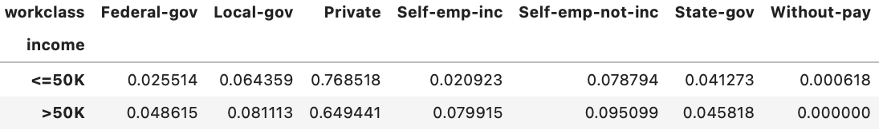
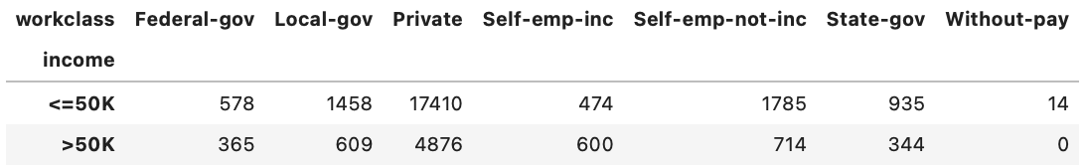

Slide 3
