Slide 1
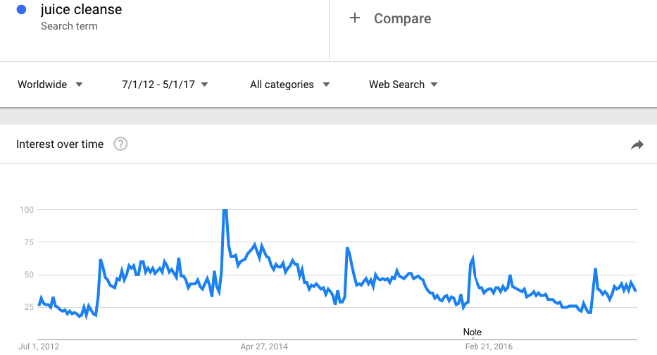
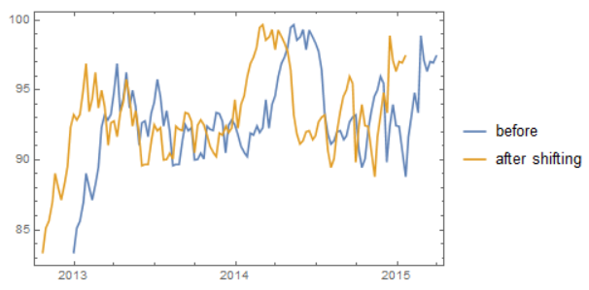
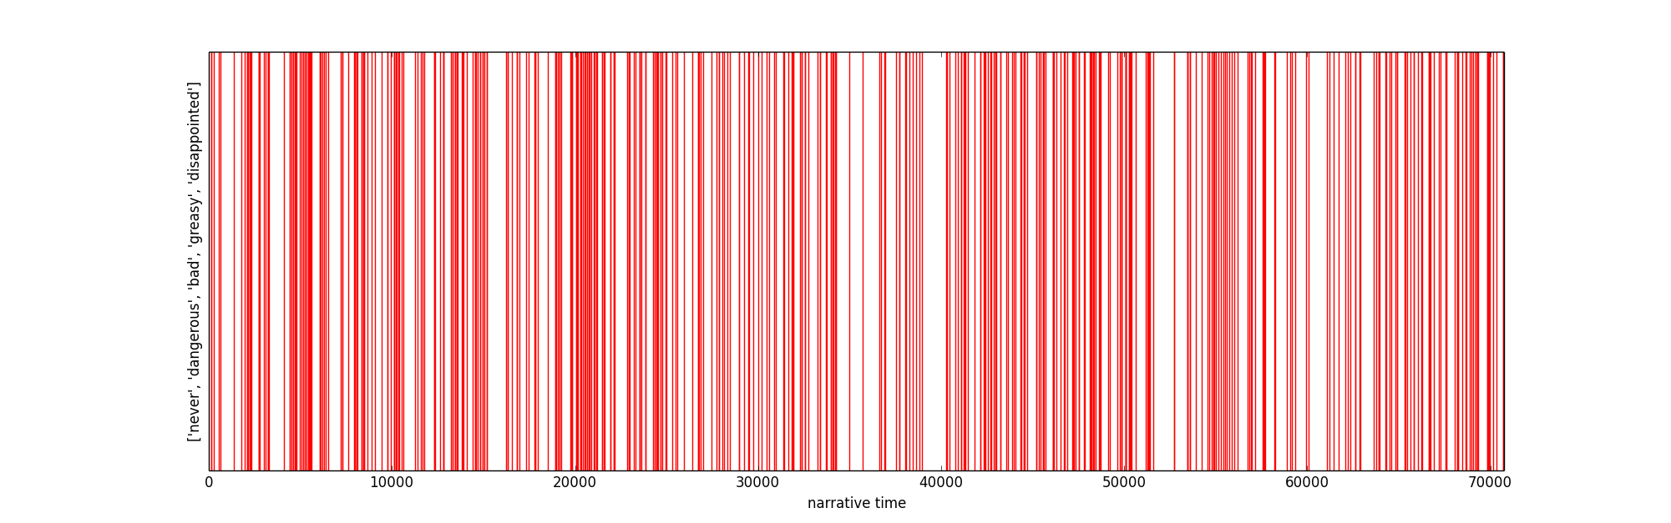
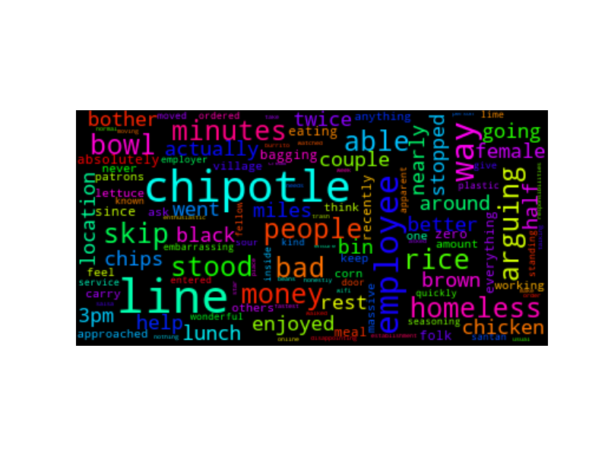
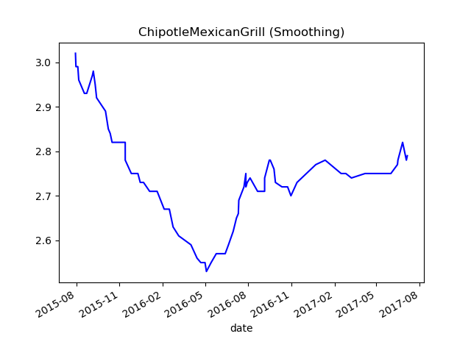
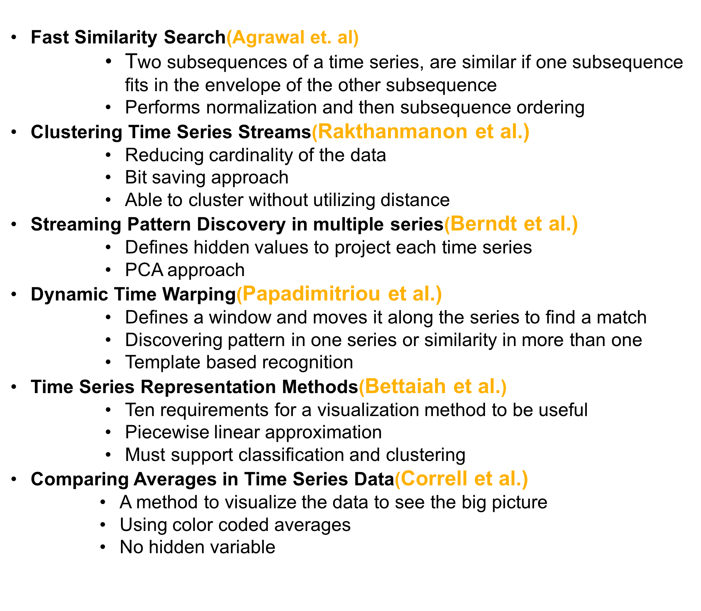
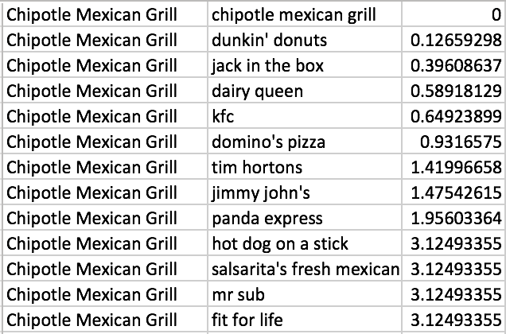
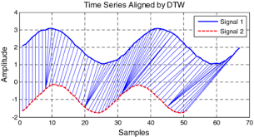
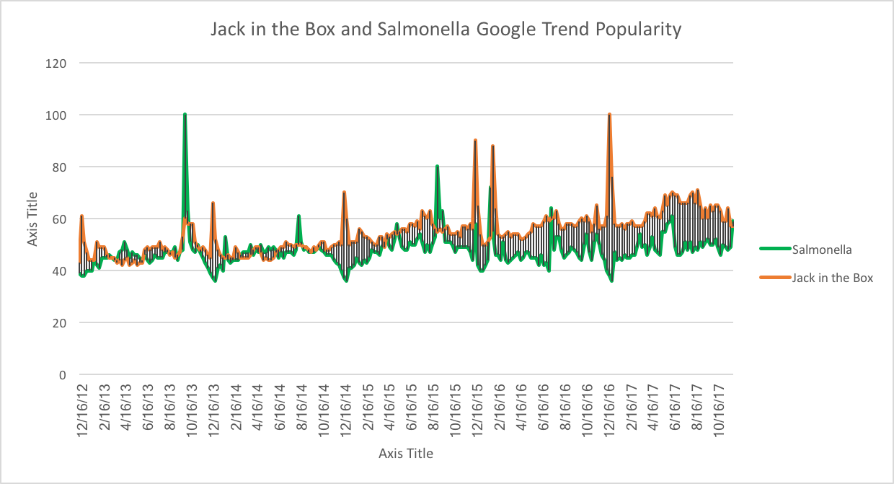
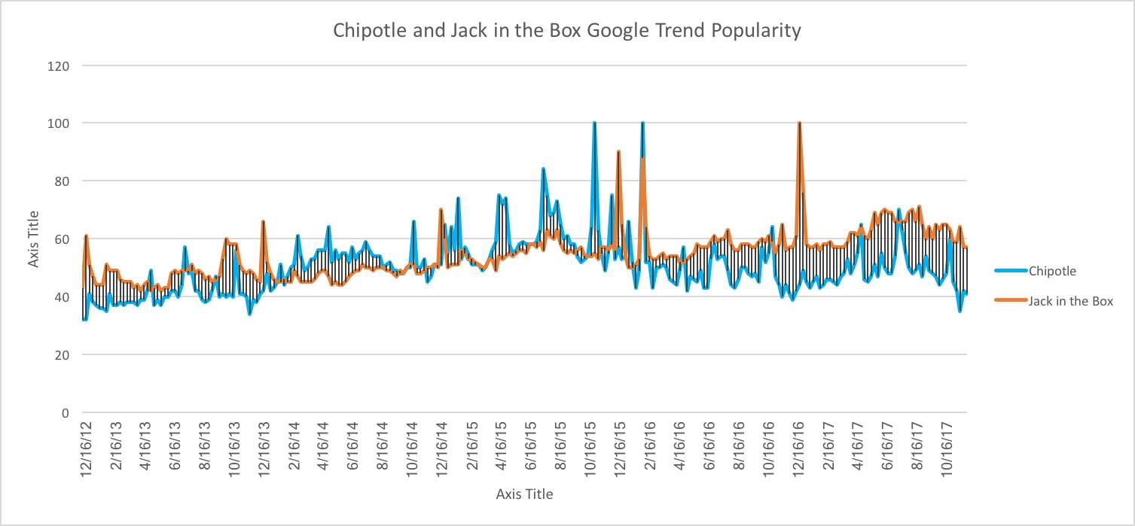
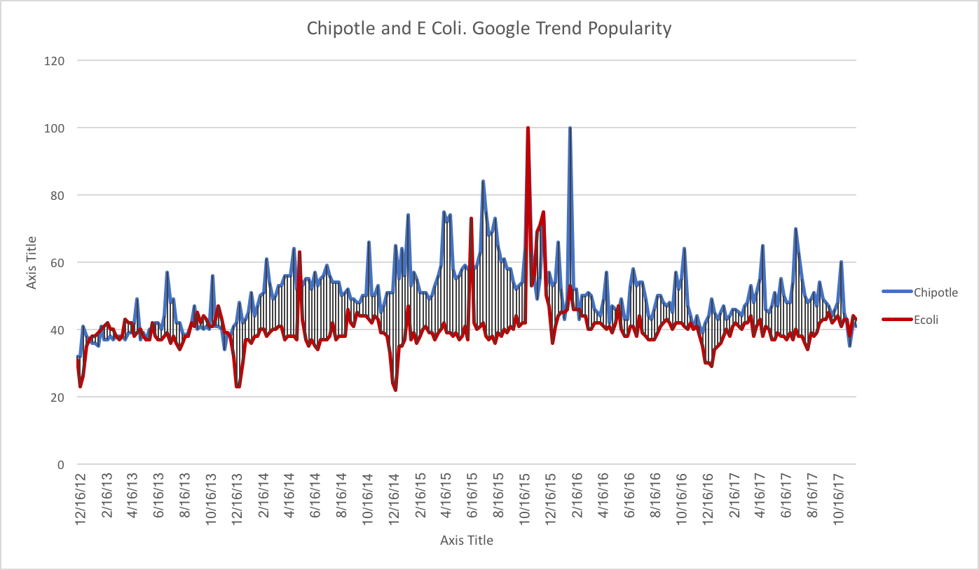
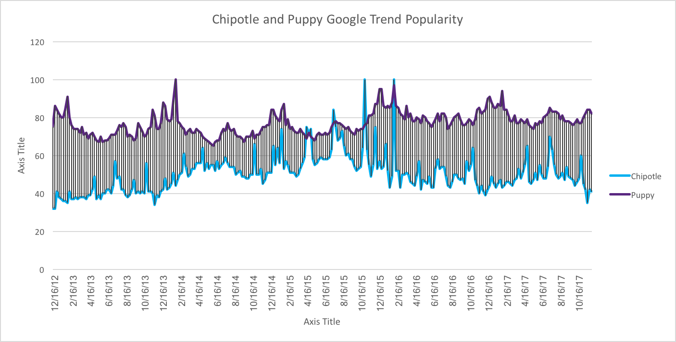

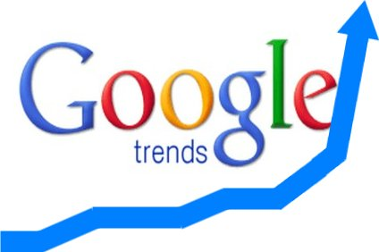


Ytrend : Why Did You Rate Me Like That?
Jasmine Kim UC Riverside jkim509@ucr.edu | Shirin Haji Amin Shirazi UC Riverside shaji007@ucr.edu | Bailey Herms UC Riverside bherm001@ucr.edu
Introduction
Proposed Method
WordCloud was used to find out what words were the most frequent in the reviews during the dips.
    Mostly negative words ! These can be used to search for specific Google Trends. (example: employee strike and complaints about the service.
The lexical dispersion plot also shows that many negative words have been used around the same time of the dip.
  Yelp is a trusted source for reviews
  No explanation on the reason behind the ratings
  Lets explain why! better decisions
Steps:
  Crawl and clean the Yelp Dataset Challenge
  Extract the target business’ stars and reviews
  Plot time series of Yelp rating for businesses
        Check visually if business display’s any interesting patterns or dips and peaks to determine if it is interesting
      Once determined interesting, extract the stars and reviews of businesses or categories to compare against target business
      Perform normalization on time series, such as time normalization using quartiles, Z normalization, and rolling window mean, before comparing
  Extract patterns and measure similarity using tools DTW
        Euclidean distance of corresponding points on two time series
  Mark different time periods corresponding to a sudden fall or rise in the ratings
  Text mine the reviews over the given time periods to find most used words
  Use the words to explore Google Trends and extract time series of the given subjects
        Use WordCloud as a representation
  Utilize Google Trends time series and the text mining results to explain the Yelp star reviews
Challenges:
  Yelp star review data is sparse and discrete
  Data per business is sparse
  The range of the Google Trends’ time series and Yelp star review time series are not the same
        Example: Yelp reviews may go down but Google Trends may go up if a particular restaurant gets a lot of bad publicity
  Text reviews are full of sentiment related words and many general phrases
        Not as professional and precise as predicted.
We now have gluten-free buns!
Burgers(Gtrends)
KFC ratings(Yelp)
Be aware of E-coli!
It’s always better to have more knowledge resources.
    1-Yelp stars 2-Yelp text reviews 3-Google Trends
Related Work
Example : Chipotle Mexican Grill reviews on yelp
Can we find out what happened during the dip?
Problem Definition
“Given the Yelp review data and Google Trends topic searches, we utilize time series similarity search and text clustering to explain certain businesses’ Yelp review trends”
Where did the data come from?
Yelp Dataset Challenge provides us with different businesses name, category, location, rating and peoples reviews and stars given.
business.json reviews.json user.json categories.json
What tools did we use?
  DTW (Dynamic Time Warping)
  Z Normalization
  Normalization of Time using Quartiles
  Solve the problem of having time series with different lengths which is required when using DTW
  Rolling Window Mean
    Average Yelp reviews over a window of multiple data points because the Yelp star review range is too small and discrete
  WordCloud
  Lexical dispersion plot
What are the main components of our work?
Our work includes three different aspects of data mining:
1. Pattern recognition in time series
2. Measuring similarity and correlation between different time series
3. Text mining
Results
After choosing some of the categories defined in the Yelp data, we used DTW to find similarities between different businesses.
  What is similar to Chipotle?
  Euclidean distance from DTW
Lets see which of these are actually correlated!
Conclusions
“Google Trends, Yelp Stars time series and Yelp review text can be utilized to understand and explain why a certain business has been rated in a specific manner.”
We can see that food poisoning has had a great impact of many businesses like Chipotle Mexican Grill and the correlation is reasonable. In contrast, we can see that other categories like poppies for instance, do not have the same trends!
Can we utilize Google trends data to explain what is happening?
Normalize the data, use DTW , find falls and peaks, mine corresponding text.
Using knowledge gathered from multiple resources, we can now explain yelp review trends.
Now lets utilize text mining!...
We want to figure out the reason behind sudden increase or decrease in a business’ rating.
We can also text mine the review text around the targeted time period.
Search for the most used words on Gtrend and utilize the information

