Slide 1
Impact of Compulsory Schooling on Socioeconomic Outcomes
An Analysis Using Regression Discontinuity Design
Jasmine Jia
May 10, 2024

Slide 2




Introduction
Purpose:
Investigate the transformative impact of compulsory education on various facets of life including educational attainment, earnings, marital status, and parental status by the age of 45.
Brief Overview:
Policy Implementation:
Date Enacted: September 1, 1951.
Requirement: School attendance is mandatory until age 16 for those born on or after this date.
Goal: Establish a baseline education for all individuals.
Notes:
Jiali

Slide 3
Introduction (continued)
Policy significance:
Justifying and optimizing public expenditures on education.
Necessitating adjustments in social policies including housing, welfare, and healthcare systems.
Narrowing the gap of inequality by ensuring every child receives a fundamental level of education.
Endogeneity concerns:
Self-selection bias
The risk of reverse causality
Omitted variable bias
Notes:
Jiali

Slide 4
Research Design
Fuzzy vs. Sharp RDD:
Fuzzy RDD accounts for imperfect compliance with the policy.
Unlike sharp RDD, the assignment to treatment at the cutoff is not strictly deterministic, allowing for variability.
Instrumental Variable (IV) Approach & Two-stage Least Squares (2SLS Estimation):
Definition and Role:
Z (Instrument): The cutoff date (September 1, 1951) acts as an instrument.
X (Treatment Variable): Indicates whether a student left school at or after age 16.
Y (Outcome Variables): Focus on log earnings, marital status, parental status at age 45, and years of schooling attained.
IV Conditions:
Inclusion Condition: Strong predictor of the treatment, ensuring that the instrument affects the treated group.
Exclusion Condition: Ensures the instrument affects the outcome only through the treatment.
Notes:
Jiali

Slide 5
Research Design (continued)
Control vs. Treatment Groups:
Segmentation Based on Cutoff:
Control Group: Born before September 1, 1951.
Treatment Group: Born on or after September 1, 1951.
Assumes comparability for those near the cutoff, differing only in policy impact.
Construction of the Running Variable:
Definition: Measures days between each individual's birthdate and the policy implementation date.
Binning for Analysis:
It is segmented into 90-day intervals around the cutoff.
Enhances analysis precision and handles data granularity.
Notes:
Jiali

Slide 6
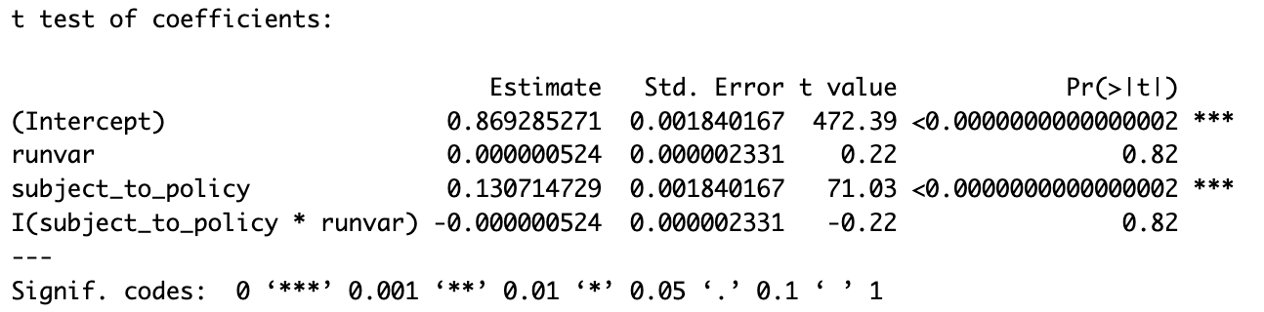
First Stage
First Stage Analysis:
OLS Specification:
Regression Results:
Findings: Students that were subject to the policy were 13.1% more likely to leave school at age 16 or later (p < 0.001).
Statistical Evidence: T-statistic on the policy indicator is 71.03, indicating a robust first-stage relationship.
Notes:
We use a two-stage least squares approach to estimate the effect of the policy on long-term outcomes. Unlike a sharp RDD, the assignment to treatment in a fuzzy RDD is not strictly deterministic at the cutoff date, reflecting some variability in compliance with the policy: in other words, some students not subject to the policy may still have stayed in school until at least age 16, and conversely, some students subject to the policy may not have adhered to it and dropped out before age 16. Because of this difference in treatment assignment and actual treatment status, the fuzzy RDD capitalizes on an instrumental variable (IV) approach by instrumenting treatment status with treatment assignment. In the context of this study, this means that we instrument whether a student attended school until at least age 16 with whether the student was subject to the minimum drop-out age policy.

Slide 7
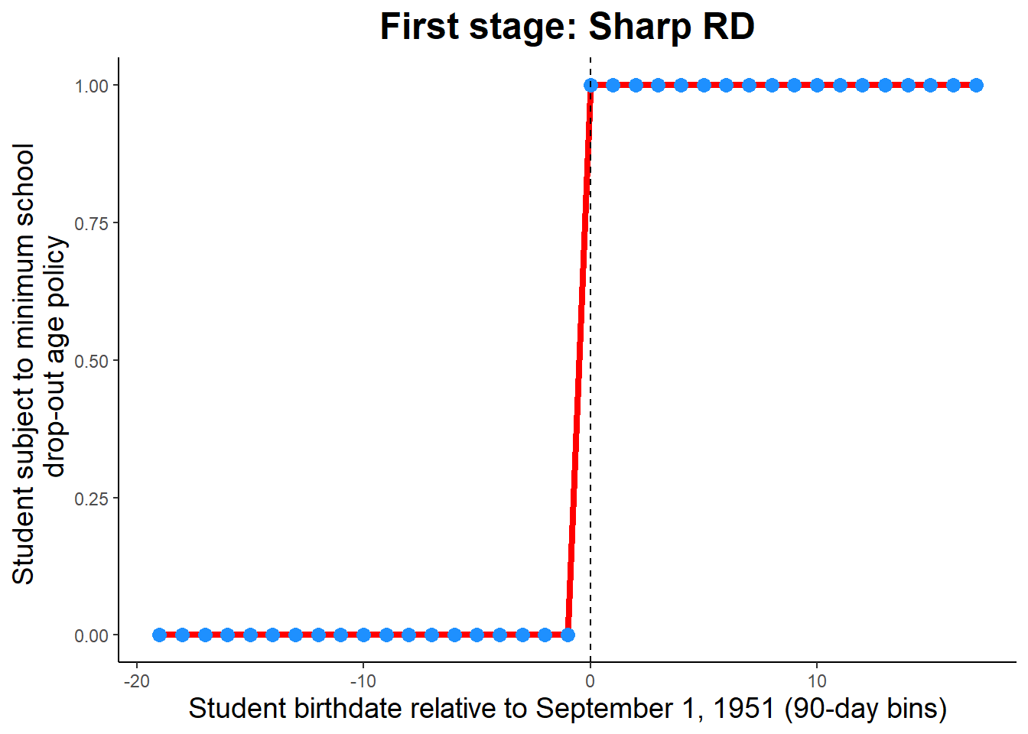
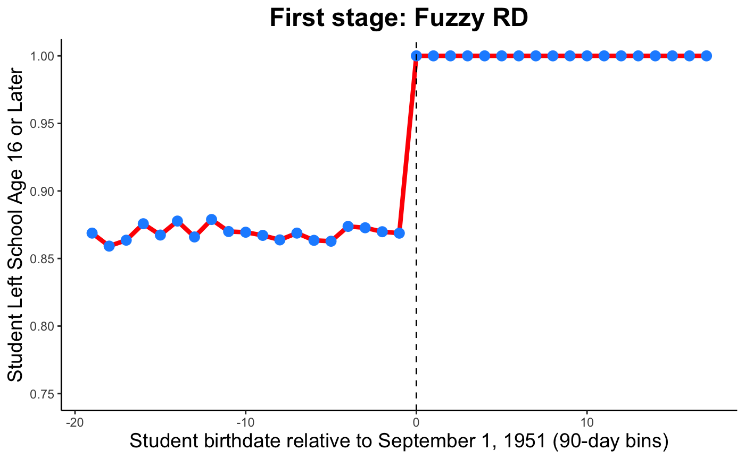
First Stage Visual Assessments
Notes:
To visually assess the validity of the instrument, we plot both the sharp first stage and fuzzy first stage results. That is, the sharp first stage plot examines assigned treatment against the running variable: in other words, all students with a birthdate before the cutoff have an assigned treatment of zero, and all other students have an assigned treatment status of one. As discussed, in actuality treatment was not deterministic in this manner: as seen in the fuzzy first stage plot, at least 85% of students in each bin to the left of the cutoff remained in school until at least age 16. However, as expected, the sharpest discontinuity occurs at the cutoff: once the policy went into effect, there was almost 100% adherence to the policy for cohorts born on or after the cutoff date. As an additional robustness check, we conducted a permutation test of 500 simulations: in each simulation, we randomly assigned the distance from the cutoff (thereby randomly assigning the instrumental variable) and re-estimated regression equation (1) using this randomly-assigned running variable and instrument. As expected, we find that the distribution of the coefficient on the randomly-assigned instrumental variable for these 500 simulations centers on zero (i.e., our instrumental variable is not just a good predictor of X by random chance).

Slide 8
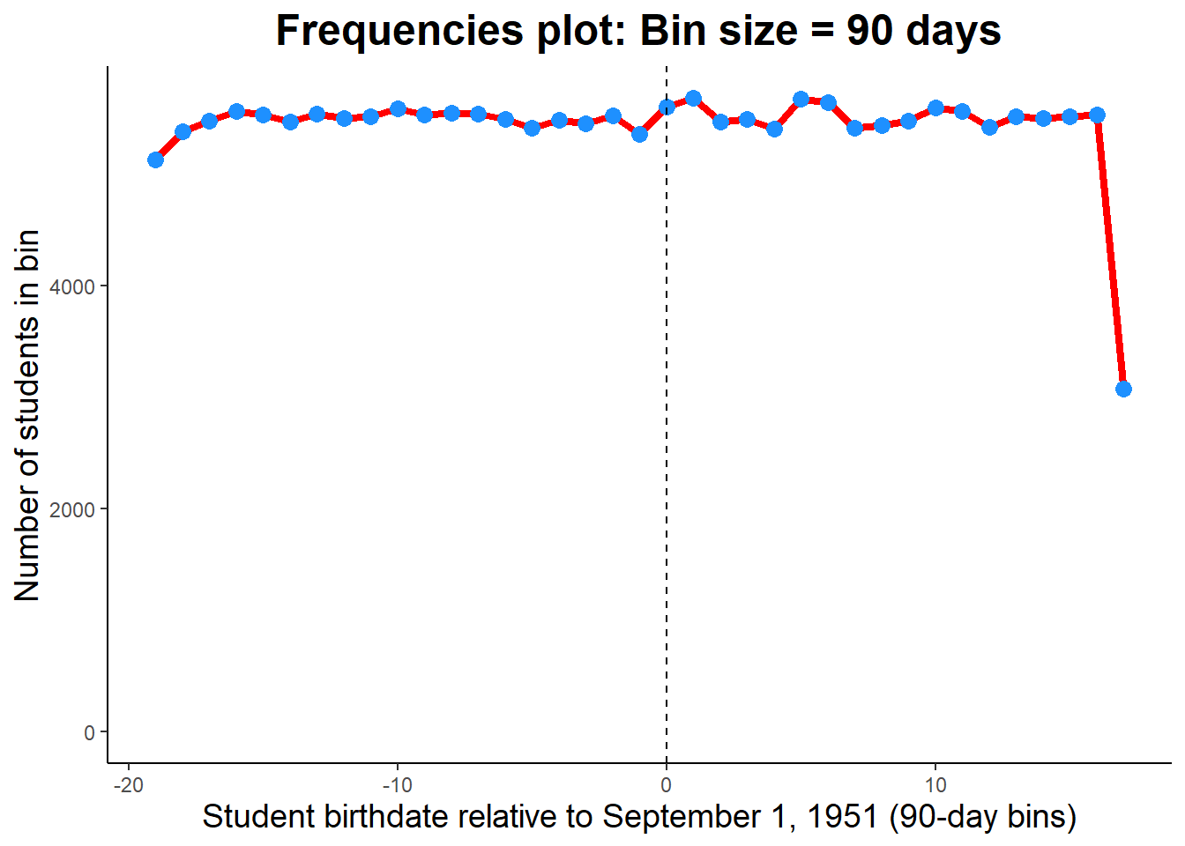
First Stage: Assumptions
No bunching
(2) No other discontinuous changes at the cutoff
No covariates in our analysis
Notes:
In the context of RDD, two other important assumptions must hold. First, students must not be able to choose their treatment assignment. In this context, that means choosing whether to be born before September 1, 1951 vs. on or after this date. Clearly, students themselves have no choice in birthdate. However, depending on when the announcement was made about this policy, treatment manipulation could plausibly occur. For example, perhaps the forthcoming policy was announced in the summer of 1950; this could presumably have factored into family planning. In contrast, if the policy was announced after September 1951 but before the students entered grade school (e.g., perhaps in September 1953), there would be no way to manipulate treatment status. We graphically validate whether we see evidence that families could choose a student’s treatment status by examining the bin size of bins above and below the threshold (i.e., looking for bunching). While we do see a decrease in frequency between bin -2 and bin -1, as well as an increase between bin 0 and bin 1, it is by a marginal amount (Figure 3). In zooming out and looking at all bins, we generally see that the bin size stays relatively constant, consistent with the necessary assumption. (Note that the bin size for the last bin is much smaller than the rest - not a problem…)
The second assumption that must hold is that there are no other discontinuous changes at the cutoff. We would traditionally check this assumption by examining covariate index plots for all covariates in the analysis; however, since this dataset does not include any covariates, this step is skipped.

Slide 9
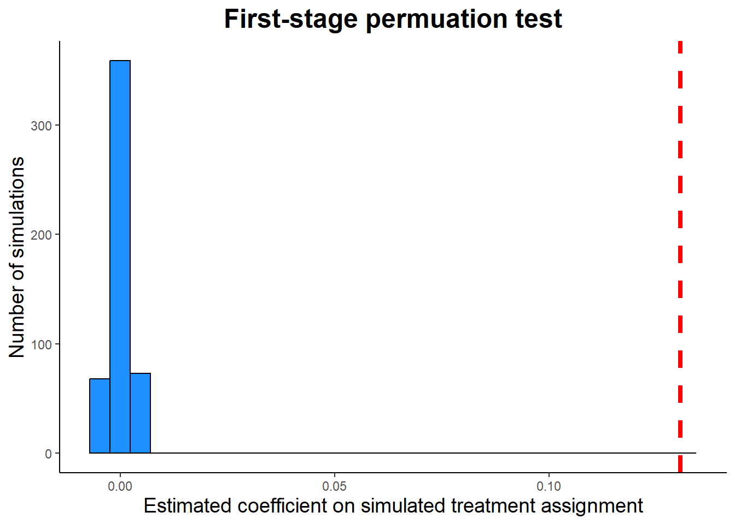
First Stage: Permutation Test
Notes:
As an additional robustness check, we conducted a permutation test of 500 simulations: in each simulation, we randomly assigned the distance from the cutoff (thereby randomly assigning the instrumental variable) and re-estimated regression equation (1) using this randomly-assigned running variable and instrument. As expected, we find that the distribution of the coefficient on the randomly-assigned instrumental variable for these 500 simulations centers on zero (i.e., our instrumental variable is not just a good predictor of X by random chance). Our real first-stage estimate for the instrumental variable (0.131) is far to the right of the distribution from the permutation test (Figure 4). In this context, the coefficient means that students subject to the policy were 13.1% more likely to leave school at age 16 or higher compared to students not subject to the policy.

Slide 10
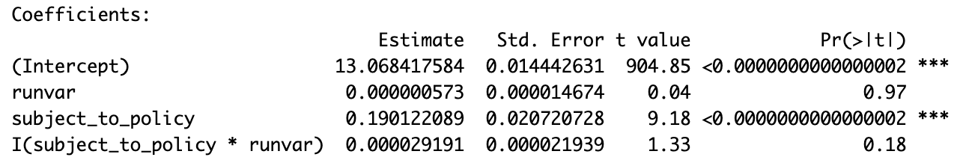
Years of Schooling
First Stage Analysis:
OLS Specification:
Regression Results:
Findings: Students that were subject to the policy on average completed 0.19 more years of schooling than student not subject to the policy (p < 0.001).
Statistical Evidence: T-statistic on the policy indicator is 9.18, indicating a robust first-stage relationship.
Notes:
Jasmine

Slide 11
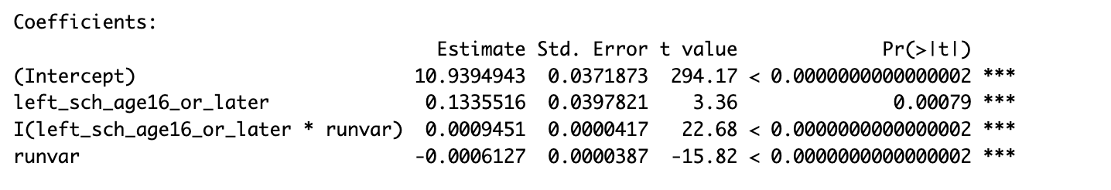
Earnings
Regression Equation and Results:
Equation Used:
Purpose: To isolate the direct effect of schooling beyond age 16 on earnings at age 45.
Key Findings:
Primary Coefficient (β2): The coefficient for staying in school after age 16 is 0.134, indicating a 13.4% increase in earnings at age 45 compared to peers who left school earlier.
Runvar Coefficient (β1): The rate of change in earnings for those who did not stay in school until age 16 is -0.062 percentage point.
Runvar + Interaction Term (β1 + β3): The rate of change in earnings for those who left school after age 16 is 0.033 percentage points.
Notes:
Jasmine

Slide 12
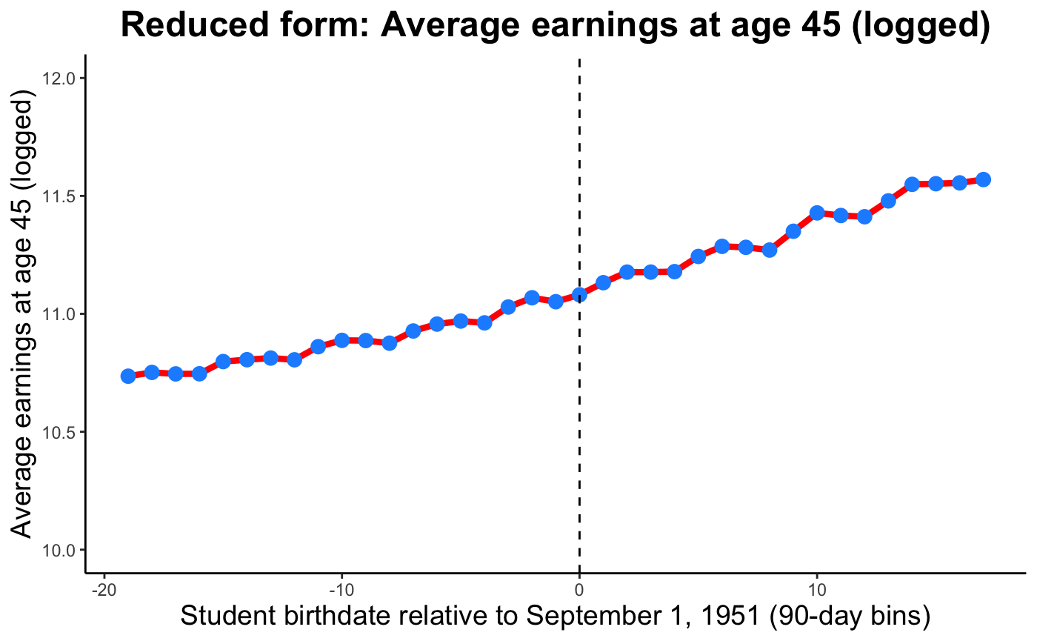
Earnings
Threshold Indicator
Cutoff Date: The Vertical dashed line at '0' on the x-axis represents the September 1, 1951 cutoff.
Division: Splits the cohort into those required (post-cutoff) and not needed (pre-cutoff) to stay in school until at least age 16.
Trend Analysis
Before the Threshold:
There is a slight, consistent increase in logged earnings as one approaches the threshold from the left.
Indicates that pre-policy factors have already begun impacting earnings.
After the Threshold:
Noticeable, pronounced increase in earnings right after crossing the threshold.
Strong evidence of the positive impact of extended schooling on earnings.
Statistical Significance
Key Highlight: Statistically significant increase in earnings for those subjected to compulsory schooling, affirming the policy's effectiveness.
Notes:
Jasmine

Slide 13
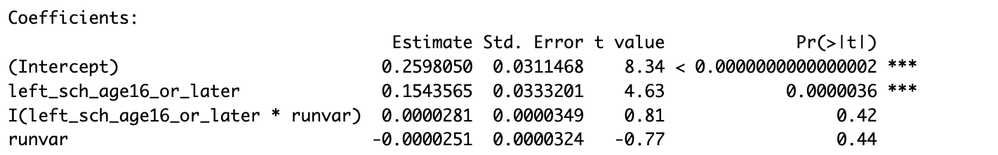
Marital Status
Regression Equation and Results:
Equation Used:
Purpose: Examine how staying in school beyond age 16 influences marital status at age 45.
Key Findings:
Primary Coefficient (β2): Statistically significant increase of 15.4% in the likelihood of being married at age 45 for those who stayed in school past age 16.
Runvar Coefficient (β1): The rate of change in probability of marriage for those who did not stay in school until age 16 is -0.00251%, however this term is not statistically significant and therefore negligible.
Runvar + Interaction Term (β1 + β3): The rate of change in probability of marriage for those who left school after age 16 is 0.0003% and is also not statistically significant.
Notes:
Jasmine

Slide 14
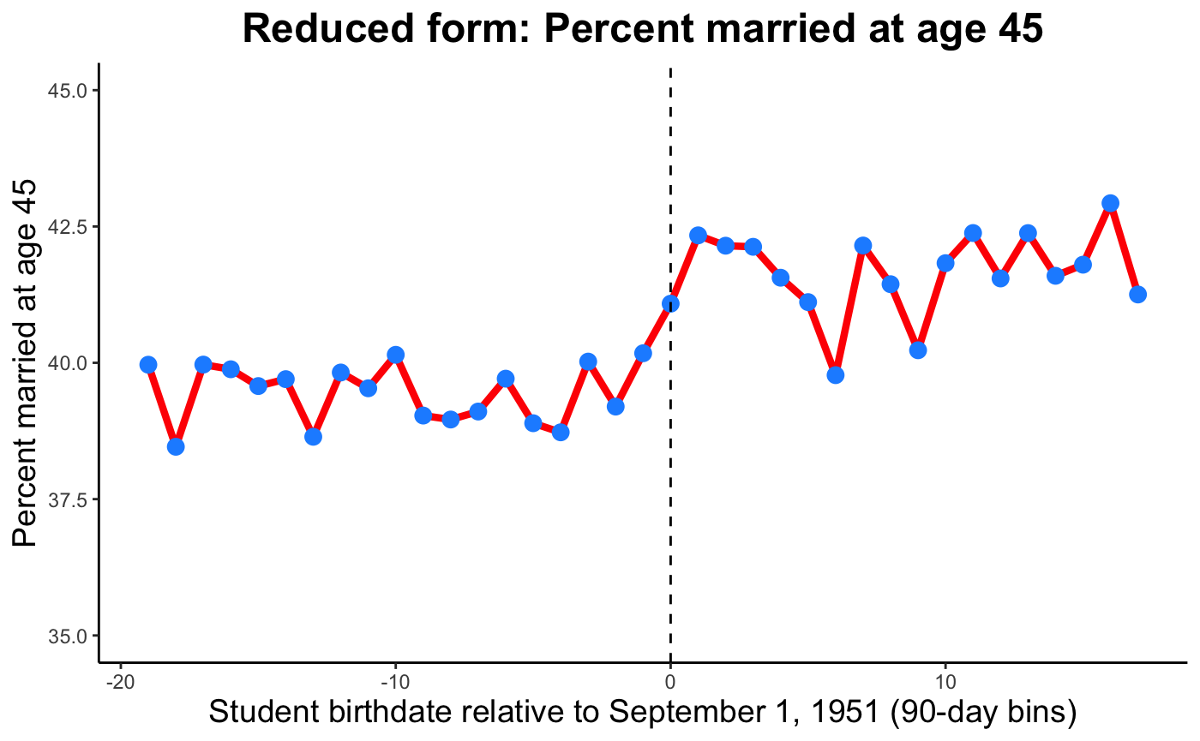
Marital Status
Reduced Form Plot Analysis:
Visual Description: The plot shows a noticeable jump in the percentage of individuals married at age 45 as they cross the policy threshold.
Before the Threshold: Relatively stable or minor fluctuations in marital rates.
After the Threshold: Clear increase, indicating a positive impact of extended schooling on marital rates.
Notes:
Jasmine

Slide 15
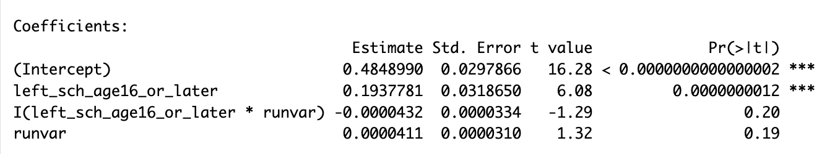
Children
Regression Equation and Results:
Equation Used:
Purpose: Examine how remaining in school beyond age 16 influences the likelihood of having children by age 45.
Key Findings:
Primary Coefficient (β2): Statistically significant increase of 19.4% in the likelihood of having children at age 45 for those who stayed in school past age 16.
Runvar Coefficient (β1): The rate of change in probability of having children for those who did not stay in school until age 16 is 0.0041%, however this term is not statistically significant and therefore negligible.
Runvar + Interaction Term (β1 + β3): The rate of change in probability of having children for those who left school after age 16 is ~0% and is also not statistically significant.

Slide 16
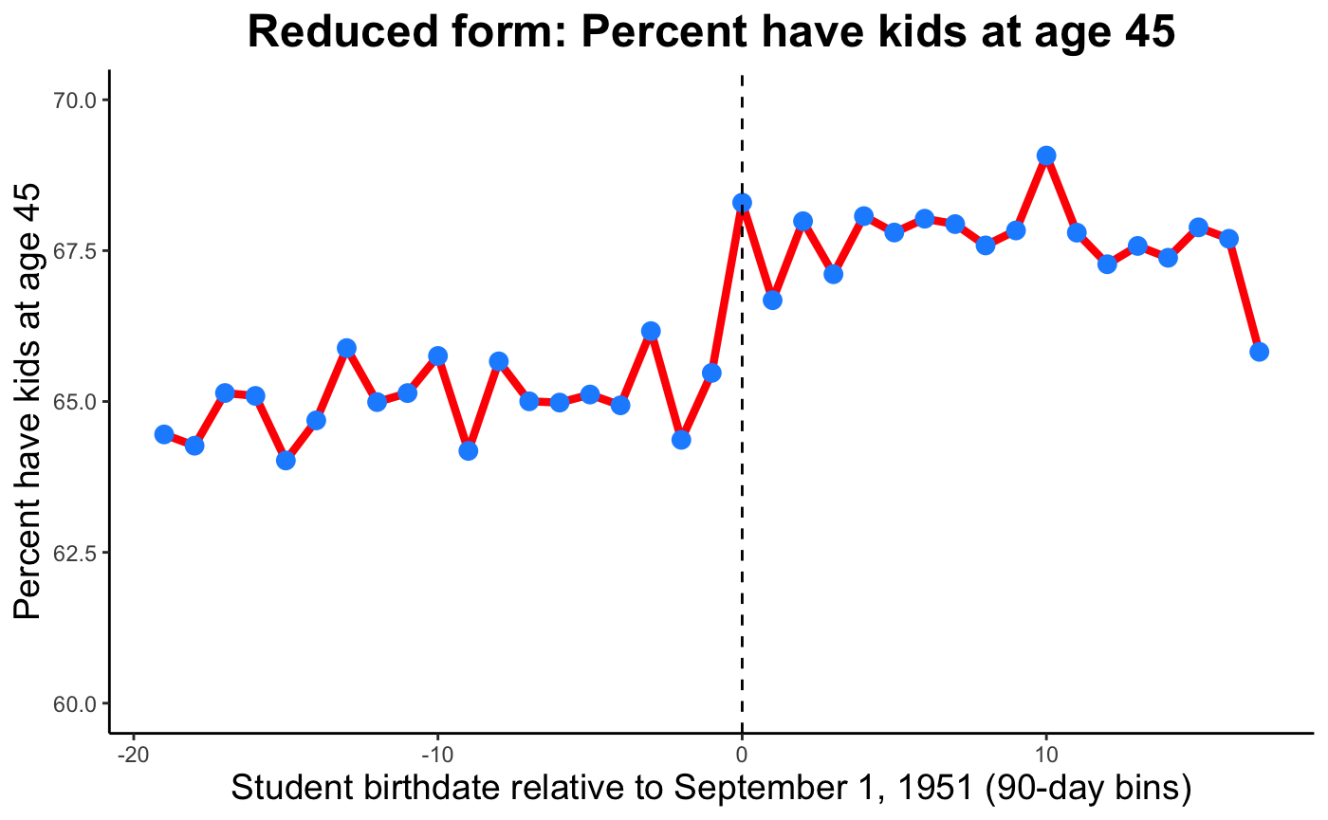
Children
Reduced Form Plot Analysis:
Visual Description: The plot shows fluctuations in the percentage of individuals having children at age 45 across the policy threshold.
Observations:
Before the Threshold: Varied rates with some fluctuations, generally showing a stable or slight trend in parental status.
After the Threshold: Although there are ups and downs, the overall trend does not show a clear increase; rather, it highlights the complexities and potentially other factors influencing the decision to have children besides education.

Slide 17
Permutation Test
Permutation Testing:
The objective of Testing:
To validate the robustness of the estimated causal effects of schooling on various outcomes (earnings, marital status, children) by randomized treatment assignments.
Permutation Test Results:
Plot Explanation: Histogram showing the distribution of the estimated coefficients on simulated treatment assignment.
Key Observation: The absolute coefficient (indicated by the dashed red line) is significantly to the right of the distribution, suggesting that the observed effect of schooling on education is not due to random variation but likely represents an actual causal effect.
Statistical Significance: The distance of the actual coefficient from the center of the distribution emphasizes its statistical significance beyond what would be expected by chance.
Implications: This significant deviation from zero in the real data supports the hypothesis that staying in school past the age of 16 has a substantial and statistically significant positive effect on earnings, marital status, and having children.

Slide 18
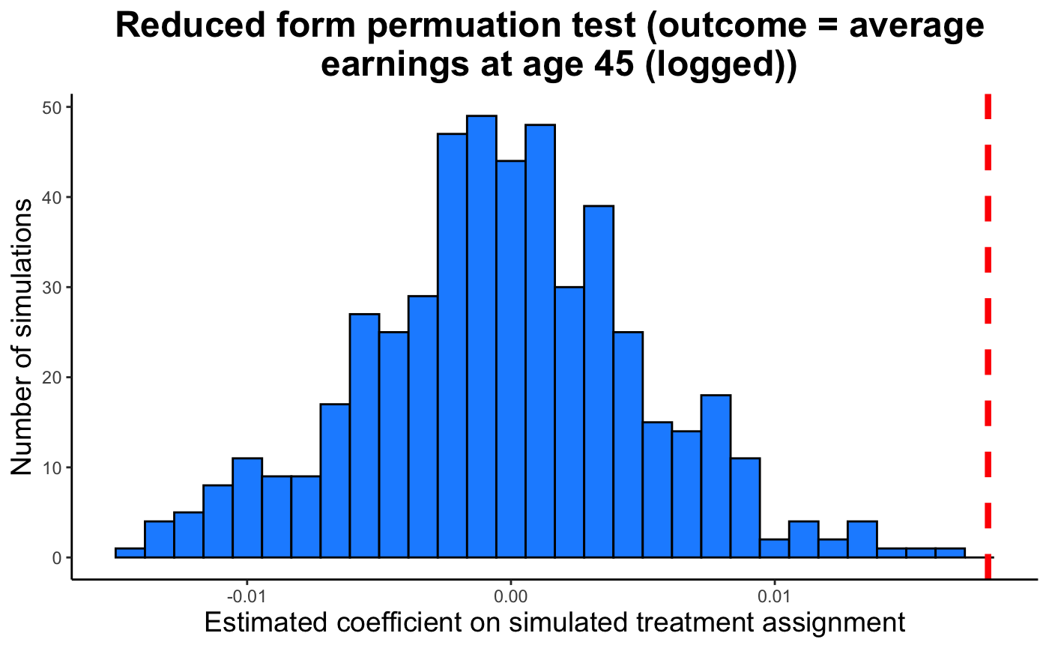
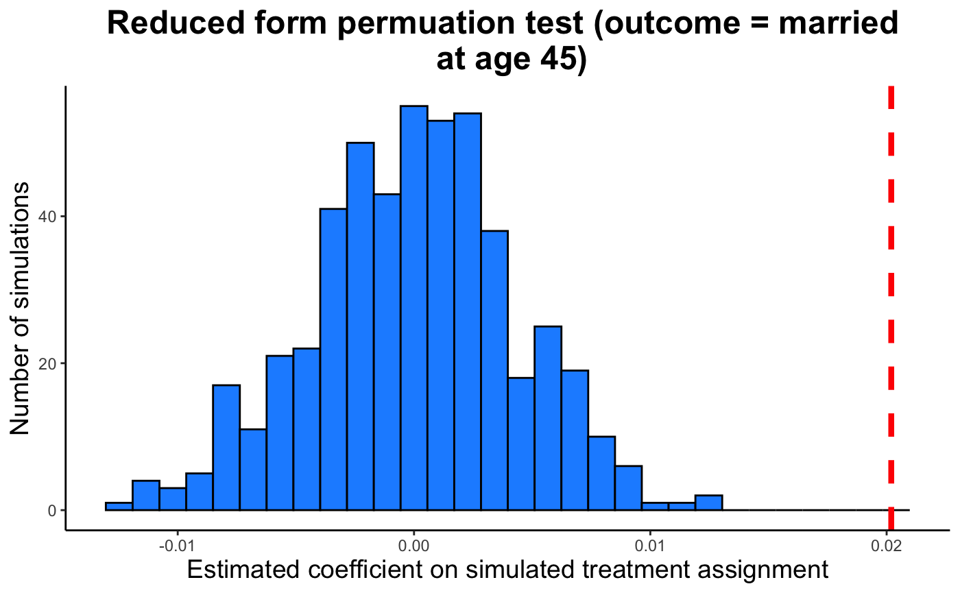
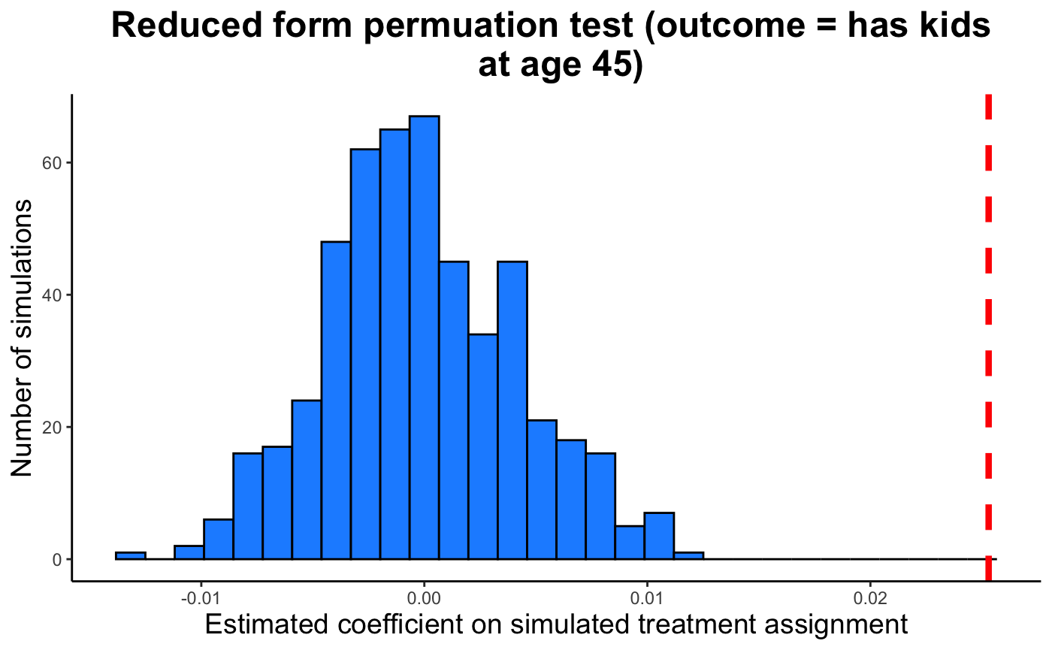
Permutation Test

Slide 19
Conclusion
The effects of extended schooling beyond age 16 on education, earnings, marital status, and presence of children are both positive and statistically significant..
Policy Relevance
Insight: The plot illustrates that higher educational attainment due to the policy correlates with increased earnings.
Policy Impact: Reinforces the economic value of extending mandatory schooling.
Broader Impact
Our results advocate for policies that encourage prolonged educational engagement.
The societal benefits of investing in longer schooling durations are big.

