Slide 1

HR ATTRITION DATA ANALYSIS
FINDINGS AND RECOMMENDATIONS
ANALYSIS AND PRESENTATION BY: JASMINE O’NEAL
FRITO LAY PROPERTY INFORMATION
1

Slide 2
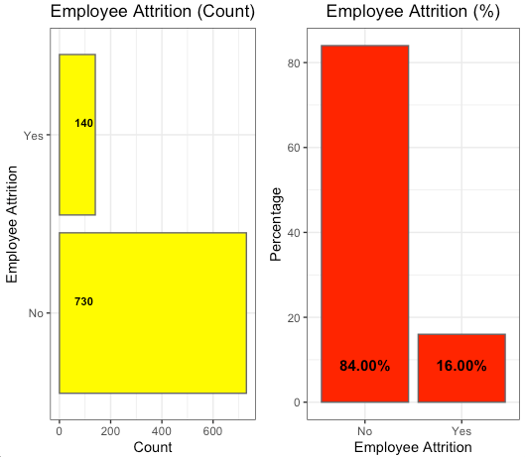
Data Disclaimer
Employee attrition breakdown imbalanced
No 84% compared to Yes at 16%
Options considered on how to handle
Remove No’s to make analysis balanced
Perform analysis as-is
Up-sampling for classification
FRITO LAY PROPERTY INFORMATION
2

Slide 3
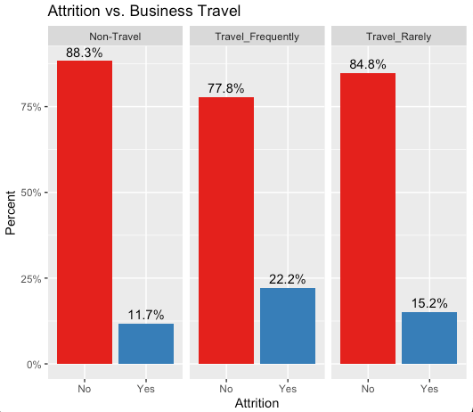
Turnover: Work/Life Balance
Employees that travel frequently had a higher attrition rate at 22% compared to those that didn’t travel
Employees that travel rarely had the second highest attrition rate at 15%
FRITO LAY PROPERTY INFORMATION
3

Slide 4
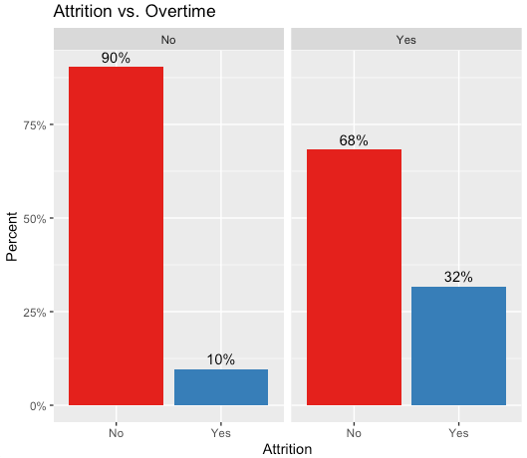
Turnover: Work/Life Balance
Employees that worked overtime had a higher rate of attrition at 32% compared to those that didn’t work overtime at 10%
FRITO LAY PROPERTY INFORMATION
4

Slide 5
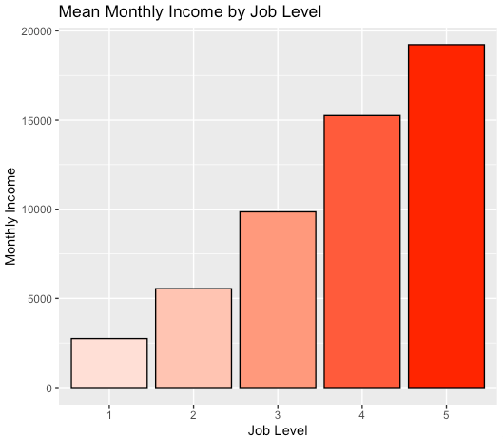
Turnover: Compensation
Monthly Income varies among different job levels
Could these discrepancies lead to attrition as employees pursue higher compensation?
FRITO LAY PROPERTY INFORMATION
5

Slide 6
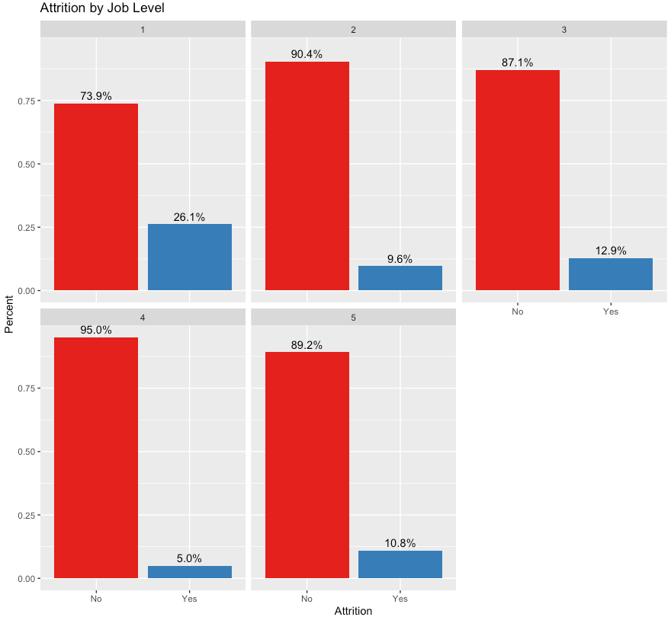
Turnover: Compensation
Employees in lower job levels experience more attrition compared those in higher job levels
Job level 5 has a higher attrition rate at 10% compared to Job Level 4 at 5%
FRITO LAY PROPERTY INFORMATION
6

Slide 7
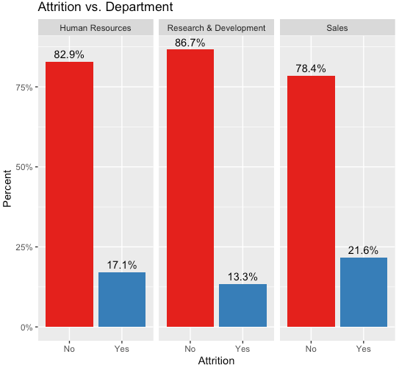
Turnover: Based on Department
Sales department has the highest attrition rate at 21% followed by Human Resources at 17%
These departments may experience more attrition due to performance expectations
FRITO LAY PROPERTY INFORMATION
7

Slide 8
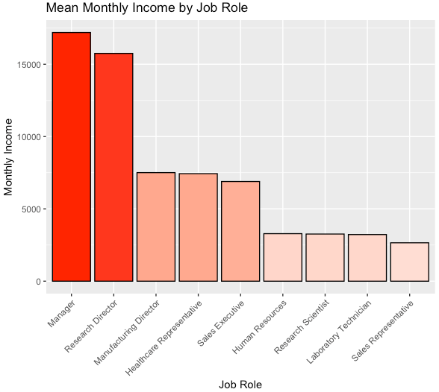
Mean Monthly Income by Job Role
Employees in management roles tend to have higher income
Employees in individual contributor roles tend to have lower income
FRITO LAY PROPERTY INFORMATION
8

Slide 9
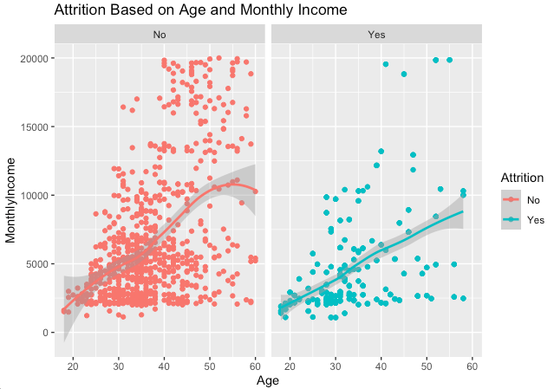
Stay or Leave?
Older employees more likely to have higher income and stay compared to younger employees
Younger employees more likely to leave in order to pursue higher income
Able to predict classification of attrition with 64% accuracy
FRITO LAY PROPERTY INFORMATION
9

Slide 10
Recommendations
Should offer flexible work options for employees that left due to business travel or overtime
Since younger employees are more likely to leave early in their career for other opportunities or better compensation, should offer higher salaries in entry level roles
Should assess job satisfaction of department/roles in more detail to understand if conditions or performance expectations can be improved to lesson attrition
FRITO LAY PROPERTY INFORMATION
10

Slide 11
Questions?
Additional questions can be directed towards:
jasmineo@smu.edu
Github Documentation:
Repository
https://github.com/jasmineo1/CaseStudy2DDS.git
Site
https://jasmineo1.github.io/index.html
YouTube Presentation:
https://youtu.be/ms2W7HdwB4o
FRITO LAY PROPERTY INFORMATION
11

Slide 12
Sources
Logo:
https://1000logos.net/frito-lay-logo/
FRITO LAY PROPERTY INFORMATION
12

