Slide 1
Beers and Brewery Data Analysis
Findings and Recommendations
Presented by: Jasmine O’Neal
Analysis By: Jasmine O’Neal and Connor Dobbs

Slide 2
Data Disclaimer
There were roughly 1000 missing IBU values for beers across the country
Three options considered on how to handle
Find missing values
Replace missing values with average
Remove from related analysis

Slide 3
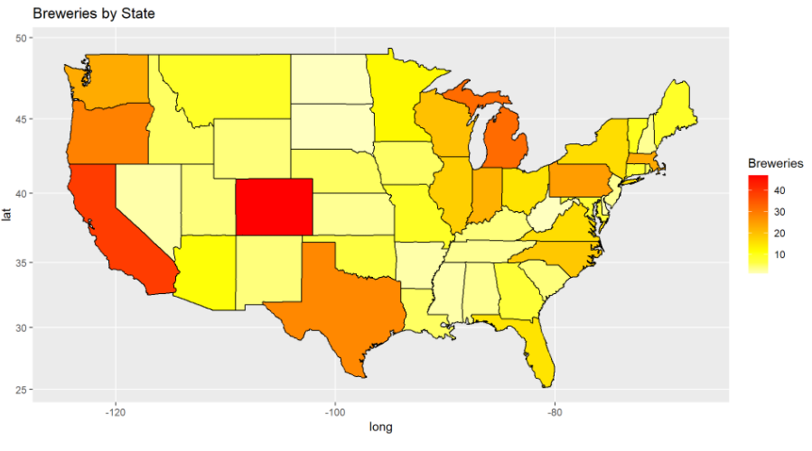
Breweries
Only 19 States had 10 or more unique breweries
Colorado has the most unique breweries at 47

Slide 4
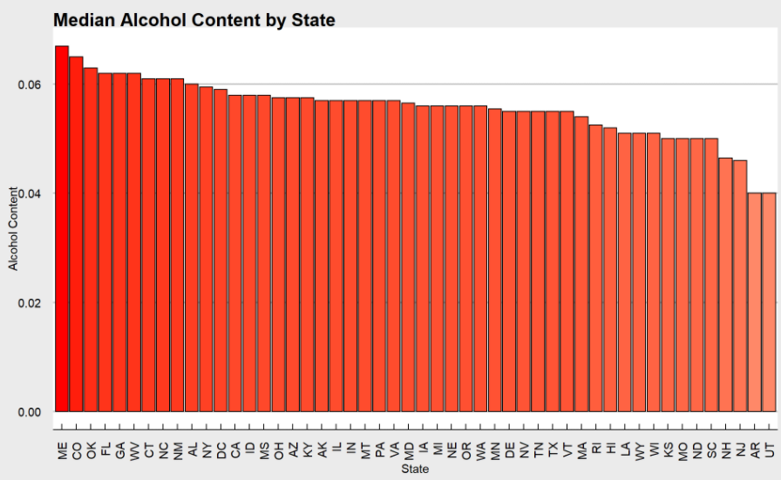
Median ABV State Trends
Median Alcohol content of beer varieties level between most states
Utah unsurprisingly the lowest due to legal limit of 4% by weight

Slide 5
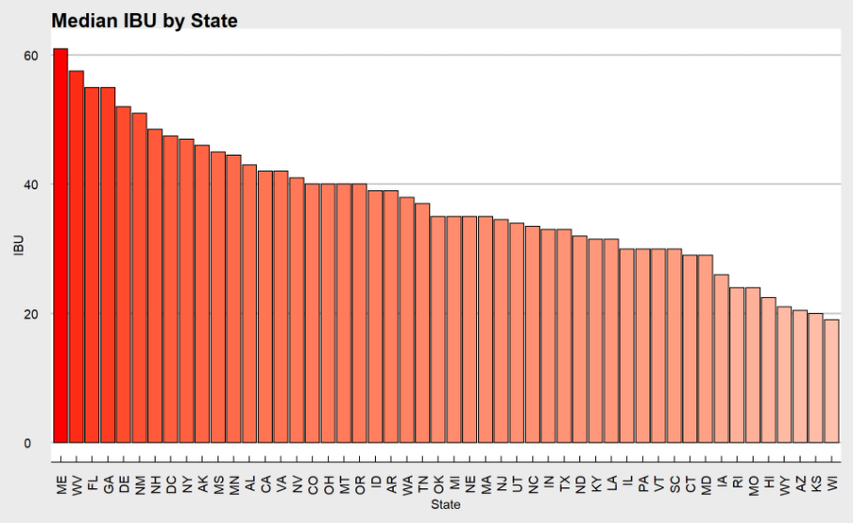
Median IBU State Trends
Larger variance than ABV
Maine has more than triple the median IBU than the lowest median state, Wisconsin

Slide 6
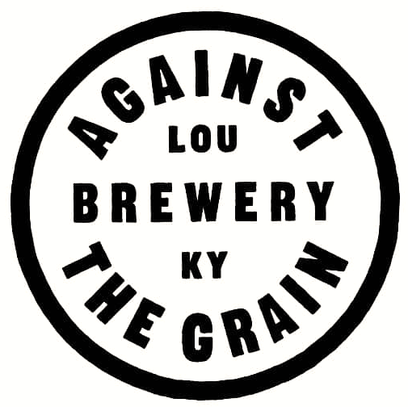
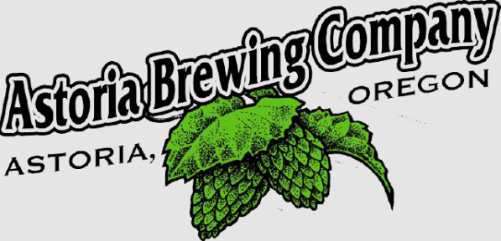
The Extremes
Against the Grain Brewery in Kentucky has the highest ABV beer offering at .125
Astoria Brewing Company in Oregon has the highest IBU beer offering at 138

Slide 7
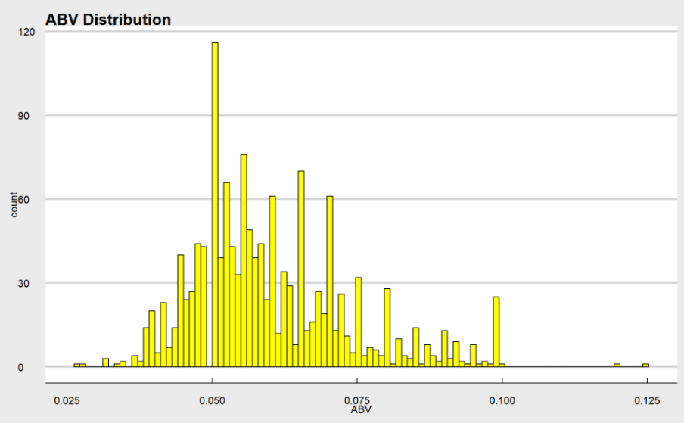
Alcohol Content Variability
Distribution is slightly right skewed
Median: .057 Mean: .059
Half of the values fall between .05 and .068
Lowest ABV: .027 Highest ABV: .125

Slide 8
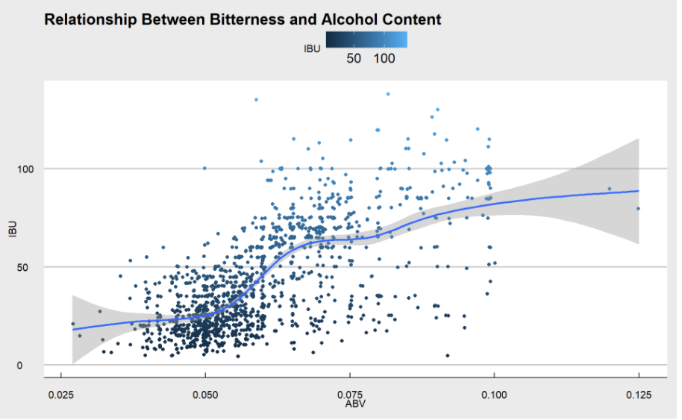
ABV vs IBU
Apparent correlation visible between ABV and IBU
As one increases the other tends to as well, particularly between an ABV of ~.05 and ~.08

Slide 9
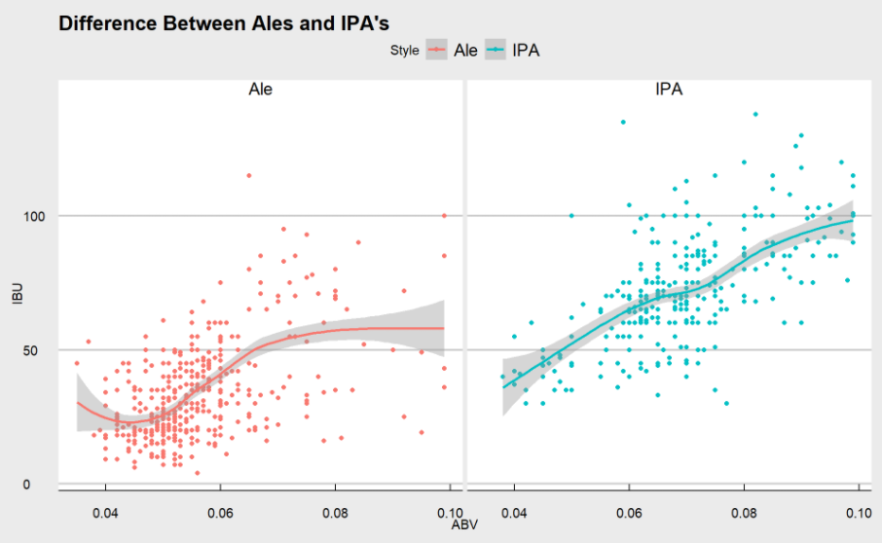
Ale or IPA?
IPAs tend to have a higher ABV and IBU
Allows us to predict the classification of an unknown beer with 85%+ accuracy

Slide 10
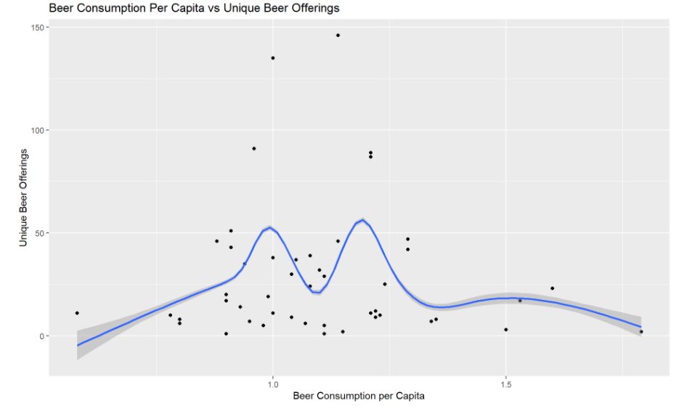
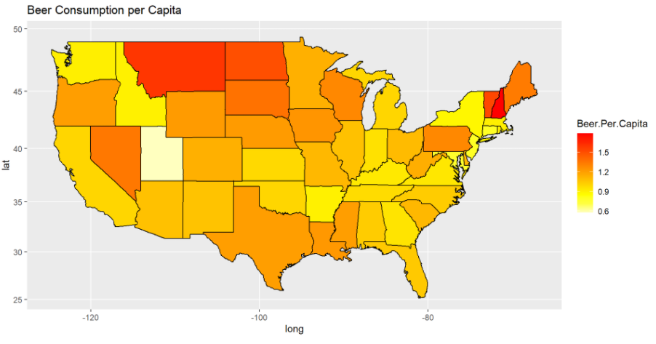
More Beer, More Better?
Compared alcohol consumption data to beer offerings by state
Found insufficient evidence of correlation between more local beer offerings and increased consumption
Notes:
Montana, Dakotas, Vermont, New Hampshire

Slide 11
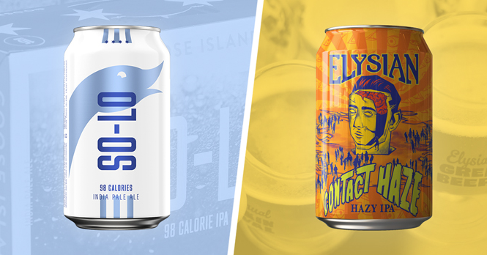
So, what next?
Increasing local beer offerings likely won’t lead to an increase in sales
Instead – capture more market share by continuing to acquire local craft breweries that offer IPAs in areas that prefer more bitter beer to appeal to unique market preferences
Notes:
Chicago’s Goose Island and Seattle’s Elysian Brewing

Slide 12
Questions?
Additional questions can be directed towards
dobbs@smu.edu
jasmineo@smu.edu
Github Documentation:
https://github.com/connordobbs/DDSProjectOne
YouTube Presentation:
https://youtu.be/B4LbjSFX9-A

Slide 13
Sources
Logos from:
https://us.budweiser.com/
https://atgbrewery.com/
https://astoriabrewingcompany.com/
Info on recent craft brewery acquisitions and image:
https://www.brewbound.com/news/anheuser-buschs-craft-division-bets-on-new-ipas-from-goose-island-elysian-in-2020/
National Institute on Alcohol Abuse and Alcoholism Consumption Data
https://pubs.niaaa.nih.gov/publications/surveillance115/tab2_18.htm

