Slide 1
📊 Supermarket Sales Business Dashboard
Total Transactions
1000
Total Revenue
Np.float64
(322966.749)
Average Rating
Np.float64
(6.9727)
Top Product Line
‘Food and beverages’

Slide 2
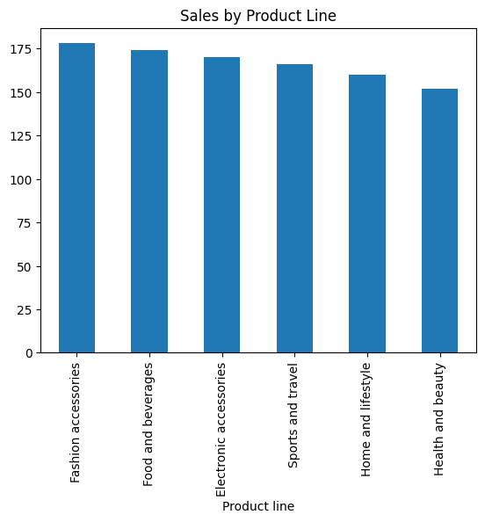
1️⃣ Revenue by Product Line (Bar Chart)

Slide 3
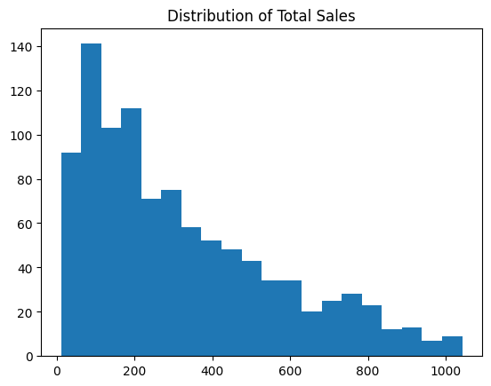
2️⃣ Monthly Revenue Trend (Line Chart)

