Slide 1
DIGITAL PORTFOLIO
STUDENT NAME: JASMINE R
REGISTER NO AND NMID: 2422k0712 / asbruaj2422k0712
DEPARTMENT: COMPUTER SCIENCE
COLLEGE/COLLEGE UNIVERSITY: AVP COLLEGE OF ARTS AND SCIENCE/BHARATHIYAR UNIVERSITY.

Slide 2

PROJECT TITLE
MY DIGITAL PORTFOLIO

Slide 3
AGENDA
Problem statements
Project overview
End users
•Tools and Technologies
Portfolio design and Layout
Features and Functionality
Results and Screenshots
Conclusion
GitHub link

Slide 4

PROBLEM STATEMENTS
Problem : Traditional paper or PDF resumes cannot effectively showcase skills, projects, and achievements
• Issue : Lack of interactivity, hard to update, difficult to share
• Need : A dynamic, attractive, and easily updatable digital portfolio platform for students, job seekers, freelancers, and professionals.
• Future Enhancements : AI-based resume building, analytics, and other advanced features.

Slide 5

PROJECT OVERVIEW
“This digital portfolio provides a short introduction about me, details of the projects I have worked on, my skills, and my contact information. It highlights my personal achievements, talents, and important efforts in a clear and simple way.

Slide 6
WHO ARE THE END USER
• 1. This portfolio can be used by students, job seekers, freelancers, and professionals.
2. It helps them to showcase projects, skills, experiences, and achievements in a clear way.
• 3. In short, it acts as a simple digital space to present personal and professional growth.

Slide 7
TOOLS AND TECHNOLOGIES
1. Modern Solution – Traditional resumes lack interactivity; digital portfolio shows skills & projects dynamically
2. Tools & Features – Built with HTML, CSS, JS, includes profile, projects, customization, easy sharing.
3. Impact & Future – Helps students & professionals stand out; future scope with AI and Analysis.

Slide 8
PORTFOLIO DESIGN AND LAYOUT
Home / About Me → Basic intro, photo, short description
Projects → Showcase with images, links, descriptionsSkills → Technical + soft skills with progress bars/icons
•Contact → Form / email / social media links Responsive Layout →Mobile + Desktop friendly.

Slide 9
FEATURES AND FUNCTIONALITY
Navigation Bar with Smooth Tools
Project Showcase with Images/Details
Interactive Elements (Hover Effects, Animations)
Contact Form (with Validation)
Responsive Design for All

Slide 10
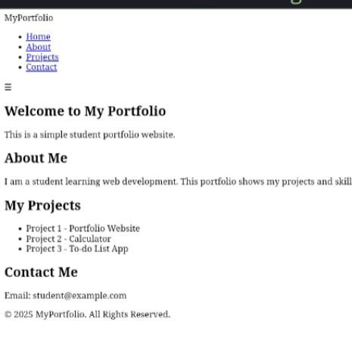
RESULTS AND SCREENSHOTS

Slide 11
CONCLUSION
Dynamicy and interactive digital portfolioResponsive design (desktop + mobile)Easy project showcase and contact form.
Students and job seekers can showcase skills easilyProfessionals can share work and get opportunitiesPromotes digital Literacy and growth.

