Slide 1
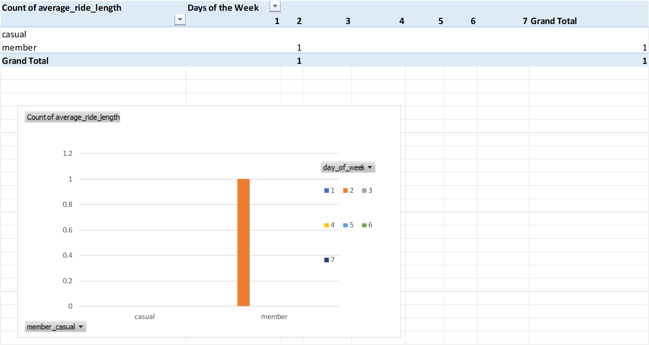
Count of average_ride_length using the divvy-tripdata set

