Slide 1
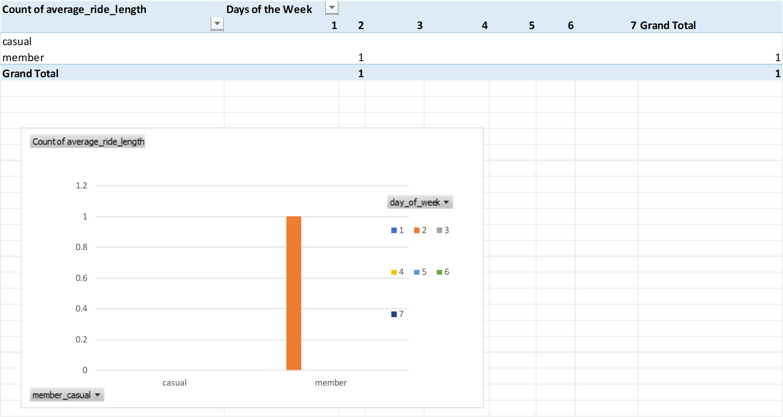
Count of average_ride_length

