Slide 1
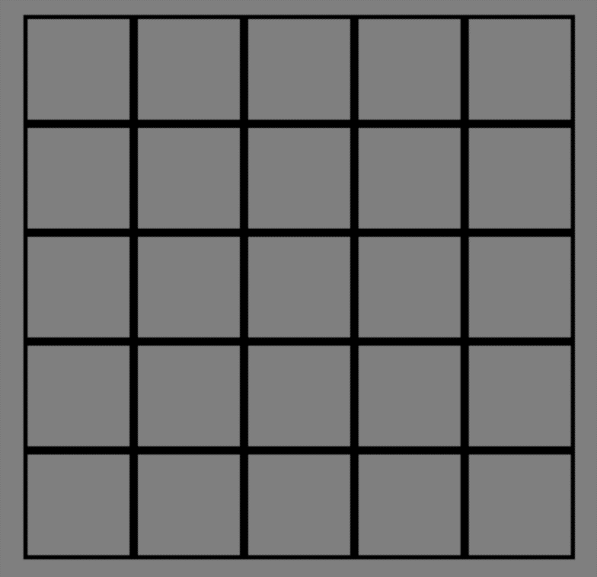
Hello and thank you for participating in this study!
In each trial of this task you will have a grid that looks like this:
It is your task to determine which of the two colours is the majority colour.
[Left Click to Go Back]
[Right Click to Continue]

Slide 2
On each trial, the grid will start off looking like this:
You will be flipping tiles on the grid to reveal the colour underneath.
[Left Click to Go Back]
[Right Click to Continue]

Slide 3
Click on a tile to reveal the colour underneath.
[Left Click to Go Back]
[Right Click to Continue]

Slide 4
The tile in black indicates the next tile to be revealed.
[Left Click to Go Back]
[Right Click to Continue]

Slide 5
To reveal its colour, use the left click button on your mouse.
[Left Click to Go Back]
[Right Click to Continue]

Slide 6
The next tile to be revealed will then be marked in black.
Click the left mouse button again to see the colour of the new tile.
[Left Click to Go Back]
[Right Click to Continue]

Slide 7
You can flip as many tiles as you want before making a final decision about which is the majority colour.
You can only click the left mouse button when there is a black square on the grid.
[Left Click to Go Back]
[Right Click to Continue]

Slide 8
When you are ready to answer, click on the square tile below the grid.
[Click to Continue]

Slide 9
To choose your answer, click your choice of colour below the grid.
[Click to Continue]

Slide 10
When you ready to answer, press the space bar with your left hand.
.
Answer
Flip
[Left Click to Go Back]
[Right Click to Continue]

Slide 11
If you think the left colour is the majority, left click on your mouse.
[Left Click to Go Back]
[Right Click to Continue]

Slide 12
If you think the right colour is the majority, right click on your mouse.
[Left Click to Go Back]
[Right Click to Continue]

Slide 13
This trial is an example of the “Fixed” mode. In this game mode, if you correctly choose the majority colour, you will win 100 points, regardless of the number of tiles you have turned over. However, if your choice is incorrect, you will lose 100 points, also regardless of the number of tiles seen.
Occasionally, you will be asked about how confident you are on which is the majority colour.
[Left Click to start the Practice Trial]

Slide 14
The next trials are in “Fixed” mode.
You will not lose any points for any tile you choose to flip over.
[Left Click to continue when you are ready]

Slide 15
The next trials are in “Decreasing” mode.
You will lose 10 points for every tile you choose to flip over.
[Left Click to continue when you are ready]

Slide 16
This trial is an example of the "Decreasing" mode. In this game mode, the number of points you earn for a correct answer will vary: if you correctly choose the majority colour, you will win 10 points for every uncovered tile remaining on the board. However, if your choice is incorrect, you will lose 100 points, regardless of the number of tiles you have seen.
Occasionally, you will be asked about how confident you are on which is the majority colour.
[Left Click to start the Practice Trial]

Slide 17
The next series of blocks will be in the ”Forced" mode. In this game mode, if you correctly choose the majority colour, you will win 100 points. If your choice is incorrect, you will lose 100 points. However, you will not get to choose how many tiles you flip before answering. Instead, you will flip tiles until you will be forced to give a response.
You will now practice the task for a few trials.
[Click to start the Practice Phase]

Slide 18
Well done!
Now the Experimental Phase will begin.
[Left Click to Continue]

Slide 19
The End!
Thank you so much for participating!

