Slide 1
Big Market Data Analysis
Prepared By: Jasmine Yadav

Slide 2
INTRODUCTION
Big market can be defined as the area of economic activity available supply of or potential demand for specified goods or services.
Data analysis helps this business holders to get a better understanding of market situations.
For example, analysis of customer purchasing behavior helps to identify the products sold most and thus produces those products accordingly.
This also helps to get ahead of other competitors.

Slide 3
OBJECTIVES
This helps to get ahead of their competitors.
This helps in making better business decisions.
This helps in analyzing customer trends and satisfaction, which can lead to new and better products and services.
It gives better insight of customers base.
It helps in easy flow for managing resources.

Slide 4
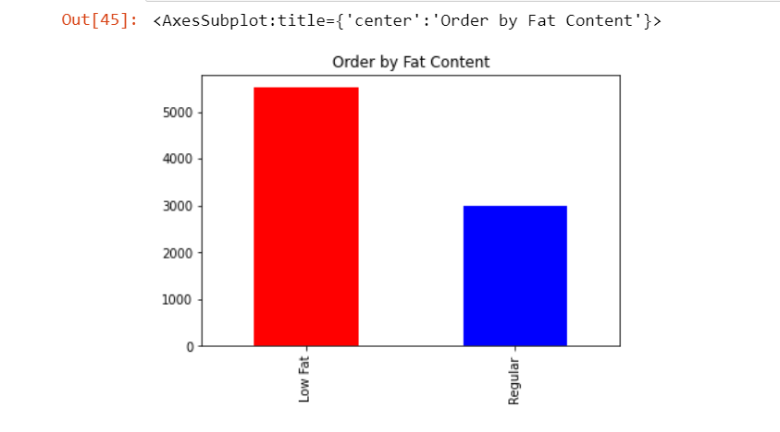
ORDER BY FAT CONTENT
We can see that the number of 'Low fat' food orders are comparatively higher than the 'Regular' food orders.
This finding shows that people are more conscious about their health and prefer to eat healthy.

Slide 5
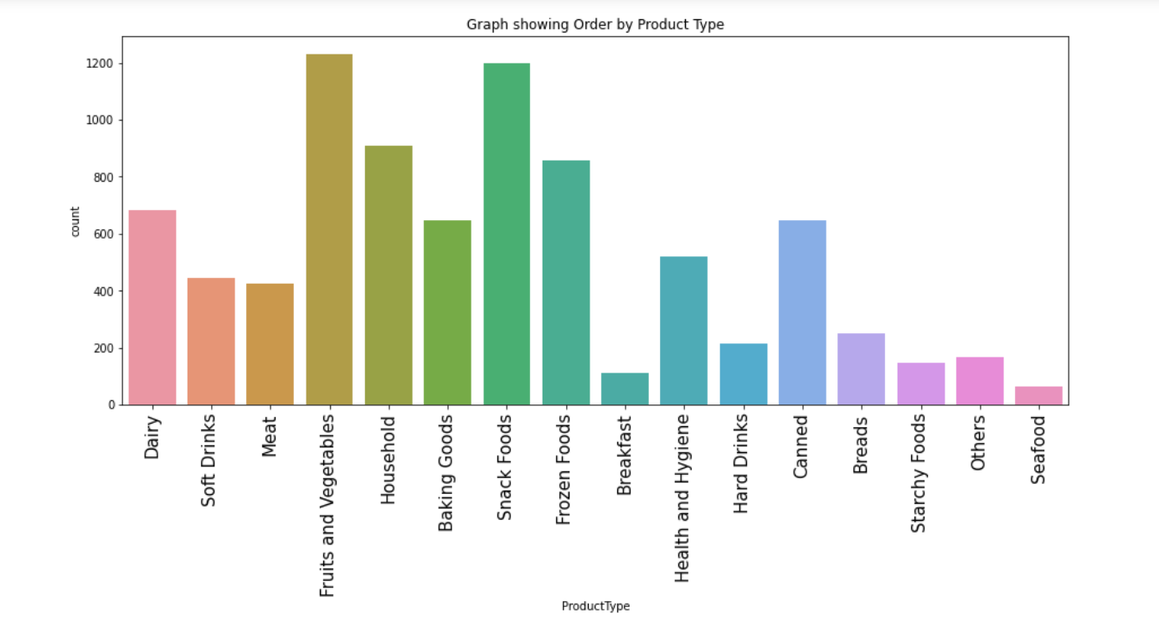
ORDER BY PRODUCT TYPE
We can see that the 'Fruits and Vegetables' are the type of product that are ordered in highest number.
Also, 'Sea food' are the product type ordered in lowest number.
This also results to the conclusion that people prefer eating more healthy.

Slide 6
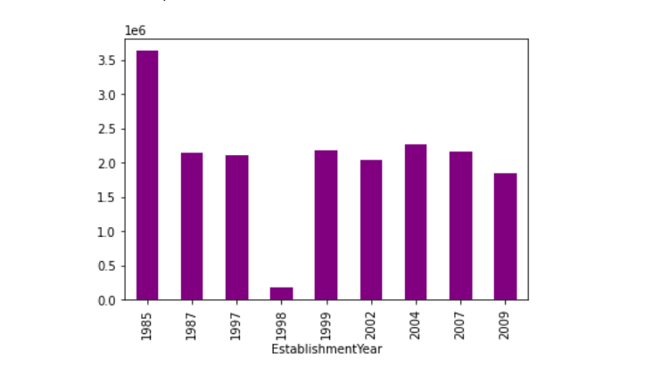
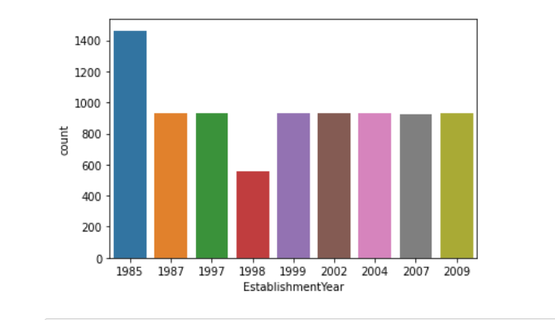
OUTLET SALES BY YEAR
The above graphs show that the sales declined in the year 1998.

Slide 7
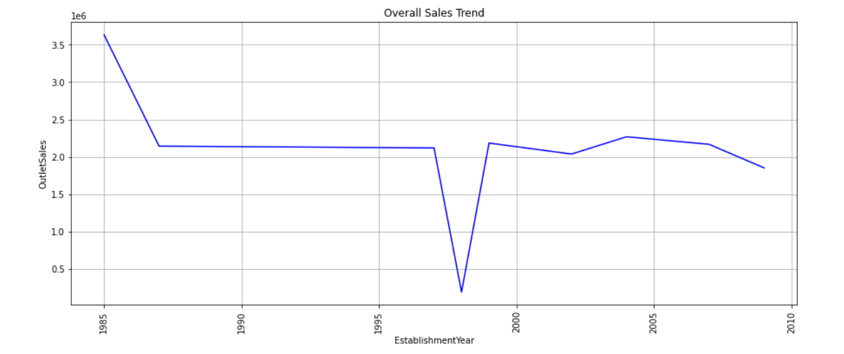
OVERALL SALES TREND

Slide 8
THE END.

