Slide 1

Estimation of Knee Adduction Moment During Walking Using Wearable Sensor Data with an Optimized Sequence-based Artificial Recurrent Neural Network
Yu-Pin Liang, DPT
Li-Shan Chou, PhD
Motion Analysis Research Group, Department of Kinesiology, Iowa State University

Slide 2
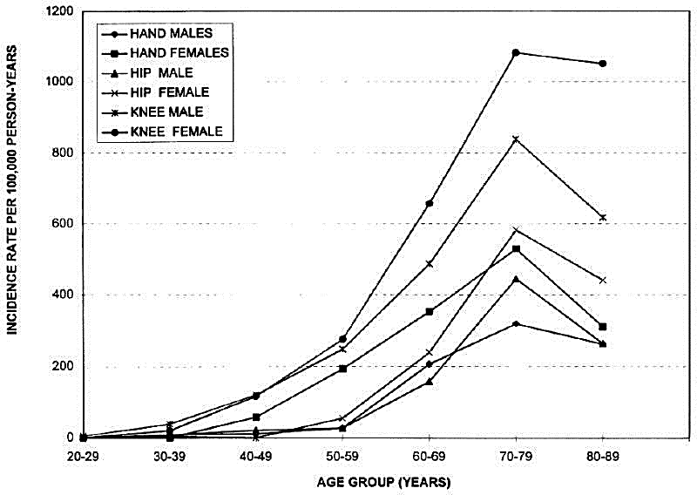
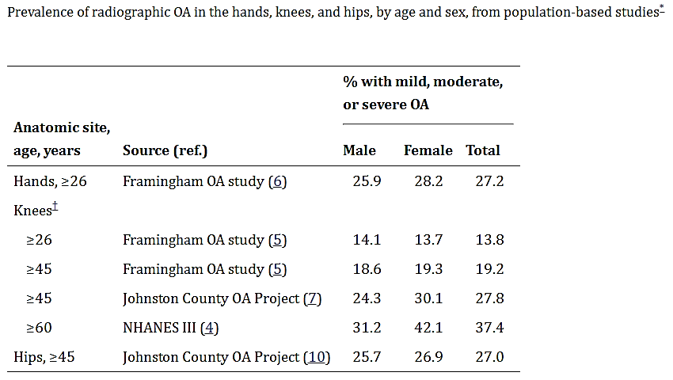
Knee Osteoarthritis
Knee joint is most commonly affected by osteoarthritis
(Oliveria et al., 1995)
Nearly a third of US citizens affected by osteoarthritis of knee by age 70
(Lawrence et al., 2008)

Slide 3
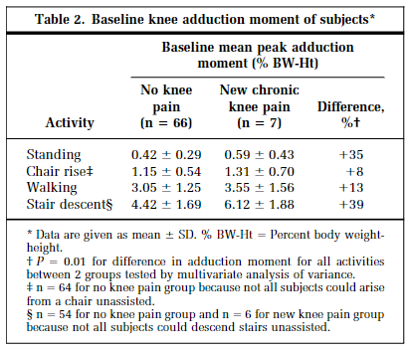
Knee Osteoarthritis & KAM
Peak knee adduction moment (KAM) during walking is a sensitive biomechanical marker for predicting the risk of knee osteoarthritis
(Amin et al., 2004)

Slide 4
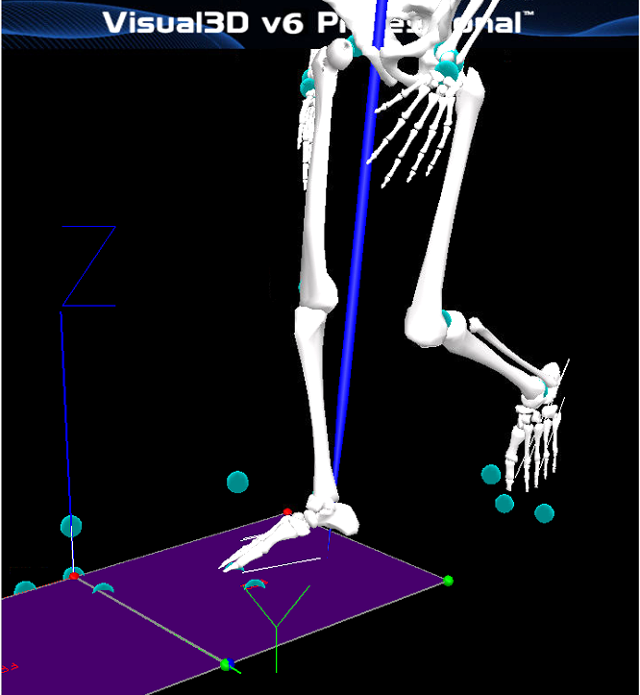
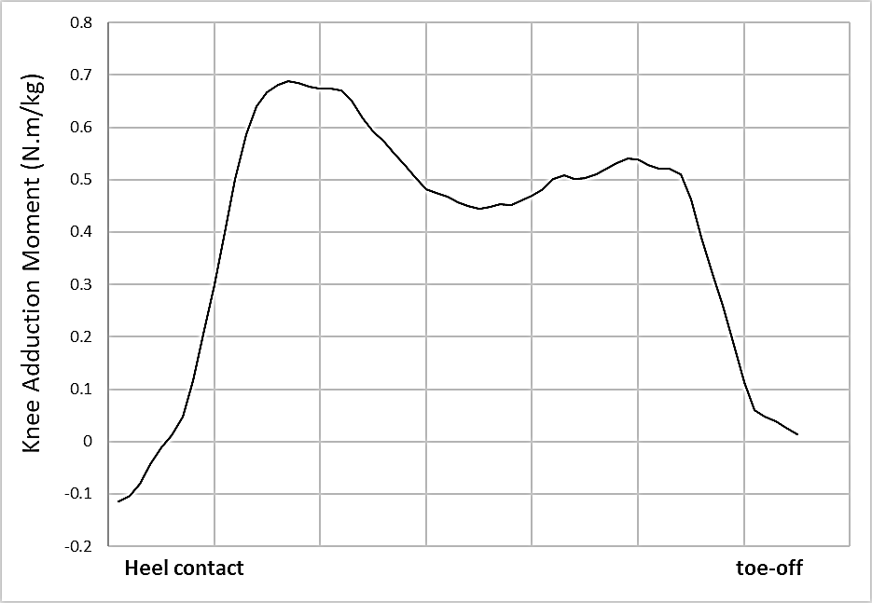
Measure Knee Adduction Moment (KAM)
However, measuring KAM requires for equipment and technical processing significantly.
Restricted in Lab environment

Slide 5
Solution
Wearable Sensors
Sequence-based Artificial Recurrent Neural Network (RNN)
Long Short-term Memory (LSTM)
Predict Knee Adduction Moment

Slide 6
Purpose
The purpose of this study was to estimate KAM during walking using data measured from accelerometers with the RNN-LSTM modeling.

Slide 7
Lab Setting & Participant
12 males and 12 females (normal and over-weight)
Motion data from 9 walking trials with three different walking speeds (self-selective, slow and fast) collected using a 12-camera motion analysis system.
Two tri-axial accelerometers were placed at the femur epicondyle and the condyle of the tibia and fibula
KAM was calculated with Visual3D

Slide 8
LSTM model
Dataset: Training (80%), Testing (20%)
Training dataset: K-Fold Cross Validations, k=6
Feature selection: Six variables available for input features (2 sensors x 3 axes)
6 features -> models with 5 features -> kept combination yielded the lowest root mean square error (RMSE) -> models with 4 features …
Model with the combination of lowest number of features that delivers lowest RMSE was selected as optimal input vectors

Slide 9
K-Fold Cross Validations, k = 6
DATASET
TRAINING SET
TESTING SET
1st iteration
.
.
.
.
.
.
6th iteration
 |  |  |  |  | Validation
 |  |  |  | Validation
 |  |  | Validation
 |  | Validation
 | Validation
Validation

Slide 10
LSTM model
Principal component analysis (PCA) to reduce dimensions
Output vector: KAM during the stance phase.
Model: three LSTM blocks followed by a fully connected layer
Dropout probability: 0.2; mini-batch size: 5
Learning rate: 0.01
Maximum number of epochs: 1000
RMSE was used to estimate how well the model fit testing dataset

Slide 11
Results
Result from K-Fold Cross Validations
Figure1. Mean RMSEs for models with different combinations of input features while performing the cross-validation.

Slide 12
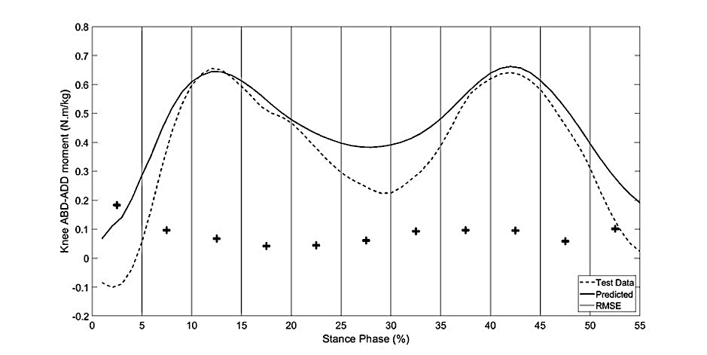
Results
Model result from lowest RMSE input vector:
- Lat_AP, Lat_ML, Lat_SI, and Med_ML accelerations
RMSE = 0.0993
Figure2. Representative plots the predicted and test data of KAM and overall RMSE in every 5% of stance phase.

Slide 13
Discussion
Walking speed -> strong association with peak KAM -> Lat_AP
Vertical ground reaction force -> knee joint moment -> Lat_SI
Discrepancies are relatively small for peak KAMs, which are most important indicator for knee osteoarthritis.
The combination of wearable sensor data and RNN-LSTM modeling could potentially eliminate barriers from clinician's access to the informative gait kinetic data.

Slide 14
THANK YOU FOR YOUR LISTENING
Any question?
Email: yupinl@iastate.edu

