Slide 1
Database Design
A database is a collection of data that represents some aspects of real world called “miniworld” or ”enterprise”
What data to store?
Database design starts from understanding user requirements
Understanding…hmm?
Imagine you are designing databases for many customers, with different requirements for sure!
Notes:
To understand, we need to communicate. The problem is how. We need to learn how to talk and how to listen. We human have a variety of ways of communications, such as writing, talking, video, gestures. Here we want an approach that allows us to collect information as much as possible, as flexible as possible, and also as accurately as possible. But unfortunately flexibility and accuracy is often a dilemma.

Slide 2

Communication is hard, very hard
Can you describe this picture?
Can your audience understand what you are talking about?
Imagine your job is to describe pictures (many!!), or to listen and understand the descriptions
What would you do to make your life easier?
This is a million $$$ question.
Notes:
To understand, we need to communicate. The problem is how. We need to learn how to talk and how to listen. We human have a variety of ways of communications, such as writing, talking, video, gestures. Here we want an approach that allows us to collect information as much as possible, as flexible as possible, and also as accurately as possible. But unfortunately flexibility and accuracy is often a dilemma.

Slide 3
How about doing this?
There are 3 persons
Person 1 is a boy
Person 2 is a lady
Person 3 is a man
There is 1 dog
Dog 1 is black
Person 1 and Person 2 are holding hands
Person 2 and Person 3 are holding hands
Person 1 holds the leash of dog 1
For each picture, always follow two steps to describe:
What objects the pictures have?
What interactions these objects have to each other?
Notes:
To understand, we need to communicate. The problem is how. We need to learn how to talk and how to listen. We human have a variety of ways of communications, such as writing, talking, video, gestures. Here we want an approach that allows us to collect information as much as possible, as flexible as possible, and also as accurately as possible. But unfortunately flexibility and accuracy is often a dilemma.

Slide 4
Entity-Relationship (ER) model
ER is a high-level conceptual data model
What data to store?
Database design starts from understanding user requirements
Whatever we do, we want two questions answered:
What entities does this mini-world have?
What relationships exist among these entities?
Notes:
To understand, we need to communicate. The problem is how. We need to learn how to talk and how to listen. We human have a variety of ways of communications, such as writing, talking, video, gestures. Here we want an approach that allows us to collect information as much as possible, as flexible as possible, and also as accurately as possible. But unfortunately flexibility and accuracy is often a dilemma.

Slide 5
Basic terms and notations
An entity is a uniquely identifiable object that exists on its own (e.g., an employee, a department)
Entities have attributes
An attribute is a key attribute if its values are distinct for each individual entity
There may have multiple key attributes
Similar entities (having same attributes) form an entity set
name
name
ssn
dob
did
address
Employees
Departments
Notation
an entity set : a rectangle
an attribute: a circle and a line connected to a rectangle
a key attribute: underlined
Text
there are a number of Entities E, each of which has attribute A1, A2, …, and An, where Ai is unique

Slide 6
Relationship: Association among two or more entities.
Example: Attishoo works in the Pharmacy department.
Relationship Set: Collection of similar relationships.
name
name
since
did
address
ssn
dob
Employees
works-in
Departments
Notation
a relationship set: a diamond
Every participating entity is connected to it by a dotted edge
Every attribute is also connected to it by an edge
an attribute: a circle and a line connected to a rectangle
Text
An Ex may “have to do with” an Ey, where the relationship has attributes A1, A2, …, and An
An Ex and an Ey may participate in a relationship called Rz, which has attributes A1, A2, …, and An

Slide 7
name
name
since
did
address
ssn
dob
Employees
works-in
Departments
e1
e2
e3
e4
e5
e1, d1, 01/01/1998
e3, d3, 01/05/1985
d1
d2
d3
Notes:
Entities + Relationships = World. A world having only entities is a dead world. The relationships among these entities bring the world alive.
Examples: university
faculty
students
buildings
courses
vehicles
research projects
...
Now relationships among these entities

Slide 8
two entity sets may have different relationships
name
name
since
did
address
ssn
dob
Employees
works-in
Departments
manages
since

Slide 9
Entities in a same set can participate in some relationship
name
name
since
did
address
ssn
dob
Employees
works-in
Departments
super-visor
subor-dinate
manages
Since
Reports_To
since

Slide 10
more than two entity sets may participate
in a same relationship set
name
title
terms
cid
ssn
dob
instructors
teach/enroll
course
i1
i2
c1
c2
c3
i1, s1, c1
i1, s2, c1
i2, s3, c1
Instructor i teaches student s enrolled in course c
s1
s2
s3
students
ssn
name
dob

Slide 11
How about this ER diagram? How is it different from the previous one? It may not tell who teach which students. For example, who is teaching s3?
name
title
terms
cid
ssn
dob
instructors
teach
course
c1
c2
c3
i1
i2
i1, c1
i2, c1
Enroll]
s1, c1
s2, c1
s3, c1
Instructor i teaches student s enrolled in course c
i1, s1, c1
i1, s2, c1
i2, s3, c1
s1
s2
s3
students
ssn
name
dob

Slide 12
A relationship may be participated by any number of entity sets
name
title
terms
cid
ssn
dob
teach-
enroll-
use
instructors
course
books
students
bid
title
ssn
name
dob

Slide 13
So far, only two notations E and R, but they are very powerful in describing a “world”. When designing a database, think about these two questions and answer in corresponding grammars
What entities it has
There are a number of E_1, each of which has attributes A_1, A_2, ..., and A_n, where A_i is unique, A_j is unique, and ..., so on; ……
What relationships exist among these entities
E_x “has to do with” E_y, where the relationship has attributes A_1, A_2, ..., and A_n; ……
Example: A database for university
E: faculty, students, courses, buildings, vehicles, research projects, departments, parking lots ...
R: A faculty teaches some students in buildings...

Slide 14
The two questions are fundamental – most descriptions in user requirements can be translated into
E: There are a number of Entities E, with attributes a1, …, an
R: Entity A has a relationship with Entity B
However, there are usually other information, e.g.,
Every student must take at least one course
A vehicle can be registered under only one driver
A vehicle must be registered under one and only one driver
As such, we want to expand the basic form of ER to express participation constraints
Things start to get complicate!!

Slide 15
Uni-participation (also called key constraint)
Each entity in an entity set can participate in at most one relationship in a relationship set
Notation: u
If there is no such constraint, then it is called multi-participation, denoted as m
m
u
Employees
Manages
Departments
e1
e2
e3
e4
e5
e1, d1
e1, d3
e2, d2
e1, d1
e2, d1
d1
d2
d3
which one allowed?
A department can participate in relationship “manages” at most one time
➔Every department can have at most one manager (but does not have to)

Slide 16
Total participation
Every entity in an entity set must participate in a relation set
Notation: solid line
If there is no such constraint, then it is called partial-participation, denoted as dotted line
m
m
Employees
Manages
Departments
e1
e2
e3
e4
e5
e1, d1
e1, d3
e1, d1
e2, d1
e2, d3
e3, d3
d1
d2
d3
which one allowed?
Every department must participate in relationship “manages”
→ Every department must have at least one manager

Slide 17
Uni-participation and total participation
Every entity in an entity set must participate in a relation set and participate only once
Notation: u and solid line
m
u
Employees
Manages
Departments
e1
e2
e3
e4
e5
e1, d1
e1, d3
e1, d1
e2, d1
e2, d3
e3, d3
d1
d2
d3
which one allowed?
Every department must participate in relationship “manages” and only once
→Every department must have one and only one manager

Slide 18
Quick Review: Participation Constraint
Question 3: Is there any participation constraint on relationships?
Uni-participation: An entity can participate in a relationship at most once
Total-participation: Every entity in an entity set must participate in a relationship
A combination of both: Every entity in an entity set must participate in a relationship but only once

Slide 19
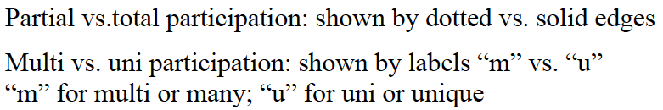
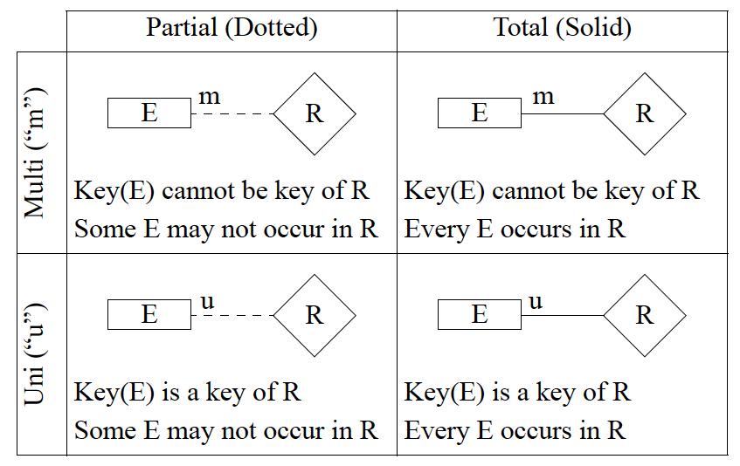
Notations used in this class

Slide 20
No standards on notations: Different notations may be used by different books, companies, or tools
Partial vs. total participation: shown by a thin line vs a thick line
Multi vs uni participation: shown by a line without vs with an arrow
Partial ( thin line)
Total ( thick line)
Multi ( no arrow)
R
E
R
E
Some E may not occur in R
Every E occurs in R
Uni (arrow)
E
R
E
R
An E may occur in R only once
Every E must occur in R and occur only once

Slide 21
A quick review
What E does it have?
There are a number of Ex, each of which has attributes A1, A2, …, An, where Ai is unique
:::
What R does it have?
Ex and Ey participate in relationship R, which has attribute A1, …, An
:::
Any constraints on R?
At most and at least on an entity’s participation in a relationship
Uni-participation (at most one time
Total-participation (at least one time)
Key terms
Entity
Attribute
key attribute
Relationship
Constraint
Uni-participation
Total-participation

Slide 22
Problem 1
Multiple entity sets participate
in a same relationship set
It records the relationships among students, instructors, and courses
students
instructors
teach/enroll
courses
instructors
teach
course
enroll
students
It records the relationships between instructors and courses, and the relationships between course and students, BUT not the relationships between instructors and students

Slide 23
Problem 2
Entity set or attribute
classroom
Here classroom is an attribute for relationship teach. It can have any value.
instructors
teach
courses
i1
i2
i1, c1, room1
i1, c2, roomX
c1
c2
r1
r2
Here classroom is an entity set, which has a number of members. Only these members can participate in relationship teach.
classroom
i1
i2
c1
c2
instructors
teach
courses
i1, c1, r1
i1, c2, r2

Slide 24
Problem 3
Constrains
m
m
student
register
club
m
m
student
register
club
u
m
student
register
club

Slide 25
E-R Model Exercises
Read an ER diagram
Draw an ER diagram

Slide 26
name
name
since
did
address
ssn
dob
m
m
Employees
works-in
Departments
Two entity sets:
Employees with attributes SSN, name, and dob, where SSN is unique
Departments with attributes did, name, address, where did is unique
One relationship set
“works-in” between Employees and Departments, with attribute since
Constraint
An employee can participate in “works-in” one or more times, or does not participate at all
multi- and partial participation
A department can participate in “works-in” one or more times, or does not participate at all
multi- and partial participation

Slide 27
name
name
since
did
address
ssn
dob
m
u
Employees
works-in
Departments
Two entity sets:
Employees with attributes SSN, name, and dob, where SSN is unique
Departments with attributes did, name, address, where did is unique
One relationship set
“works-in” between Employees and Departments, with attribute since
Constraint
An employee can participate in “works-in” one or more times, or does not participate at all
multi- and partial participation
A department can participate in “works-in” at most once
uni- and partial participation
Semantically: a department can have at most one employee

Slide 28
name
name
since
did
address
ssn
dob
m
u
Employees
works-in
Departments
Two entity sets:
Employees with attributes SSN, name, and dob, where SSN is unique
Departments with attributes did, name, address, where did is unique
One relationship set
“works-in” between Employees and Departments, with attribute since
Constraint
An employee can participate in “works-in” one or more times, or does not participate at all
multi- and partial participation
Every department must participate in “works-in” once and only once
uni- and total participation
Semantically: a department can have at most one employee and only one employee

Slide 29
name
name
since
did
address
ssn
dob
u
u
Employees
works-in
Departments

Slide 30
name
name
since
did
address
ssn
dob
u
u
Employees
works-in
Departments
Two entity sets:
Employees with attributes SSN, name, and dob, where SSN is unique
Departments with attributes did, name, address, where did is unique
One relationship set
“works-in” between Employees and Departments, with attribute since
Constraint
An employee can participate in “works-in” at most one time
uni- and partial participation
Semantically: an employee can work in at most one department
Every department must participate in “works-in” once and only once
uni- and total participation
Semantically: a department can have at most one employee and only one employee

Slide 31
Drawing ER diagram
What entity sets?
attributes, key attribute
What relationship sets?
attributes
ISA?
What constraints?
uni- vs. multi-participation
total vs. partial participation

Slide 32
Exercise 1
A company has a number of employees. The attributes of EMPLOYEE include Employee_ID (identifier), Name, Address, and Birthdate.
The company also has several projects. Attributes of PROJECT include Project_ID (identifier), Project_Name, and Start_Date.
Each Employee may be assigned to one or more projects, or may not be assigned to a project.
A project must have at least one employee assigned, and may have any number of employees assigned.
An employee’s billing rate may vary by project, and the company wishes to record the applicable billing rate (Billing_Rate) for each employee when assigned to a particular project.

Slide 33
Exercise 2
A university has a large number of courses in its catalog. Attributes of COURSE include Course_number (identifier), Course_name, and Units.
Each course may have one or more different courses as prerequisites, or may have no prerequisites. Similarly, a particular course may be a prerequisite for any number of courses, or may not be prerequisite for any other course.

Slide 34
Exercise 2’
There are a number of people, attributes of which include SSN, name, and gender.
A person may have to do with another person, e.g., sharing common interests such as fishing, soccer, and so on.
Is this ER-diagram efficient to implement? How about searching of all persons who have to do with a given person?
An alternative solution: using each person’s id as a table name and let the table store the people s/he has to do with and the relationship.
Yet this is no longer an ER diagram
Another solution is Graph model (e.g., Neo4J)

Slide 35
Exercise 3
A hospital has a large number of registered physicians and patients.
Attributes of PHYSICIAN include Physician_ID (identifier) and Specialty.
Attributes of Patients include Patient_ID (identifier) and Patient_Name.
Any patient who is admitted must have exactly one admitting physician. A physician may optionally admit any number of patients.
Once admitted, a given patient must be treated by at least one physician. A particular physician may treat any number of patients, or may not treat any patients.
Whenever a patient is treated by a physician, the hospital wishes to record the details of the treatment (Treatment_Detail). Components of Treatment_Detail include Date, Time, and Results.

Slide 36
A quick review
Q1: What E does it have?
Q2: What R does it have?
Q3: Any constraints on R?
Uni-participation vs. multi-participation
Total-participation vs. partial-participation
One more question, a special kind of relationship :
Q4: Is there any relationship that is ISA?

Slide 37
ISA (`is a’) Hierarchies
If we declare A ISA B, every A entity is also considered to be a B entity.
Reasons for using ISA:
To add attributes specific to a subclass.
To identify entities that participate in a relationship.
name
ssn
lot
Employees
hourly_wages
hours_worked
ISA
contractid
Hourly_Emps
Contract_Emps
Overlap constraints:
Can Joe be an Hourly_Emps as well as a Contract_Emps entity? (Allowed/disallowed)
Default value: no overlap;
Otherwise, write Hourly_Emps OVERLAPS Contract_emps
Covering constraints:
Does every Employees entity also have to be an Hourly_Emps or a Contract_Emps entity? (Yes/no)
Default value: no;
Otherwise write Hourly_Emps and Contract_Emps COVER Employees

Slide 38
Exercise 4
A university has a number of people
attributes: SSN, name, address
A person can be a faculty, a student, a staff
faculty attributes: rank, salary, research areas, grants
student attributes: first enrollment date, gpa
staff attributes: rank, salary, specialty
A person must be either a faculty, a student, and/or a staff
A student can be a staff and vice versa
A facutly can be a student and vice versa

Slide 39
Exercise 5
Construct an E-R diagram for the instructor of the COMS DB course to record the following information.
The instructor has a number of students and a number of teaching assistants (TAs)
Each student has SSN, CName, and Email
Each TA has a TName and Email
Each student is assigned with one and only one TA as his/her primary TA
A TA may or may not have any student
The course has a number of tasks (e.g., homework, project, exam), each of which has a TaskName, DueDate, and Points
A student may take several tasks and each task must be graded by at least one TA. The date that a student submits a task and the points they receive must be recorded.

Slide 40
ER design is subjective. There are often many ways to model a given scenario!
Analyzing alternatives can be tricky, especially for a large enterprise. Common choices include:
Entity vs. attribute, entity vs. relationship, binary or n-ary relationship, whether or not to use ISA hierarchies.
ER diagrams can use different notations, but use the same concept.
Several software tools are available for creating ER diagrams: IBM Rational Rose, Microsoft Visio
Question to think
Is there anything that cannot be described by ER model?

