Slide 1
What operators you want for table?
Definition
Create a table
Drop a table
Alter a table
Manipulation
Insert a record
Delete a record
Search a record
Update a record
Join two tables
What else?
How are they actually executed?

Slide 2
Relational Algebra
A user query is expressed using SQL or other languages, ideally natural languages
A parsed query is essentially treated as a relational algebra expression
Selection (б)
Join ( )
Project(Π)
Union, intersection and difference, cross product
Query optimizer
Enumerates the possible plans to evaluate expression,
Select a small subset of these plans and estimate their cost
User Query
Query Parser
Parsed Query
Query Optimizer
Plan
Generator
Plan Cost
Estimator
Catalog
Manager
Query Plan Evaluator

Slide 3
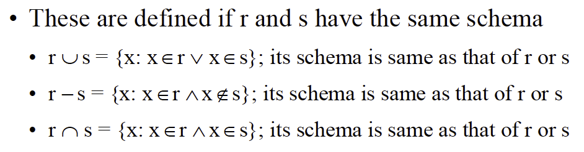
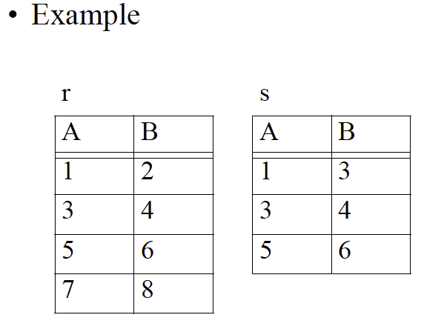
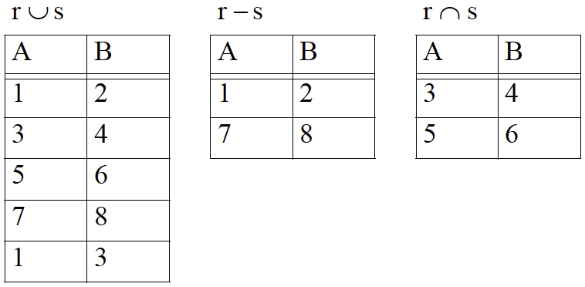
Union, Intersection and Difference Operators

Slide 4
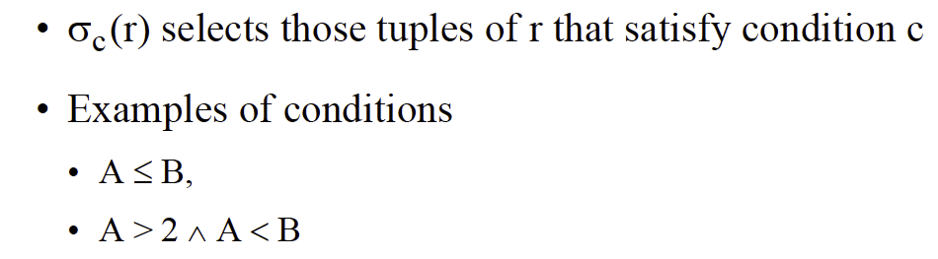

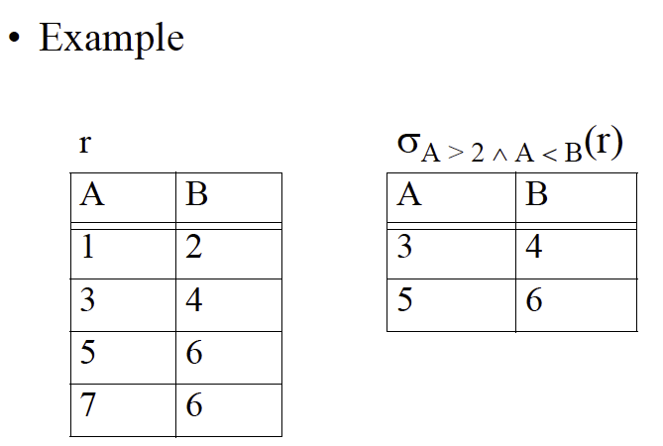
Select Operator

Slide 5
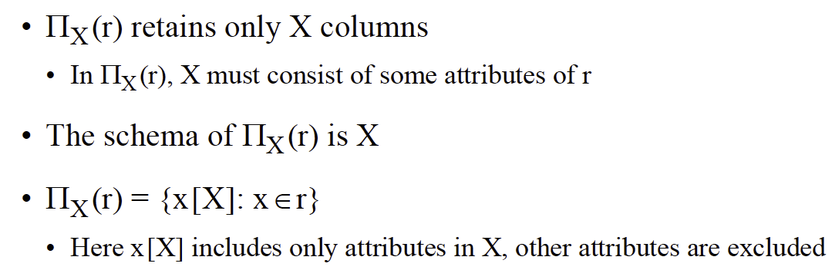
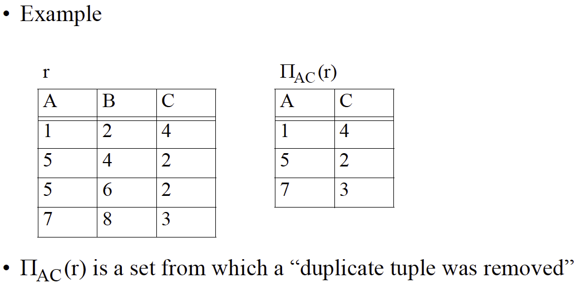
Project Operator

Slide 6
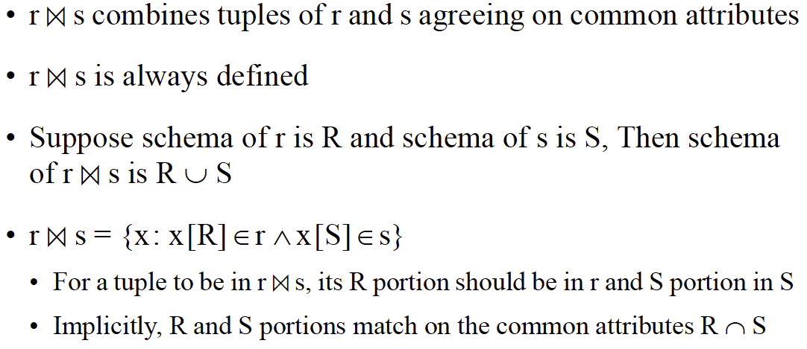

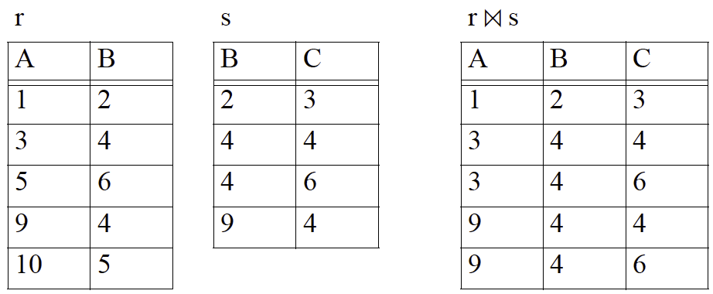
Natural Join Operator

Slide 7
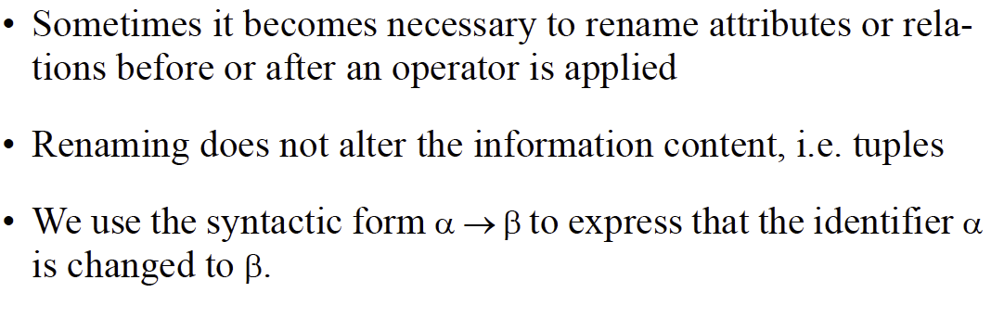
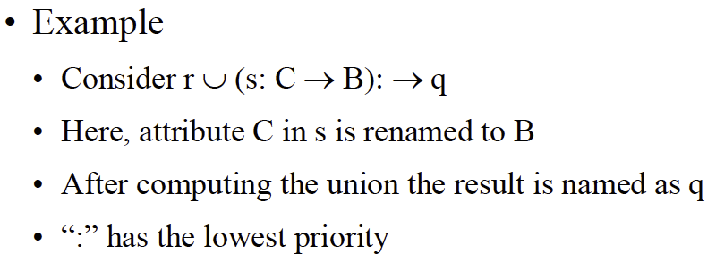
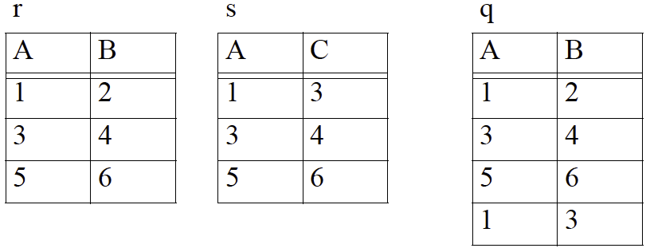
Renaming Operator

Slide 8
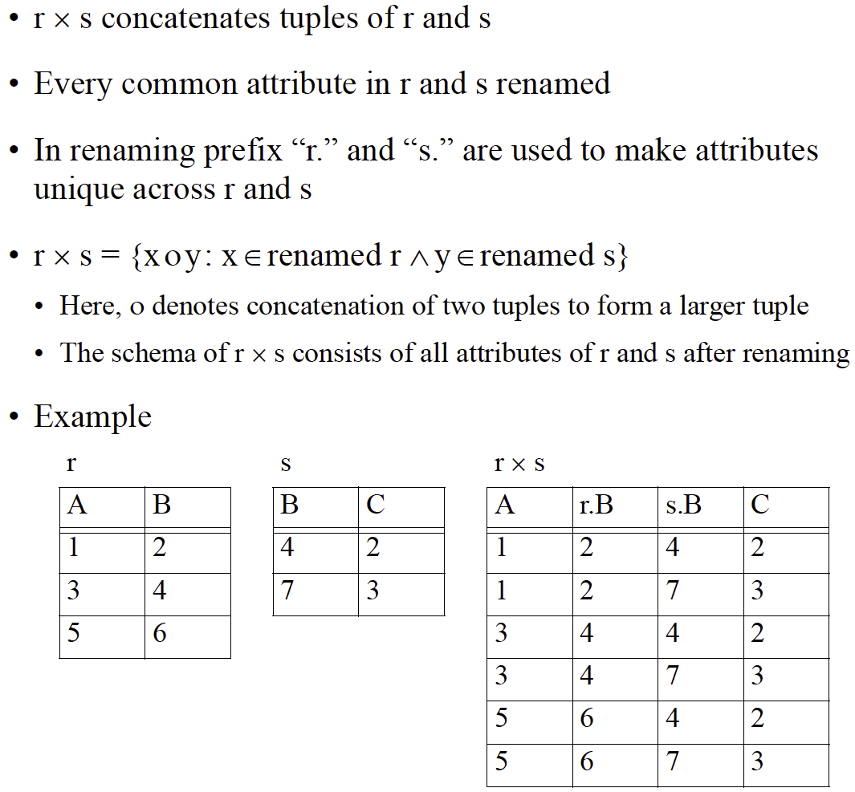
Cross Product Operator

Slide 9
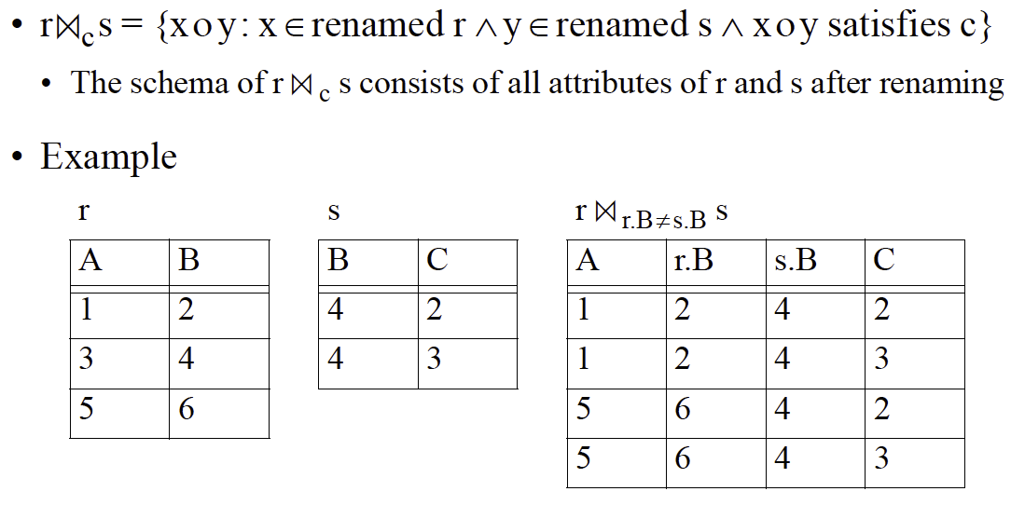
Additional Join Operators

Slide 10
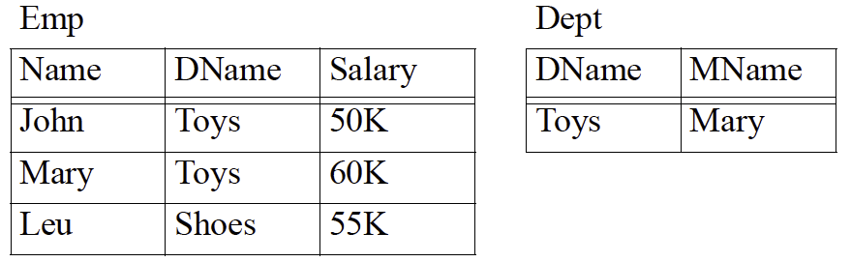
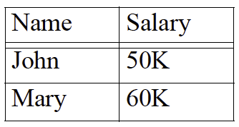
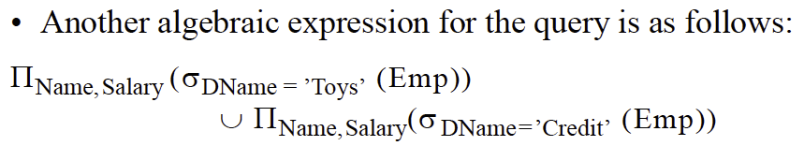
Relational Algebra as a Query Language

Slide 11
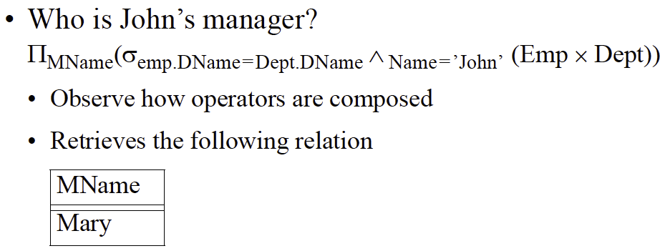
Relational Algebra as a Query Language

Slide 12
Exercise
Sailors(sid, sname, rating, age)
Boats(bid, bname, color)
Reserve(sid, bid, day)
Find the names of sailors who have reserved boat 103

Slide 13
Exercise
Sailors(sid, sname, rating, age)
Boats(bid, bname, color)
Reserve(sid, bid, day)
Find the names of sailors who have reserved boat 103

Slide 14
Exercise
Sailors(sid, sname, rating, age)
Boats(bid, bname, color)
Reserve(sid, bid, day)
Find the names of sailors who have reserved a red boat
Notes:
This exercise comes from Chapter 4

Slide 15
Exercise
Sailors(sid, sname, rating, age)
Boats(bid, bname, color)
Reserve(sid, bid, day)
Find the colors of boats reserved by Lubber

Slide 16
Sailors(sid, sname, rating, age)
Boats(bid, bname, color)
Reserve(sid, bid, day)
Find the names of sailors who have reserved a red or a green boat

Slide 17
Sailors(sid, sname, rating, age)
Boats(bid, bname, color)
Reserve(sid, bid, day)
Find the names of sailors who have reserved a red or a green boat

Slide 18
Sailors(sid, sname, rating, age)
Boats(bid, bname, color)
Reserve(sid, bid, day)
Find the names of sailors who have reserved at least one boat

Slide 19
Sailors(sid, sname, rating, age)
Boats(bid, bname, color)
Reserve(sid, bid, day)
Find the sids of sailors with age over 20 who have not reserved a red boat

