Slide 1















Giberson et. al
Medical Information Management System

Slide 2





Problem Statement
http://www.problemStatement.com
Duplicate records
Paper-based records are prone to double entry
Increasing patient records is becoming difficult to manage
Errors in medical record
Improper transcriptions or
Illegible writing have been known to cause medication mix ups.
Incomplete and partial medical records
Improper record keeping practices.
Lack of information validation
Important medical information are not captured
Medication error, wrong procedure / test

Slide 3
Impending Problem
Your patient health information has been compromised!
Patient Safety Alert!
!
OK
Cancel

Slide 4
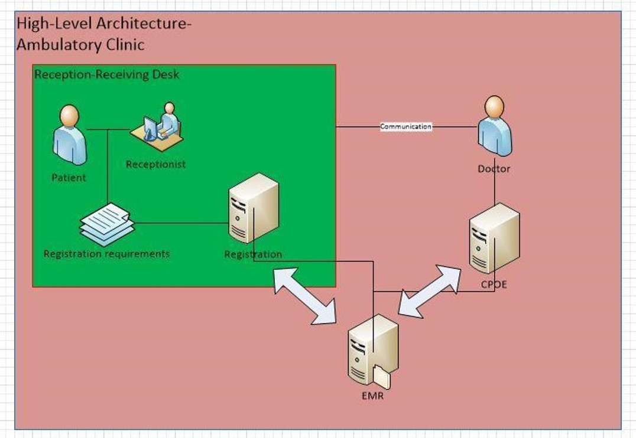
Visio
File
Home
Insert View Format
High Level Architecture

Slide 5
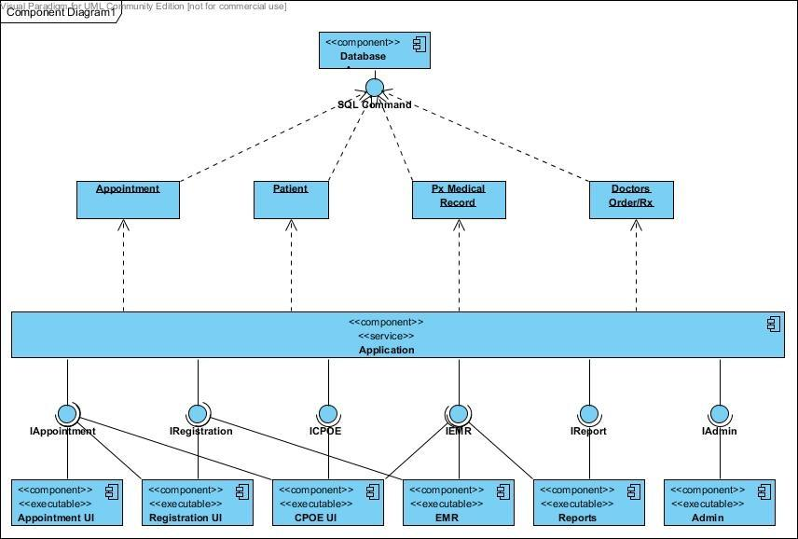
Visio

Slide 6
Pinned Application
Pinned Application
Appointment
Registration
CPOE
Medical Records
Reports
Admin
Giberson et.al
Pharmacy
Radiology
Laboratory
Results
Print Forms
Control Panel
Devices and Printers
Default Programs
Help and Support
MEDICAL INFORMATION MANAGEMENT SYSTEM
Giberson et.al Deliverables
!
OK
Cancel
All Programs
Search programs and files
Shut Down
3:00PM
3/14/2011

Slide 7
Pinned Application
Pinned Application
Appointment
Registration
CPOE
Medical Records
Reports
Admin
APPOINTMENT
Giberson et.al
Pharmacy
Radiology
Laboratory
Results
Print Forms
Control Panel
Devices and Printers
Default Programs
Help and Support
•Schedule maintenance
Check for doctors availability!
Set clinic time slot policy!
•Booking appointment
Want to create appointment?
Patient cancels appointment?
All Programs
Search programs and files
Shut Down
3:00PM
3/14/2011

Slide 8
Pinned Application
Pinned Application
Appointment
Registration
CPOE
Medical Records
Reports
Admin
REGISTRATION
•Demographics(mandatory fields)
•Contact info
•Patient finance(insurance details)
•Referrals(physician)
•Allergies!
Giberson et.al
Pharmacy
Radiology
Laboratory
Results
Print Forms
Control Panel
Devices and Printers
Default Programs
Help and Support
All Programs
Search programs and files
Shut Down
3:00PM
3/14/2011

Slide 9
Pinned Application
Pinned Application
Appointment
Registration
CPOE
Medical Records
Reports
Admin
CPOE-Computerize Physician Order Entry
•Assessment (patient vital signs)
•Clinical ordering
•Medication
•Clinical documentation
–Medical observation and impression
–Final diagnosis
Giberson et.al
Pharmacy
Radiology
Laboratory
Results
Print Forms
Control Panel
Devices and Printers
Default Programs
Help and Support
All Programs
Search programs and files
Shut Down
3:00PM
3/14/2011

Slide 10
Pinned Application
Pinned Application
Appointment
Registration
CPOE
Medical Records
Reports
Admin
MEDICAL RECORDS
mgiberson
Pharmacy
Radiology
Laboratory
Results
Print Forms
Control Panel
Devices and Printers
Default Programs
Help and Support
Search patient medical records
View historical & current records
Filter records to be viewed
All Programs
Search programs and files
Shut Down
3:00PM
3/14/2011

Slide 11
Pinned Application
Pinned Application
Appointment
Registration
CPOE
Medical Records
Reports
Admin
C:\Windows\System32\cmd.exe\COMP231
Microsoft Windows [Version 7.1.7000]
Copyright (c) 2008 Microsoft Corporation. All rights reserved.
C:\Users\Giberson et.al>MIMS
C:\Issue_Encountered/Conflicts
>Database Design
>Activity Workflow
>Unit Testing
>Collision of codes\gitHub
Developers
Design
Analysis
Implementation
Results
Print Forms
Control Panel
Devices and Printers
Default Programs
Help and Support
All Programs
Search programs and files
Shut Down
3:00PM
3/14/2011

Slide 12
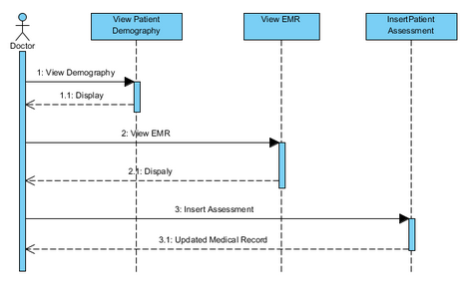
Sequence Diagram: Medical Records

Slide 13
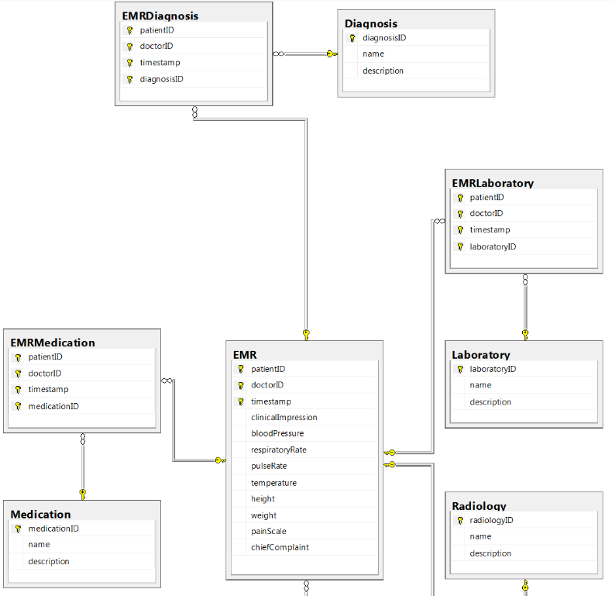
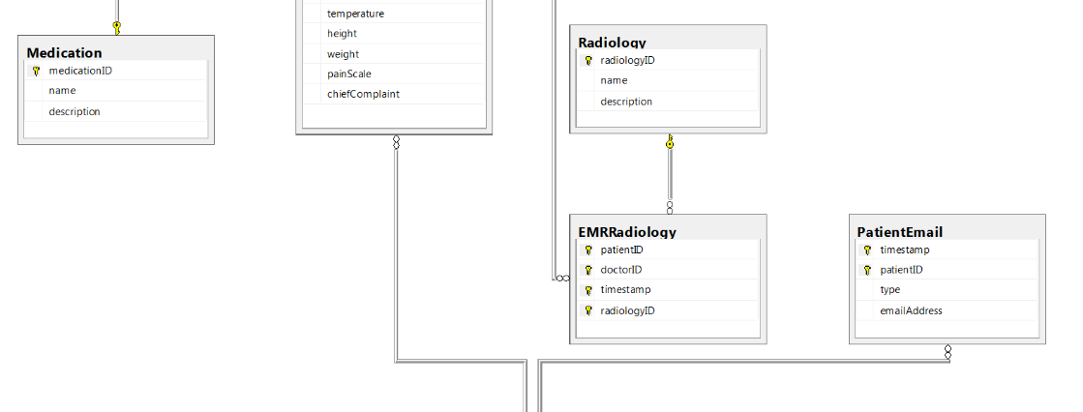
Database Design

Slide 14
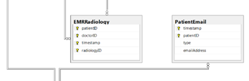
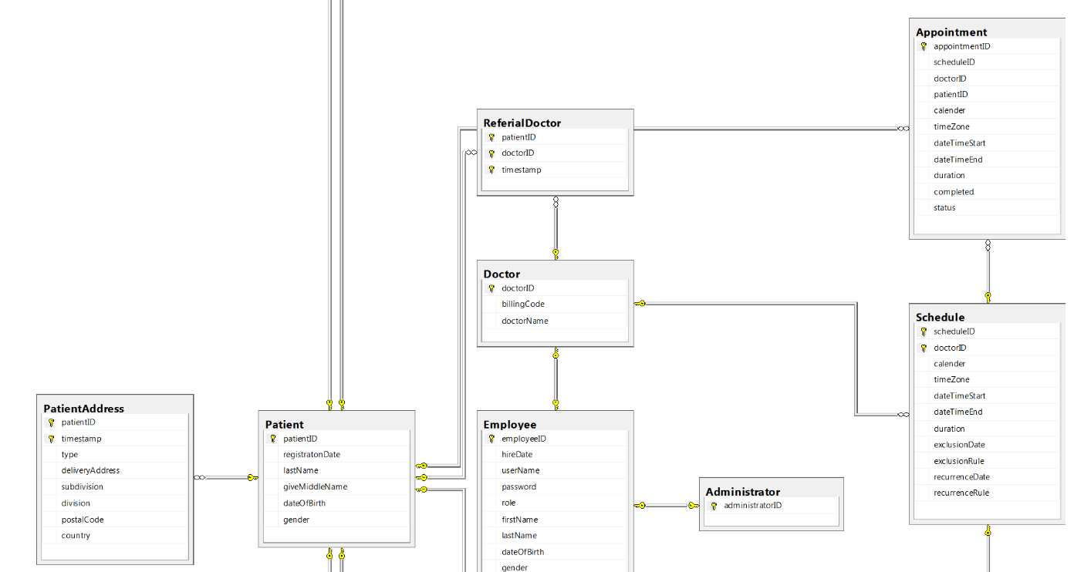
Database Design

Slide 15
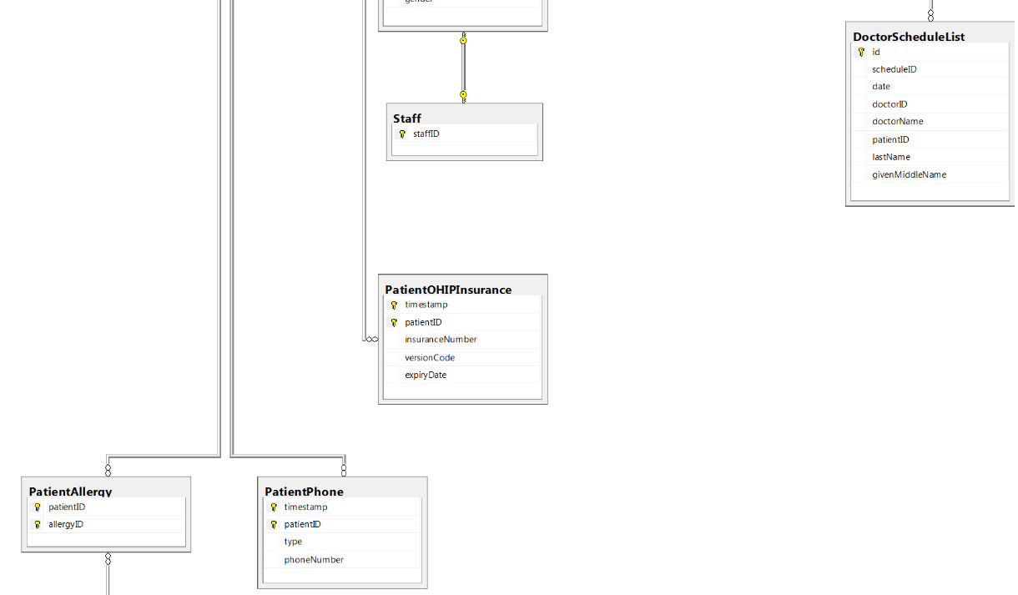
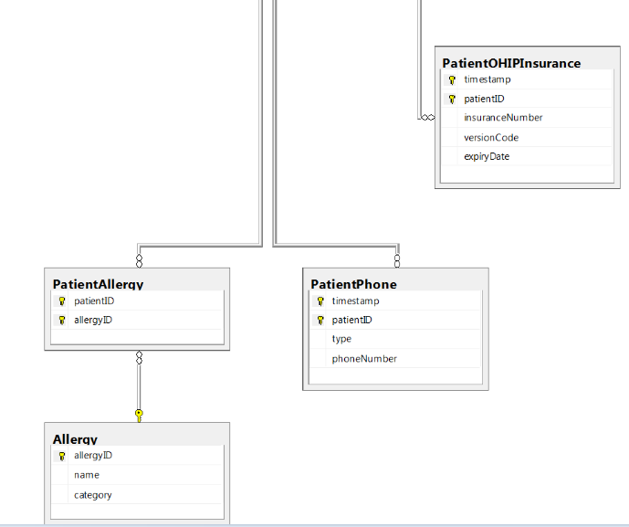
Database Design

Slide 16
SYSTEM DESIGN
Design
The Medical Information Management System project requires:
CRU patient information
CRUD employees (subsystem)
Project is being built on a Microsoft environment:
Coding in a Microsoft supported language (C#).
Using a Microsoft SQL Database:
Design Rationale
<Insert Database Diagram>
A person could have multiple addresses, phone numbers, emails.
A patient could have multiple insurances, allergies.
A patient should have multiple EMR.
A EMR could have multiple medication, laboratory, radiology, diagnosis.
Medication, Laboratory, Radiology, Diagnosis and Allergies are referenced tables
Eliminate redundancy:
patient and employee have redundant information in both tables is store as person
Anomalies:
Doctor, manager, receptionist are separate tables to improve portability at the cost of efficiency.

Slide 17
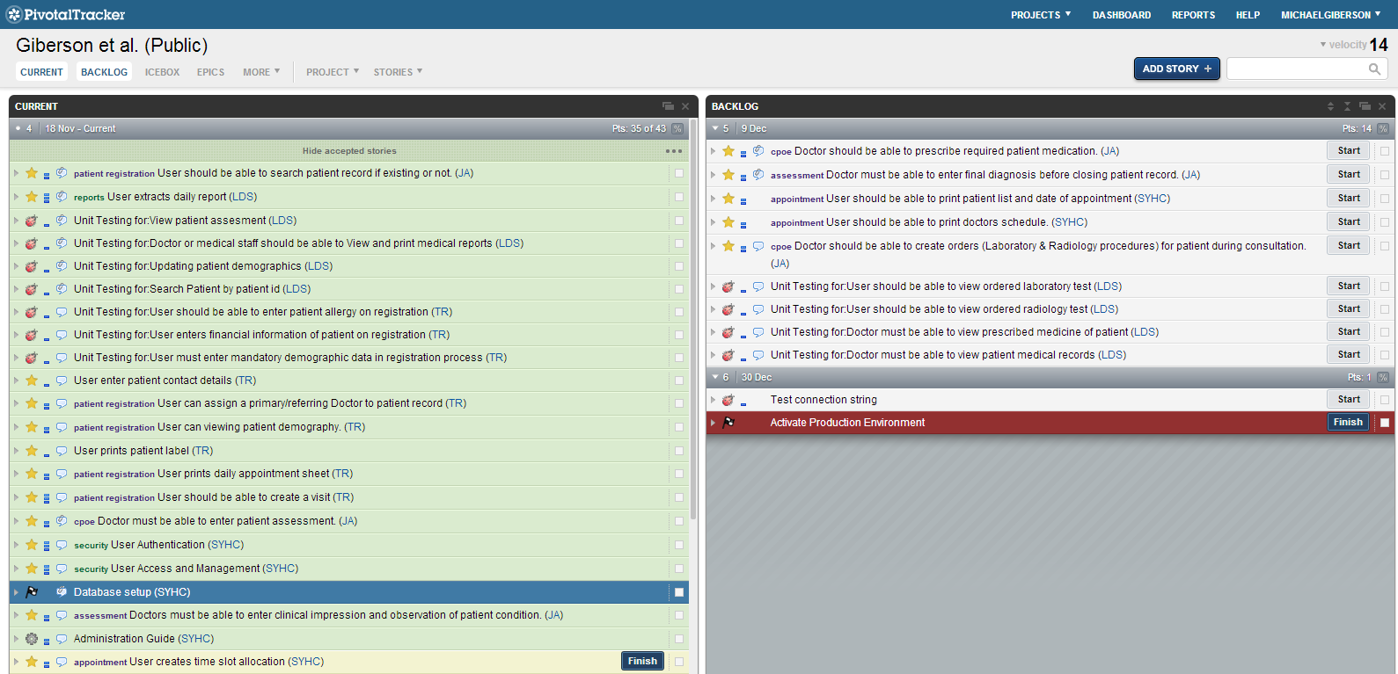
Pivotal Tracker
https://www.pivotaltracker.com/s/projects/909420

Slide 18
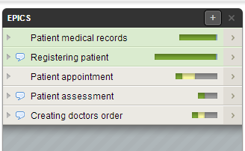
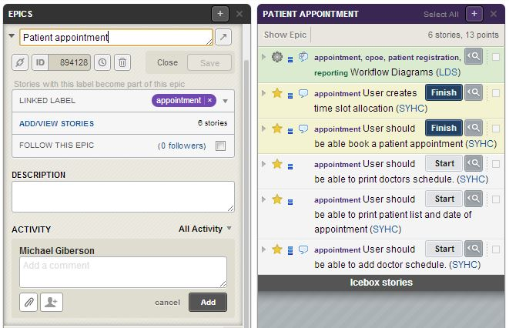
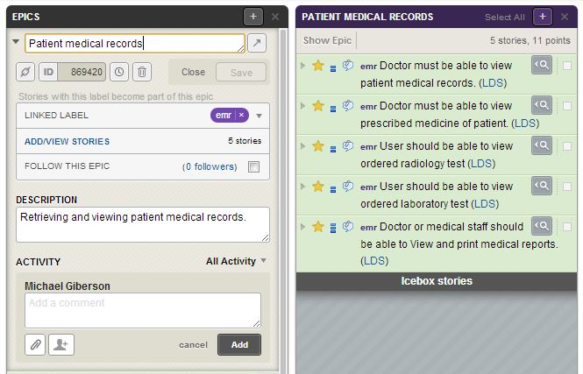
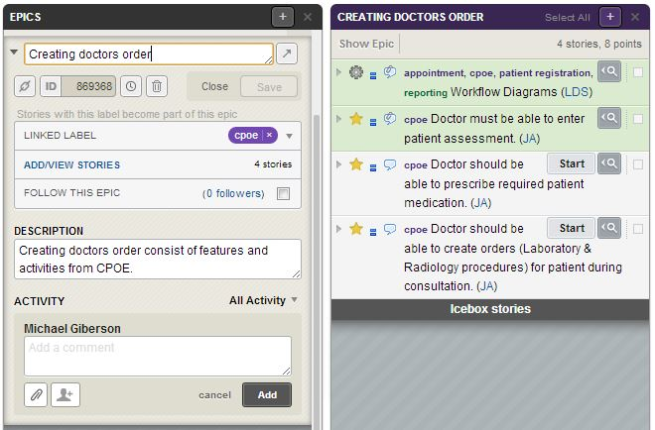
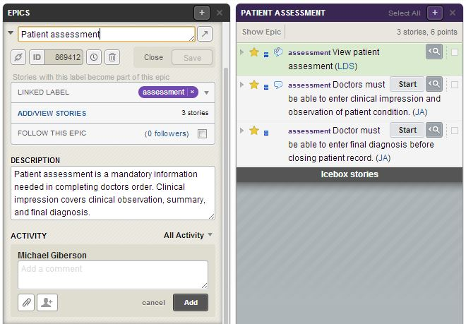
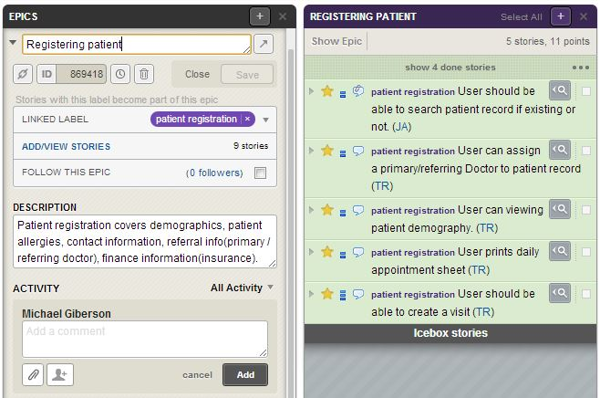
Pivotal Tracker
https://www.pivotaltracker.com/s/projects/909420

Slide 19
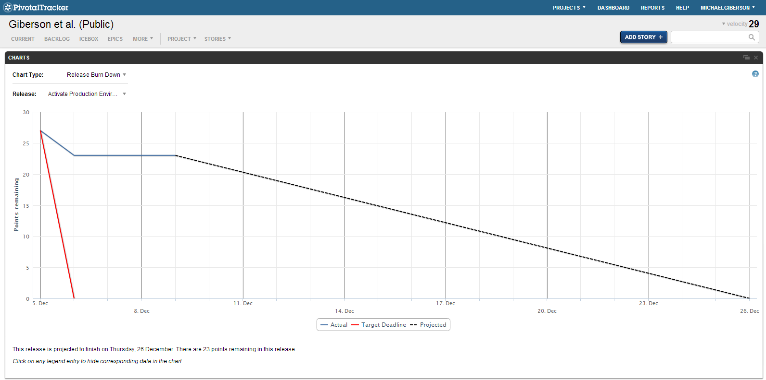


Web page title
https://www.pivotaltracker.com/s/projects/909420

Slide 20
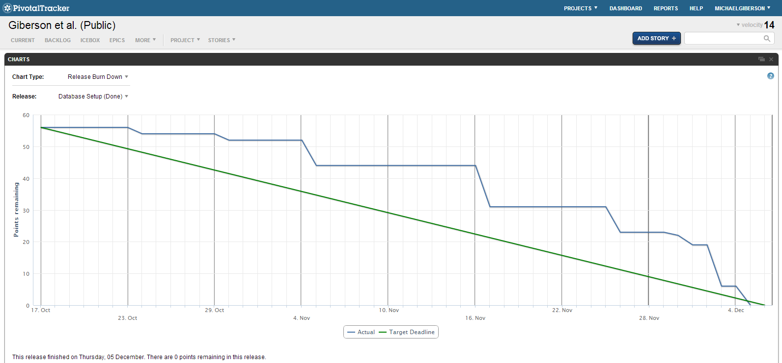

Web page title
https://www.pivotaltracker.com/s/projects/909420

Slide 21
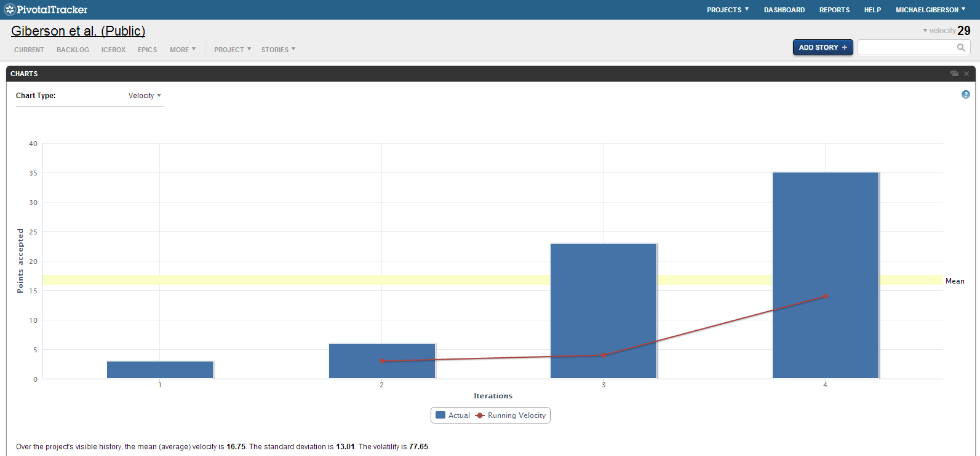
Web page title
https://www.pivotaltracker.com/s/projects/909420

Slide 22
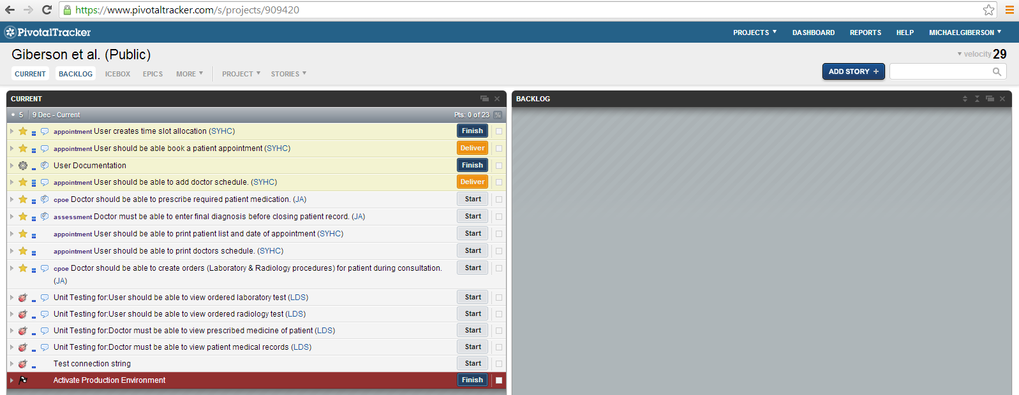

Slide 23
