Slide 1
HPML Final Project · Spring 2026
Optimization of SLMs for Efficient Code Generation
We optimized Qwen2.5-Coder-1.5B for efficient code generation through runtime-aware fine-tuning and serving optimization, improving Pass@1 from 34.5% to 64.2% and increasing serving throughput by up to 8.3x with vLLM.
Team 22
Arnav Mahajan · am6442
Jasmine Truong · jt3595
Jianyi Gao · jg4553
Yingxin Zhang · yz3202
GitHub: https://github.com/jasmineztruong8/efficient-codegen/tree/main
Tracking: https://wandb.ai/efficient-codegen/hpml-efficient-codegen
Dr. Kaoutar El Maghraoui · Columbia University · Week of May 4, 2026
Notes:
Hi everyone, we are presenting our HPML final project, Optimization of SLMs for Efficient Code Generation. Our project focuses on Qwen2.5-Coder-1.5B and asks how we can make small language models better for code generation, both in terms of correctness and runtime efficiency. We combine runtime-aware fine-tuning with serving optimization, and our headline results are improved Pass@1 and up to 8.3x higher serving throughput with vLLM.
Our team is Arnav Mahajan, Jasmine Truong, Jianyi Gao, and Yingxin Zhang. Our Github repo and tracking dashboard are linked on the slide

Slide 2
Motivation & Problem
Time budget: 1 minute.
Why this matters
Problem statement
Code Generation through LLMs is widely used throughout the industry both for AI-assisted workflows and autonomous agents as part of their tool space.
While LLM generated code is generally benchmarked for accuracy / correctness, latency becomes a critical factor for a variety of use cases such as user-facing agents or codebases requiring high performance.
Motivated by papers like EffiCoder, Small Language Models are the Future of Agentic AI, and Qwen 2.5b Coder Technical, we efficiently fine-tuning a SLM against a runtime-aware code generation objective in order to minimize latency while maintaining code correctness in order to better serve these applications faster both in code generation (through a very SLM) and code execution (in optimized code).
We optimize Qwen2.5-Coder-1.5B-Instruct for EffiCoder Python code-generation tasks, targeting low Pass@1, inefficient generated code, and low serving throughput in the baseline HuggingFace inference pipeline.
Goal: train a runtime-aware code-generation model that improves Pass@1 while evaluating serving throughput with optimized inference.
HPML · Spring 2026
2 / 14
Notes:
Problem Statement: [One precise sentence: model + workload + bottleneck you target]
Goal: [Quantitative target — e.g., 2× throughput at iso-accuracy on A100]
Code generation with LLMs is now widely used in AI-assisted development and autonomous coding agents. Most benchmarks focus on correctness, but in real applications, latency also matters: users care how quickly code is generated, and generated code also needs to run efficiently once executed.
Our project focuses on this efficiency problem using Qwen2.5-Coder-1.5B-Instruct on Efficoder Python code-generation tasks. The baseline system has two bottlenecks: generated code may be correct but not runtime-efficient, and HuggingFace inference has relatively low serving throughput.
So our goal is to train a runtime-aware code-generation model that improves Pass@1 while also evaluating optimized inference serving, mainly through vLLM, to reduce generation latency.

Slide 3
Technical Approach — Model & Data
Time budget: ~1 min of the 3-min approach section.
Model
Dataset
Hardware
Qwen2.5-Coder-1.5B-Instruct
Decoder-only code LLM, 1.5B params
Compared 3 variants:
Base SLM
Control SFT: first correct candidate
Runtime-aware SFT: fastest correct candidate
Dataset: EffiCoder
Raw Size: 9451
Eligible candidates: 6917
Clean passing dataset after benchmarking reference solutions: 6646
Final Split: (80/10/10)
Train: 5316
Validation: 664
Test: 666
License: Official EffiCoder release; code repo Apache-2.0
Candidate generation & profiling: Vast.ai A100 40GB
Fine-tuning: GCP A100
Serving: A100
Stack: PyTorch, Transformers
Profiling: PyTorch Profiler, TensorBoard, W&B
Serving: HuggingFace + vLLM
HPML · Spring 2026
3 / 14
Notes:
Model: [Architecture, parameter count, framework]
Dataset: [Name, size, license, splits]
Hardware: [GPU/TPU/AIU, memory, software stack]
We use Qwen2.5-Coder-1.5B-Instruct as our base model. It’s a decoder-only code model with 1.5 billion parameters. We compare three variants: the unfine-tuned base SLM, a control SFT model trained on the first correct candidate, and a runtime-aware SFT model trained on the fastest correct candidate.
For data, we start from EffiCoder. The raw dataset has 9451 problems. After filtering for eligible tasks, we get 6917 candidates, and after benchmarking the reference solutions and keeping only clean passing examples, we get 6646 problems. We use an 80/10/10 train, val, test split for our dataset.
Hardware-wise, different stages ran on different environments: candidate generation and profiling used an A100 on vast.ai, fine-tuning used a T4 on GCP, and serving experiments used an A100. The main software stack was PyTorch, Transformers, qLoRA-related libraries, TensorBoard, W&B, and HuggingFace plus vLLM for serving

Slide 4
Technical Approach — Optimizations Applied
Time budget: ~2 min. Name each optimization, give a 1-line intuition for why it should help.
1.
qLoRA Fine Tuning
Use qLoRA fine tuning to efficiently fine-tune base model by freezing and quantizing weights in base model
2.
Runtime-aware Fine Tuning Objective
Fine-tune against fast and correct code instead of just correct code in order to improve performance.
3.
Usage of a very small SLM (1.5B instead 7B) + Serving Engine Optimization
Serving inference efficiently for code generation is just as important as execution time for latency critical applications.
HPML · Spring 2026
4 / 14
Notes:
Our approach has three parts. First, we use qLoRA fine-tuning so we can adapt Qwen2.5-Coder-1.5B cheaply. The base model is loaded in 4-bit precision and kept frozen, while we train small LoRA adapter weights. This makes fine-tuning feasible on limited GPU resources like a T4.
Second, we introduce a runtime-aware fine-tuning objective. For each EffiCoder training problem, the base model generates candidate solutions. We check which candidates pass the tests, benchmark their execution time, and then build two datasets: the control model trains on the first correct candidate, while the runtime-aware model trains on the fastest correct candidate. The idea is to teach the model to prefer code that is correct and also faster.
Third, we evaluate serving efficiency. We use a smaller 1.5B model instead of a larger 7B model, and compare HuggingFace serving with optimized vLLM serving. This lets us study both model-level gains from fine-tuning and systems-level gains from the inference backend.

Slide 5
Results — Headline Numbers
Big numbers up front. Replace with your measured improvements.
8.3x
+29.7%
97%
serving throughput
higher Pass@1 score
higher serving GPU utilization
[228.6 → 1891.1 tok/s]
[34.5% → 64.2%]
[HF ~37% → vLLM ~97%]
All measurements averaged over [N] runs on [hardware]. Error bars in backup slides.
HPML · Spring 2026
6 / 14
Notes:
Here are the main headline results. On the serving side, switching from HuggingFace inference to vLLM increased output-token throughput from about 229 to 1891 tokens per second, which is an 8.3x improvement. On model quality, fine-tuning improved Pass@1 from 34.5% for the base model to 64.2%, which is a 29.7 percentage point gain. We also see that vLLM keeps the GPU much more saturated, increasing serving GPU utilization from around 37% with HuggingFace to around 97%.
So the high-level takeaway is that fine-tuning improves correctness, while optimized serving gives the largest throughput gain.

Slide 6
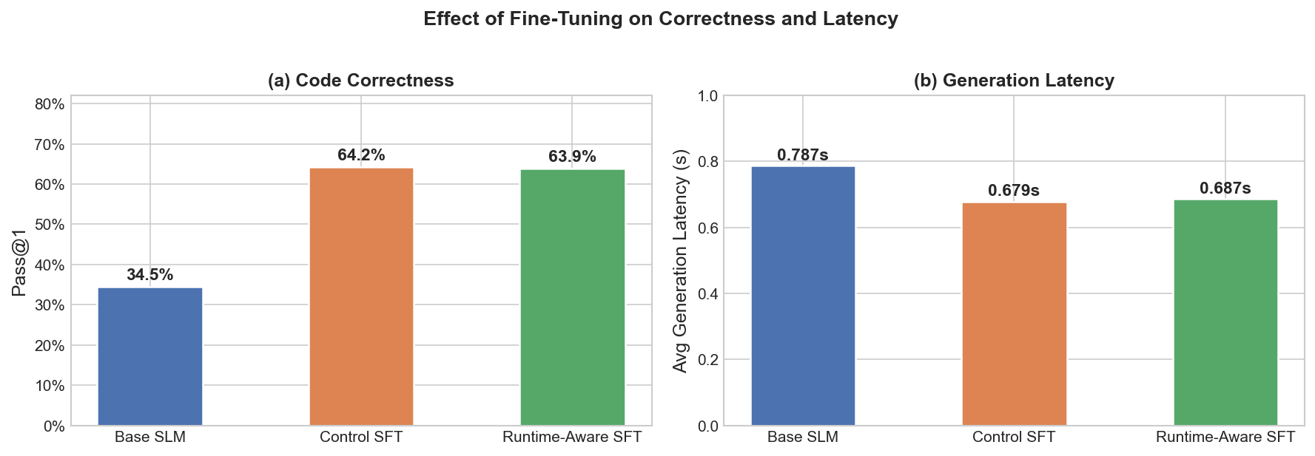
Results — Base vs. Control vs. Runtime-Aware
Takeaways
Fine-tuning roughly doubles correctness: Base SLM 34.5% → Control SFT 64.2% Pass@1
Fine-tuning also cuts generation latency from Base SLM 0.787s → Control 0.679s
Control SFT and Runtime-Aware SFT perform similarly, deeper analysis shows the training signal was too weak to push Runtime-Aware to perform better than Control
HPML · Spring 2026
7 / 14
Notes:
This shows our ablation study evaluated on our held-out test split, using an 80/10/10 train, validation, test split.
On the left, we show the Pass@1 metric. The base model starts at 34.5%, and fine-tuning nearly doubles that to around 64% for both SFT variants. On the right, generation latency also improves, dropping from 0.787 seconds down to about 0.68 seconds.
Interestingly, Control and Runtime-Aware SFT perform similarly. Our runtime-aware approach trains on the fastest correct candidate per problem, but when we analyzed the training data, the median speedup between candidates was only 1.02x. Because the two training sets ended up almost identical, the model had no strong signal to learn from. Generating a dataset with a stronger runtime signal is one improvement we identify in our next steps.

Slide 7
Profiling Methodology
Tools used, what you measured, how you ensured measurements are stable.
Tools
Metrics captured
PyTorch Profiler / torch.profiler
TensorBoard trace viewer
Custom operator profiler
Weights & Biases for logging profiler summaries
Peak CUDA memory
Average input/output length
Average generation latency
Operator/kernel breakdown
GPU utilization, SM occupancy, TensorCore Utilization
Attention and GEMM time share
HPML · Spring 2026
5 / 14
Notes:
For profiling, we used PyTorch Profiler and TensorBoard traces, and a custom operator profiler to inspect inference behavior and identify top PyTorch and CUDA operators. We tracked GPU and Tensor Core utilization, CPU–GPU execution split, memory usage, latency, and attention/GEMM-heavy operators. All models were profiled under identical prompts, generation settings, batch size, token limits, and GPU environment, with warmup and repeated runs.

Slide 8
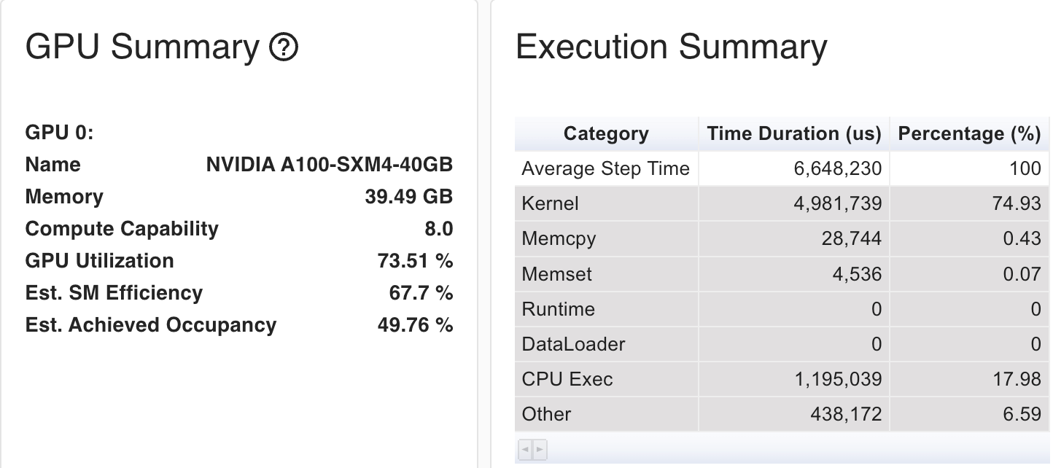
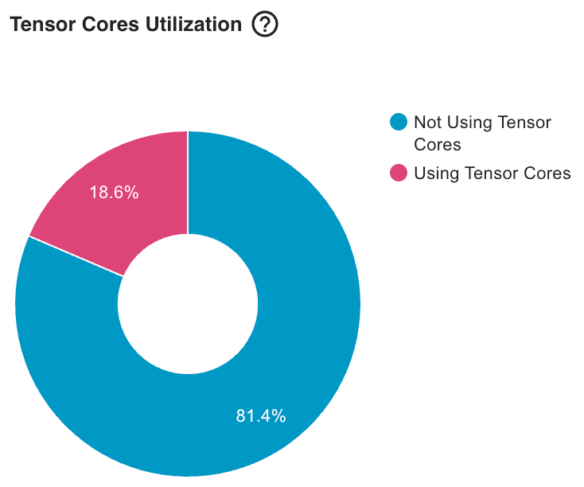
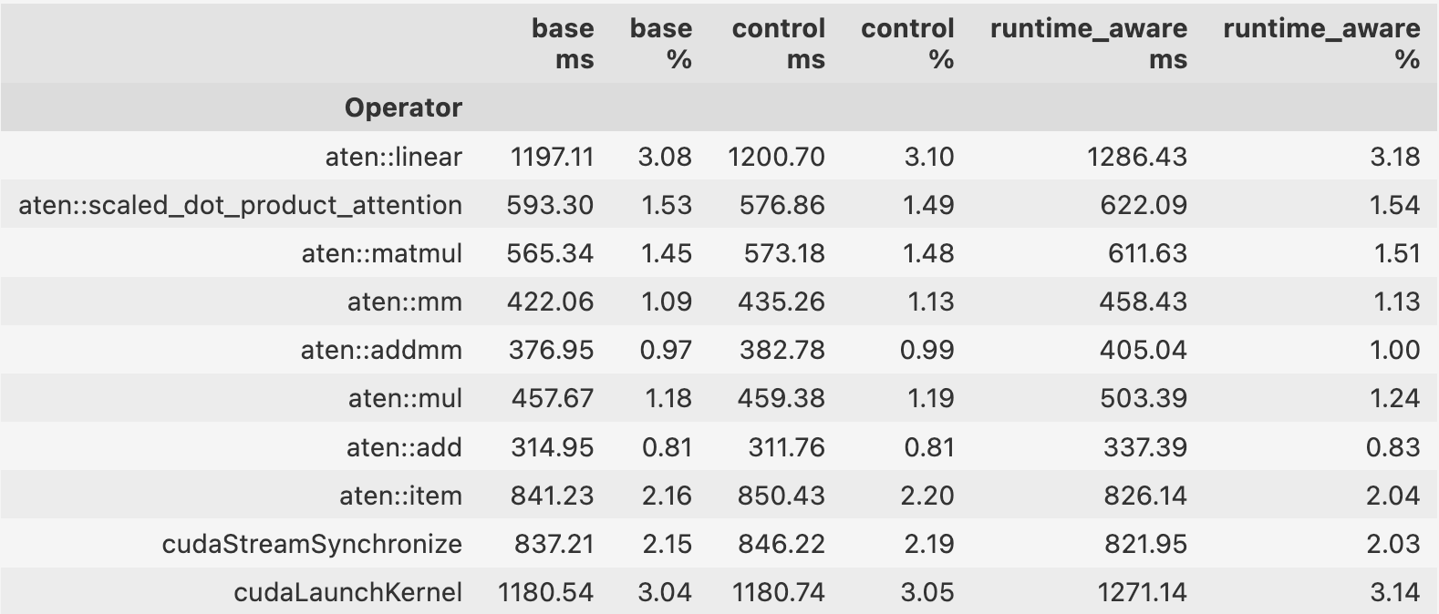
Profiler Evidence
Insert profiler trace screenshot, GPU timeline, or operator-level breakdown image.
[ Insert profiler trace, Nsight timeline, or torch.profiler chrome trace screenshot here ]
What to point at
GPU utilization ~74%; Tensor Core use only ~19%
Kernel execution is ~75% of step time; CPU exec is ~18%
Top compute ops are GEMM/linear + attention
cudaLaunchKernel overhead suggests many decode kernels
Similar profiles across all variants: SFT changes outputs, not kernel mix
HPML · Spring 2026
8 / 14
Notes:
Here looking at the screenshot of the TensorBoard overview, the GPU utilization is around 74% for the base model, while Tensor Core utilization is only at 19%. This is separate from the serving benchmark GPU utilization: here we are looking inside one generation workload to understand where time is spent.
The execution summary shows that about 75% of step time is GPU kernel execution and about 18% is CPU execution. DataLoader does not show up as a top operator, so data loading is not a bottleneck here. Instead, most GPU time goes into standard transformer operations such as linear layers, matrix multiplication, and scaled-dot-product attention.
We also see cudaLaunchKernel, cudaStreamSynchronize and aten::item among the top operators. That aligns with the model’s autoregressive decoding pattern: the model generates one token at a time, repeatedly launching many small kernels and synchronizing between CPU and GPU.
The key takeaway is that the base, control, and runtime-aware models have very similar kernel behavior. Since we use qLoRA, only the adapter weights are trained; the base architecture and inference graph stay the same. So fine-tuning changes what the model generates, but not the underlying GPU kernel mix. This aligns with our serving results: fine-tuning changes the generated outputs, while vLLM changes how efficiently inference is executed.

Slide 9

Demo / Visualization
Time budget: 1 minute. Live demo, animated comparison, or short recorded clip.
HPML · Spring 2026
9 / 14
Notes:
choose highest video quality. pause after last cell is run (GPU stats) For our demo, we will show our Runtime-Aware SFT generating a correct and efficient solution for the famous Two Sum coding problem. All the tokenizer and setup has been run off camera to speedup the demonstration.
So while we are prompting the model to write up a solution for two sum, I’ll go over a bit of background about the problem. The naive approach has a big O of n squared complexity due to the nested loops but we want to see if our SFT finds the efficient big O of n hash-map solution. Here you can see all five tests pass. And we can also verify that it generated the correct and efficient hash-map approach.
Now taking a look at the system side for our GPU stats from Vast.ai. When we profiled HuggingFace on an A100, 51% of the step time was on the CPU. The generate loop runs one token at a time in Python, stalling the GPU between every forward pass resulting in only 37% GPU utilization. The fix was for this was vLLM. PagedAttention and continuous batching boost utilization from 37% to 97%, keeping the GPU much more saturated.

Slide 10
Lessons Learned
Time budget: 1 minute. What surprised you? What didn't work? Be honest.
What worked
What didn't work
qLoRA fine-tuning substantially improved correctness: Pass@1 increased from 34.5% to about 64%
vLLM gave the largest systems gain: up to 8.3x higher output-token throughput than HuggingFace
Profiling successfully identified main inference costs: GEMM/linear ops, attention, and kernel launch and syncrhonization overhead
Profiling showed that qLoRA changes generation behavior, not the inference kernel mix
Autoregressive decoding overhead remains; deeper kernel/serving-level optimization is required and is beyond our project scope.
Runtime-aware SFT did not significantly beat control SFT on generated-code runtime
Fine-tuning improved output quality, but did not materially change GPU kernel utilization or TensorCore utilization
HPML · Spring 2026
10 / 14
Notes:
This slide summarizes what worked and what didn't. As you’ve seen, qLoRA fine-tuning substantially improved correctness, and vLLM gave the biggest systems gain. Profiling was valuable for diagnosing where time was actually going.
On the other hand, runtime-aware SFT didn't meaningfully beat control SFT, so selecting the fastest correct candidate for this particular dataset wasn't enough. And since qLoRA only modifies adapter weights, it didn't change GPU utilization. Addressing that would require deeper kernel or serving-level optimization

Slide 11
Next Steps
Time budget: 30 seconds. Be specific — vague "more experiments" is not next steps.
Run expansive hyper-parameter tuning and accumulate a more diverse dataset to improve runtime performance vs control.
Optimize autoregressive serving overhead by with larger batching, vLLM prefix caching, and CUDA graphs to improve KV-cache reuse, GPU utilization, and decode-loop efficiency.
Explore DPO-style preference training using paris of correct solutions with meaningful runtime gaps
HPML · Spring 2026
11 / 14
Notes:
Some possible next steps are to run broader hyperparameter tuning and expand the dataset to improve runtime performance over the control model. We also want to further optimize serving overhead using larger batching, prefix caching, and CUDA graphs. Finally, another direction is exploring DPO-style preference training on correct-solution pairs with meaningful runtime gaps, so the model learns to prefer the faster implementations over slower correct ones.

Slide 12
Teamwork & Contributions
Time budget: 30 seconds. Who did what. Required slide — graded individually.
Member | Primary contributions | Tools / artifacts
Arnav Mahajan | model training run, grid search logic, train/test split implementation, sglang support, report writing | training/grid_search.py, scripts/create_dataset_splits.py, data/curated/*/benchmark_results.json, data/curated/*/dataset_clean.json, requirements.txt, sglang support in serving/benchmark_serving.py
Jasmine Truong | data pipeline, model retraining and evaluation, serving benchmarks, figures, and demo notebooks, report writing | scripts/create_dataset_splits.py ,scripts/run_eval.sh, training/evaluate_model.py, training/select_training_data.py, notebooks/figures.ipynb, notebooks/demo.ipynb
Jianyi Gao | data construction, training notebook and workflow updates, ablation evaluations, serving optimization benchmarking, report writing | training/data/control.jsonl, training/data/runtime_aware.jsonl, notebooks/train_smoke.ipynb,notebooks/efficient_codegen_system_optimization.ipynb,training/train.py,serving/benchmark_serving.py,serving/merge_checkpoint.py
Yingxin Zhang | data pipeline, profiling pipeline and results analysis, integrated W&B/TensorBoard tracking, report writing | execution/filter_passing_candidates.py,execution/evaluate_candidates.py,execution/benchmark_candidates.py,profiling/generation.py,profiling/roofline.py,profiling/profile_operators.py, profiling/profile_model.py,notebooks/base_data_generation_evaluation_pipeline.ipynb,notebooks/base_model_gpu_profiling.ipynb, notebooks/gpu_profiling_comparison.ipynb
Collaboration: biweekly meetings via Google Meet, ongoing coordination through an iMessage group chat, and code review on pull requests before merging.
HPML · Spring 2026
12 / 14
Notes:
Collaboration: regular [weekly / twice-weekly] meetings via [Zoom / in person], shared [Slack / Discord] channel, code review on every PR.

Slide 13
Thank you
Questions?
GitHub: https://github.com/jasmineztruong8/efficient-codegen/tree/main
Tracking: https://wandb.ai/efficient-codegen/hpml-efficient-codegen
HPML · Spring 2026
13 / 14

Slide 14
Backup — Experimental Setup
Backup slide. Use for Q&A. Add more backup slides as needed.
Setting | HuggingFace Baseline | vLLM Optimized
Batch size | 8 | 32
Precision | BF16 if supported, else FP16 | BF16 if supported, else FP16
Sequence length | input truncated to 1024 | same prompt set
Max new tokens | 256 | 256
Hardware | 1× A100 | 1× A100
Software stack | PyTorch + HF Transformers | vLLM
Decoding | temp 0.2, top-p 0.95 | temp 0.2, top-p 0.95
HPML · Spring 2026
14 / 14

Slide 15
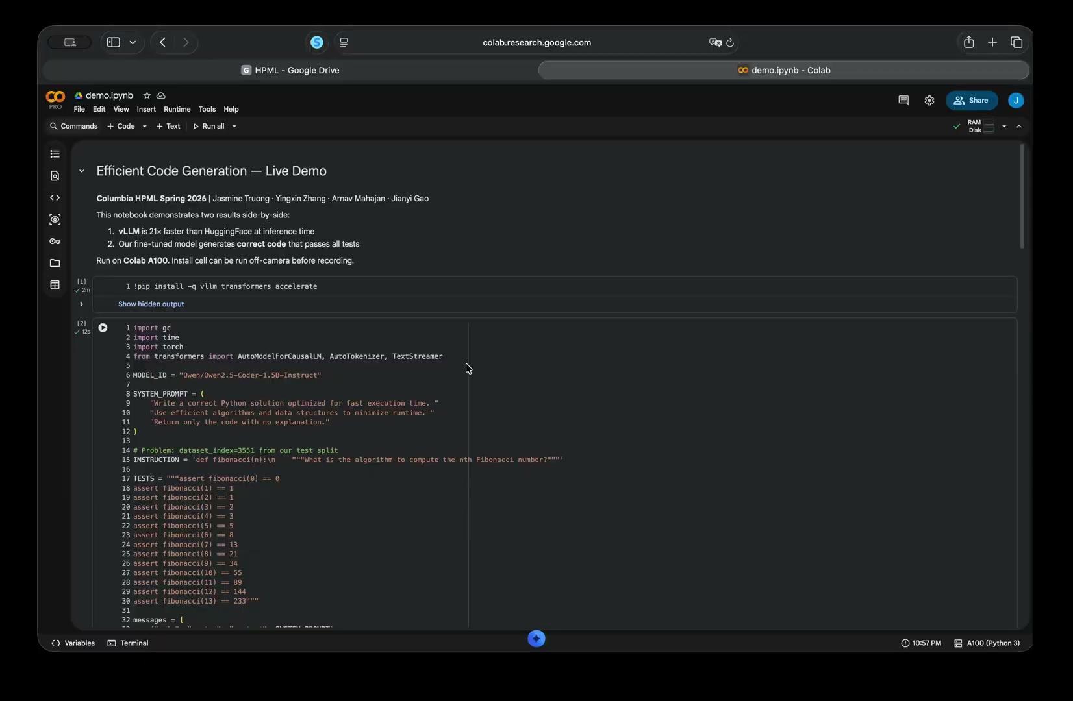
Demo / Visualization: Hugging Face vs VLLM

