Slide 1

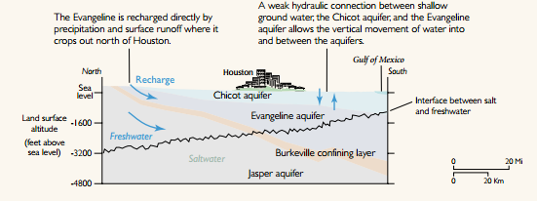
Galloway, Devin, David R. Jones, and Steven E. Ingebritsen, eds. "Land subsidence in the United States." (1999).

Slide 2
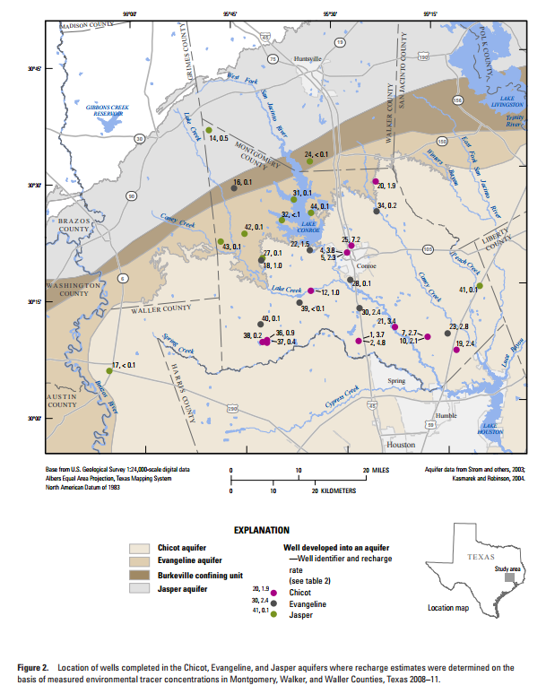

Slide 3
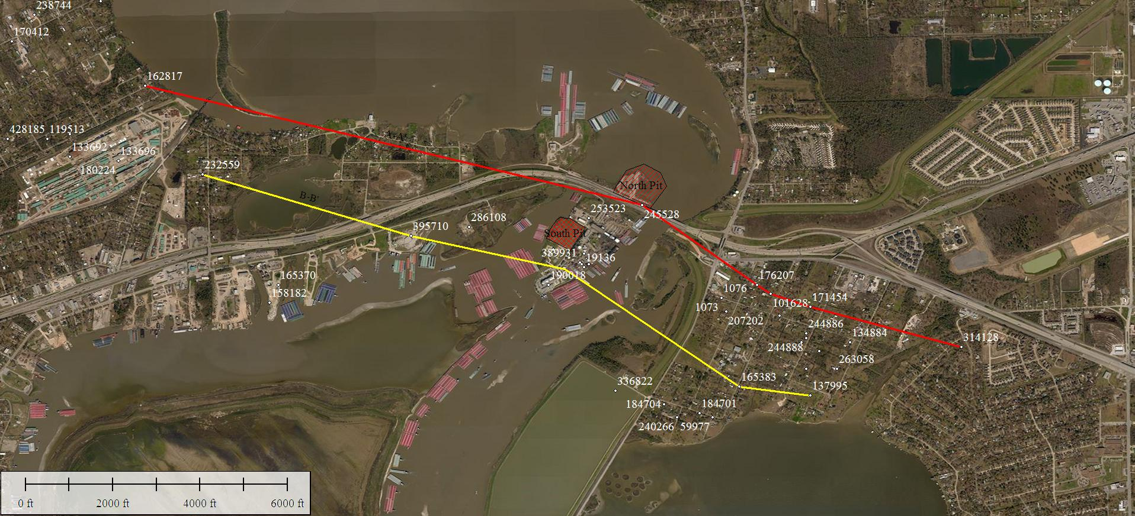
Cross Sections

Slide 4
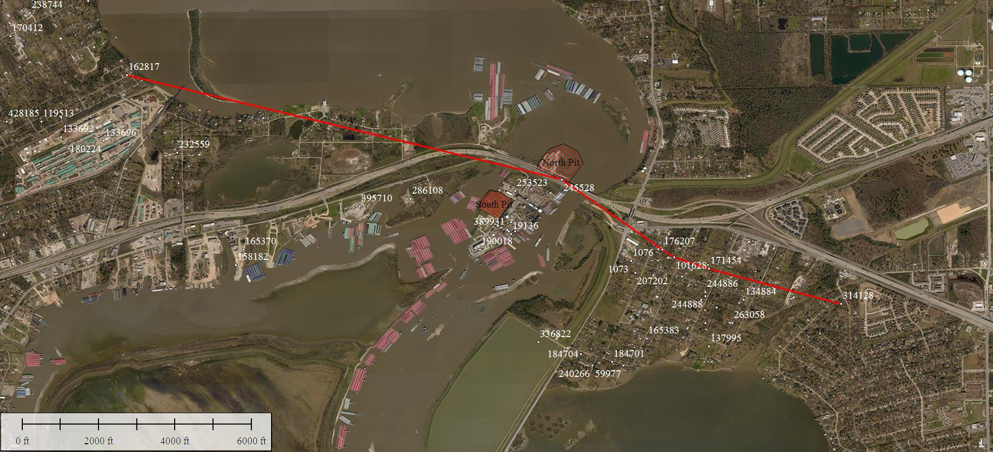
Cross Section A-A’

Slide 5
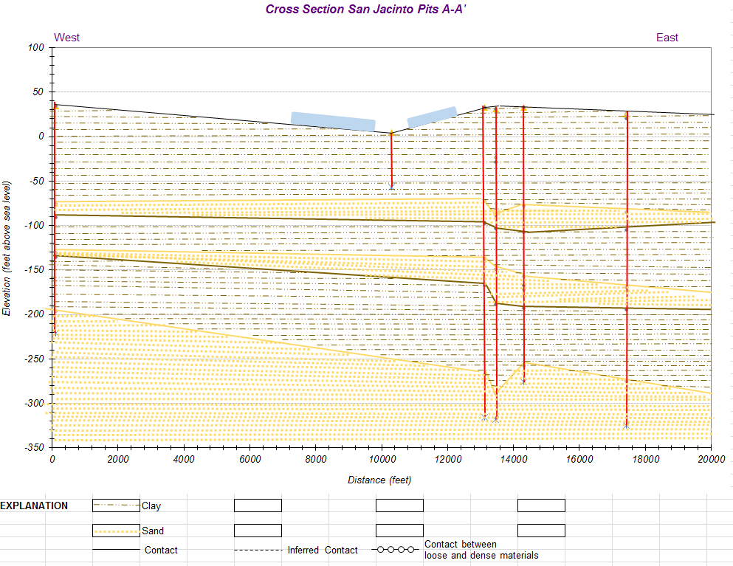

Slide 6
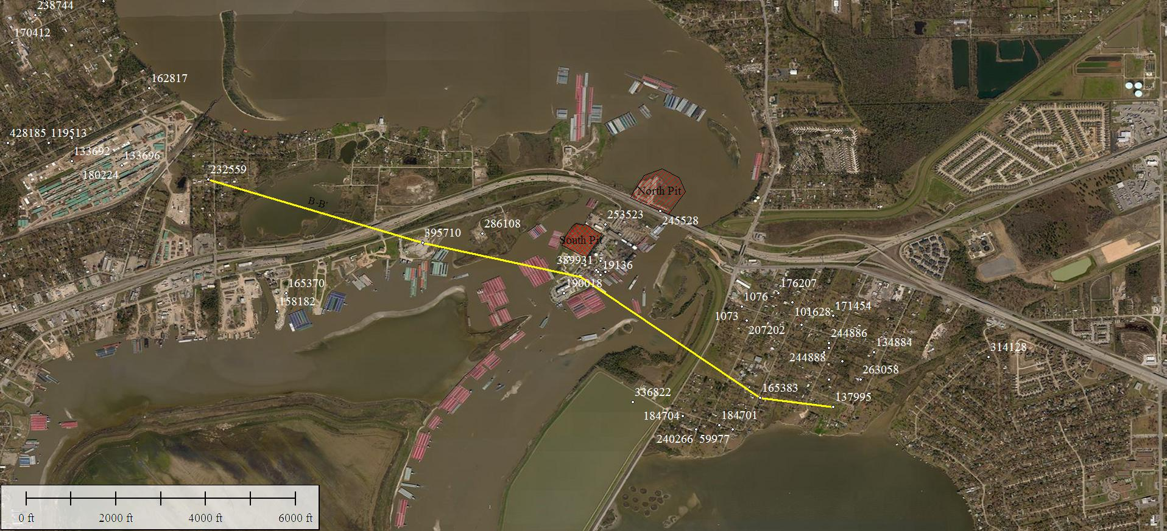
Cross Section B-B’

Slide 7
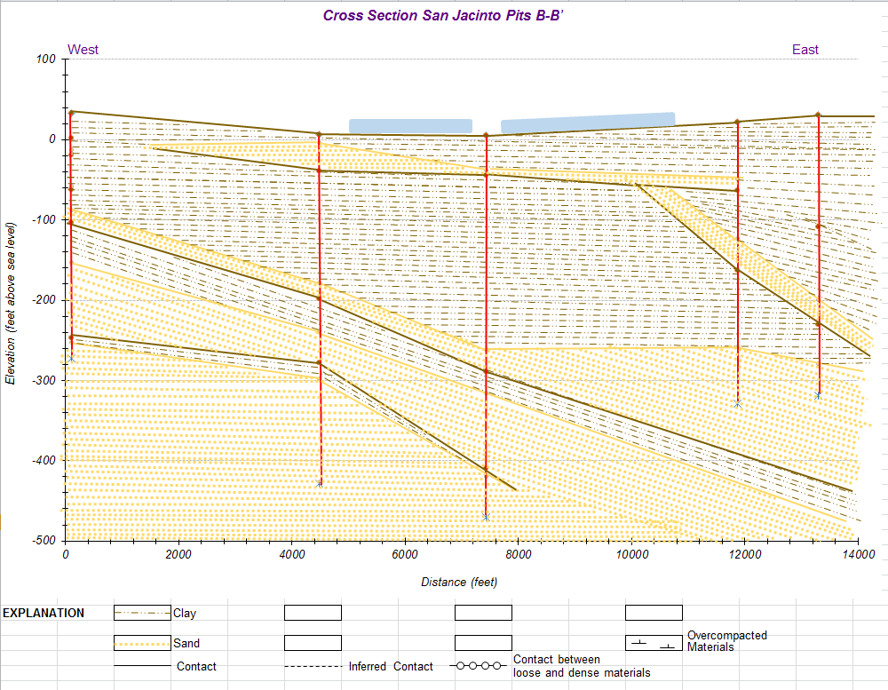

Slide 8
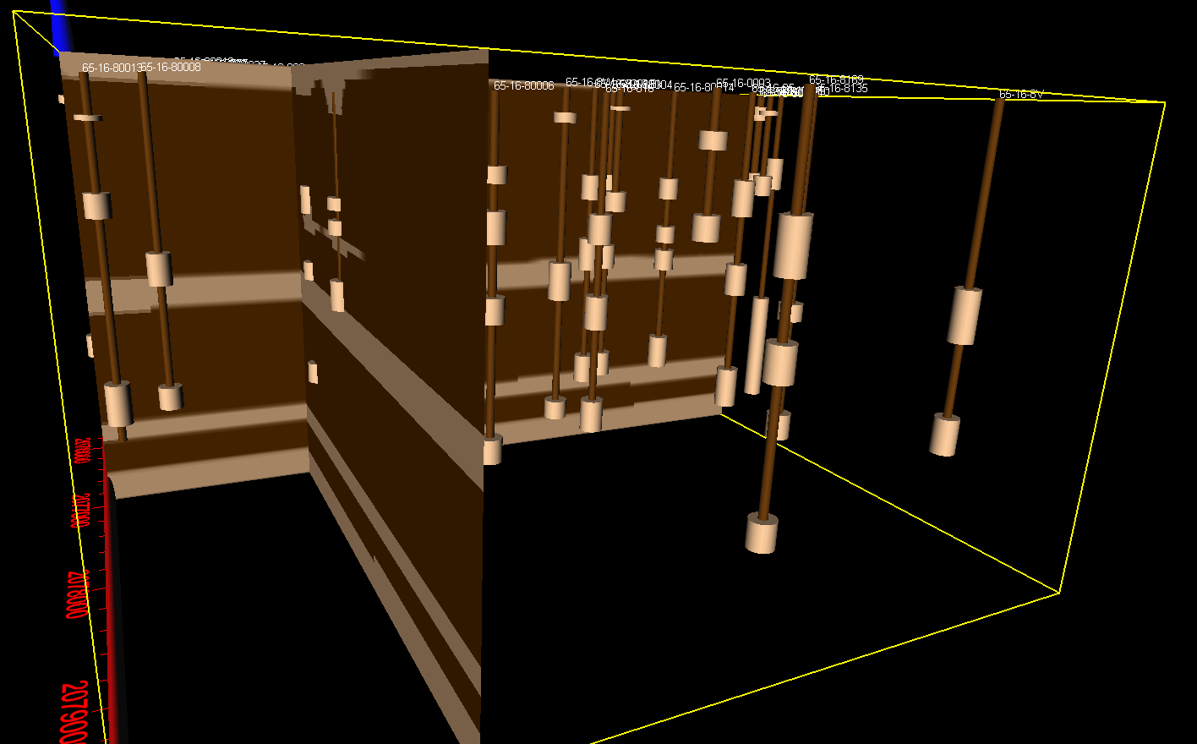

Slide 9
