Slide 1
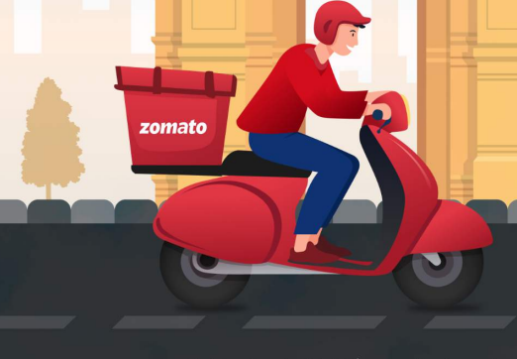
ZOMATO EXPANSION PROJECT
Presentation By -
Jasmin Rajesh Patel

Slide 2


Slide 3
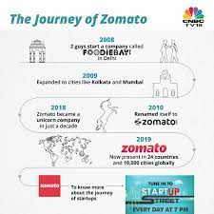
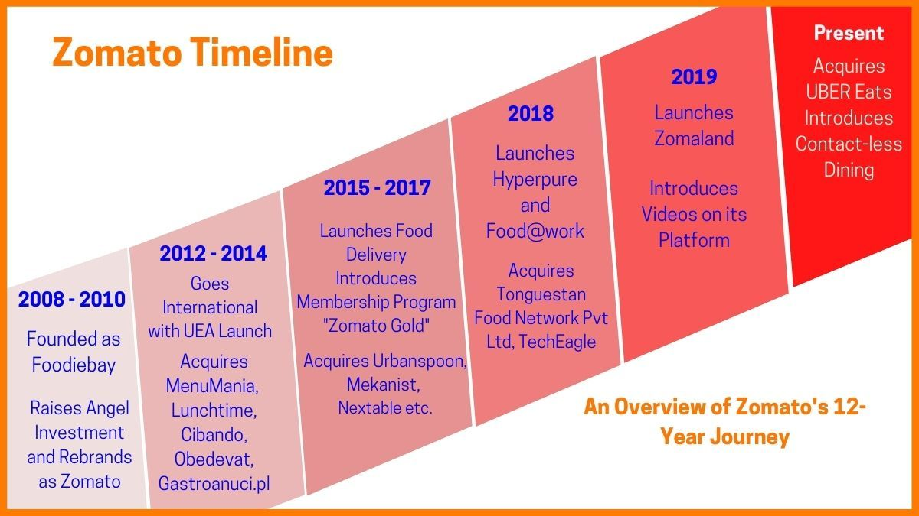
ZOMATO JOURNEY

Slide 4
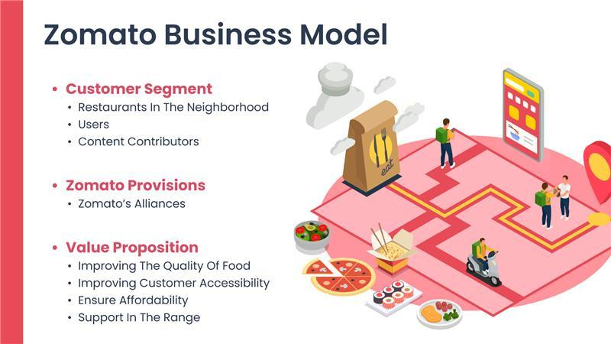

Slide 5
PROBLEM STATEMENT
SUGGESTING SOME COUNTRIES AND CITIES FOR OPENING NEW RESTAURANTS AND EXPANSION STRATEGIES FOR ZOMATO BY ANALYSING THEIR DATASETS.

Slide 6
Contents
Overview
Countries & Cities
for Expansion
Current Scenario
01
02
03
04
Food Expenditure
05
Competition
Cuisines
06
Additional Facilities
Main Findings
07
08
09
Conclusion

Slide 7
Global Overview

Slide 8
Market Trends
More than 1000 restaurants opened each year.

Slide 9
Expansion Opportunities

Slide 10
Current Scenario

Slide 11
We must have a balanced expenditure on food.

Slide 12
Competition

Slide 13
Cuisines
Choice of Cuisines affects the restaurant ratings.

Slide 14
Online Table Booking
Home Delivery
These Additional Facilities affects customer’s ratings.

Slide 15
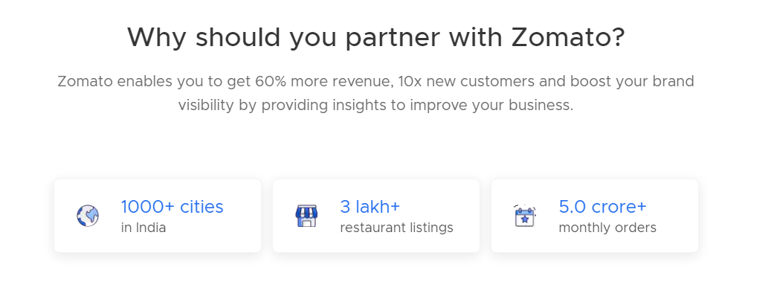
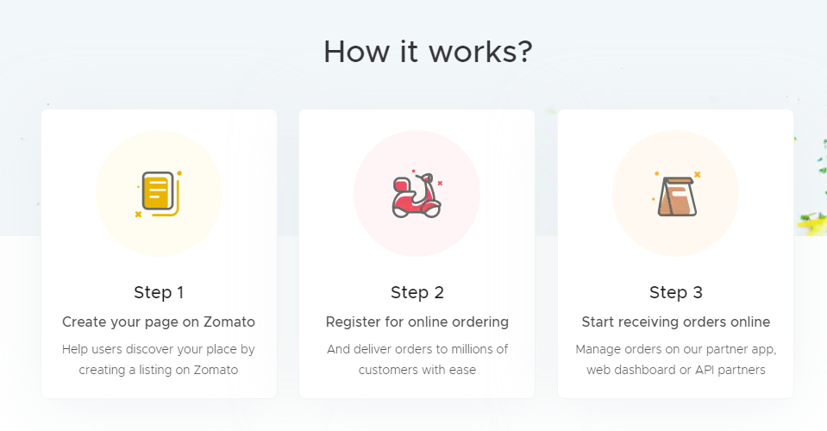
We can offer the current high rating Restaurants to tie up with us.

Slide 16
Conclusion
Top 4 selected countries for our expansion are Australia, Canada, Singapore, Sri Lanka. Our Major Focus will be on Australia, As this Country has 3 most suitable cities.
According to our data, To get a higher rating, We must keep the rate of cuisines in the middle range, keep high quality cuisines and provide additional facilities in our new Restaurants.
We must offer more services like online delivery and table booking to increase the customer’s ratings because customers enjoy additional ease & convenience in their dining experience.

Slide 17
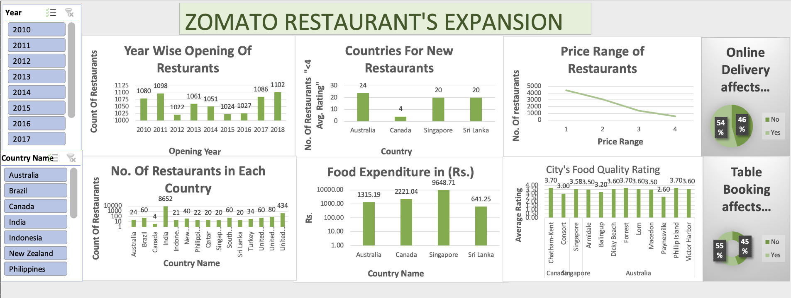

Slide 18
Thank You

