Slide 1

AM 1:
POPULISMUSFORSCHUNG

Slide 2
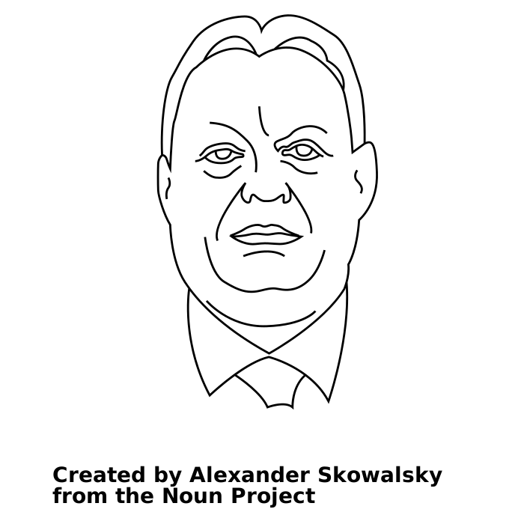
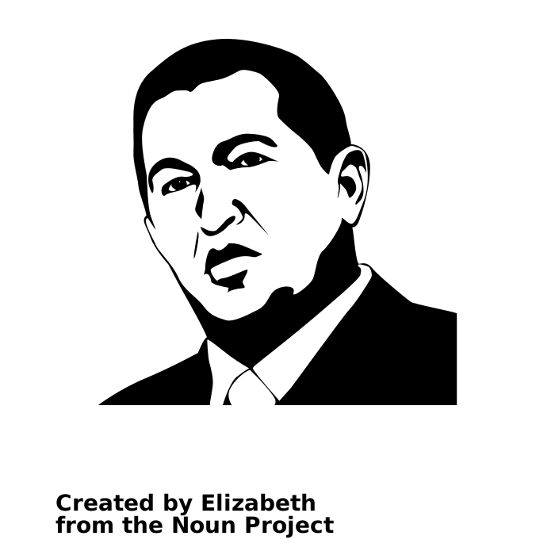

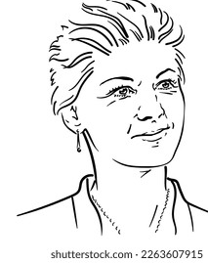

Created by leo-graph.com
from the Noun Project

Slide 3
Two Challenges

