Slide 1
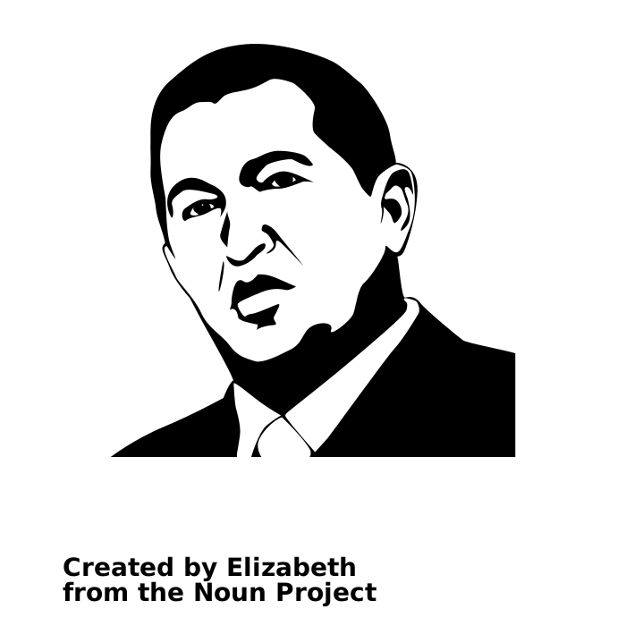

Slide 3
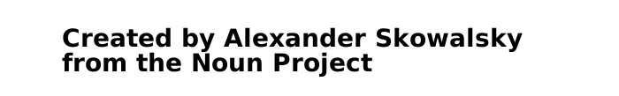
Created by leo-graph.com
from the Noun Project

