Slide 1
Stake Holder’s Console
Health Mon

Slide 2


ANM- Auxiliary Nurse Midwifery
Care Coordinator – Mr. Liam Jackson
Liam Jackson is a care coordinator who is involved in managing Diabetes patients.
Block level / District Health Officer

Slide 3
DHO Console
DHO Portal
DHO looks at looks at all the information related to the RCH Program run in Ghodegaon – Maharashtra EAST
RCH Program Trends
ICDS Program Trends
Stake holders Performance
Outcome
SMS/Chats/Emails
My Calendar
Notes:
RCH – Reproductive and Child Health Care Program
ICDS – Integrated Child Development Scheme

Slide 4
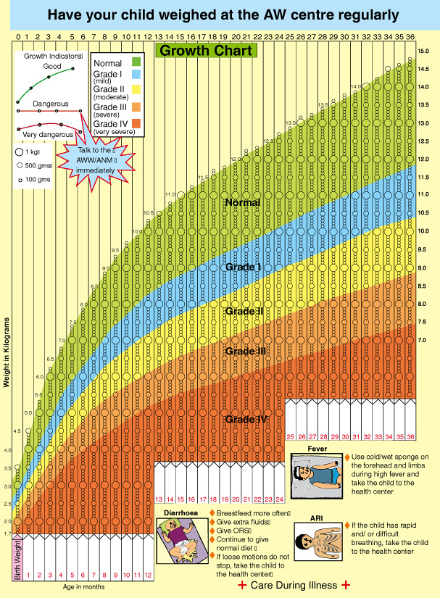
Malnutrition Dashboard
DHO Portal
DHO looks at looks at all the information related to the ICDS Program run in Ghodegaon – Maharashtra EAST for specified duration
% of Malnutritious Children

Slide 5
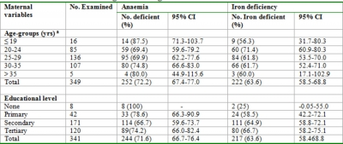
Maternal mortality dashboard
Percentage of women who died
Maternal Anemia and Iron Deficiency Trend
DHO Portal
DHO looks at all the RCH program trends related to the RCH Program run in Ghodegaon – Maharashtra EAST

Slide 6
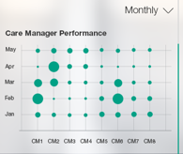
AHA/AWW/ANM Performance
Performance
Consultant/MO views all the Program level, Stake holder level compliances / performance
ASHA / AWW/ANM

Slide 7
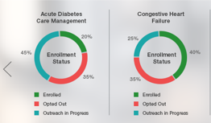
Program Performance
Performance
DHO view Program Performance – Duration , Area wise
Pre natal Care Management
Anaemia,Malnutrition management of Children - 0 to 6yrs

Slide 8
DHO Dashboard
DHO Portal
% of Enrolled Beneficiaries
% drop outs
Performance of Stake holders
Performance of the Program – Area wise , Age group wise, Period wise
Inventory Trends
Expenditure – Program wise, Area wise
Percentage of avoidable maternal deaths
Percentage of maternal deaths due to the third delay (i.e. delay in receiving adequate treatment at a health facility)
Percentage of maternal deaths that occurred in women not scheduled for antenatal care
DHO views performance of the Program as well as Stake holders

Slide 9
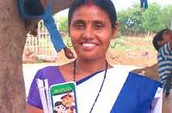
ASHA – Accredited Social Health Activist
ANM- Auxiliary Nurse Midwifery

Slide 10
ASHA Console
ASHA Console
ASHA records, views the activities related to Prenantal, Intranatal,Postnatal care of beneficiary
Conduct Survey
Health Assessment
Registration
Capture Vitals/ Investigations/Anthropometric data
Appointment Scheduling/ Referral
Educate/Counsel
SMS/Chats/Emails
Dashboard

Slide 11
ASHA Dashboard
ASHA Console
Details of Beneficiaries
Log of Health Survey
Women Health Record
Log of Vitals, health data captured and treatment given
Immunization details
Details of Health Check up Camps conducted
Inventory record – Medications, instruments, disposables
Log of training needs & training provided to beneficiaries
Log of trainings attended
Log of referral
Eligible couple register
ANC register
Infection (RTI/STI ) Register
High risk pregnancy register
Janani Suraksha Expenditure Register
Behavior Change communication Register (BCC)
Sterilization Register
ASHA maintains and views Reports/Registers

Slide 12
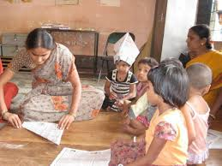
AWW- Anganwadi Worker

Slide 13
AWW Console
AWW Console
AWW records, views the activities related to 0 to 6yrs Children
Conduct Survey
Health Assessment
Registration
Capture Vitals/ Investigations/Anthropometric data
Educate/Counsel
SMS/Chats/Emails
Dashboard
Notes:
AWW -Angan Wadi Worker

Slide 14
AWW Dashboard
AWW Console
Details of Beneficiaries
Log of Health Survey
Child Growth Record
Log of Vitals, health data captured and treatment given
Immunization details
Details of Health Check up Camps conducted
Inventory record – Medications, instruments, disposables
Log of training needs & training provided to beneficiaries
Log of trainings attended
Log of referral
Birth register
Child death register
T.B Register
Children diseases register
Expenditure Register
Vitamin A,D .. register
AWW maintains and views Reports/Registers :
Notes:
AWW -Angan Wadi Worker

Slide 15
AWW Dashboard- Child Growth Chart
AWW Console
AWW views Dashboard :

Slide 16

Auxiliary Nurse Midwifery
ANM- Auxiliary Nurse Midwifery
Care Coordinator – Mr. Liam Jackson
Liam Jackson is a care coordinator who is involved in managing Diabetes patients.

Slide 17
ANM Console
ANM Console
ANM records, views the activities of Patient
Health Assessment
Registration
Investigations/Immunizations /Vitals
Educate/Counsel
Referrals
SMS/Chats/Emails
Dashboard
Notes:
AWW -Angan Wadi Worker

Slide 18
ANM Dashboard
AWW Console
Details of Beneficiaries
Immunization details
Health Checkup registers
Birth /Death Registers
Trainings to AWW, ASHA
Team Huddle
Medication ,Vitamins , instruments inventory Management
AWW maintains and views Reports/Registers :
Notes:
AWW -Angan Wadi Worker

Slide 19

Medical Officer /Consultant/Specialist
ANM- Auxiliary Nurse Midwifery
Care Coordinator – Mr. Liam Jackson
Liam Jackson is a care coordinator who is involved in managing Diabetes patients.

Slide 20
MO/Consultant Console
MO/Consultant Console
MO/Consultant records, views the diagnosis , treatment and trends of beneficiaries
My Patients
Gaps of Care
Trends
Treatment
SMS/Chats/Emails
My Calendar
Dashboard

Slide 21
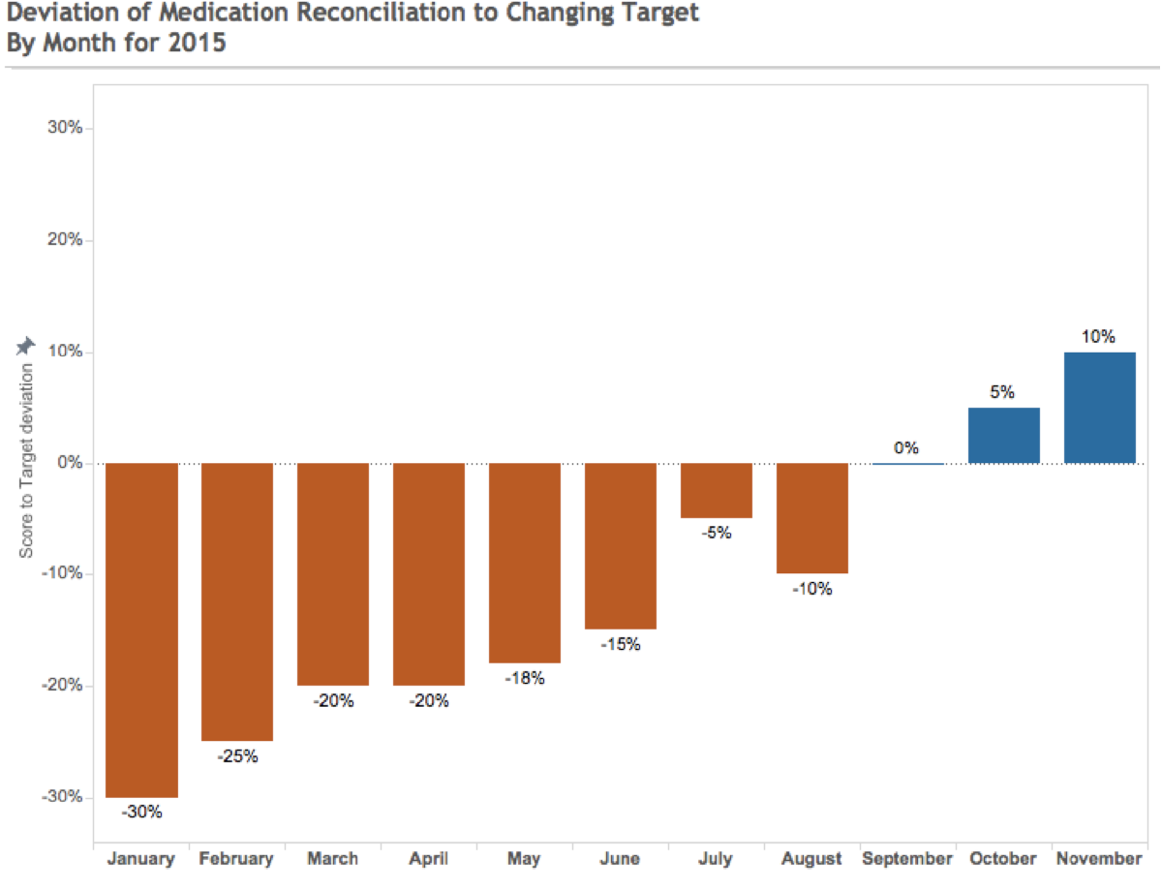
Medication Reconciliation of My Patients
Medication Reconciliation
Consultant/MO views all the information which includes Demographics, Conditions, Current Medications, assessments completed, etc.
She can also view the ‘Care Plan Goals’ and ‘Appointments’ created for her

Slide 22
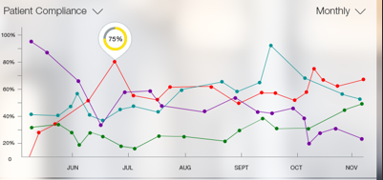
Compliances
Compliances
Consultant/MO views all the Program level, Patient level compliances

Slide 23

Patient – Pregnant Women and Child
ANM- Auxiliary Nurse Midwifery
Care Coordinator – Mr. Liam Jackson
Liam Jackson is a care coordinator who is involved in managing Diabetes patients.

Slide 24
Patient Console
Patient Console
Patient Logs into HealthMon App
My Tasks/Calendar
My Care Plan
Education Links Audio, Video
Alerts/SMS
My Health Reports
Help

Slide 25
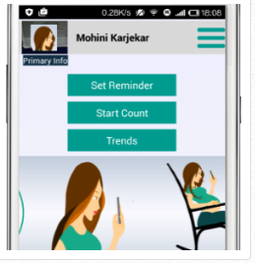
Patient View – Tasks (Kick Count of Baby)
Patient Console
Patient records, views Tasks
Prabhadevi Sapkal

Slide 26
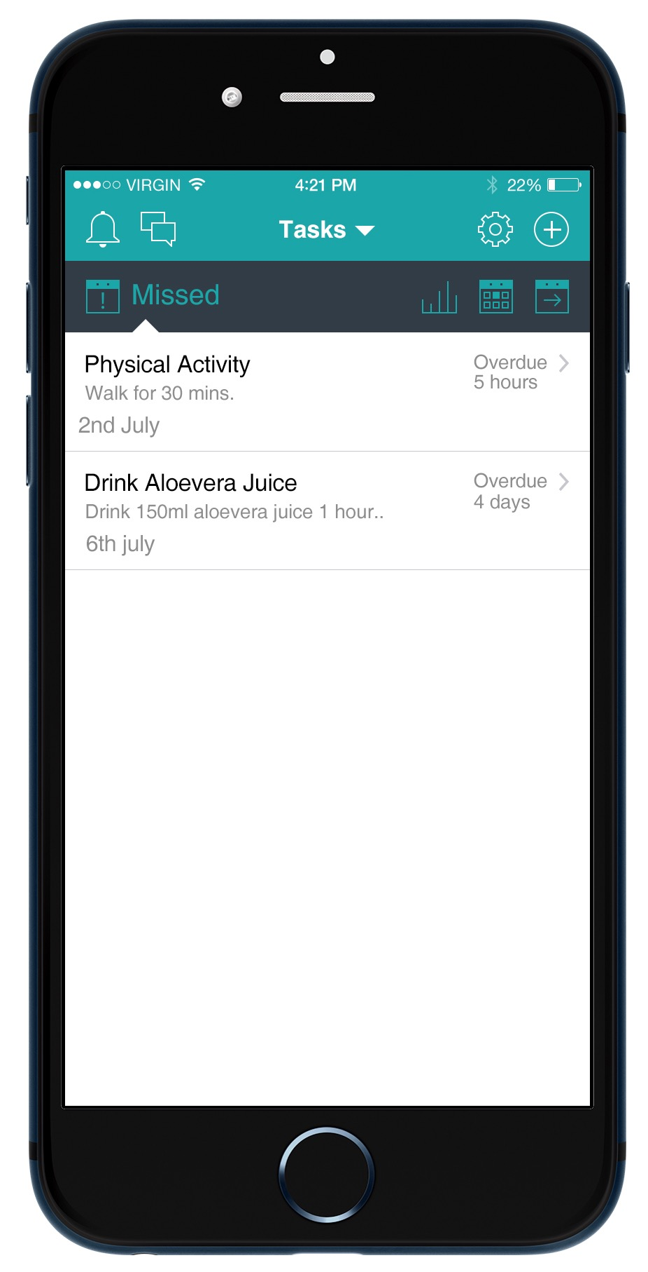
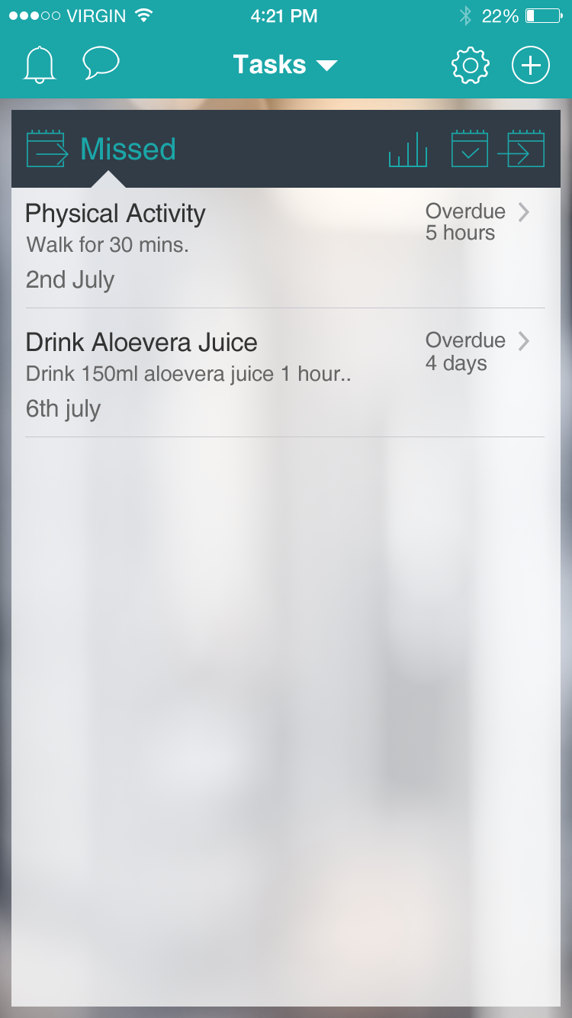
Patient View Notification/SMS
Patient Console
Patient gets alerts/sms in case of any discrepancy found or follow up or if any new education link is made available

Slide 27
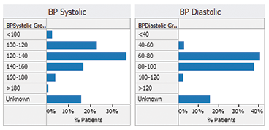
BP Trends Monitoring of Patients
BP Trends
Consultant/MO views all the information which includes Demographics, Conditions, Current Medications, BP, Hb, Glucose level monitoring, BMI, HbA1C etc..

Slide 28
MO/Consultant Dashboard
MO/Consultant Portal
% of Enrolled Beneficiaries – Age wise, diagnosis wise
% drop outs
Performance/ Health Status of Beneficiaries
Missed records- Immunization, Medications, Check ups
MTP trends
High risk patients
Referral cases
Birth Records
Death Records
MO/Consultant views Dashboard

Slide 29
MO/Consultant views Dashboard
Sample Mockups

Slide 30
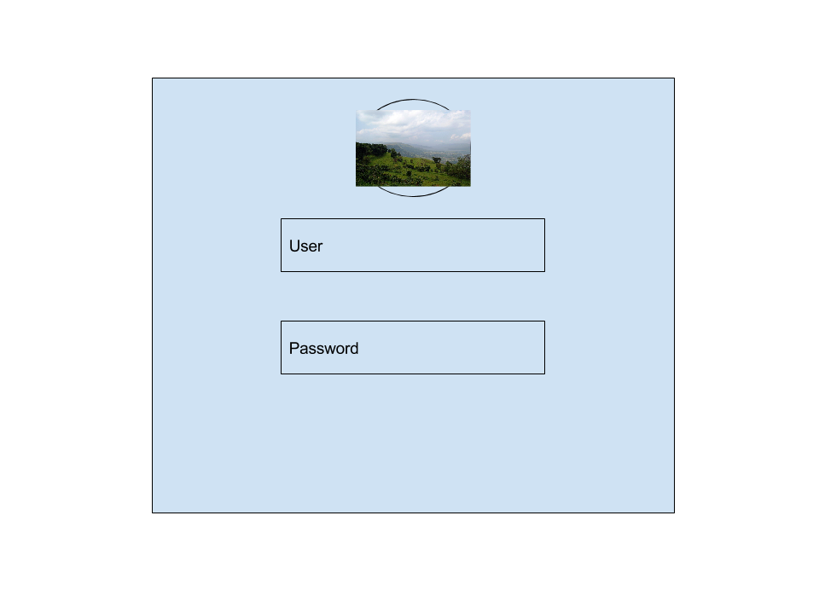
Login Screen
Login Screen
Stake holders logs into HelathMon App

Slide 31
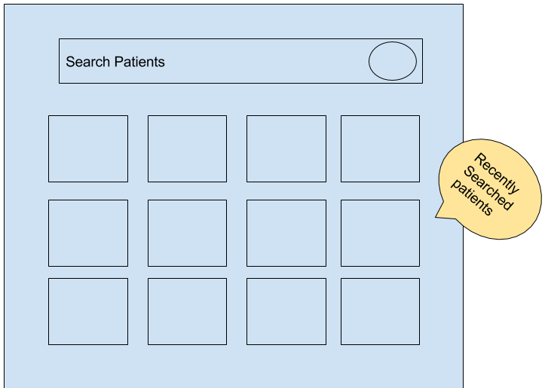
Patient List and Search
Enrolled Patients Screen
Stakeholders views the list of patients enrolled in the program and assigned to him.

Slide 32
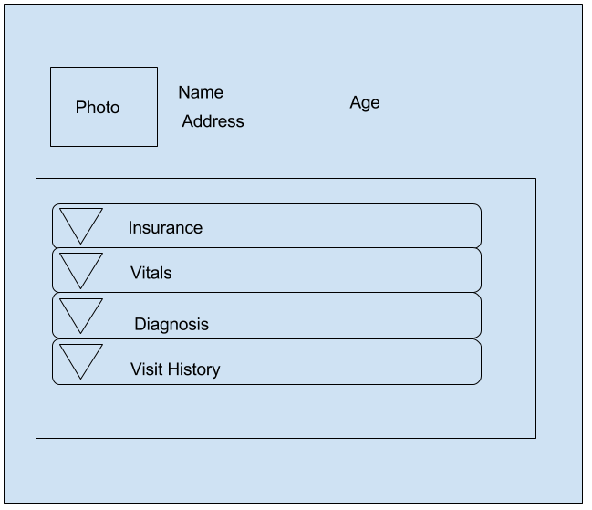
Patient Details
Patient Details
Stake holder records & views Patient details in the App – Demographics , Vitals, Diagnosis, Treatment

Slide 33
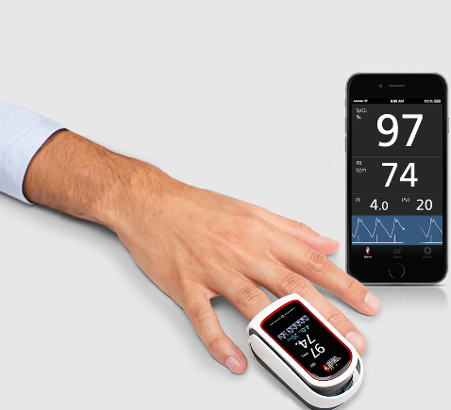
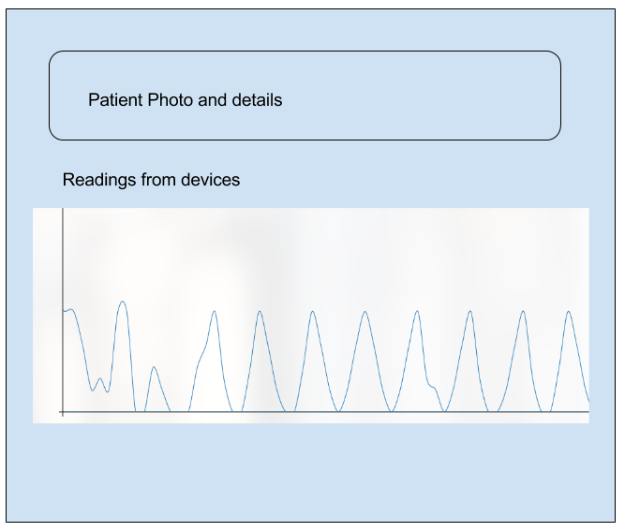
Vitals Recording – POC Device Integration
Vitals Recording
Stake holder captures Vitals with the help of medical devices into App

Slide 34
Thank You !

