Slide 1

Civic voice
JASNA SHERIN M
MES24MCA-2024
Department of Computer Applications
MES College of Engineering, Kuttippuram
20/08/2025

Slide 2
PRODUCT OWNER Mr.Vasudevan t v ASSISTANT PROFESSOR DEPARTMENT OF COMPUTER APPLICATIONS MES COLLEGE OF ENGINEERING, KUTTIPPURAM

Slide 3
TABLE OF CONTENTS
Introduction
Objective
Existing System
Proposed System
Motivation
Functionalities
Module Description
Developing Environment
Sprint Backlog
Product Backlog
User Story
Project Plans
Data Flow Diagrams
ER Diagram

Slide 4
Civic voice
Civic Voice is a digital platform for public grievance redressal, allowing citizens to file complaints related to government services like education, healthcare, sanitation, transport, etc.
It provides a centralized online portal where complaints are categorized and automatically routed to the appropriate government department for action.

Slide 5
Civic voice
Features:
Secure registration and login for citizens.
Easy complaint submission with category, location, and description.
Automatic routing to the correct department with a unique complaint ID.
Real-time status tracking with email/SMS notifications.
Admin dashboard for managing, updating, and recording complaints.

Slide 6
OBJECTIVES
Provide an easy-to-use interface for citizens to lodge complaints..
Automatically route grievances to relevant department.
Enable real-time tracking of complaint status.
Promote transparency, accountability, and efficiency in public service delivery.
Maintain a digital record of complaints for future reference and analysis

Slide 7
EXISTING SYSTEM
Citizens currently depend on helplines, physical offices, or local complaint boxes to report issues, leading to slow responses and lack of transparency.
There is no single unified platform; citizens must contact each department separately, making the process inconvenient.
CPGRAMS – Central government’s online portal for filing and tracking complaints, but mainly covers central departments.
mSeva and I Change My City – Mobile-based platforms for registering civic issues, but limited to specific regions or service

Slide 8
PROPOSED SYSTEM
Unlike CPGRAMS, mSeva, and I Change My City, Civic Voice offers a single unified platform for all departments with a simpler, more user-friendly interface.
Improves on existing systems by adding an automatic routing engine that sends complaints directly to the right department without manual intervention.
Provides better updates than current portals by offering real-time tracking with quick email/SMS alerts.
Ensures lasting impact through complete digital complaint records that build transparency, trust, and accountability in governance

Slide 9
MOTIVATIONS
Improve citizen trust in government systems.
Reduce processing delays and manual forwarding.
Provide data-driven insights for better planning.
Ensure every complaint is recorded, tracked, and resolved systematically.
Make grievance redressal accessible to all through a simple, user-friendly interface.
Promote transparency and accountability in public service delivery.

Slide 10
FUNCTIONALITIES
Allow users to register complaints under different sectors such as education, health, transport, sanitation, etc.
Enable user account creation and secure login for complaint submission and tracking.
Automatically route complaints to the relevant government department based on category and location.
Provide complaint tracking using a unique complaint ID.
Send acknowledgment and status update emails to users.
Allow administrators to view, update, and resolve complaints through a secure admin dashboard.
Maintain records of complaint history and actions taken for future reference.

Slide 11
MODULE DESCRIPTION
1. Citizen Module
Register & Login Securely – Citizens create an account and log in to access the complaint services.
Submit Complaints – Fill complaint form with category, location, and description of the issues.
Track Status in Real Time – Check the current progress of the complaint at any time.
View Complaint History – Access previous complaints and their resolution details.
Receive Notifications – Get acknowledgment and status updates via email/SMS

Slide 12
MODULE DESCRIPTION
2. Admin Module
View Assigned Complaints – See all complaints routed to their department with filtering and sorting options.
Update Complaint Status – Change the status to pending, in progress, resolved, or closed, with remarks if needed.
Generate Reports – Create analytical reports for performance monitoring and decision-making
Maintain Complaint Records – Keep digital logs of all complaints for accountability and audit.
Send Feedback/Responses – Communicate with citizens if additional information is required.

Slide 13
DEVELOPING ENVIRONMENT
Operating System: Windows
Front End: JavaScript, HTML, CSS
Back End: Python(django)
Database: Sqlite/Mysql
IDE: Visual Studio Code
Version Control: GitHub

Slide 14
SPRINT BACKLOG
Backlog item | Status And Completion Date | Original Estimation in Hours |  | Day 1 hrs | Day 2 hrs | Day 3 hrs | Day 4 hrs | Day 5 hrs | Day 6 hrs |  | Day 7 hrs | Day 8 hrs | Day 9 hrs | Day 10 hrs
SPRINT1
User registration& login | 18/08/2025 | 4 |  | 1 | 1 | 1 | 1 | 0 | 0 | 0 | 0 | 0 | 0 | 0
Complaint submission form | 22/08/2025 | 5 |  | 1 | 1 | 1 | 1 | 1 | 0 | 0 | 0 | 0 | 0 | 0
Complaint categorization logic | 26/08/2025 | 4 |  | 1 | 1 | 1 | 1 | 0 | 0 | 0 | 0 | 0 | 0 | 0
SPRINT 2
Complaint Routing with ID & Tracking System | 09/09/2025 | 10 | 1 | 1 | 1 | 1 | 1 | 1 | 1 |  | 1 | 1 | 1 | 1
Email Notification System | 12/09/2025 | 5 | 1 | 1 | 1 | 1 | 1 | 1 | 0 |  | 0 | 0 | 0 | 0

Slide 15
SPRINT BACKLOG
Backlog tem | Completion Date | Original Estimation in Hours | Day 1 hrs | Day 2 hrs | Day 3 hrs | Day 4 hrs | Day 5 hrs | Day 6 hrs | Day 7 hrs | Day 8 hrs | Day 9 hrs | Day 10 hrs
SPRINT3
Admin Dashboard | 20/09/2025 | 7 | 1 | 1 | 1 | 1 | 1 | 1 | 1 | 0 | 0 | 0
Complaint Status Update Module | 24/09/2025 | 6 | 1 | 1 | 1 | 1 | 1 | 1 | 0 | 0 | 0 | 0
SPRINT 4
Reports & Analytics | 28/10/2025 | 5 | 1 | 1 | 1 | 1 | 1 | 0 | 0 | 0 | 0 | 0
Feedback/Response System | 09/10/2025 | 4 | 1 | 1 | 1 | 1 | 0 | 0 | 0 | 0 | 0 | 0
TOTAL |  | 50 | 9 | 9 | 9 | 9 | 5 | 6 | 2 | 1

Slide 16
PRODUCT BACKLOG
ID | NAME | PRIORITY | ESTIMATE (Hours) | STATUS
1 | User Registration / Login | High | 4 | completed
2 | Complaint Submission Form | High | 5 | completed
3 | Complaint Categorization Logic | High | 4 | in progress
4 | Complaint Routing with Unique ID & Tracking | High | 10 | In progress
5 | Email Notifications System | Medium | 5 | In progress

Slide 17
PRODUCT BACKLOG
ID | NAME | PRIORITY | ESTIMATE (Hours) | STATUS
6 | Admin Dashboard | High | 7 | completed
7 | Complaint Status Update Module | High | 6 | In progress
8 | Reports & Analytics | Medium | 5 | Not Started
9 | Feedback / Response System | Medium | 4 | Not Started

Slide 18
USER STORY
User Story ID | As a type of User | I want to | So that i can
1 | Citizen (User) | Register | Create an account and start submitting complaints securely
2 | Citizen (User) | Login | Access my account securely and track complaint history
3 | Citizen (User) | Submit Complaint | Report issues related to public services easily
4 | Citizen (User) | Categorize my complaint | Ensure it is sent to the correct department based on type
5 | Citizen (User) | Track my complaint using a unique ID | Monitor progress and know if it is pending, in progress, or resolved

Slide 19
USER STORY
User Story ID | As a type of User | I want to | So that I can
6 | Citizen (User) | Receive Notifications | Stay updated through email/SMS about complaint status changes
7 | Admin | View all complaints on Dashboard | See assigned complaints with sorting/filtering options
8 | Admin | Update Complaint Status | Mark a complaint as Pending/In progress/Resolved/Closed with remarks
9 | Admin | Generate Reports & Maintain Records | Analyze complaints, monitor department performance, and keep digital logs

Slide 20
PROJECT PLAN
User StoryID | Task Name | Start Date | End Date | Days | Status
1 | Sprint 1 | 18/08/2025 | 21/08/2025 | 20 | completed
2 |  | 22/08/2025 | 25/08/2025 |  | completed
3 |  | 26/08/2025 | 08/09/2025 |  | completed
4 | Sprint 2 | 09/09/2025 | 11/09/2025 | 11 | In progress
5 |  | 12/09/2025 | 19/09/2025 |  | In progress

Slide 21
PROJECT PLAN
User StoryID | Task Name | Start Date | End Date | Days | Status
6 | SPRINT 3 | 20/09/2025 | 23/09/2025 | 7 | Not started
7 |  | 24/09/2025 | 27/09/2025 |  | Not started
8 | SPRINT 4 | 28/09/2025 | 08/10/2025 | 16 | Not started
9 |  | 09/10/2025 | 12/10/2025 |  | Not started

Slide 22
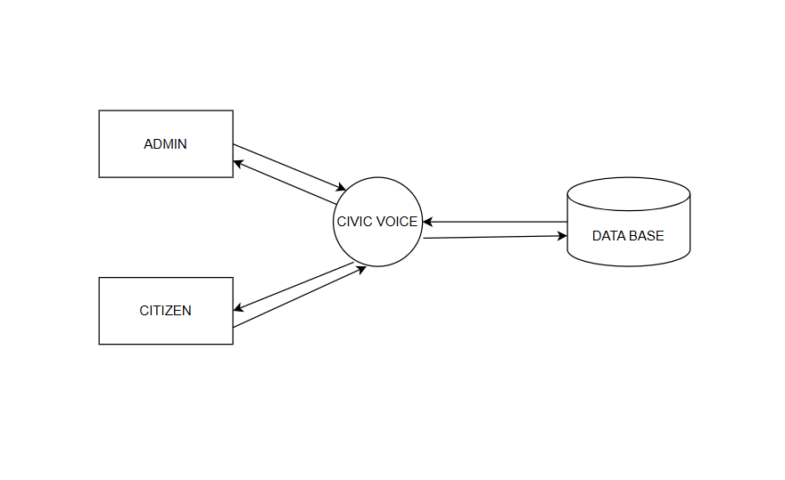
DATA FLOW DIAGRAM
LEVEL 0

Slide 23
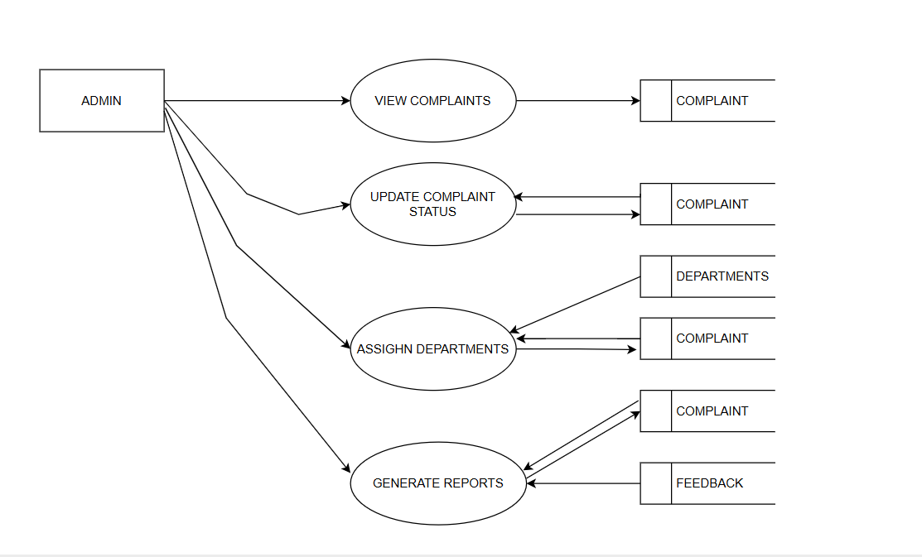
DATA FLOW DIAGRAM
Level 1

Slide 24
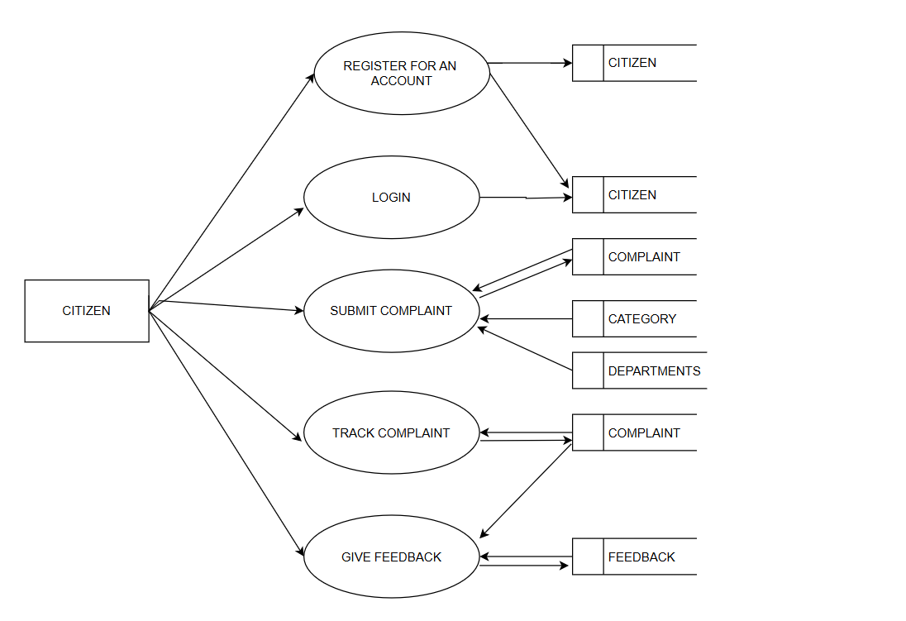
DATA FLOW DIAGRAM
Level 1.1

Slide 25
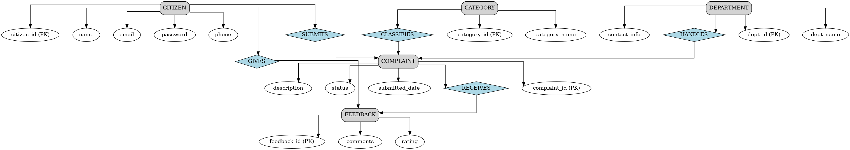
ER DIAGRAM

Slide 26
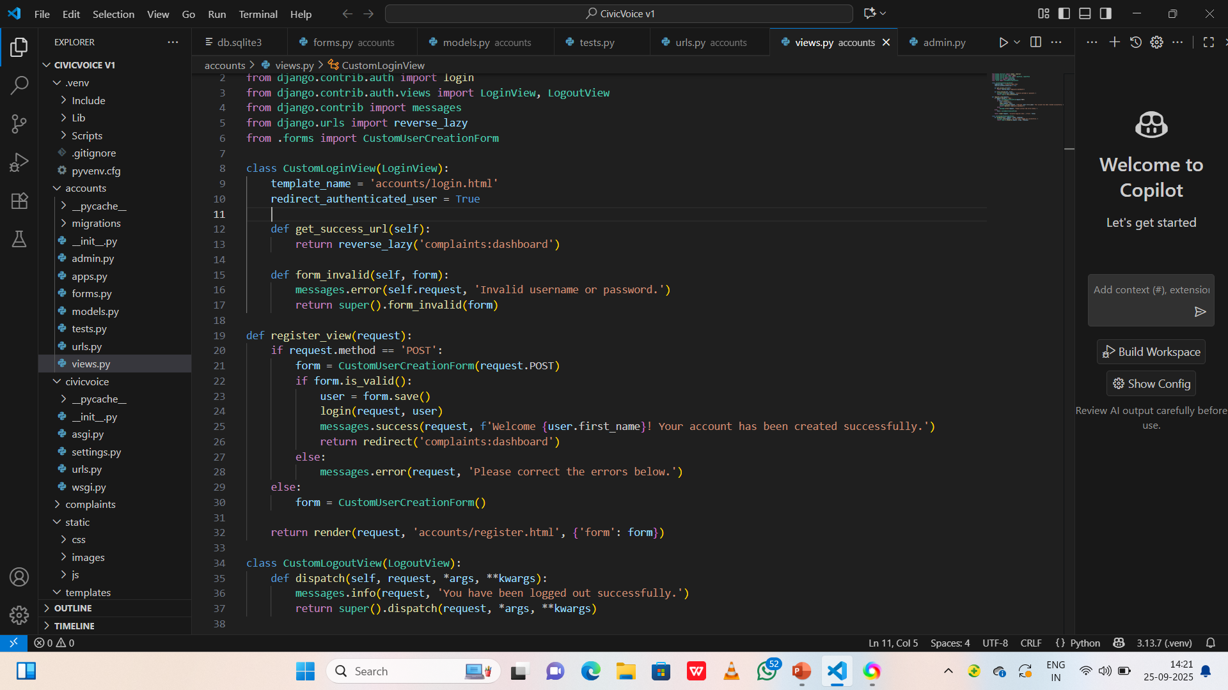
FUNCTIONALITIES :code-snippet:1

Slide 27
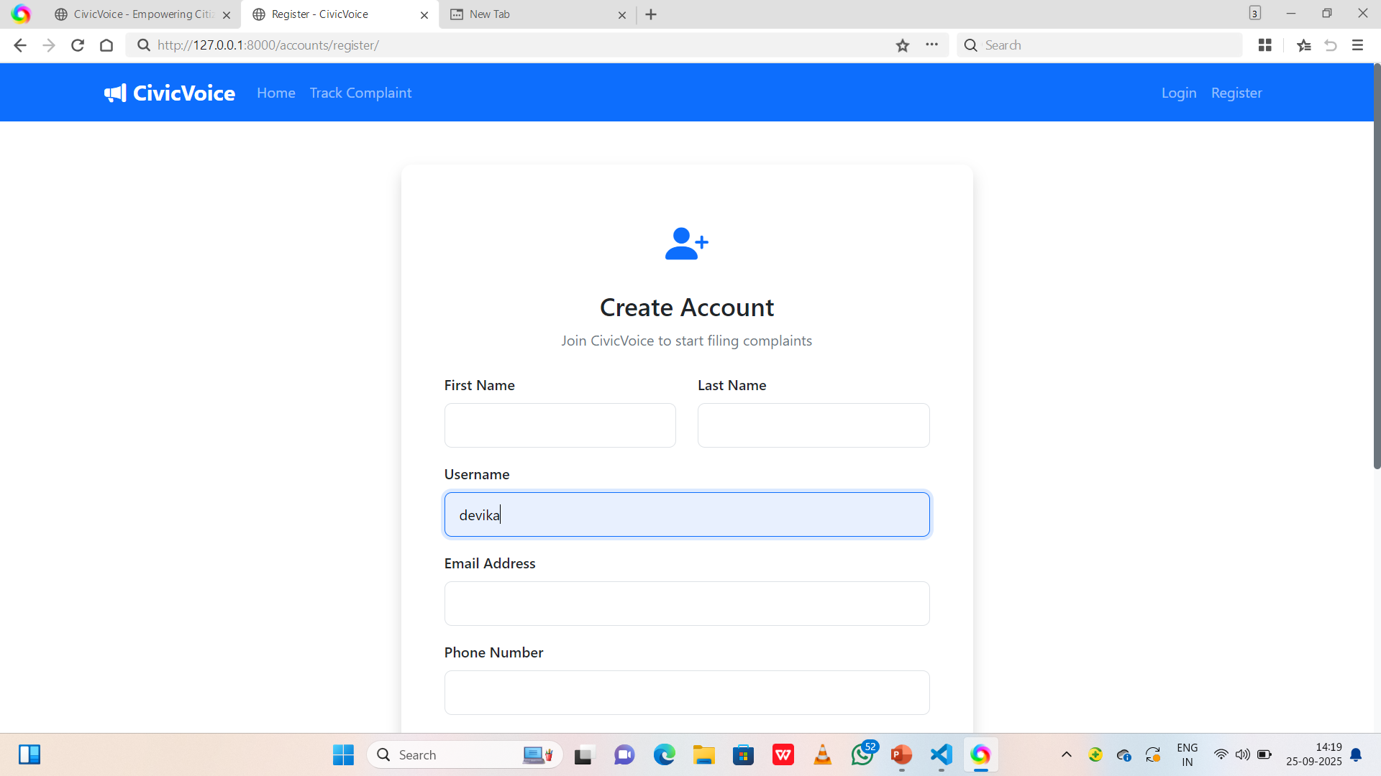
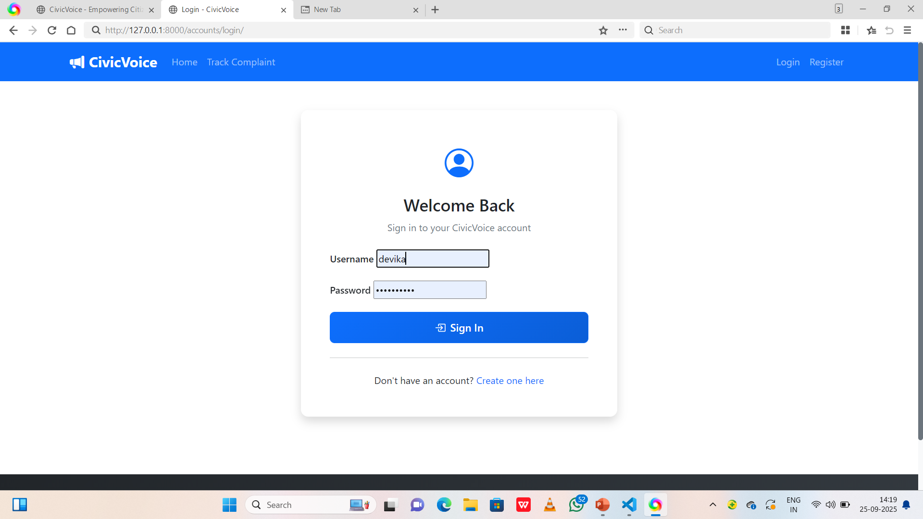
Screenshot

Slide 28
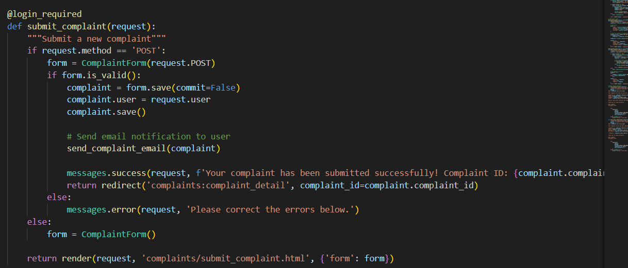
Code snippet:2

Slide 29
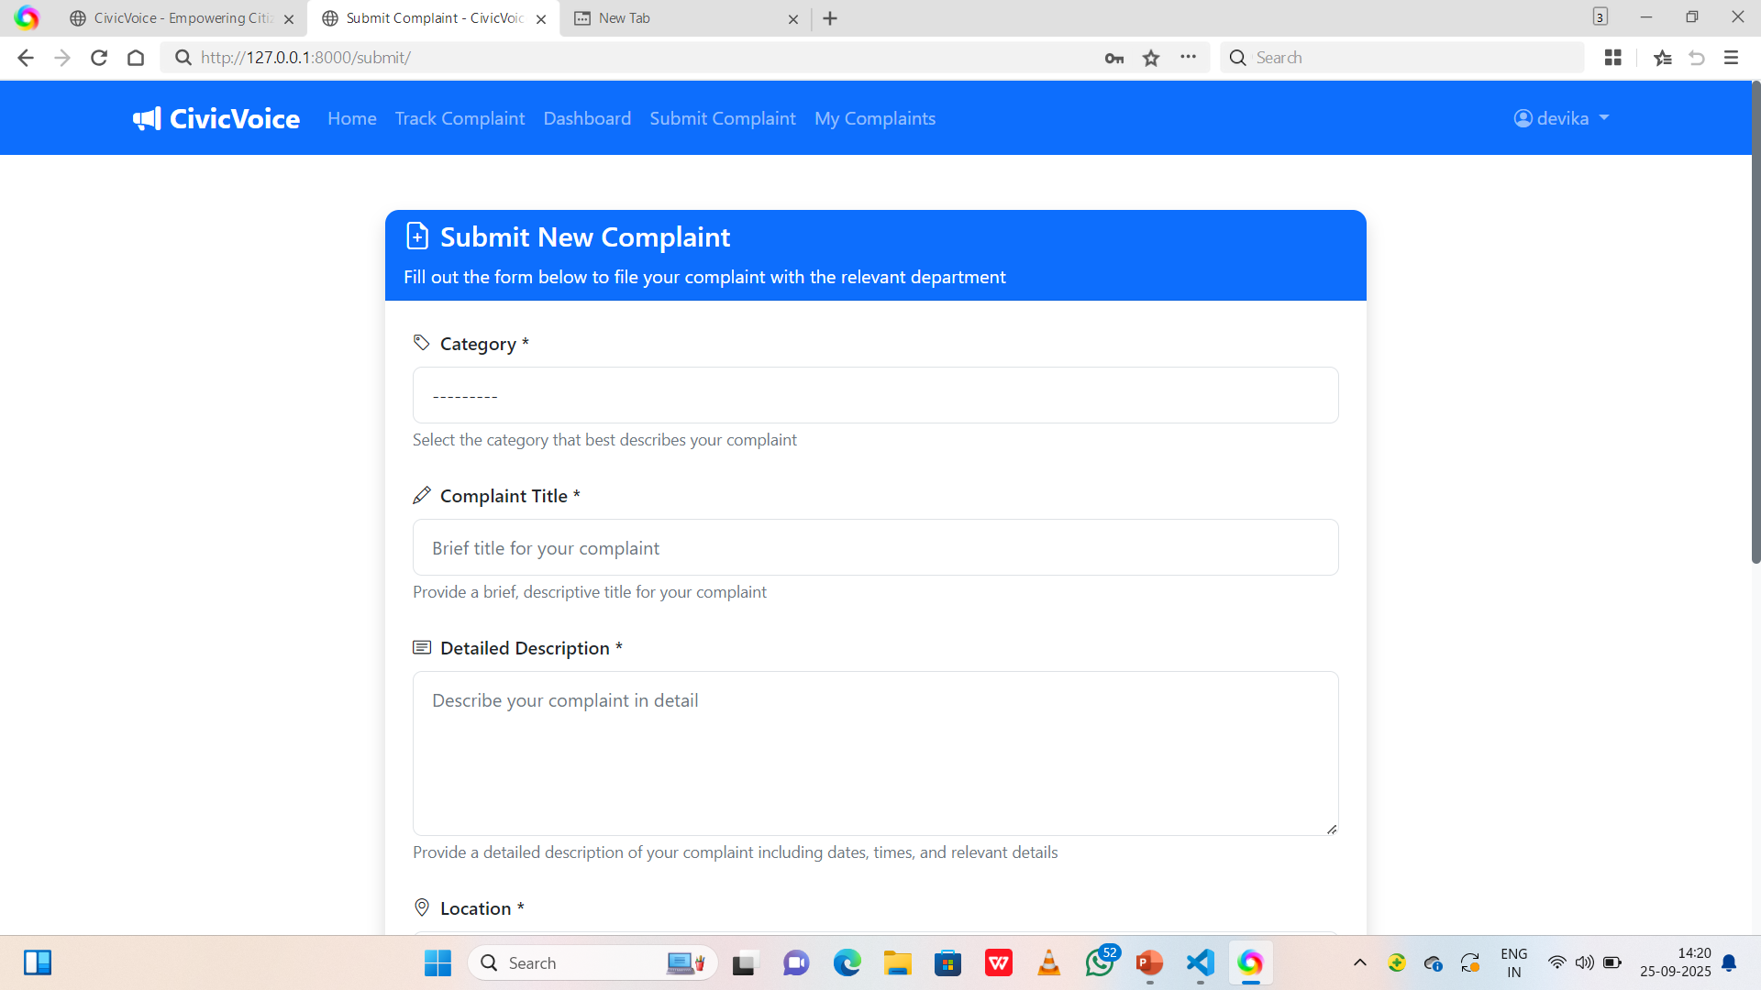
screenshot

Slide 30
THANK YOU

