Slide 1
CS636 Data Analytics with R Programing
Instructor
Zhi Wei

Slide 2
Course Logistics
Basic information
Requirements
Goal

Slide 3
CS636 Data Analytics with R Programing
Instructor
Zhi Wei, GITC 4214A, zhiwei@njit.edu, (973)642-4497
Jianlan Ren, TA, jr689@njit.edu
Time & Place
Thursdays 1:00am-3:55 pm, TIER 106
Office Hour:
Thurs 4:00pm-4:50pm, Fridays 2:30pm-4:40pm.
Or by appointment
Textbooks
R Programming for Data Science, by Roger D. Peng
Using R for Introductory Statistics, by John Verzani, 2014, ISBN 1466590734
Advanced R, by Hadley Wickham, ISBN 9781466586963

Slide 4
Course websites
http://web.njit.edu/~zhiwei/CS636/
http://canvas.njit.edu/

Slide 5
Requirements
Homework & computing lab exercise (5%)
Quiz (20%)
Term Project (10%)
Midterm (25%)
Final (40%)
A: 90% or above;
B+: [83% - 90%);
B: [75% - 83%);
C+: [67% - 75%);
C: [60% - 67%);
F: Below 60%.

Slide 6
Homework (2 %)
Homework assignments
Try to do it independently, discussions allowed, but copying is forbidden.
Homework Grading Policy
Your homework: may have several homework assignments, but pick only one (the worst one) to grade. Namely, if you miss one assignment, you get 0.
Late homework policy
25% penalization per late day;
Not accepted more than 3 days late

Slide 7
Lab exercise (3 %)
Have a lab session every week
Lab exercises
Focus on R computing exercises
3 students a group
Graded as a group: team work is important!
1~3 groups will be selected for test by the end of lab session.

Slide 8
Two Term Projects (10%)
Project 1
Scrape data from web
Project 2
Kaggle competition https://www.kaggle.com/competitions
Submit a report to summarize what you have done and results you obtained
1~5 students a group.
Present results to the class
More details to be announced soon
Notes:
provide an additional way to gain a deeper understanding of a specific topic.

Slide 9
Quiz (20%)
R programming
5 Quizzes
Every other week

Slide 10
Two Exams (65%)
One midterm and one Final (25%+40%)
In-class; closed book; a cheating sheet allowed
Final is cumulative

Slide 11
Canvas Participation
To promote "after-class" discussions, extra credits are usually given to those participating in the Moodle discussions most actively as well as those helping answer questions in the Moodle.

Slide 12
Goal
Gain programming proficiency of R
Familiarize you with the commonly used analytical techniques in Data Science
Develop the way of data science thinking
Learn how to preprocess, explore and interpret real data
Learn how to model real problems using computational techniques

Slide 13
Intro to R
Zhi Wei

Slide 14
What is R?
Statistical computer language similar to S-plus
Interpreted language (like Matlab)
Has many built-in (statistical) functions
Easy to build your own functions
Good graphic displays
Extensive help files

Slide 15
Strengths
Many built-in functions
Can get other functions from the internet by downloading libraries
Relatively easy data manipulations
Weaknesses
Not as commonly used by non-statisticians
Not a compiled language, language interpreter can be very slow, but allows to call own C/C++ code

Slide 16
R, Statistics, Data Science
Packaging: a crucial infrastructure to efficiently produce, load and keep consistent software libraries from (many) different sources / authors
Statistics
most packages deal with statistics and data analysis
State of the art: many statistical researchers provide their methods as R packages
R vs Python for Data Science: The Winner is …
https://www.kdnuggets.com/2017/09/python-vs-r-data-science-machine-learning.html
On the web, you can find many numbers comparing the adoption and popularity of R and Python
You will find R only in a data science environment; As a general purpose language, Python, on the other hand, is widely used in many fields, such as web development.
http://res.cloudinary.com/dyd911kmh/image/upload/f_auto,q_auto:best/v1523009719/main-qimg-9dcf536c501455f073dfbc4e09798a51_vpijr0.png

Slide 17
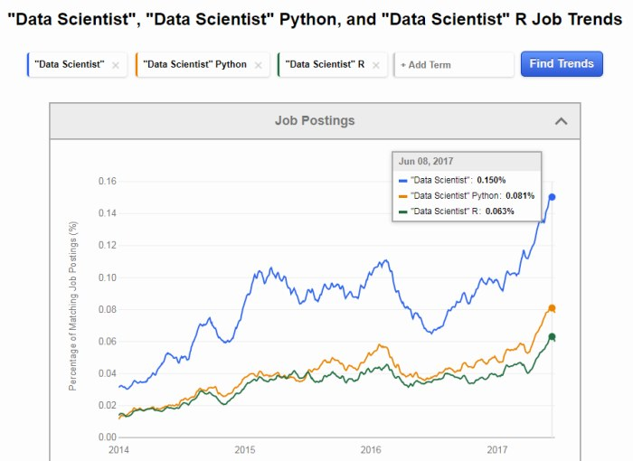
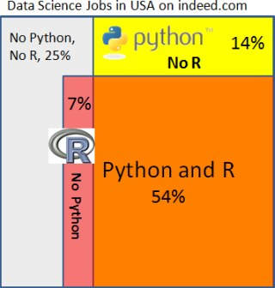
R vs Python

Slide 18
When to use R?
When
Requires standalone computing or analysis on individual servers.
Great for exploratory work: it's handy for almost any type of data analysis because of the huge number of packages and necessary tools to get up and running quickly
R can even be part of a big data solution.

Slide 19
How to use/learn R?
How
(optional) Install and Use Rstudio IDE
Getting started with R (Basic grammars)
Get to use/learn those popular packages
dplyr, plyr and reshape2 for data manipulation
stringr for string operation
ggplot2 for data visualization
…
Do (a lot of) practices including real projects

Slide 20
Install RStudio
An integrated development environment (IDE) available for R
a nice editor with syntax highlighting
there is an R object viewer
there are a number of other nice features that are integrated
How to install
https://youtu.be/bM7Sfz-LADM

Slide 21
Starting and stopping R
Starting
Windows: Double click on the R icon
Unix/Linux: type R (or the appropriate path on your machine)
Stopping
Type q()
q()is a function execution
Everything in R is a function
q merely returns the content of the function

Slide 22
Writing R code
Can input lines one at a time into R
Can write many lines of code in any of your favorite text editors (including Rstudio) and run all at once
Simply paste the commands into R
Use function source(“path/yourscript”), to run in batch mode the codes saved in file “yourscript” (use options(echo=T) to have the commands echoed)

Slide 23
R as a Calculator
> log2(32)
[1] 5
> sqrt(2)
[1] 1.414214
> seq(0, 5, length=6)
[1] 0 1 2 3 4 5
> plot(sin(seq(0,
2*pi, length=100)))

Slide 24
Recalling Previous Commands
In WINDOWS/UNIX one may use the arrow up key or the history command under the menus
Given the history window then one can copy certain commands or else past them into the console window

Slide 25
Language layout
Three types of statement
expression: it is evaluated, printed, and the value is lost (3+5)
assignment: passes the value to a variable but the result is not printed automatically (out<-3+5)
comment: (#This is a comment)

Slide 26
Naming conventions
Any roman letters, digits, underline, and ‘.’ (non-initial position)
Avoid using system names: c, q, s, t, C, D, F, I, T, diff, mean, pi, range, rank, tree, var
Hold for variables, data and functions
Variable names are case sensitive

Slide 27
Arithmetic operations and functions
Most operations in R are similar to Excel and calculators
Basic: +(add), -(subtract), *(multiply), /(divide)
Exponentiation: ^
Remainder or modulo operator: %%
Matrix multiplication: %*%
sin(x), cos(x), cosh(x), tan(x), tanh(x), acos(x), acosh(x), asin(x), asinh(x), atan(x), atan(x,y) atanh(x)
abs(x), ceiling(x), floor(x)
exp(x), log(x, base=exp(1)), log10(x), sqrt(x), trunc(x) (the next integer closer to zero)
max(), min()

Slide 28
Defining new variables
Assignment symbol, use “<-” (or =)
Scalars
>scal<-6
>value<-7
Vectors; using c() to enter data
>whales<-c(74,122,235,111,292,111,211,133,16,79)
>simpsons<-c("Homer", "Marge", "Bart", "Lisa", "Maggie")
Factors
>pain<-c(0,3,2,2,1)
>fpain<-factor(pain,levels=0:3)
>levels(fpain)<-c("none", "Mild", "medium", "severe")

Slide 29
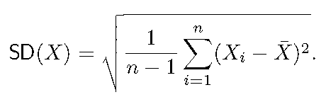
Use functions on a vector
Most functions work on vectors exactly as we would want them to do
>sum(whales)
>length(whales)
>mean(whales)
sort(), min(), max(), range(), diff(), cumsum()
Vectorization of (arithmetic) functions
>whales + whales
>whales - mean(whales)
Other arithmetic funs: sin(), cos(), exp(), log(), ^, sqrt()
Example: calculate the standard deviation of whales

Slide 30
Functions that create vectors
Simple sequences
>1:10
>rev(1:10)
>10:1
Arithmetic sequence
a+(n-1)*h: how to generate 1, 3, 5, 7, 9?
>a=1; h=2; n=5 OR
>a+h*(0:(n-1))
Repeated numbers
>rep(1,10)
>rep(1:2, c(10,15))
getting help: ?rep or help(rep)
help.search(“keyword”) or ??keyword
>c(1:10, 10:1)
>fractions(1/(2:10))
>library(MASS) #to have fractions()
>seq(1,9,by=2)
>seq(1,9,length=5)

Slide 31
Matrix
There are several ways to make a matrix
To make a 2x3 (2 rows, 3 columns) matrix of 0’s:
>mat<-matrix(0,2,3)
To make the following matrix:
>mat2<-rbind(c(71,172),c(73,169),c(69,160),c(65,130))
>mat3<-cbind(c(71,73,69,65),c(172,169,160,130))
To make the following matrix:
mat4<-matrix(1:10,2,5, byrow=T)
71 | 172
73 | 169
69 | 160
65 | 130
1 | 2 | 3 | 4 | 5
6 | 7 | 8 | 9 | 10

Slide 32
Accessing data by using indices
Accessing individual observations
>whales[2]
Slicing
>whales[2:5]
Negative indices
>whales[-1]
Logical values
>whales[whales>100]
>which(whales>100)
>which.max(whales)

Slide 33
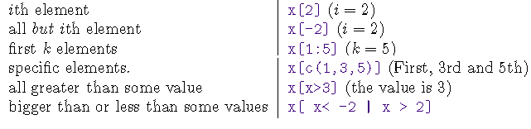
Indexing of vector/matrix
x=1:10
mat=matrix(1:24, nrow=4)
mat[,2] # 2nd column
mat[2,] # 2nd row
mat[c(2,4),] # 2nd and 4th row
mat[1:3,1] # 1 to 3 element in column 1
mat[-c(2,4),] # all but row 2 and 4

Slide 34
Create logical vectors by conditions
Logical operators: <, <=, >, >=, ==, !=
Comparisons
Vectors: AND &; OR |
Longer forms &&, ||: return a single value
all() and any()
Examples
X=1:5
X<5; X>1
X >1 & X <5; X >1 | X <5;
all(X<5); any(X>1); all(X<5) && any(X>1)
%in% operator: x %in% c(2,4)

Slide 35
Missing values
R codes missing values as NA
is.na(x) is a logical function that assigns a T to all values that are NA and F otherwise
>x[is.na(x)]<-0
>mean(x, na.rm=TRUE)

Slide 36
Reading in other sources of data
Use R’s built-in libraries and data sets
>range(lynx) #lynx is a built-in dataset
>library(MASS) # load a library
>data(survey) # load a dataset in the library
>data(survey, package="MASS")#load just data
>head(survey)
>tail(survey)
Copy and paste by scan()
>whales=scan()
1: 74 122 235 111 292 111 211 133 156 79
11:
Read 10 items

Slide 37
Read formatted data
Read data from formatted data files, e.g. a file of numbers from a single file, a table of numbers separated by space, comma, tab etc, with or without header
>whale=scan(file="whale.txt")
“whale.txt”:
74 122 235 111 292 111 211 133 156 79
>whale=read.table(file="whale.txt", header=TRUE)
“whale.txt”:
texas florida
74 89
122 254
…. ….
>read.table(file=file.choose()) # specify the file
>read.table(file="http://statweb.stanford.edu/~rag/stat141/exs/whale.txt",header=T) # read from internet

Slide 38
Data frame
A “data matrix” or a “data set”
it likes a matrix (rectangular grid)
But unlike matrix, different columns can be of different types
Row names have to be unique
>alphabet<-data.frame(index=1:26, symbol=LETTERS)
read.table() stores data in a data frame
Access var in a dataset: $, attach(), with()
>library(ISwR) #load the package that provides thuesen data
>data(thuesen)
>names(thuesen) #variable names
> blood.glucose # not visible
>length(thuesen$blood.glucose)
>with(thuesen, range(blood.glucose))
>attach(thuesen)
>range(blood.glucose)
>detach(thuesen)

Slide 39
More about data frame
Indexing of data frames is the same as that of vector and matrix >energy[energy$stature== "lean",]
Sorting rows by order()
>energy[order(energy$expend),]
>energy[with(energy, order(stature, expend)),]
Selecting subsets of data by subset()
>subset(energy, stature=="lean" & expend>8)
Splitting data
>split(energy$expend, energy$stature)

Slide 40
Lists
A larger composite object for combining a collection of objects
Different from data frame, each object can be of different length, in additional to being of different types
>a=list(whales=c(74,122,235,111,292,111,211,133,16,79),
simpsons=c("Homer", "Marge", "Bart", "Lisa", "Maggie"))
Access by $ or [[]]: a$simpsons or a[[2]]

Slide 41
Manage the work environment
What if there are more variables defined than can be remembered?
ls() list all the objects(var, fun, etc) in a given environment
rm(a, b): delete variables a and b
rm(list=ls()) will ?
Get and set working directory
>getwd()
>setwd("working/directory/path")
Save and load working environment
>save.image(file="filename.RData")
>load(file="filename.RData")

Slide 42
scripting
Edit your commands using your favorite text editors
How to run
Inside R: >source(filename)
Takes the input and runs them
Do syntax-check before anything is executed
Set echo=T to print executed commands
OR copy & paste
Outside R: R CMD BATCH filename

Slide 43
How to install packages
To install CRAN packages, execute from the R console the following command:
(1)> install.packages("UsingR", lib="/afs/cad.njit.edu/u/z/h/zhiwei/R_library")
(2)> source("http://bioconductor.org/biocLite.R")
> biocLite(c("UsingR"), lib="/afs/cad.njit.edu/u/z/h/zhiwei/R_library")
OR download the package and install it directly
R CMD INTALL aPackage_0.1.tar.gz –l /afs/cad.njit.edu/u/z/h/zhiwei/R_library
Load a library
>library("ISwR",lib="/afs/cad.njit.edu/u/z/h/zhiwei/R_library")
OR
>.libPaths(c("/afs/cad.njit.edu/u/z/h/zhiwei/R_library",.libPaths()))
>library("UsingR")

Slide 44
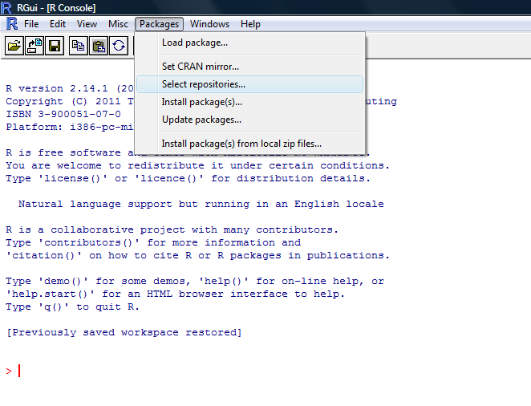
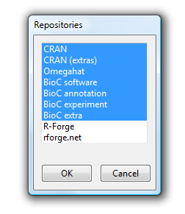
Windows: Set repositories
Make sure you include necessary repositories (you may simply select all of them)

Slide 45
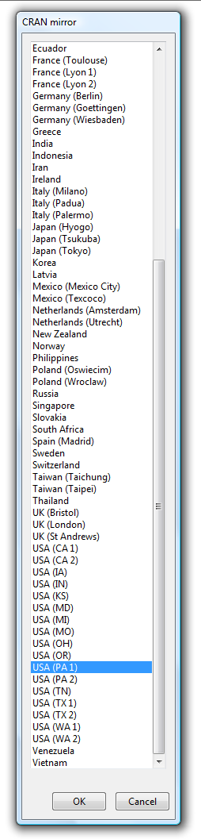
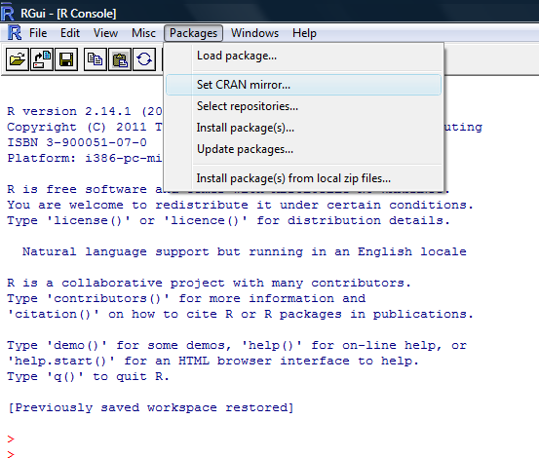
Windows: Set CRAN mirror
You can choose anyone but physically close ones are preferred

Slide 46
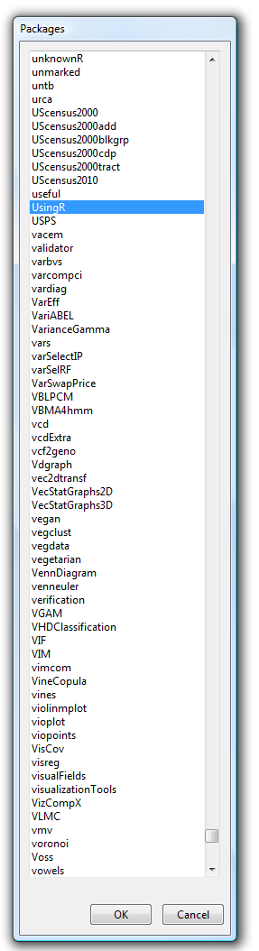
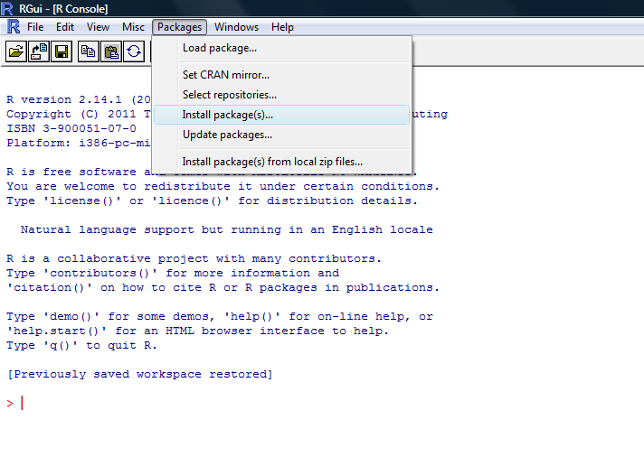
Windows: install packages

Slide 47
Additional references
Beginners should print out the R Reference Card
http://cran.r-project.org/doc/contrib/Short-refcard.pdf
The R-FAQ (Frequently Asked Questions on R)
http://cran.r-project.org/doc/FAQ/R-FAQ.html
A rather terse introduction to R online
http://cran.r-project.org/doc/manuals/R-intro.html
Bioconductor
http://www.bioconductor.org/
A useful online manual for R & Bioconductor
http://manuals.bioinformatics.ucr.edu/home/R_BioCondManual

Slide 48
Computing Lab Ex.
Lab 1
Install UsingR and ISwR packages to your own directory
Using R for Introductory Statistics, Page 18: 1.1-1.12
1.18, 1.19

Slide 49
Acknowledgments
Jeff Solka: for some of the slides adapted or modified from his lecture slides at George Mason University
Brian Healy: for some of the slides adapted or modified from his lecture slides at Harvard University

Slide 50
Next week
Getting Data In and Out of R
Homework 1 due
First Quiz

