Slide 1
Optimized Load Balancing: Leveraging Hardware Awareness for Performance Enhancement
EE499 Final Project Presentation

Slide 2
introduction 5 w’s? load balancing
Ideal desired behavior
Core 0
load balancing aims to distribute the load across the hardware (cores) so that task execution is faster
Core 1
Notes:
Load balancing: 5 Whys
[optional] current cpu load statistics: the decade of wasted core
To exemplify the types of resource contention, consider simultaneous multi-threaded (SMT) threads on a
CMP that appear as identical logical CPU cores to the OS, but share most of the computing resources on the chip, including caches and registers. Processes scheduled to run on different SMT threads at the same time contend for the resources on the chip. Similarly, CPUs within the same NUMA node share memory and I/O bandwidth.

Slide 3
introduction 5 w’s? load balancing
Ideal desired behavior
Core 0
load balancing aims to distribute the load across the hardware (cores) so that task execution is faster
execution behavior leads to unbalancing
io-bound task
compute-bound task
Core 1
At time t ms
Core 0
Core 1
Notes:
Load balancing: 5 Whys
[optional] current cpu load statistics: the decade of wasted core
To exemplify the types of resource contention, consider simultaneous multi-threaded (SMT) threads on a
CMP that appear as identical logical CPU cores to the OS, but share most of the computing resources on the chip, including caches and registers. Processes scheduled to run on different SMT threads at the same time contend for the resources on the chip. Similarly, CPUs within the same NUMA node share memory and I/O bandwidth.

Slide 4
introduction 5 w’s? load balancing
Ideal desired behavior
Core 0
load balancing aims to distribute the load across the hardware (cores) so that task execution is faster
execution behavior leads to unbalancing
io-bound task
compute-bound task
Core 1
At time t ms
Core 0
Core 1
Notes:
Load balancing: 5 Whys
[optional] current cpu load statistics: the decade of wasted core
To exemplify the types of resource contention, consider simultaneous multi-threaded (SMT) threads on a
CMP that appear as identical logical CPU cores to the OS, but share most of the computing resources on the chip, including caches and registers. Processes scheduled to run on different SMT threads at the same time contend for the resources on the chip. Similarly, CPUs within the same NUMA node share memory and I/O bandwidth.

Slide 5
5 w’s? load balancing
Ideal desired behavior
Core 0
load balancing aims to distribute the load across the hardware (cores) so that task execution is faster
execution behavior leads to unbalancing
io-bound task
compute-bound task
need for re-balancing
Core 1
At time t ms
Core 0
Core 1
At time t ms
Core 0
Core 1
Notes:
Load balancing: 5 Whys
[optional] current cpu load statistics: the decade of wasted core
To exemplify the types of resource contention, consider simultaneous multi-threaded (SMT) threads on a
CMP that appear as identical logical CPU cores to the OS, but share most of the computing resources on the chip, including caches and registers. Processes scheduled to run on different SMT threads at the same time contend for the resources on the chip. Similarly, CPUs within the same NUMA node share memory and I/O bandwidth.

Slide 6
load balancing current factors considered
cache affinity
Core 0
cache-affinity
Core 1
Notes:
Load balancing: 5 Whys
[optional] current cpu load statistics: the decade of wasted core
To exemplify the types of resource contention, consider simultaneous multi-threaded (SMT) threads on a
CMP that appear as identical logical CPU cores to the OS, but share most of the computing resources on the chip, including caches and registers. Processes scheduled to run on different SMT threads at the same time contend for the resources on the chip. Similarly, CPUs within the same NUMA node share memory and I/O bandwidth.

Slide 7
load balancing current factors considered
cache affinity
Core 0
cache-affinity
NUMA locality
Core 1
NUMA locality
Core 0
Node 0
Core 1
Core 0
Node 1
Core 1
Notes:
Load balancing: 5 Whys
[optional] current cpu load statistics: the decade of wasted core
To exemplify the types of resource contention, consider simultaneous multi-threaded (SMT) threads on a
CMP that appear as identical logical CPU cores to the OS, but share most of the computing resources on the chip, including caches and registers. Processes scheduled to run on different SMT threads at the same time contend for the resources on the chip. Similarly, CPUs within the same NUMA node share memory and I/O bandwidth.

Slide 8
load balancing current factors considered
cache affinity
Core 0
cache-affinity
NUMA locality
too-many balance attempts have failed
if (tsk_cache_hot <= 0 ||
env->sd->nr_balance_failed > env->sd->cache_nice_tries) {
active balance (aggressively migrate without any consideration to reduce the load, don’t waste time in calculating the suitability of the task)
if (env->flags & LBF_ACTIVE_LB)
return 1;
Core 1
NUMA locality
Core 0
Node 0
Core 1
Core 0
Node 1
Core 1
Notes:
Load balancing: 5 Whys
[optional] current cpu load statistics: the decade of wasted core
To exemplify the types of resource contention, consider simultaneous multi-threaded (SMT) threads on a
CMP that appear as identical logical CPU cores to the OS, but share most of the computing resources on the chip, including caches and registers. Processes scheduled to run on different SMT threads at the same time contend for the resources on the chip. Similarly, CPUs within the same NUMA node share memory and I/O bandwidth.

Slide 9
load balancing possible areas of improvement
Simultaneous Multi-threading
1
2
Ideal behavior: all threads use independent functional units
3
4
1
Actual behavior: two or more threads may want to use same functional unit at the same time.. e.g. multi-cycle division
2
3
4
assumed that SMT threads are independent cores, what if..
Notes:
Load balancing: 5 Whys
[optional] current cpu load statistics: the decade of wasted core
To exemplify the types of resource contention, consider simultaneous multi-threaded (SMT) threads on a
CMP that appear as identical logical CPU cores to the OS, but share most of the computing resources on the chip, including caches and registers. Processes scheduled to run on different SMT threads at the same time contend for the resources on the chip. Similarly, CPUs within the same NUMA node share memory and I/O bandwidth.

Slide 10
load balancing possible areas of improvement
output j
Simultaneous Multi-threading
NUMA Node
1
1
1
2
Ideal behavior: all threads use independent functional units
2
4
3
2
3
2
2
4
switch fabric
3
1
4
3
1
Actual behavior: two or more threads may want to use same functional unit at the same time.. e.g. multi-cycle division
2
4
4
1
4
3
4
assumed that SMT threads are independent cores, what if..
no awareness about I/O or memory contention within the numa node
Notes:
Load balancing: 5 Whys
[optional] current cpu load statistics: the decade of wasted core
To exemplify the types of resource contention, consider simultaneous multi-threaded (SMT) threads on a
CMP that appear as identical logical CPU cores to the OS, but share most of the computing resources on the chip, including caches and registers. Processes scheduled to run on different SMT threads at the same time contend for the resources on the chip. Similarly, CPUs within the same NUMA node share memory and I/O bandwidth.

Slide 11
motivation
can we improve the load average of the existing compute infrastructure, reaping benefits in performance, costs and energy consumption?
Notes:
why topic is important and relevant

Slide 12
can_migrate_task()
returns (1 – migrate, 0 – not migrate) whether the task can be migrated and selects the destination cpu
Notes:
why topic is important and relevant

Slide 13
objective
Develop bigger model, improving the accuracy
pruning to reduce the number of parameters to <= published model with minimal loss of accuracy (99%)
try different types of networks including SVM
Jingde Chen, Subho S. Banerjee, Zbigniew T. Kalbarczyk, and Ravishankar K. Iyer. 2020. Machine Learning for Load Balancing in the Linux Kernel. In 11th ACM SIGOPS Asia-Pacific Workshop on Systems (APSys ’20), August 24–25, 2020, Tsukuba, Japan. ACM, New York, NY, USA, 8 pages. https://doi.org/10.1145/3409963.3410492

Slide 14
Data pipeline
Ubuntu 18.04 wouldn’t boot-up
After 10’s of restarts, conjectured that latest nvidia drivers aren’t compatible
begin from Ubuntu 20.04 focal
Installed Ubuntu without VM to extract the real performance metrics
Notes:
Various optons tried to generated the data
Cpu load
VM
VM Bytes

Slide 15
Data pipeline
open-source toolchain
frequent updates
version mismatches
instructions on official guthub readme do not work as-is
Installed Ubuntu without VM to extract the real performance metrics
eBPF utility
think of eBPF like a probe (ammeter or voltmeter) to measure what’s going on inside kernel
run hello_world of eBPF
Notes:
Various optons tried to generated the data
Cpu load
VM
VM Bytes

Slide 16
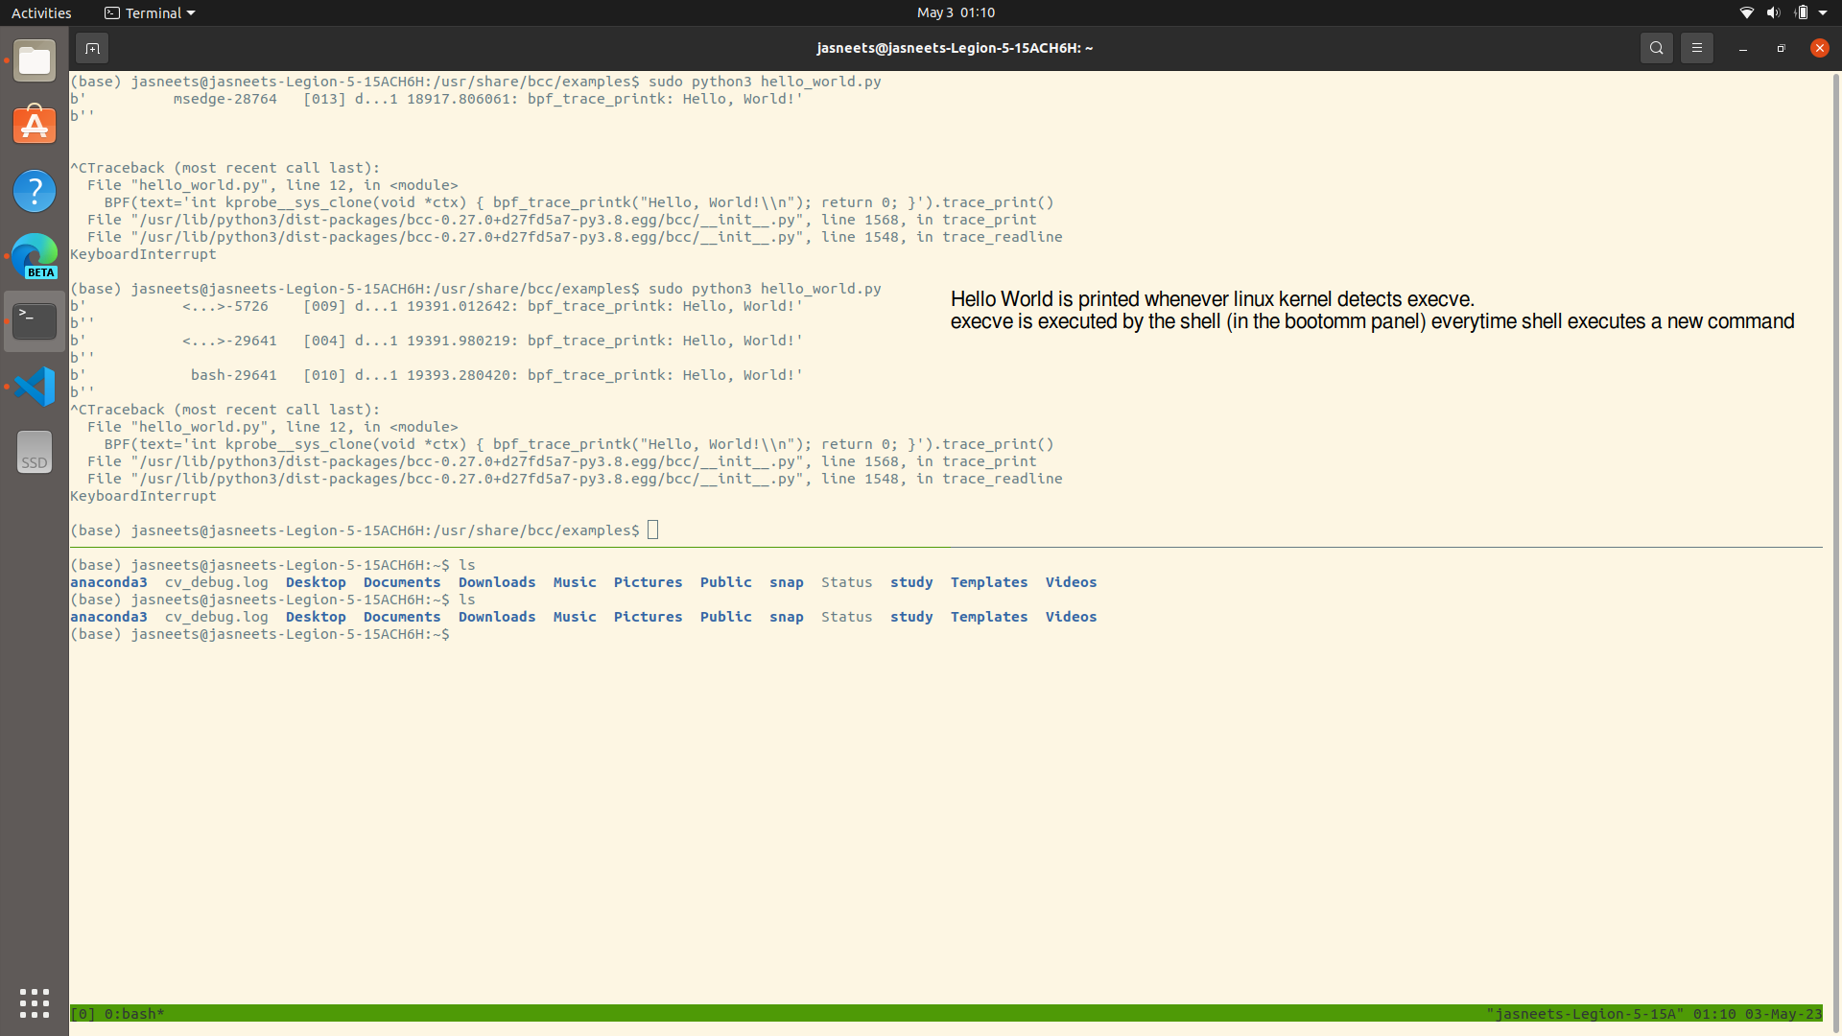
Data pipeline
open-source toolchain
frequent updates
version mismatches
instructions on official guthub readme do not work as-is
Installed Ubuntu without VM to extract the real performance metrics
eBPF utility
think of eBPF like a probe (ammeter or voltmeter) to measure what’s going on inside kernel
run hello_world of eBPF
Notes:
Various optons tried to generated the data
Cpu load
VM
VM Bytes

Slide 17
Data pipeline
figuring out if there is any modification from ubuntu in the kernel
Installed Ubuntu without VM to extract the real performance metrics
run hello_world of eBPF
right source for kernel 20.04 (ubuntu kernel or the linux)
Notes:
Various optons tried to generated the data
Cpu load
VM
VM Bytes

Slide 18
Data pipeline
building pristine kernel to ascertain working tool chain
official instructions from Ubuntu do not work as-is
configuration file
$ /boot/config-$(uname –r)
has several options that keep on adding and detailed documentation available
Installed Ubuntu without VM to extract the real performance metrics
run hello_world of eBPF
right source for kernel 20.04 (ubuntu kernel or the linux)
Notes:
Various optons tried to generated the data
Cpu load
VM
VM Bytes

Slide 19
Data pipeline
building pristine kernel to ascertain working tool chain
Paper shared the code on kernel v4.15
diff 5.15 vs 4.15 to understand changes made in the functions under consideration and where exactly to apply the patch
Installed Ubuntu without VM to extract the real performance metrics
run hello_world of eBPF
understand changes to be made with respect to kernel 5.15
right source for kernel 20.04 (ubuntu kernel or the linux)
Notes:
Various optons tried to generated the data
Cpu load
VM
VM Bytes

Slide 20
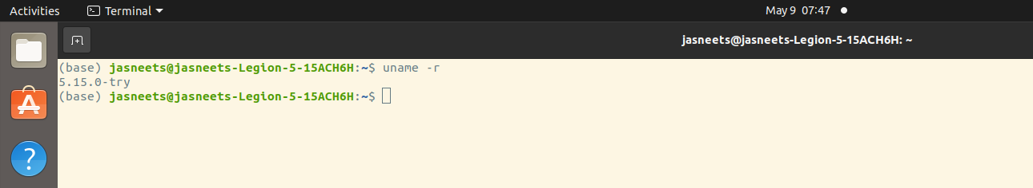
Data pipeline
building pristine kernel to ascertain working tool chain
boot-up
compile the kernel with new changes
wi-fi stopped working
fortunately ethernet (lan cable) was still working
Installed Ubuntu without VM to extract the real performance metrics
run hello_world of eBPF
understand changes to be made with respect to kernel 5.15
right source for kernel 20.04 (ubuntu kernel or the linux)
compile new kernel
Notes:
Various optons tried to generated the data
Cpu load
VM
VM Bytes

Slide 21
Data pipeline
building pristine kernel to ascertain working tool chain
boot-up
stress the system to mimic real workloads (server class)
reboot since system stopped responding
Installed Ubuntu without VM to extract the real performance metrics
extract as-is data
run hello_world of eBPF
understand changes to be made with respect to kernel 5.15
apply stress tools to induce migration decisions
right source for kernel 20.04 (ubuntu kernel or the linux)
compile new kernel
Notes:
Various optons tried to generated the data
Cpu load
VM
VM Bytes

Slide 22

data real
env->sd->cache_nice_tries
env->sd->cnr_balance_failed
src_rq->nr_running
dst_rq->nr_running
preferred_nid
src_nid
dst_nid
p_numa_faults[src_nid]
understand the data points to estimate the range and distribution (exponential, guassian)
9 out of 15 fields had fixed values
distil the weights available to prepare the data
86400 data points prepared with class distribution of 18% and 82%

Slide 23
data artificial
field | range | distribution | remarks
src_non_pref_nr | binary | random
delta_hot | binary | random
cpu_idle | binary | random
cpu_not_idle | binary | logic-based
cpu_newly_idle | binary | logic-based
same_node | binary | random
prefer_src | binary | random
prefer_dst | binary | random
src_len | 0~55 | guassian | mean = 0, std_dev = 3
src_load |  | exponential
dst_load |  | exponential
dst_len | 0~55 | guassian | mean = 0, std_dev = 3
delta_faults | 0~10 | guassian
extra_fails | binary | random
buddy_hot | binary | random
distil the weights available to prepare the data
86400 data points prepared with class distribution of 18% and 82%

Slide 24
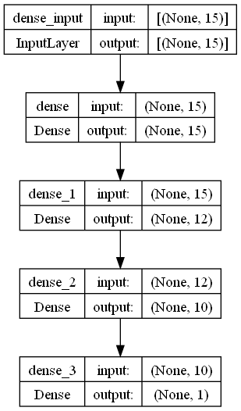
architecture
Model | 3 Hidden layer with ReLU activation in hidden layer
 | 577 parameters
 | L2 regularizer | 0.001 regularization weight
 | Weighted class (balancing)
Optimizer | Adam | Default learning rate
Loss function | Binary cross entropy | Loss function
Metrics | Accuracy | Metrics
Validation | Stratified K-fold | num_folds = 3
 | Early stopping callback
EPOCHS | 500
BATCH_SIZE | 64
H = model.fit(
X_train, y_train,
batch_size=BATCH_SIZE,
validation_data=(X_val, y_val),
epochs=EPOCHS,
class_weight=class_weights_dict,
callbacks=[misclassification_callback, early_stopping_callback],
verbose=1)
Model: 3 layers
Optimizer: Adam
Loss
Validation: Stratified Kfold with

Slide 25
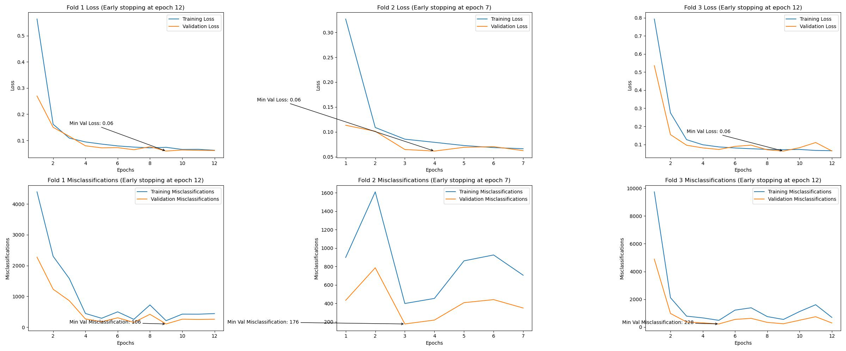
results
12 epochs before early stopping triggered
Number of miscalculations across folds at 38 (out of 21600) i.e. 0.18%
Notes:
The ROC-AUC (Receiver Operating Characteristic - Area Under the Curve) score is a performance metric that evaluates the ability of a classifier to distinguish between classes across all possible classification thresholds. In other words, it measures the classifier's ability to rank the predicted probabilities, so that the true positive rate (sensitivity) is maximized while the false positive rate (1-specificity) is minimized.
To achieve this, the ROC-AUC score considers the classifier's predicted probability values instead of the class labels. By using the probabilities, the ROC-AUC score can take into account the confidence of the classifier's predictions.
If the ROC-AUC score were to take class labels instead of probabilities, it would not be able to evaluate the classifier's performance across different thresholds. Using class labels would lead to a single point in the ROC space (true positive rate vs. false positive rate) corresponding to the threshold used to generate those labels. On the other hand, when using probabilities, the ROC curve is created by varying the threshold from 0 to 1, and the AUC value summarizes the overall performance of the classifier across all these thresholds.
In summary, the ROC-AUC score takes the real probability values because it aims to evaluate the classifier's ability to rank the predicted probabilities and maximize the true positive rate while minimizing the false positive rate across all possible classification thresholds.

Slide 26
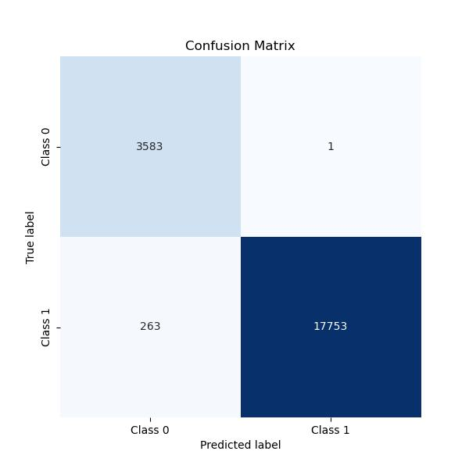
results
Test accuracy of 99%
Testing data samples count: 21600
Notes:
The ROC-AUC (Receiver Operating Characteristic - Area Under the Curve) score is a performance metric that evaluates the ability of a classifier to distinguish between classes across all possible classification thresholds. In other words, it measures the classifier's ability to rank the predicted probabilities, so that the true positive rate (sensitivity) is maximized while the false positive rate (1-specificity) is minimized.
To achieve this, the ROC-AUC score considers the classifier's predicted probability values instead of the class labels. By using the probabilities, the ROC-AUC score can take into account the confidence of the classifier's predictions.
If the ROC-AUC score were to take class labels instead of probabilities, it would not be able to evaluate the classifier's performance across different thresholds. Using class labels would lead to a single point in the ROC space (true positive rate vs. false positive rate) corresponding to the threshold used to generate those labels. On the other hand, when using probabilities, the ROC curve is created by varying the threshold from 0 to 1, and the AUC value summarizes the overall performance of the classifier across all these thresholds.
In summary, the ROC-AUC score takes the real probability values because it aims to evaluate the classifier's ability to rank the predicted probabilities and maximize the true positive rate while minimizing the false positive rate across all possible classification thresholds.

Slide 27
conclusion
need expertise in the domain to extract the ‘right’ data and process it ‘rightly’

Slide 28
challenges & journey: capability desired vs available
Dimension
Scale
1
3
5
linux kernel CFS understanding
eBPF programming
classification metrics understanding*
5 - desired
1 - as-is
* didn’t understand auc-roc, recall etc..

Slide 29
Further work
1
NUMA machine
to fetch the data outlined in the paper and not rely on distillation
Notes:
When working with a dataset, it's essential to check if the input dimensions are balanced to avoid potential biases in your model. To assess the balance of your dataset, you can consider using the following metrics and techniques:
Descriptive statistics: Calculate the mean, median, standard deviation, minimum, and maximum for each dimension to get an overview of the data distribution. This can help you identify any dimensions with extreme values or high variance.
Histograms: Visualize the distribution of each dimension using histograms. This can help you identify any dimensions with a skewed distribution or any unusual patterns.
Box plots: Box plots are a useful tool for visualizing the distribution of each dimension, showing the median, quartiles, and potential outliers.
Pairwise scatter plots: Visualizing the relationships between pairs of dimensions using scatter plots can help you detect any dependencies or strong correlations between the dimensions.
Covariance and correlation matrices: Calculate the covariance and correlation matrices to quantify the degree of linear association between pairs of dimensions. If the correlation coefficients are close to 0, it indicates low correlation, while values close to -1 or 1 indicate strong negative or positive correlations, respectively.
Dimensionality reduction techniques: Use techniques like Principal Component Analysis (PCA) or t-distributed Stochastic Neighbor Embedding (t-SNE) to reduce the dimensionality of your dataset and visualize it in a lower-dimensional space. This can help you identify any imbalances or clusters in the data.
To cover the "universe" or the full range of possible values for each dimension, it's important to ensure that your dataset is representative of the problem you're trying to solve. To achieve this, you should:
Collect data from a variety of sources and contexts to capture a diverse range of examples.
Use stratified sampling techniques to ensure that each category or subgroup within your data is represented in proportion to its prevalence in the population.
Regularly update your dataset to include new examples and trends as they emerge.
Remember that even if you manage to cover the entire range of possible values for each dimension, it's still important to validate the performance of your model using techniques like cross-validation and holdout validation to ensure that it generalizes well to unseen data.
Use workloads instead of tool-generated data
Deploy the model and check the accuracy as well as system stats like latency*, average cpu load**, run queues etc..
Train with fixed-point and again deploy and check accuracy and other stats
Insert more probes to gauge as many system stats as possible and then use richer data to train the model with fixed-point and measure accuracy as well as other system stats
Further reads
Prior work
[5] Francisco J. Cazorla, Alex Ramirez, Mateo Valero, and Enrique Fernandez. 2004. Dynamically controlled resource allocation in SMT processors. In 37th International Symposium on Microarchitecture (MICRO-37’04). IEEE, 171–182.
A. El-Moursy, R. Garg, D. H. Albonesi, and S. Dwarkadas. 2006. Compatible phase co-scheduling on a CMP of multi-threaded processors. In Proceedings 20th IEEE International Parallel & Distributed Processing Symposium. IEEE, 10 pp.–.
Martin Tillenius, Elisabeth Larsson, Rosa M. Badia, and Xavier Martorell. 2015. Resource-Aware Task Scheduling. ACM Trans. Embed. Comput. Syst. 14, 1, Article 5 (2015), 25 pages.
What performance events (hardware resource utilization model) can be extracted currently and are they being extracted to make decisions, if not why? and what parameters ought to b extracted, why they can’t be extracted (including limitations)

Slide 30
Further work
1
NUMA machine
to fetch the data outlined in the paper and not rely on distillation
2
pruning
to meet the project objective
Notes:
When working with a dataset, it's essential to check if the input dimensions are balanced to avoid potential biases in your model. To assess the balance of your dataset, you can consider using the following metrics and techniques:
Descriptive statistics: Calculate the mean, median, standard deviation, minimum, and maximum for each dimension to get an overview of the data distribution. This can help you identify any dimensions with extreme values or high variance.
Histograms: Visualize the distribution of each dimension using histograms. This can help you identify any dimensions with a skewed distribution or any unusual patterns.
Box plots: Box plots are a useful tool for visualizing the distribution of each dimension, showing the median, quartiles, and potential outliers.
Pairwise scatter plots: Visualizing the relationships between pairs of dimensions using scatter plots can help you detect any dependencies or strong correlations between the dimensions.
Covariance and correlation matrices: Calculate the covariance and correlation matrices to quantify the degree of linear association between pairs of dimensions. If the correlation coefficients are close to 0, it indicates low correlation, while values close to -1 or 1 indicate strong negative or positive correlations, respectively.
Dimensionality reduction techniques: Use techniques like Principal Component Analysis (PCA) or t-distributed Stochastic Neighbor Embedding (t-SNE) to reduce the dimensionality of your dataset and visualize it in a lower-dimensional space. This can help you identify any imbalances or clusters in the data.
To cover the "universe" or the full range of possible values for each dimension, it's important to ensure that your dataset is representative of the problem you're trying to solve. To achieve this, you should:
Collect data from a variety of sources and contexts to capture a diverse range of examples.
Use stratified sampling techniques to ensure that each category or subgroup within your data is represented in proportion to its prevalence in the population.
Regularly update your dataset to include new examples and trends as they emerge.
Remember that even if you manage to cover the entire range of possible values for each dimension, it's still important to validate the performance of your model using techniques like cross-validation and holdout validation to ensure that it generalizes well to unseen data.
Use workloads instead of tool-generated data
Deploy the model and check the accuracy as well as system stats like latency*, average cpu load**, run queues etc..
Train with fixed-point and again deploy and check accuracy and other stats
Insert more probes to gauge as many system stats as possible and then use richer data to train the model with fixed-point and measure accuracy as well as other system stats
Further reads
Prior work
[5] Francisco J. Cazorla, Alex Ramirez, Mateo Valero, and Enrique Fernandez. 2004. Dynamically controlled resource allocation in SMT processors. In 37th International Symposium on Microarchitecture (MICRO-37’04). IEEE, 171–182.
A. El-Moursy, R. Garg, D. H. Albonesi, and S. Dwarkadas. 2006. Compatible phase co-scheduling on a CMP of multi-threaded processors. In Proceedings 20th IEEE International Parallel & Distributed Processing Symposium. IEEE, 10 pp.–.
Martin Tillenius, Elisabeth Larsson, Rosa M. Badia, and Xavier Martorell. 2015. Resource-Aware Task Scheduling. ACM Trans. Embed. Comput. Syst. 14, 1, Article 5 (2015), 25 pages.
What performance events (hardware resource utilization model) can be extracted currently and are they being extracted to make decisions, if not why? and what parameters ought to b extracted, why they can’t be extracted (including limitations)

Slide 31
Further work
1
NUMA machine
to fetch the data outlined in the paper and not rely on distillation
2
pruning
to meet the project objective
3
hardware performance metrics
find out what other metrics are available to kernel and not being used
why not being used (challenges)
Notes:
When working with a dataset, it's essential to check if the input dimensions are balanced to avoid potential biases in your model. To assess the balance of your dataset, you can consider using the following metrics and techniques:
Descriptive statistics: Calculate the mean, median, standard deviation, minimum, and maximum for each dimension to get an overview of the data distribution. This can help you identify any dimensions with extreme values or high variance.
Histograms: Visualize the distribution of each dimension using histograms. This can help you identify any dimensions with a skewed distribution or any unusual patterns.
Box plots: Box plots are a useful tool for visualizing the distribution of each dimension, showing the median, quartiles, and potential outliers.
Pairwise scatter plots: Visualizing the relationships between pairs of dimensions using scatter plots can help you detect any dependencies or strong correlations between the dimensions.
Covariance and correlation matrices: Calculate the covariance and correlation matrices to quantify the degree of linear association between pairs of dimensions. If the correlation coefficients are close to 0, it indicates low correlation, while values close to -1 or 1 indicate strong negative or positive correlations, respectively.
Dimensionality reduction techniques: Use techniques like Principal Component Analysis (PCA) or t-distributed Stochastic Neighbor Embedding (t-SNE) to reduce the dimensionality of your dataset and visualize it in a lower-dimensional space. This can help you identify any imbalances or clusters in the data.
To cover the "universe" or the full range of possible values for each dimension, it's important to ensure that your dataset is representative of the problem you're trying to solve. To achieve this, you should:
Collect data from a variety of sources and contexts to capture a diverse range of examples.
Use stratified sampling techniques to ensure that each category or subgroup within your data is represented in proportion to its prevalence in the population.
Regularly update your dataset to include new examples and trends as they emerge.
Remember that even if you manage to cover the entire range of possible values for each dimension, it's still important to validate the performance of your model using techniques like cross-validation and holdout validation to ensure that it generalizes well to unseen data.
Use workloads instead of tool-generated data
Deploy the model and check the accuracy as well as system stats like latency*, average cpu load**, run queues etc..
Train with fixed-point and again deploy and check accuracy and other stats
Insert more probes to gauge as many system stats as possible and then use richer data to train the model with fixed-point and measure accuracy as well as other system stats
Further reads
Prior work
[5] Francisco J. Cazorla, Alex Ramirez, Mateo Valero, and Enrique Fernandez. 2004. Dynamically controlled resource allocation in SMT processors. In 37th International Symposium on Microarchitecture (MICRO-37’04). IEEE, 171–182.
A. El-Moursy, R. Garg, D. H. Albonesi, and S. Dwarkadas. 2006. Compatible phase co-scheduling on a CMP of multi-threaded processors. In Proceedings 20th IEEE International Parallel & Distributed Processing Symposium. IEEE, 10 pp.–.
Martin Tillenius, Elisabeth Larsson, Rosa M. Badia, and Xavier Martorell. 2015. Resource-Aware Task Scheduling. ACM Trans. Embed. Comput. Syst. 14, 1, Article 5 (2015), 25 pages.
What performance events (hardware resource utilization model) can be extracted currently and are they being extracted to make decisions, if not why? and what parameters ought to b extracted, why they can’t be extracted (including limitations)

Slide 32
Further work
1
4
NUMA machine
to fetch the data outlined in the paper and not rely on distillation
status-quo & root-cause
current load-avg across various class of machines and factors limiting it (task availability vs resource constraints)
2
pruning
to meet the project objective
3
hardware performance metrics
find out what other metrics are available to kernel and not being used
why not being used (challenges)
Notes:
When working with a dataset, it's essential to check if the input dimensions are balanced to avoid potential biases in your model. To assess the balance of your dataset, you can consider using the following metrics and techniques:
Descriptive statistics: Calculate the mean, median, standard deviation, minimum, and maximum for each dimension to get an overview of the data distribution. This can help you identify any dimensions with extreme values or high variance.
Histograms: Visualize the distribution of each dimension using histograms. This can help you identify any dimensions with a skewed distribution or any unusual patterns.
Box plots: Box plots are a useful tool for visualizing the distribution of each dimension, showing the median, quartiles, and potential outliers.
Pairwise scatter plots: Visualizing the relationships between pairs of dimensions using scatter plots can help you detect any dependencies or strong correlations between the dimensions.
Covariance and correlation matrices: Calculate the covariance and correlation matrices to quantify the degree of linear association between pairs of dimensions. If the correlation coefficients are close to 0, it indicates low correlation, while values close to -1 or 1 indicate strong negative or positive correlations, respectively.
Dimensionality reduction techniques: Use techniques like Principal Component Analysis (PCA) or t-distributed Stochastic Neighbor Embedding (t-SNE) to reduce the dimensionality of your dataset and visualize it in a lower-dimensional space. This can help you identify any imbalances or clusters in the data.
To cover the "universe" or the full range of possible values for each dimension, it's important to ensure that your dataset is representative of the problem you're trying to solve. To achieve this, you should:
Collect data from a variety of sources and contexts to capture a diverse range of examples.
Use stratified sampling techniques to ensure that each category or subgroup within your data is represented in proportion to its prevalence in the population.
Regularly update your dataset to include new examples and trends as they emerge.
Remember that even if you manage to cover the entire range of possible values for each dimension, it's still important to validate the performance of your model using techniques like cross-validation and holdout validation to ensure that it generalizes well to unseen data.
Use workloads instead of tool-generated data
Deploy the model and check the accuracy as well as system stats like latency*, average cpu load**, run queues etc..
Train with fixed-point and again deploy and check accuracy and other stats
Insert more probes to gauge as many system stats as possible and then use richer data to train the model with fixed-point and measure accuracy as well as other system stats
Further reads
Prior work
[5] Francisco J. Cazorla, Alex Ramirez, Mateo Valero, and Enrique Fernandez. 2004. Dynamically controlled resource allocation in SMT processors. In 37th International Symposium on Microarchitecture (MICRO-37’04). IEEE, 171–182.
A. El-Moursy, R. Garg, D. H. Albonesi, and S. Dwarkadas. 2006. Compatible phase co-scheduling on a CMP of multi-threaded processors. In Proceedings 20th IEEE International Parallel & Distributed Processing Symposium. IEEE, 10 pp.–.
Martin Tillenius, Elisabeth Larsson, Rosa M. Badia, and Xavier Martorell. 2015. Resource-Aware Task Scheduling. ACM Trans. Embed. Comput. Syst. 14, 1, Article 5 (2015), 25 pages.
What performance events (hardware resource utilization model) can be extracted currently and are they being extracted to make decisions, if not why? and what parameters ought to b extracted, why they can’t be extracted (including limitations)

Slide 33
Further work
1
4
NUMA machine
to fetch the data outlined in the paper and not rely on distillation
status-quo & root-cause
current load-avg across various class of machines and factors limiting it (task availability vs resource constraints)
2
pruning
to meet the project objective
5
deploy
deploy the trained model in kernel to test and measure accuracy, latency, avg. cpu_load and run_queue length
3
hardware performance metrics
find out what other metrics are available to kernel and not being used
why not being used (challenges)
Notes:
When working with a dataset, it's essential to check if the input dimensions are balanced to avoid potential biases in your model. To assess the balance of your dataset, you can consider using the following metrics and techniques:
Descriptive statistics: Calculate the mean, median, standard deviation, minimum, and maximum for each dimension to get an overview of the data distribution. This can help you identify any dimensions with extreme values or high variance.
Histograms: Visualize the distribution of each dimension using histograms. This can help you identify any dimensions with a skewed distribution or any unusual patterns.
Box plots: Box plots are a useful tool for visualizing the distribution of each dimension, showing the median, quartiles, and potential outliers.
Pairwise scatter plots: Visualizing the relationships between pairs of dimensions using scatter plots can help you detect any dependencies or strong correlations between the dimensions.
Covariance and correlation matrices: Calculate the covariance and correlation matrices to quantify the degree of linear association between pairs of dimensions. If the correlation coefficients are close to 0, it indicates low correlation, while values close to -1 or 1 indicate strong negative or positive correlations, respectively.
Dimensionality reduction techniques: Use techniques like Principal Component Analysis (PCA) or t-distributed Stochastic Neighbor Embedding (t-SNE) to reduce the dimensionality of your dataset and visualize it in a lower-dimensional space. This can help you identify any imbalances or clusters in the data.
To cover the "universe" or the full range of possible values for each dimension, it's important to ensure that your dataset is representative of the problem you're trying to solve. To achieve this, you should:
Collect data from a variety of sources and contexts to capture a diverse range of examples.
Use stratified sampling techniques to ensure that each category or subgroup within your data is represented in proportion to its prevalence in the population.
Regularly update your dataset to include new examples and trends as they emerge.
Remember that even if you manage to cover the entire range of possible values for each dimension, it's still important to validate the performance of your model using techniques like cross-validation and holdout validation to ensure that it generalizes well to unseen data.
Use workloads instead of tool-generated data
Deploy the model and check the accuracy as well as system stats like latency*, average cpu load**, run queues etc..
Train with fixed-point and again deploy and check accuracy and other stats
Insert more probes to gauge as many system stats as possible and then use richer data to train the model with fixed-point and measure accuracy as well as other system stats
Further reads
Prior work
[5] Francisco J. Cazorla, Alex Ramirez, Mateo Valero, and Enrique Fernandez. 2004. Dynamically controlled resource allocation in SMT processors. In 37th International Symposium on Microarchitecture (MICRO-37’04). IEEE, 171–182.
A. El-Moursy, R. Garg, D. H. Albonesi, and S. Dwarkadas. 2006. Compatible phase co-scheduling on a CMP of multi-threaded processors. In Proceedings 20th IEEE International Parallel & Distributed Processing Symposium. IEEE, 10 pp.–.
Martin Tillenius, Elisabeth Larsson, Rosa M. Badia, and Xavier Martorell. 2015. Resource-Aware Task Scheduling. ACM Trans. Embed. Comput. Syst. 14, 1, Article 5 (2015), 25 pages.
What performance events (hardware resource utilization model) can be extracted currently and are they being extracted to make decisions, if not why? and what parameters ought to b extracted, why they can’t be extracted (including limitations)

Slide 34
Further work
1
4
NUMA machine
to fetch the data outlined in the paper and not rely on distillation
status-quo & root-cause
current load-avg across various class of machines and factors limiting it (task availability vs resource constraints)
2
pruning
to meet the project objective
5
deploy
deploy the trained model in kernel to test and measure accuracy, latency, avg. cpu_load and run_queue length
3
hardware performance metrics
find out what other metrics are available to kernel and not being used
why not being used (challenges)
6
fixed-point
train model on fixed-point and deploy to measure same metrics
Notes:
When working with a dataset, it's essential to check if the input dimensions are balanced to avoid potential biases in your model. To assess the balance of your dataset, you can consider using the following metrics and techniques:
Descriptive statistics: Calculate the mean, median, standard deviation, minimum, and maximum for each dimension to get an overview of the data distribution. This can help you identify any dimensions with extreme values or high variance.
Histograms: Visualize the distribution of each dimension using histograms. This can help you identify any dimensions with a skewed distribution or any unusual patterns.
Box plots: Box plots are a useful tool for visualizing the distribution of each dimension, showing the median, quartiles, and potential outliers.
Pairwise scatter plots: Visualizing the relationships between pairs of dimensions using scatter plots can help you detect any dependencies or strong correlations between the dimensions.
Covariance and correlation matrices: Calculate the covariance and correlation matrices to quantify the degree of linear association between pairs of dimensions. If the correlation coefficients are close to 0, it indicates low correlation, while values close to -1 or 1 indicate strong negative or positive correlations, respectively.
Dimensionality reduction techniques: Use techniques like Principal Component Analysis (PCA) or t-distributed Stochastic Neighbor Embedding (t-SNE) to reduce the dimensionality of your dataset and visualize it in a lower-dimensional space. This can help you identify any imbalances or clusters in the data.
To cover the "universe" or the full range of possible values for each dimension, it's important to ensure that your dataset is representative of the problem you're trying to solve. To achieve this, you should:
Collect data from a variety of sources and contexts to capture a diverse range of examples.
Use stratified sampling techniques to ensure that each category or subgroup within your data is represented in proportion to its prevalence in the population.
Regularly update your dataset to include new examples and trends as they emerge.
Remember that even if you manage to cover the entire range of possible values for each dimension, it's still important to validate the performance of your model using techniques like cross-validation and holdout validation to ensure that it generalizes well to unseen data.
Use workloads instead of tool-generated data
Deploy the model and check the accuracy as well as system stats like latency*, average cpu load**, run queues etc..
Train with fixed-point and again deploy and check accuracy and other stats
Insert more probes to gauge as many system stats as possible and then use richer data to train the model with fixed-point and measure accuracy as well as other system stats
Further reads
Prior work
[5] Francisco J. Cazorla, Alex Ramirez, Mateo Valero, and Enrique Fernandez. 2004. Dynamically controlled resource allocation in SMT processors. In 37th International Symposium on Microarchitecture (MICRO-37’04). IEEE, 171–182.
A. El-Moursy, R. Garg, D. H. Albonesi, and S. Dwarkadas. 2006. Compatible phase co-scheduling on a CMP of multi-threaded processors. In Proceedings 20th IEEE International Parallel & Distributed Processing Symposium. IEEE, 10 pp.–.
Martin Tillenius, Elisabeth Larsson, Rosa M. Badia, and Xavier Martorell. 2015. Resource-Aware Task Scheduling. ACM Trans. Embed. Comput. Syst. 14, 1, Article 5 (2015), 25 pages.
What performance events (hardware resource utilization model) can be extracted currently and are they being extracted to make decisions, if not why? and what parameters ought to b extracted, why they can’t be extracted (including limitations)

Slide 35
Thank you, Sirs, Alexios and classmates

