Slide 1

Modeling collective behavior in hierarchically-organized systems
Jordan Snyder, UC Davis
with Anatoly Zlotnik and Aric Hagberg

Slide 2


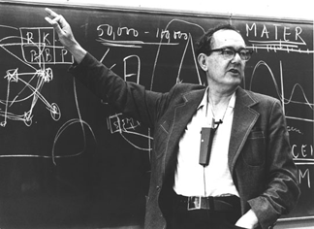
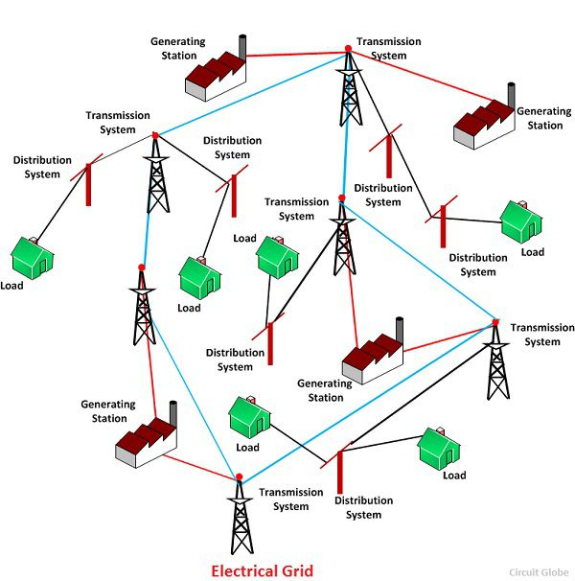
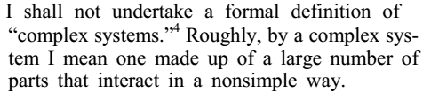
“Complex Systems”
-Herbert A. Simon, The Architecture of Complexity, 1962
Notes:
I’m interested in collective behavior; I mean, who isn’t? Over the last many years, there has been considerable interest in “complex systems”. Following Simon, I do not endeavor to define this term precisely, other than to say that a complex system is one that is made of many similar units which function as one in interesting ways.
Because I’m interested in collective behavior, I’m contractually obligated to show you a school of fish, a brain, and a power grid and claim that they’re all really the same, maaan.
One major conceptual approach to developing explanations for how complex systems work has been to relate the data of which parts interact with which, to the overall system’s performance characteristics. This sort of question makes up a large portion of the field known as “network science”.
My intention is to identify certain structural features common to many complex systems, and investigate their implications for overall system function.

Slide 3
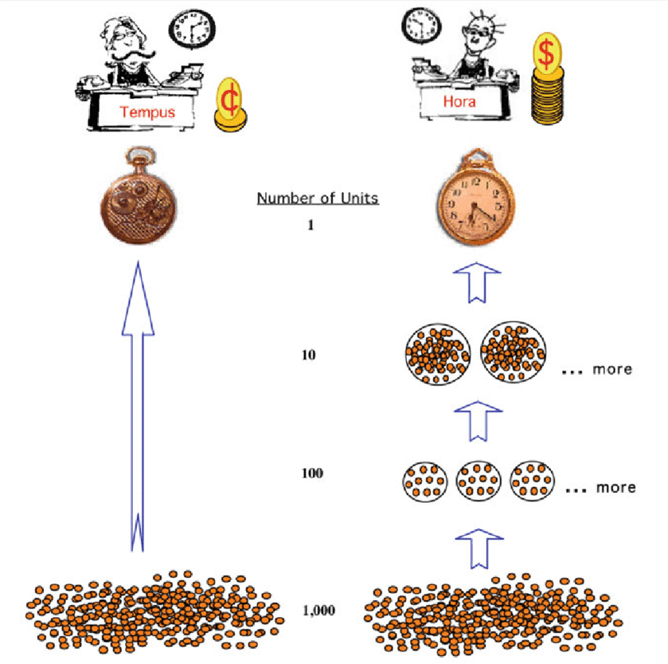
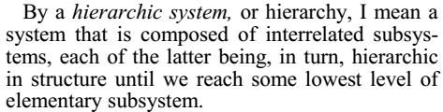
The Watchmaker Parable
Large systems will evolve faster if they are made of stable sub-systems
We should expect to see hierarchical organization
Notes:
The structural feature I will focus on is hierarchy, which was the subject of Simon’s 1962 essay, The Architecture of Complexity. In it , he argues that hierarchy is to be expected in many different naturally-occurring complex systems. To explain this, he introduces the Watchmaker parable. The parable describes two watchmakers….
His point is that hierarchical structures can grow much more quickly than non-hierarchical ones, because hierarchical systems are made up of stable sub-units that simply combine together.
This argument is obviously incomplete and imprecise. In particular, it remains to explain how hierarchical structures can operate as well as they do. To advance this goal, I propose to study mathematical models that capture effects that are common in hierarchically-structure systems.

Slide 4
Intrinsic meets Extrinsic
Within a module, units interact
Whole modules also interact with each other
At the module level, this looks like mutual coupling versus external forcing

Slide 5
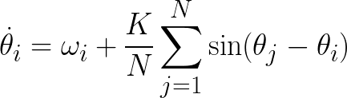


Order via mutual coupling: Kuramoto Model
Key features:
Heterogeneity:
Coupling drives phases together
Trade-off occurs at

Slide 6






Order via External Forcing: Entrainment
Weakly driven phase oscillators:
In rotating reference frame:
Where
Entrainment: , but remain different
Possible Result: splay state

Slide 7
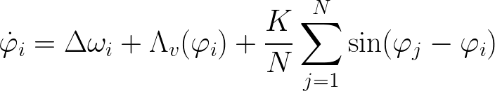


External forcing meets coupling
How does external forcing affect ability of coupling to align phases?
Plan of attack:
Pick and such that there is a splay state fixed point
Find the value of at which the splay state becomes unstable

Slide 8






Math
Goal: entrainment with phases evenly spread from –π to π
Take and
Then
The splay state is a fixed point for all values of
The splay state is stable for and unstable for
With the same natural frequencies but no forcing, phase alignment develops at

Slide 9
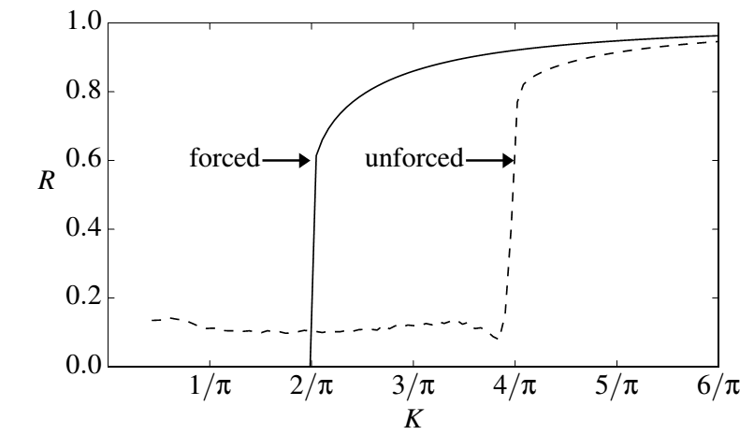
Results

Slide 10
Conclusions
Interplay of internal coupling and external forcing is a building block of complex systems
Forcing and coupling can impose different types of order, yet interact in surprising ways

