Slide 1
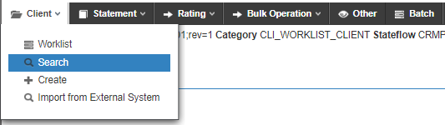
Grouping manually created and imported clients Clients that are manually created can not be connected to clients which have been imported. If a manually created client should be connected in a group, the group structure and each client has to be maintained manually.

Slide 2
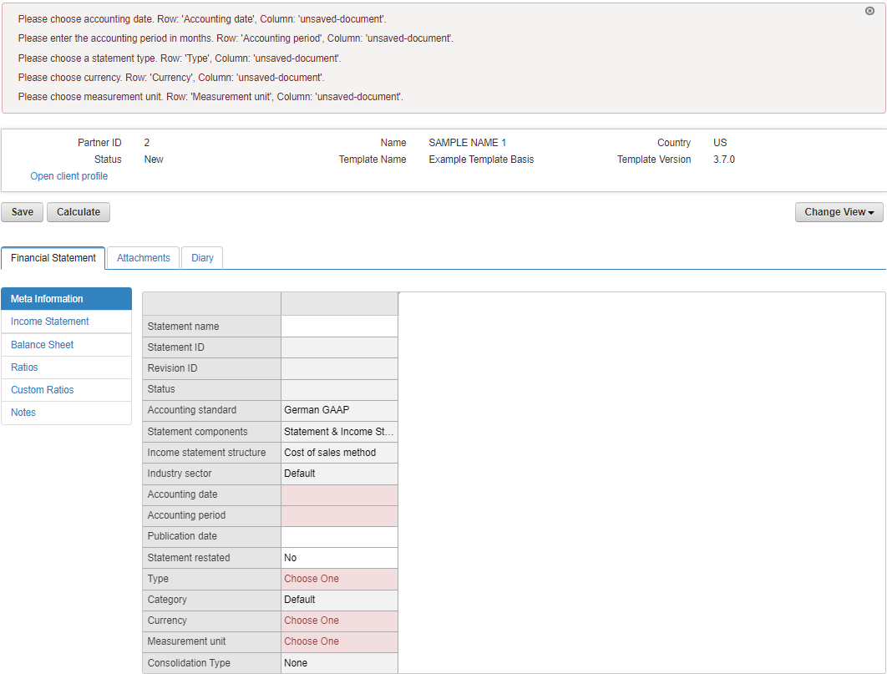
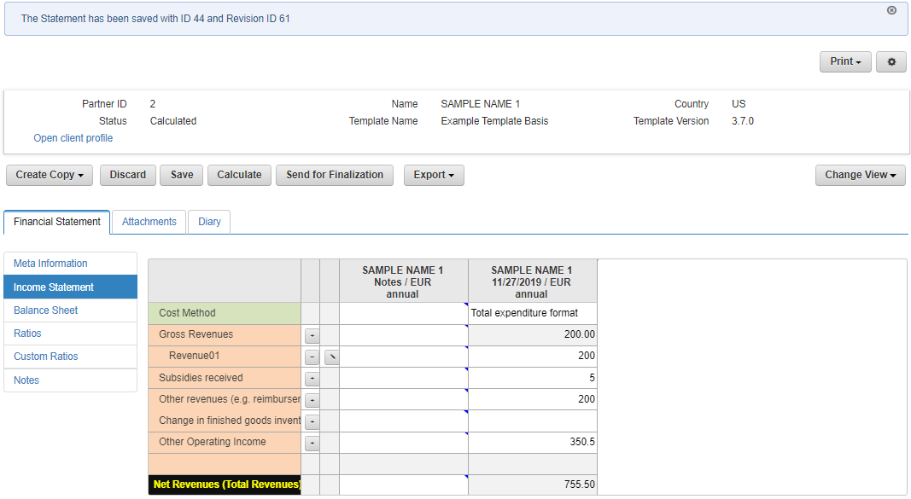
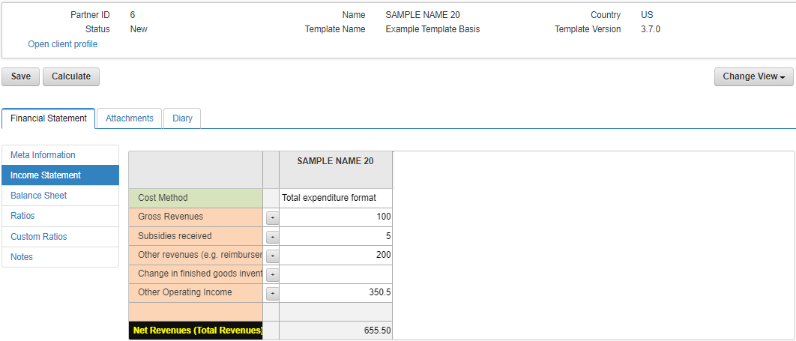
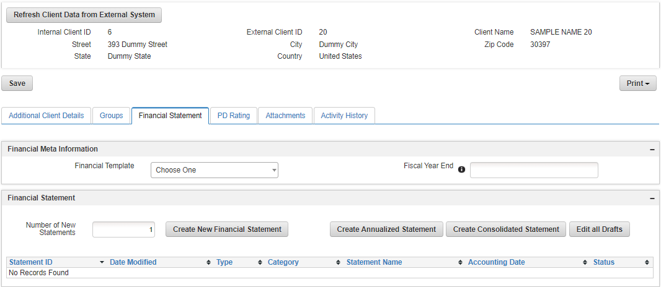
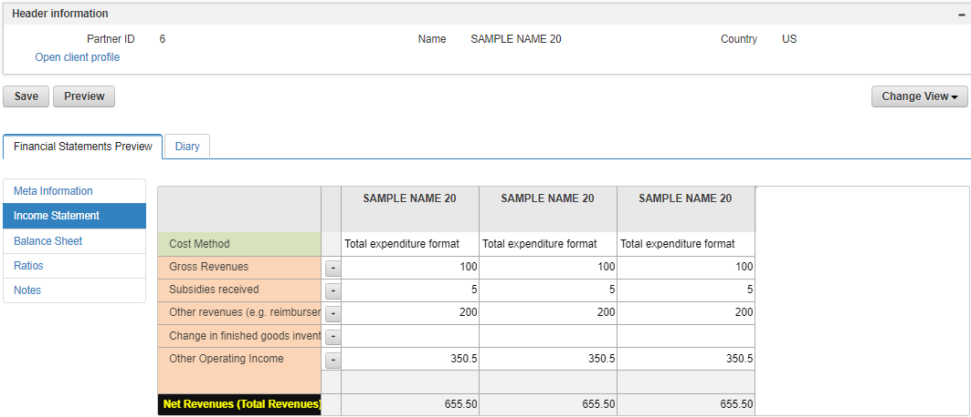

Slide 3
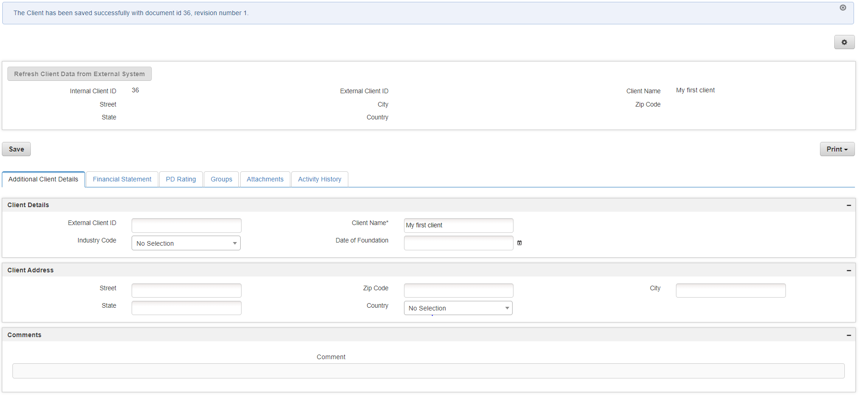
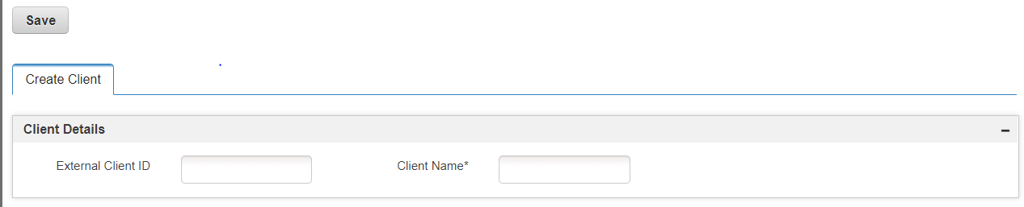
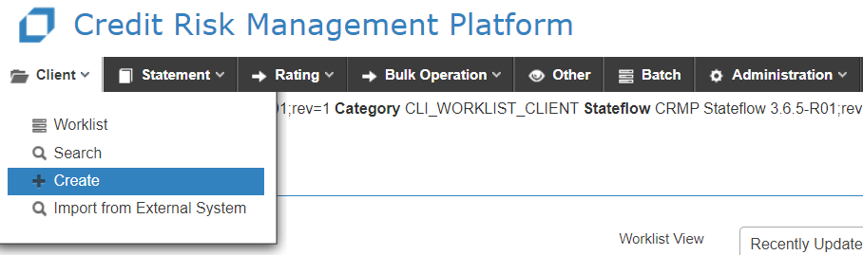

Slide 4
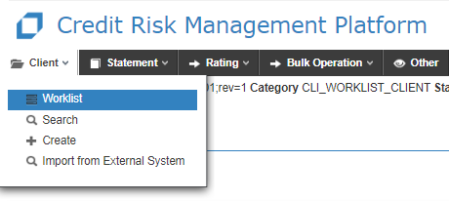
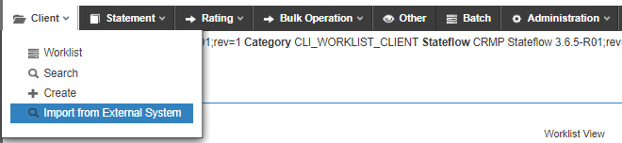

Slide 5
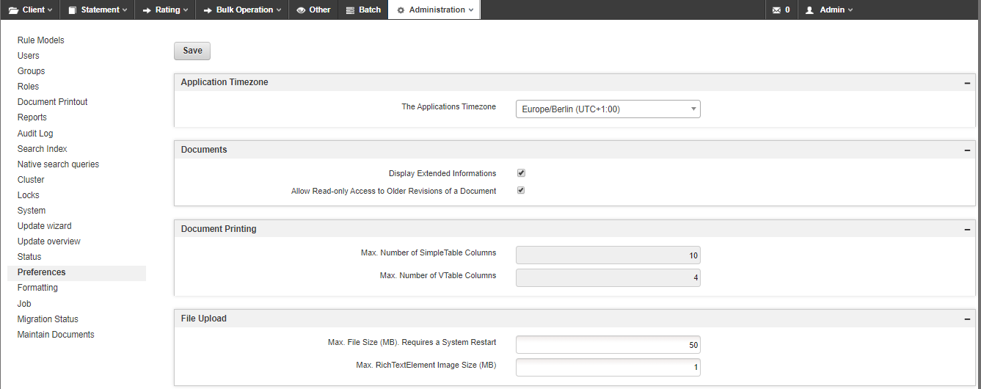

Slide 6
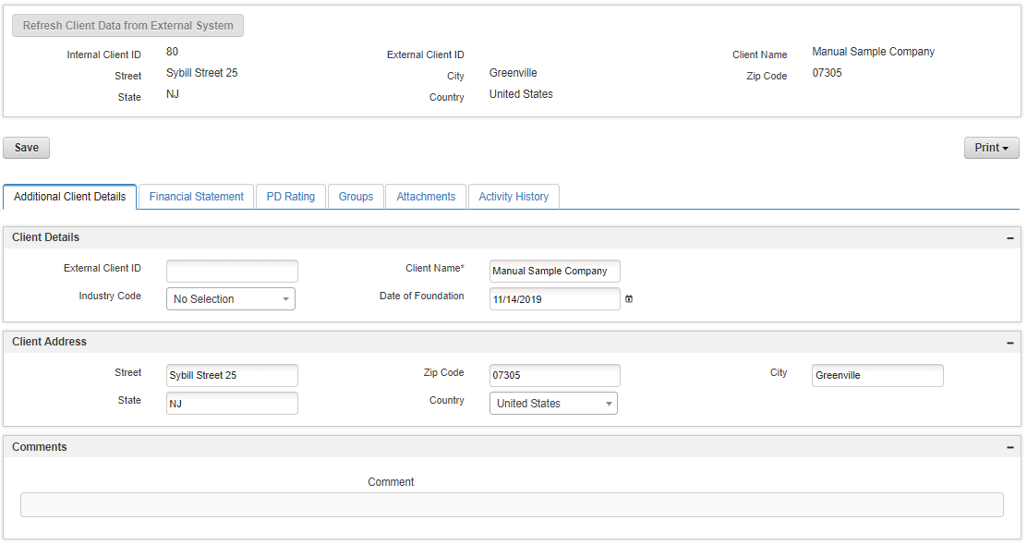

Slide 7
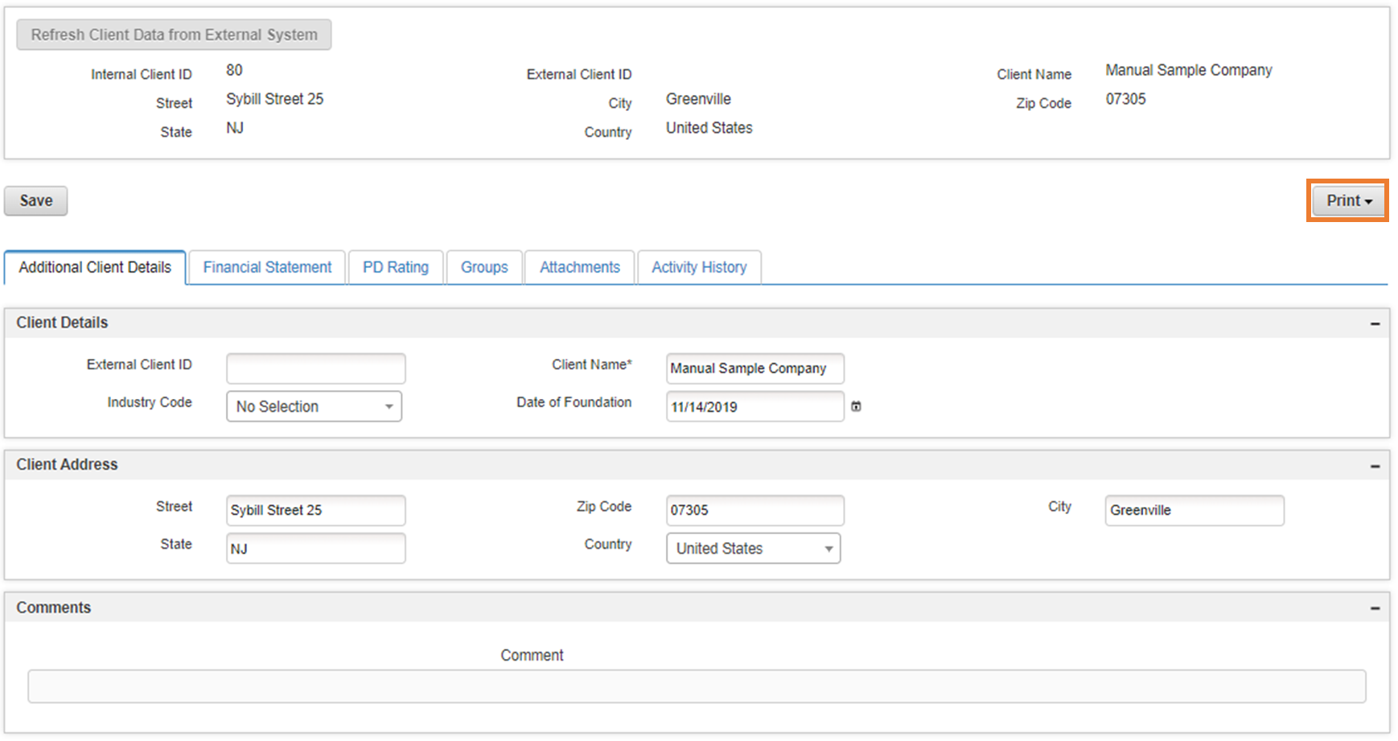

Slide 8
Financial Statement
Collaborate and Enhance
Copy
Discard
Attach
Notes
FS Template
OPTIONAL
Annualize
Capture
Finalize
Calculate
Assess
Rating
Import
Decline
Consolidate
Client
Restate
Analyze and Report
Compare
Peer Group Analysis
Export
Print

Slide 9
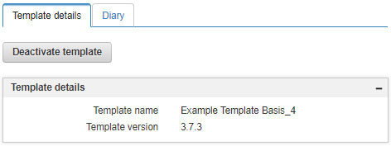
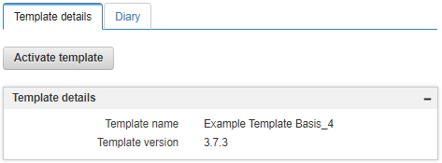


Slide 10
Select Template
Provide Meta Information
Enter & Enrich Data
Consolidate & Compare
Finalize
Report
Enter data
Currency conversion
Add Subaccounts
Unit conversion
Calculations
Compare with historic data
Notes

