Slide 1

Specification Artifacts Overview
Credit Risk Management Platform
Analysis & Design Phase

Slide 2
Agenda overview

Slide 3
Agenda
1

Slide 4
Specification Artifacts Overview
This presentation gives an overview about the specification artifacts that are typically used to specify a system based on the ACTICO Credit Risk Management Platform (CRMP). The artifacts are typically created during the analysis & design phase of a CRMP based project. It depends on the project which artifacts are required.
Artifact | Purpose
Functional Specification & Technical Design | Description of the business and technical use cases of the system
User Interface Specification | Definition of screens and validation rules of the system
Interface Specification | Detailed description of Interfaces to other systems on a field level
Scorecard Specification | Definition of scorecard logic (e.g. rating)
Financial Template Specification | Definition of balance sheet templates
Report & Printout Specification | Definition of to be used reports and printout templates

Slide 5
Agenda
2

Slide 6
Technical design
The Technical design describes the overall functionality of the system focusing on functional as well as non functional requirements and describes the design of the system.
The document is based on object oriented design industry standard best practices using UML. ACTICO uses Enterprise Architect to capture the requirements resulting in a Word document with both textual as well as graphical sections.
Functionality provided by the ACTICO Financial Spreading Module (SPR) is only briefly mentioned in the document, referring to the Financial Spreading User Guide for detailed information instead.

Slide 7
Technical design
Aspects of the technical design
Artifact | Purpose
Actors | The roles that interact the system
Use Cases | The description of the interactions between the roles and the system
Functional Requirements | Functional needs that the system must be able to fulfill
Disclaimers | Assumptions & Constraints that impacts the system
User Interfaces | High level definition of the screens and their relationship to Use Cases & Requirements
Business Objects | Definition of the Logical Data Model of the system
State Machines | Description of the workflows of the entities handled in the system
Non Functional Requirements | Non functional needs that the system must be able to fulfill
Interfaces | Definition of all interaction points of the system with surrounding systems
Deployment View | Definition of the environments the system is deployed to.

Slide 8
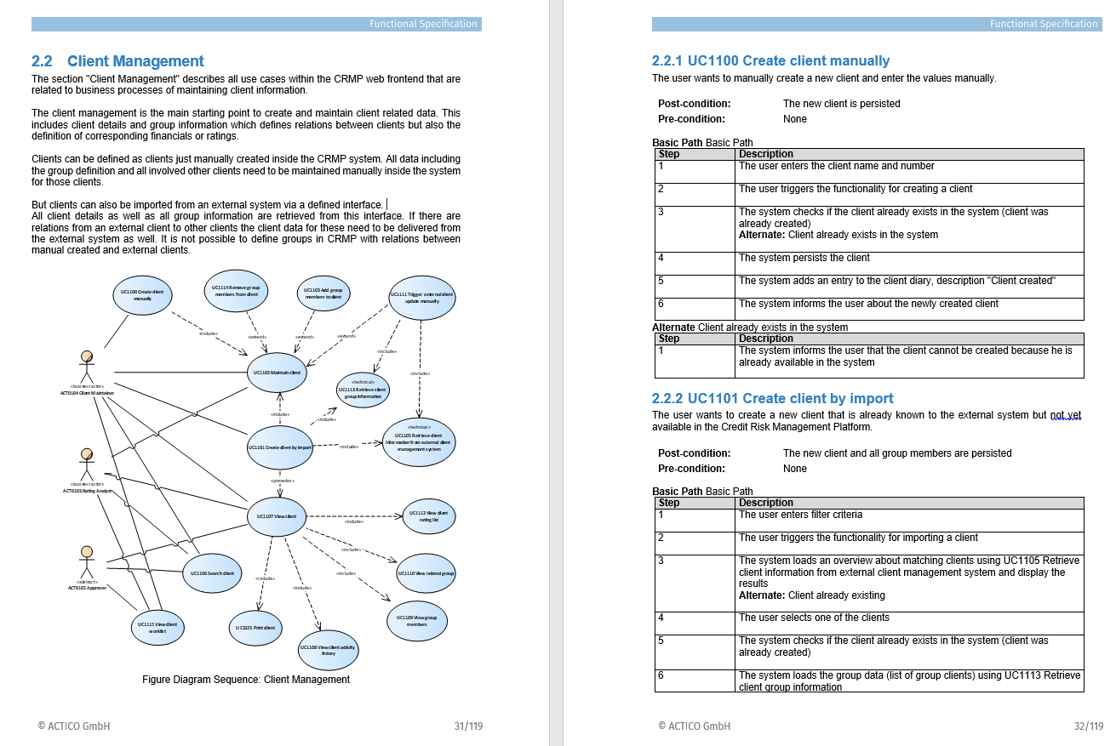
Use cases
Example

Slide 9
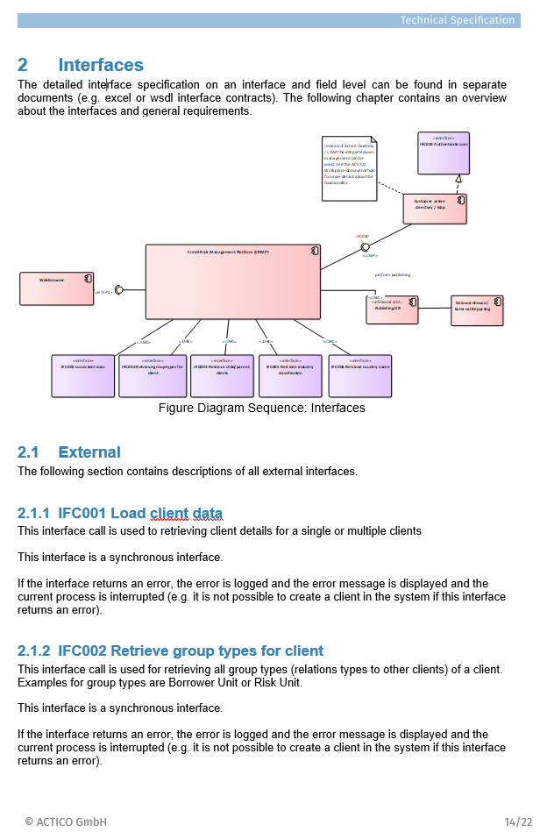
Interface description
Example

Slide 10
Agenda
3

Slide 11
User Interface Specification
The User Interface Specification defines the user interface on a field level. It also defines field level validation (e.g. field is required) and the link between user interface and Use Cases (e.g. which Use Case is triggered by a button). ACTICO is using Excel for defining the User Interface which allows business departments to closely collaborate in the Definition of the User Interface.

Slide 12
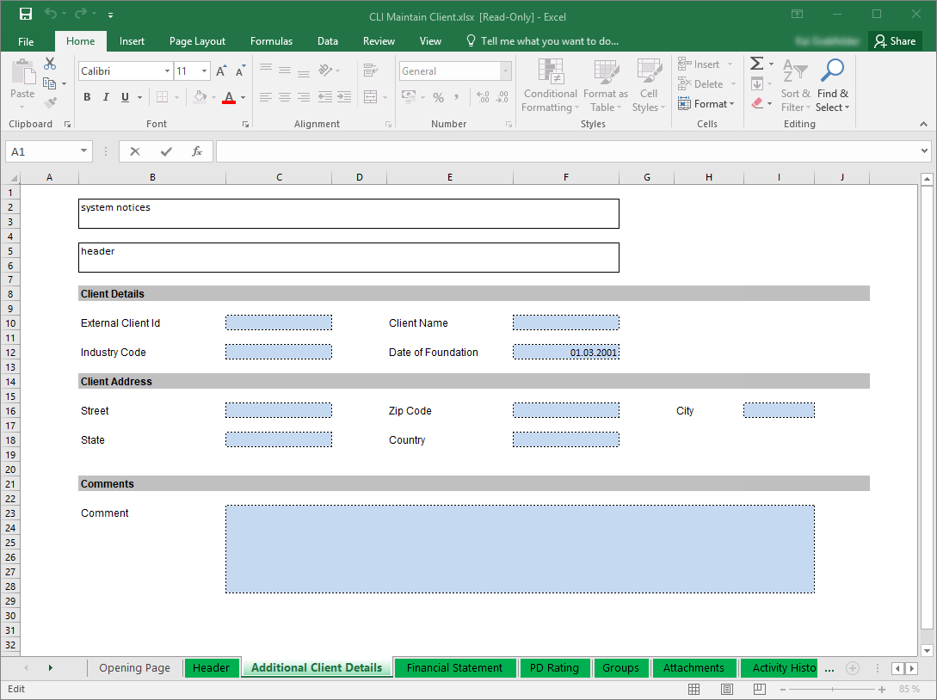
User Interface Specification
Example

Slide 13
Agenda
4

Slide 14
Interface Specification
The Interface specification describes the interfaces of the system on a field level and their mapping to the business objects. We are using Excel for the interface specification to allow a close collaboration on the specification with the interface responsible from other systems.

Slide 15
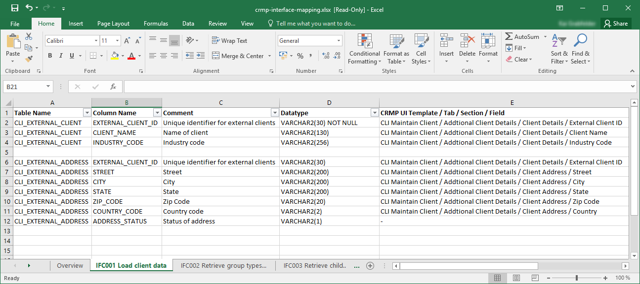
Interface Specification
Example

Slide 16
Agenda
5

Slide 17
Scorecard Specification
Scorecards are typically specified by non formal excel or word documents. The Scorecard methodology is often already available as excel files (including the calculation logic).

Slide 18
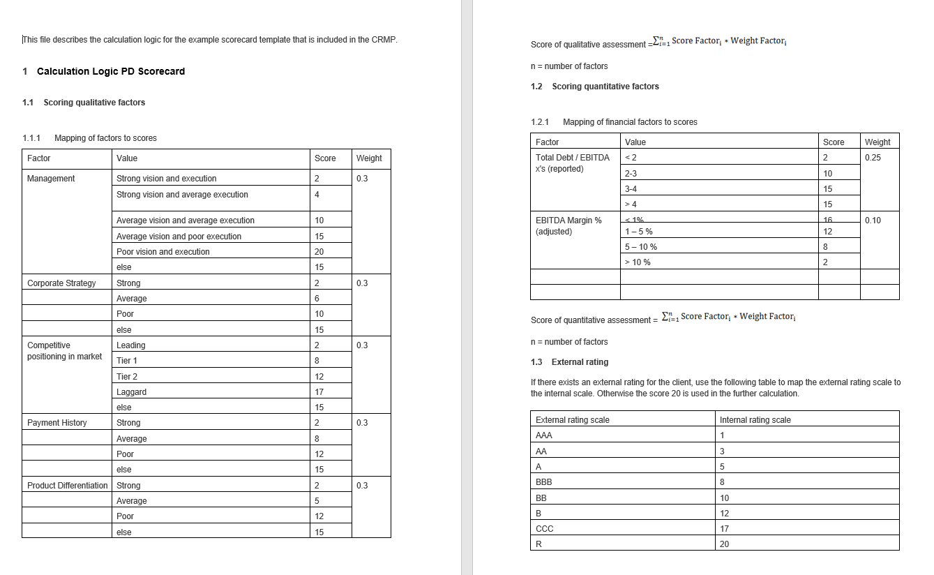
Scorecard Specification
Example

Slide 19
Agenda
6

Slide 20
Financial Template Specification
Financial Templates are typically specified as non formal excel files. Ideally in the format that is supported by the ACTICO Financial Spreading Module or in some way that allows to identify the statement position and ratio formulas

Slide 21
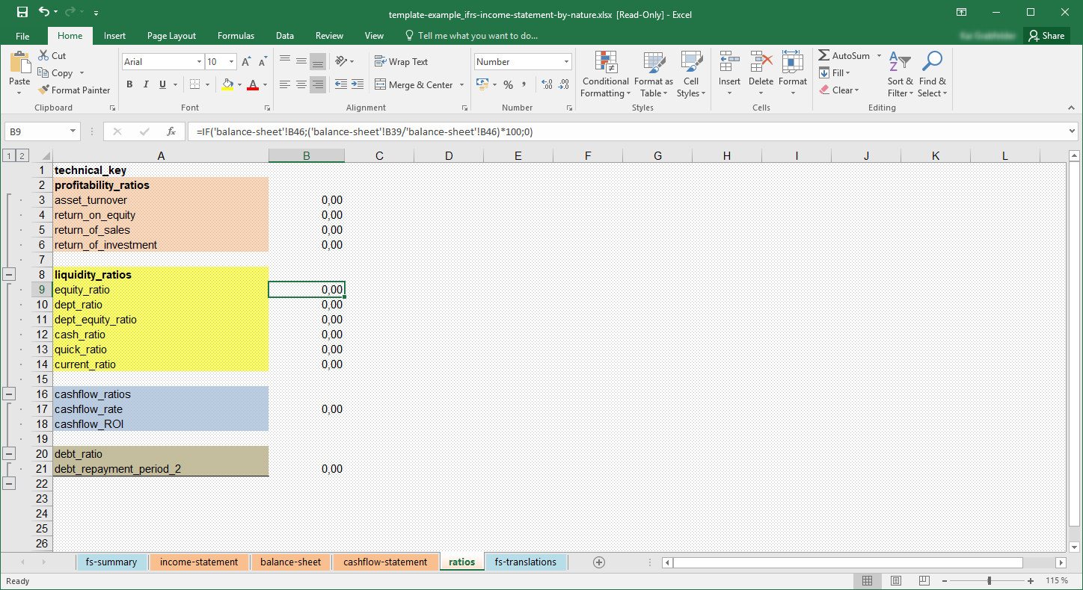
Financial Template Specification
Example

Slide 22
Agenda
7

Slide 23
Report & Printout Specification
Report & Printout Templates are typically specified as non formal word files, describing how the report / printout should look like and the mapping of the to be displayed fields to the business objects or user interface.

