Slide 1
Mechanics of Solids-CIL2030 Course Project
Mamta Kumari(B21CI025)
Manoj Solara(B21CI027)
Ruchit Kochar(B21CI038)
Jason Daniel(B21CI019)
Ankit Kumar(B21CI006)

Slide 2
Introduction
Material failure is a critical aspect of engineering design and manufacturing. Understanding how and why materials fail is essential for ensuring the safety, reliability, and performance of structures, machines, and other systems. Material failure can lead to catastrophic consequences, such as the collapse of bridges, buildings, or airplanes, and can cause serious injury or loss of life.
Further, we will explore four material failure theories - Maximum Normal Stress Theory (Rankine's Theory), Maximum Shear Stress Theory (Tresca's Theory), Maximum Distortion Energy Theory (Von Mises Theory), and Maximum Normal Strain Theory.

Slide 3
What are theories of failure?
Material strengths are determined from uniaxial tension tests.
Thus, the strengths obtained from those tension tests cannot be directly used for component design since, in actual scenarios components undergo multiaxial stress conditions.
Hence, to use the strengths determined from tension tests to design mechanical components under any condition of static loading, theories of failure are used.

Slide 4
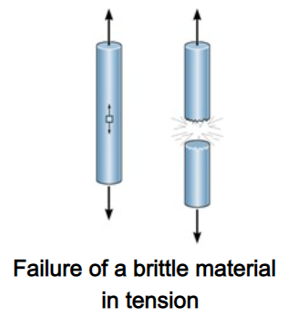
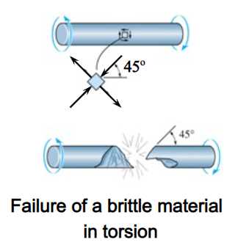
Maximum Normal Stress Theory (Rankine's Theory)
The theory states that the failure of a brittle material occurs when the maximum normal stress (σ₁) in the material exceeds its ultimate tensile strength (S_{yt}) or ultimate compressive strength (S_{yc}), depending on whether the material is in tension or compression.
Materials that are brittle, such as gray cast iron, have a tendency to experience abrupt failure through fracture without any visible signs of deformation.

Slide 5
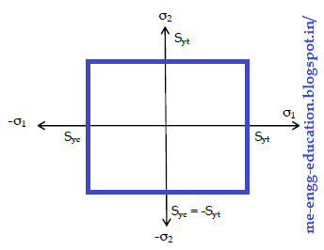




Conditions of failure and safe design
During a tension test, this fracture occurs when the normal stress reaches the ultimate stress. If the material is subjected to plane stress, failure occurs when:
For the design,
The maximum principal stress should not exceed
the working stress for the material :
Working Stress,
Here, F: Factor of Safety ​

Slide 6
Limitations
The theory only considers the effect of normal stress, neglecting the effect of shear stresses which can also cause the failure in materials.
The theory is only valid for brittle materials such as cast iron, concrete, ceramics, etc. and not for ductile materials as they undergo plastic deformation before failure.
It assumes that the material is isotropic i.e.it has the same properties in all directions. However, most of the materials are anisotropic with different properties in different directions.

Slide 7
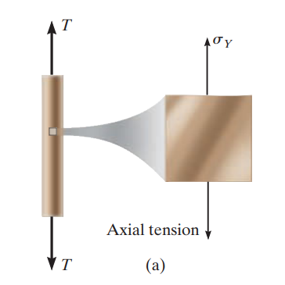
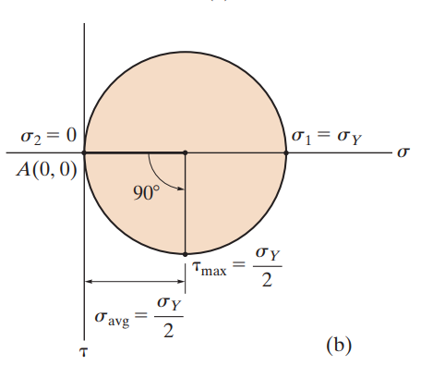
Maximum Shear Stress Theory (Tresca's Theory)
The theory states that the yielding of ductile material begins when the absolute maximum shear stress in the material reaches the shear stress that causes the same material to yield when it is subjected only to axial tension.
For example, if we twist a plastic spoon too much it will eventually break due to shear stress.

Slide 8
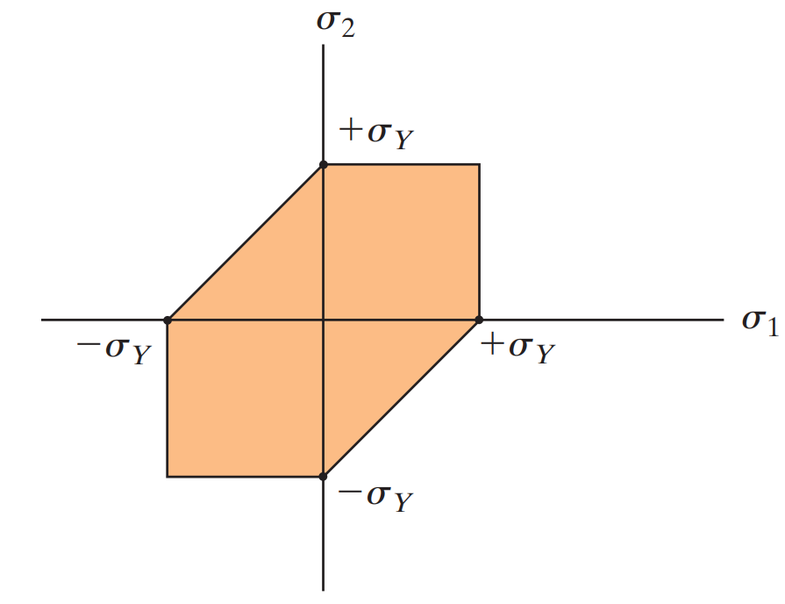



Conditions of Failure
For uniaxial stress, the failure condition is :
For plane stress
⇒
If any point of the material is subjected to plane stress, and its in-plane primary stresses lie on the boundary or outside the shaded hexagonal area indicated in the figure, the material will yield at that point, and failure of the material will occur.

Slide 9
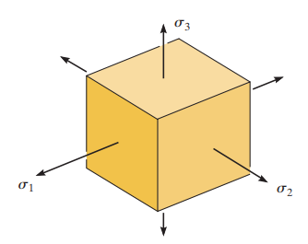

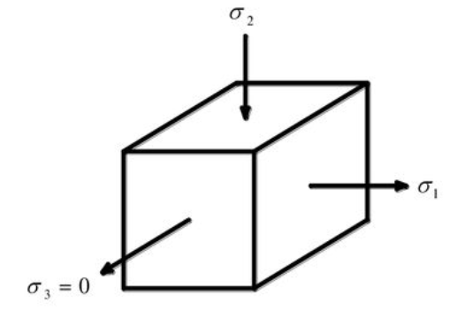


Condition for Safe Design
For the design, the maximum shear stress should not exceed the permissible shear stress:
Uniaxial Stress:
Biaxial Stress:
Triaxial Stress:​ ​

Slide 10
Limitations
The theory only considers the effect of shear stress and neglects the effect of normal stress. This can be problematic in situations where the normal stress is the dominant contributor to failure.
It is not applicable to situations where the stress is purely hydrostatic i.e. the normal stress is equal in all directions. In these situations, the maximum shear stress is zero and the theory cannot predict failure.
It also assumes that the material is isotropic i.e.it has the same properties in all directions. However, most of the materials are anisotropic with different properties in different directions.

Slide 11
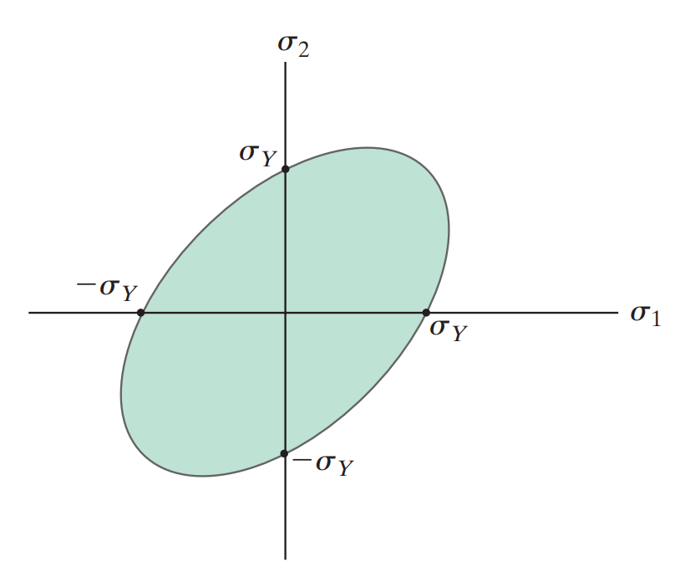

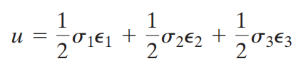
Maximum Distortion Energy Theory (Von Mises Theory)
The theory states that the elastic failure occurs when the shear strain energy per unit volume in the stressed material reaches a value equal to the shear strain energy per unit volume at the elastic limit point in tension.
The strain energy for uniaxial stress is given by:
For triaxial stress :

Slide 12



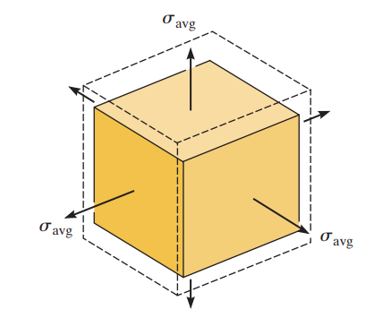
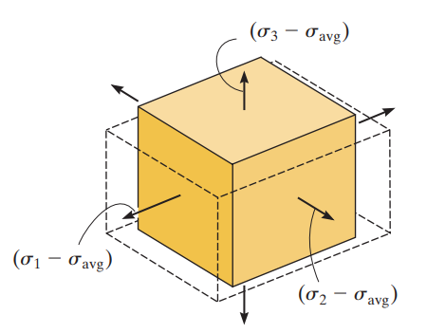
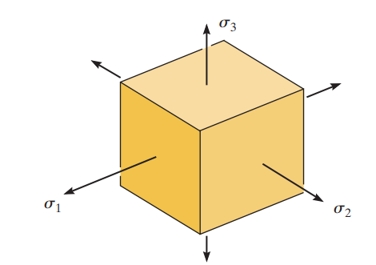


Distortion energy per unit volume:
For Plane stress (σ₃ = 0)
Uniaxial tension test (σ1 = σy , σ2 = σ3 = 0):​

Slide 13
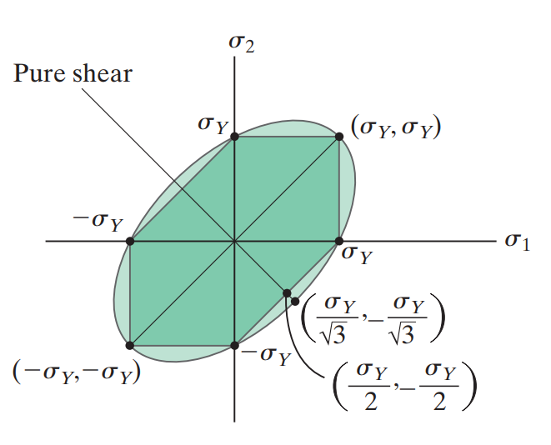

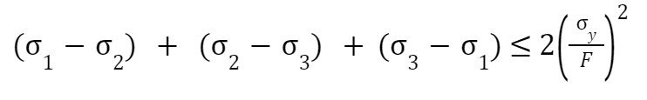
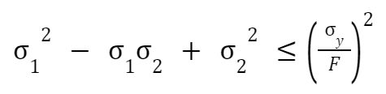
Condition for failure and safe design
The failure condition is:
For design in triaxial state of stress​ ​
Biaxial state of stress:

Slide 14
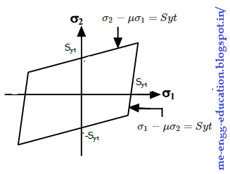

Maximum Normal Strain Theory
The theory states that the failure of a material occurs when the principal tensile strain in the material reaches the strain at the elastic limit in simple tension (or) when the minimum principal strain i.e. maximum principal compressive strain reaches the elastic limit in simple compression.
Principal strain in the direction of principal stress(σ₁):

Slide 15




Condition for failure and safe design
The failure condition:
For design, the maximum principal strain should not exceed the permissible strain.
For Biaxial stress:
F: Factor of safety
E: Young's Modulus

Slide 16
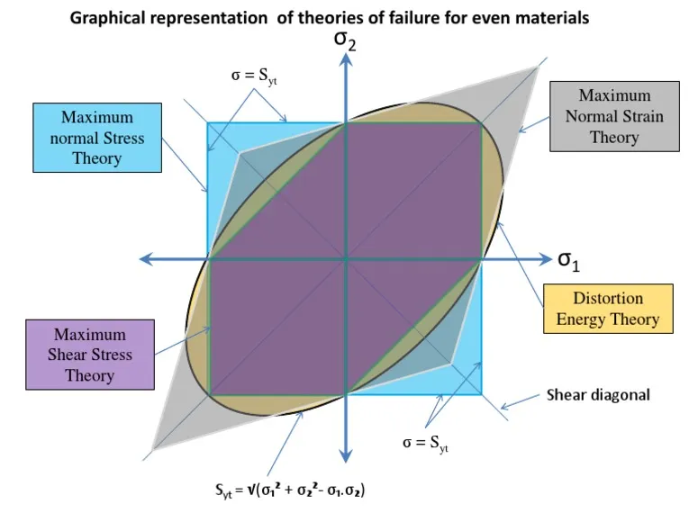
Comparison of Failure Theories
Maximum shear strain theory is the most conservative theory of all the failure theories.

Slide 17
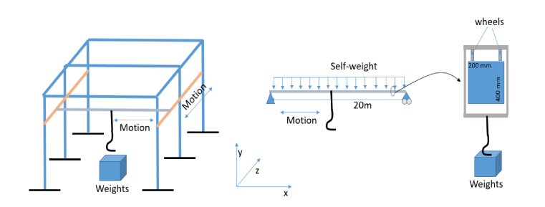
Part 2

Slide 18
In a storage house, the beam needs to carry weight upto 20KN.
The dimensions of the beam being (20x0.2x0.4) , the beam is to be made up of 10 layers of different materials, with each layer's height being 0.04m.
For computing the bending stress distribution of the beam, firstly we compute the modular ratio and then take out the equivalent length.
Further, we take out centroid of each layer followed by moment of inertia.
We get the maximum bending moment when the load is applied at the center of the beam.

Slide 19

For taking out the stress in each layer, we consider the center point of the layer.
Here:
M is the Bending Moment y is the perpendicular distance of the center of each layer from the neutral axis I is the total moment of inertia of the beam
For optimization, we put the high strength materials at the extremes and comparatively lower strength materials at the center.

Slide 20
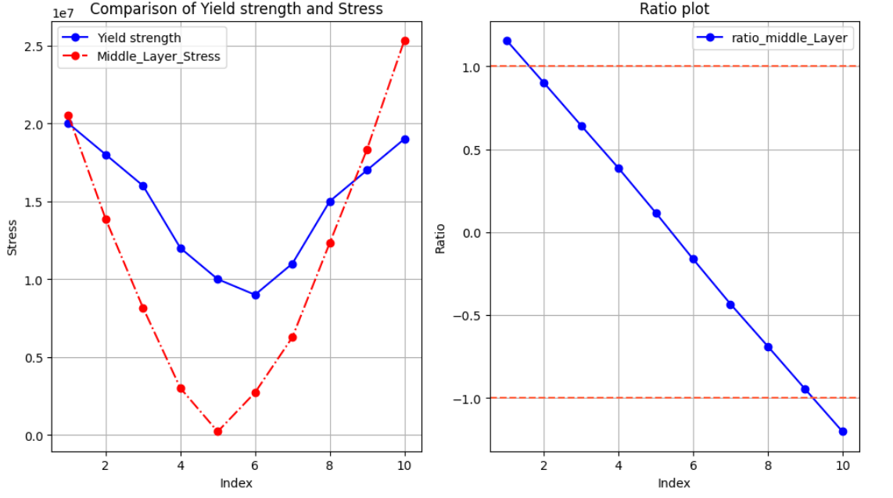

Slide 21
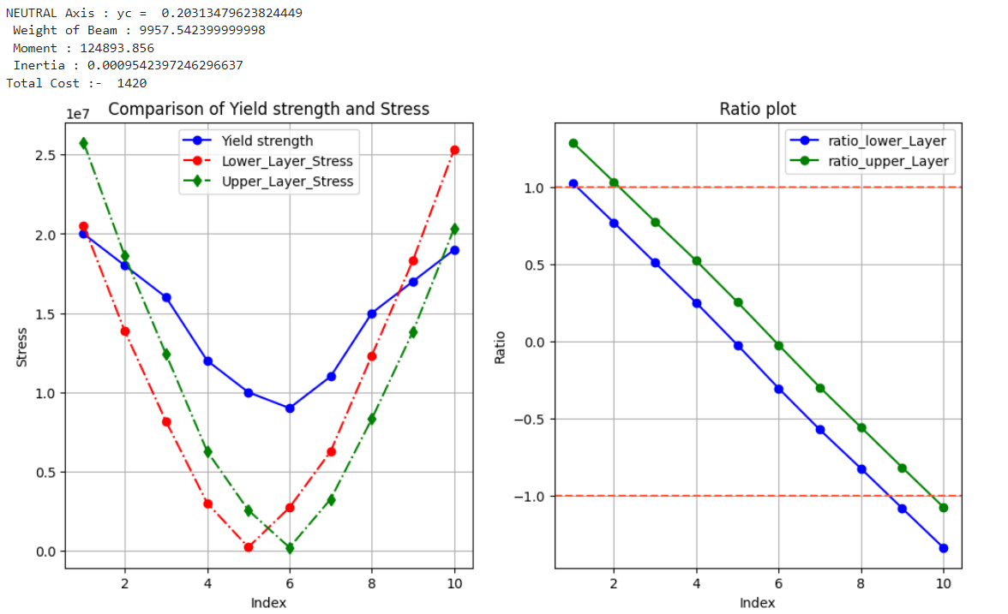

Slide 22
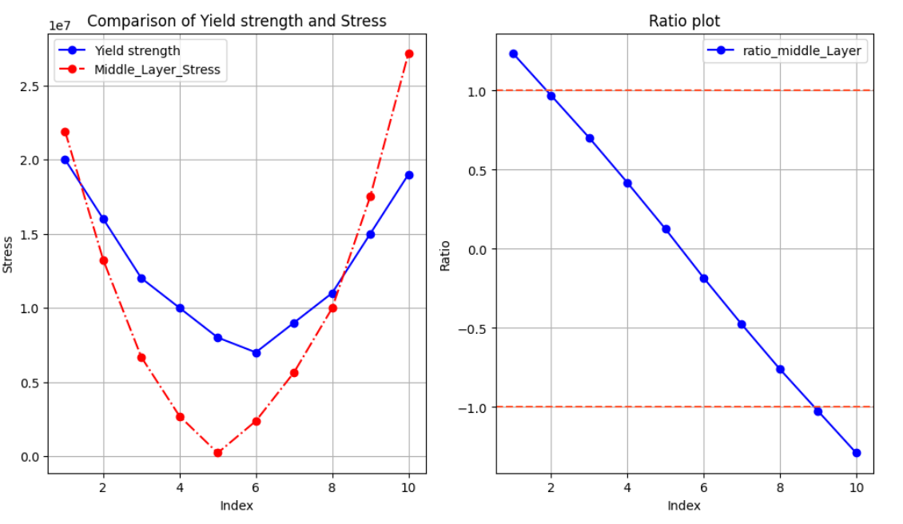

Slide 23
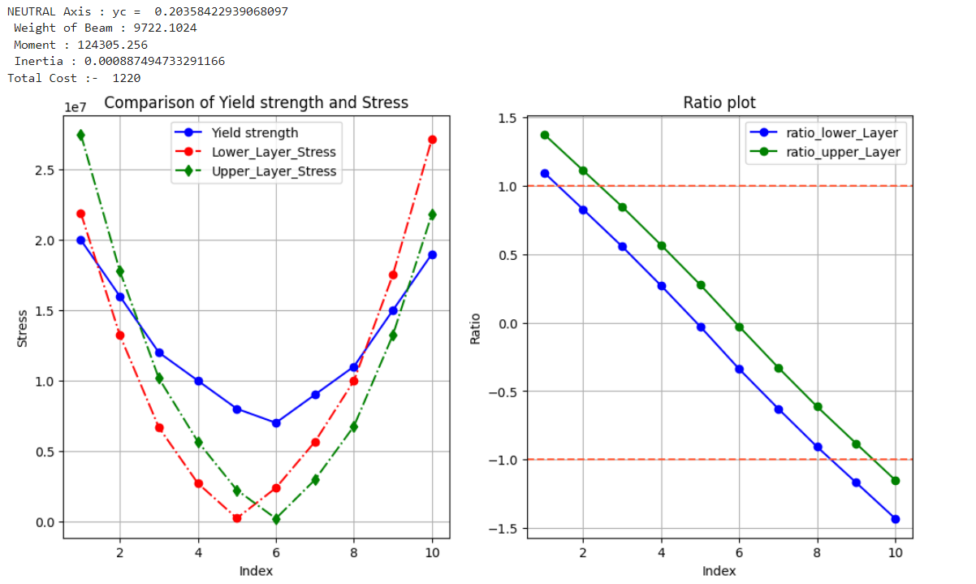

Slide 24
References:
Mechanics of Materials by R.C.Hibbeler
https://www.fidelisfea.com/post/brittle-and-ductile-failure-theories-in-fea-which-ones-should-we-choose
https://eng.libretexts.org/Bookshelves/Mechanical_Engineering/Structural_Mechanics_(Wierzbicki)/11%3A_Fundamental_Concepts_in_Structural_Plasticity/11.08%3A_Tresca_Yield_Condition

Slide 25
Contribution:
Ankit Kumar (B21CI006) - Failure Theories (Introduction & Comparison), In programming part worked on graphical representation and coding part and worked on theory behind the problem
Ruchit Kochar (B21CI038) - Failure Theories (Maximum Normal Strain Theory), in programming part worked on theory behind the problem and calculation and graphical interpretation
Jason Daniel (B21CI019) - Failure Theories (Maximum Normal Stress Theory), in programming part worked on the coding aspect and Graphical representation and interpretation and worked on theory behind the problem
Manoj Solara (B21CI027) - Failure Theories (Maximum Shear Stress Theory), in programming part worked on cost optimization part and worked on theory behind the problem
Mamta Kumari (B21CI025) - Failure Theories (Maximum Distortion Energy Theory), in programming part worked on cost optimization and worked on theory behind the problem

