Slide 1
ENGI 301 Laser Harp Controller PCB Proposal
26 November 2019
Jason Dennis

Slide 2
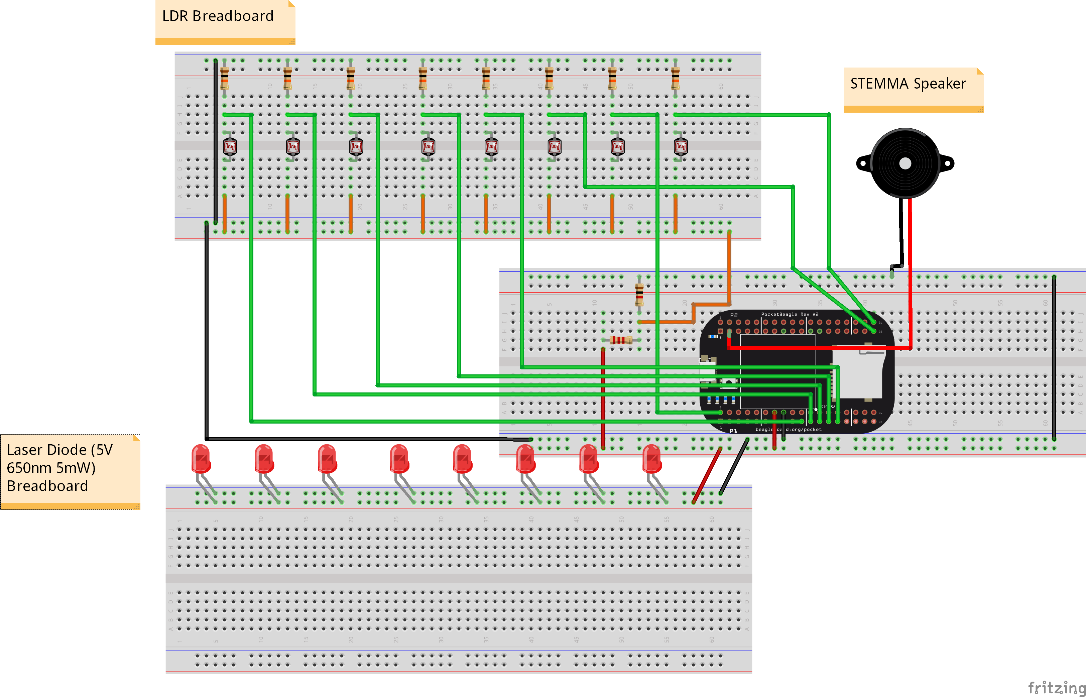
Background Information
Goal: To create a PCB for my laser harp controller that can be shared with the open source community
Board Functionality
Plugs into the pins of the PocketBeagle
Has ability to power/connect with 8 laser diodes and 8 photoresistors
Has one STEMMA speaker element attached to board

Slide 3
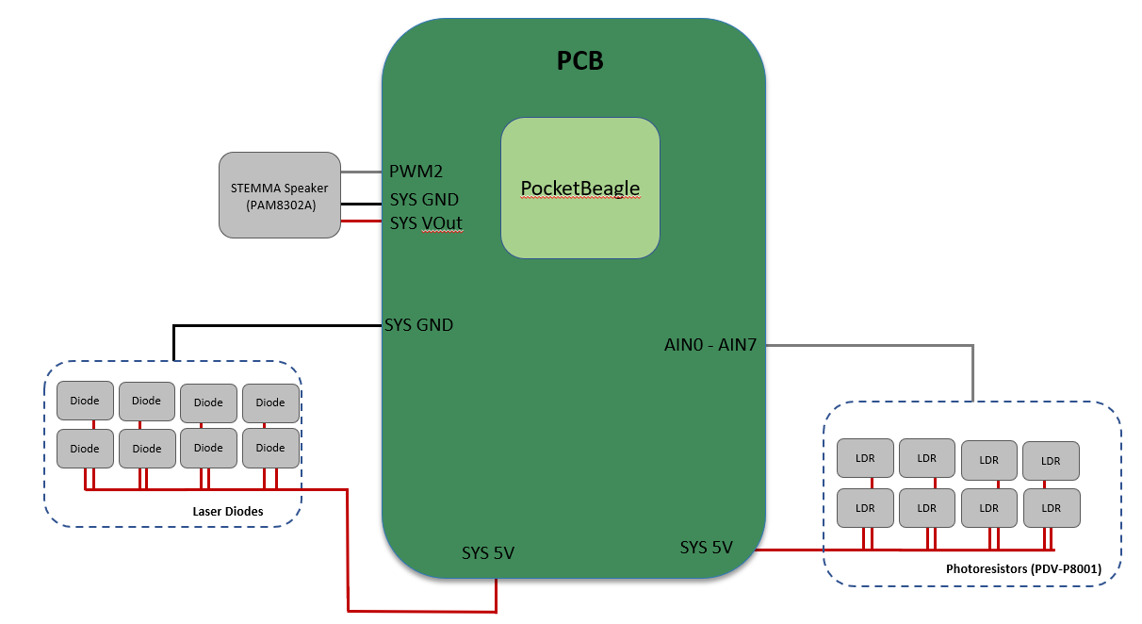
System Block Diagram
Note: 10 K resistors will be wired from the output of photoresistor to ground & input of pocketbeagle in parallel. Additionally, a voltage divider will be used to limit the voltage input for photoresistors.
Notes:
Check out the Zelda break candy dispenser on Hackster → look at library to generate musical tones
LED click screen (plugs right into inner rows on pocket beagle) → professor has 2 of them so you are more than welcome to do so
Add on/off switch
Add switch for two modes (maybe)
Maybe see if you can turn light off when you block light
Set two up to see how fast you can change tones
Cut down to like 8 tones (octave)
Try super bright LEDs and try to focus light with “pulled down housing”
Adafruit, sparkfun, or amazon
Add one with 8 dioes/resistors → then add stretch goals of 12
Introduce a transistor to add more current (max current to get out of pocket beagle is 5-6 mA)
ENGI301/project_1/docs

Slide 4
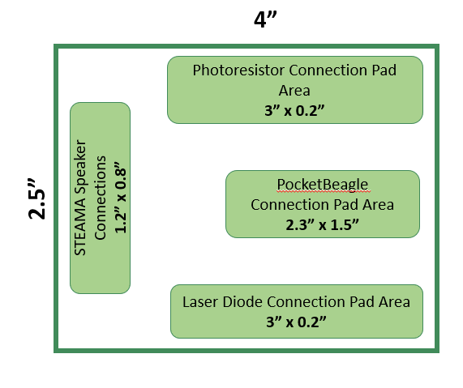
Layout Block Diagram
Note: Not drawn to scale
Notes:
2 pin JST connecters (https://www.amazon.com/daier-Micro-2-Pin-Connector-Female/dp/B01DUC1O68/ref=pd_sbs_21_t_1/140-8012437-1657602?_encoding=UTF8&pd_rd_i=B01DUC1O68&pd_rd_r=c74030ef-39c1-4d74-b80c-ef46d4e44e96&pd_rd_w=FxNwl&pd_rd_wg=mciUA&pf_rd_p=5cfcfe89-300f-47d2-b1ad-a4e27203a02a&pf_rd_r=49HJ5VSPD78PMP1PMTG4&psc=1&refRID=49HJ5VSPD78PMP1PMTG4)
Photoresistor → right angle
Lights → right angle
Mounting holes

