Slide 1
ENGI 301 Laser Harp Controller Proposal
19 October 2019*
Jason Dennis
*Updated 11/18/19

Slide 2
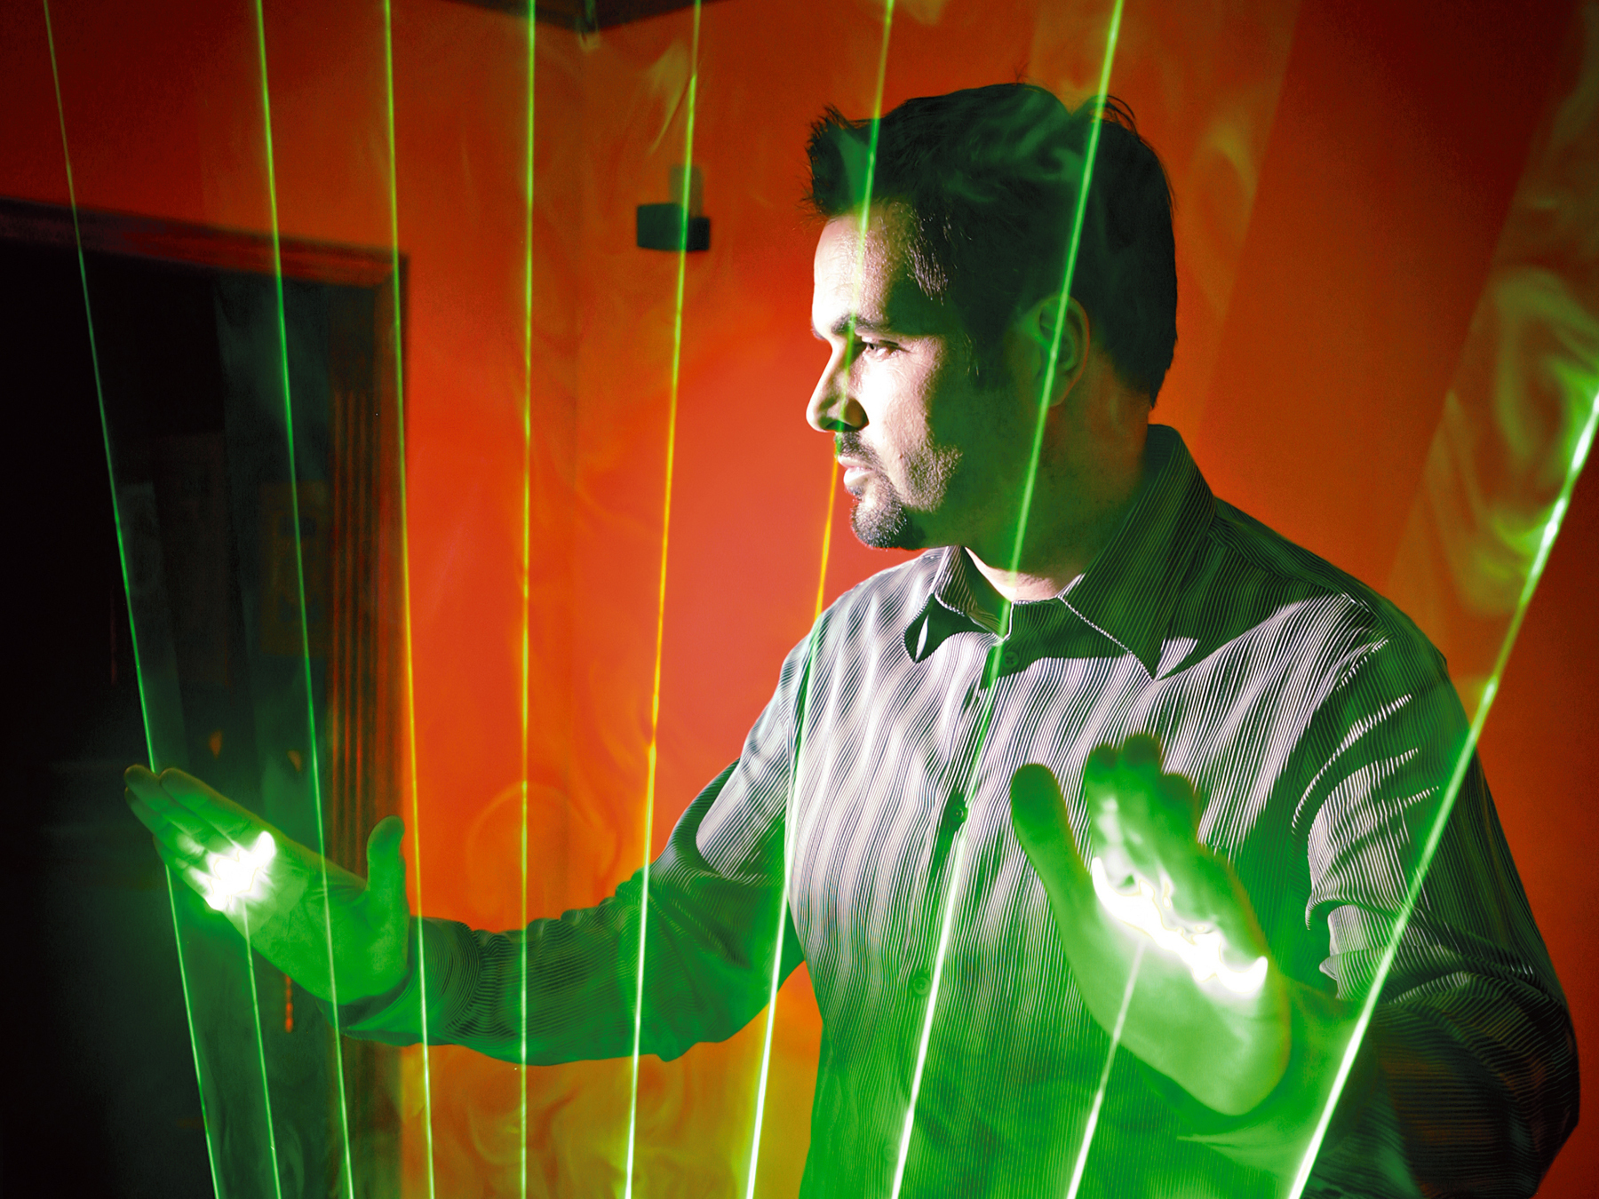
Background Information
Project Purpose: To create a laser harp that allows users to interactively play a musical instrument with just strings of light
A laser harp is an electronic musical user interface and laser lighting display
It projects several laser beams played by the musician by blocking them to produce sounds which are reminiscent of a harp
Possible Improvements / Additions
Improving the speaker / audio system to ensure the played sounds are as close to the real thing
Having a system to play multiple instruments, not just the harp
Incorporating adjustable sound
Building a stable structure to house the laser harp
Display showing what is being played
https://makezine.com/projects/laser-harp/

Slide 3
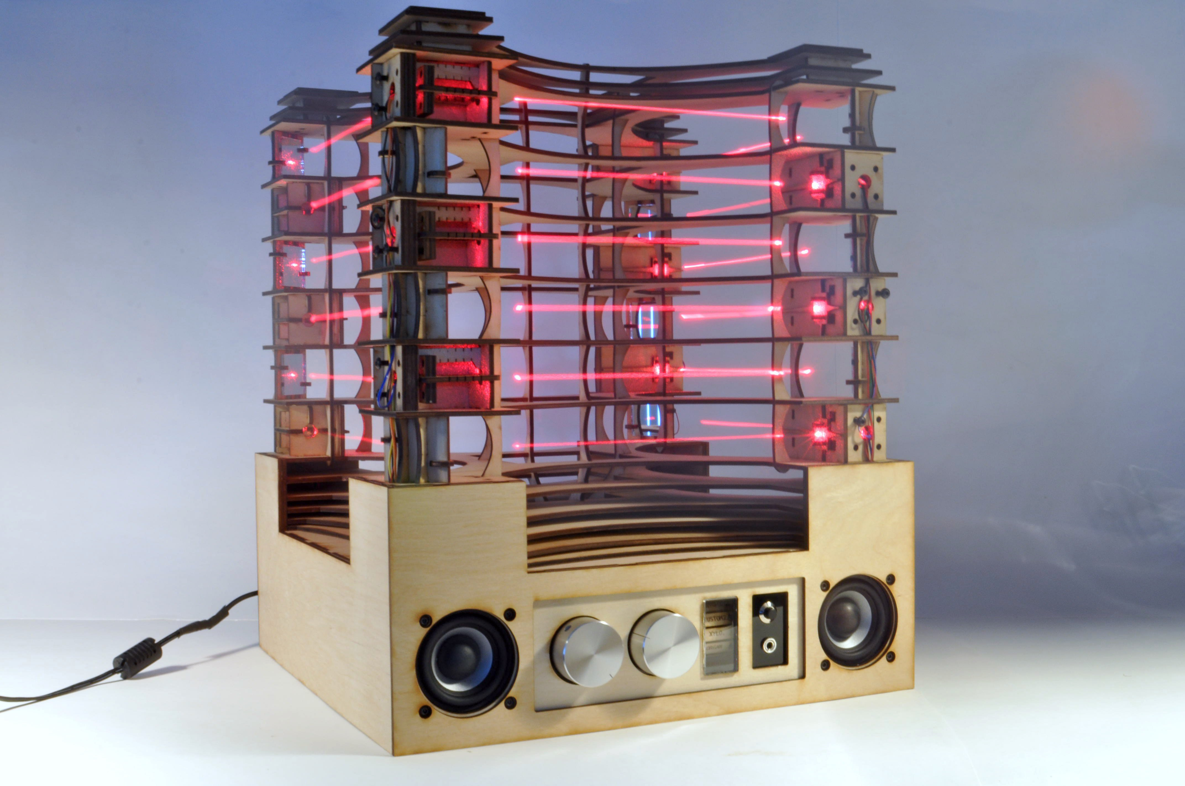
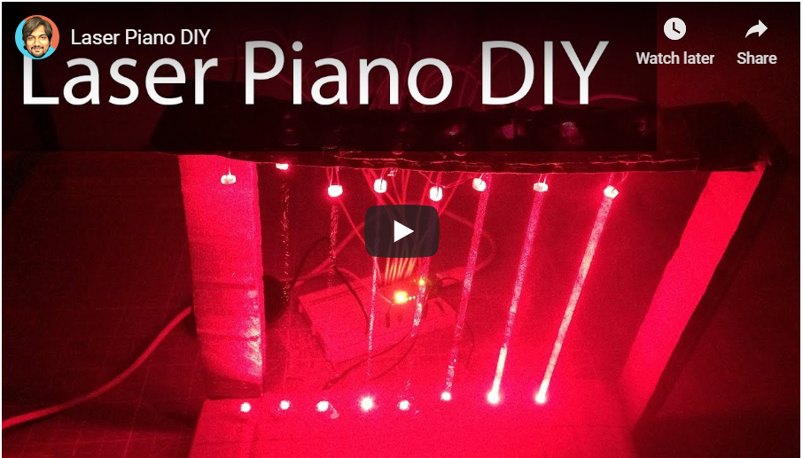
Link to Existing Projects / Libraries
Most Relevant Links / Projects
Frameless Laser Harp Arduino Code (Source)
Upright Laser Harp
DIY Laser Piano (electronic piano GitHub)
Simple Arduino Piano
Hello Drum Arduino Library
Tone Generation Library
Arduino – Tone Library
Bhagman – Tone (GitHub)
Other Useful Links / Projects
Running Arduino on BeagleBone
IR Breakbeam Candy Dispenser
Spotify-Pod

Slide 4
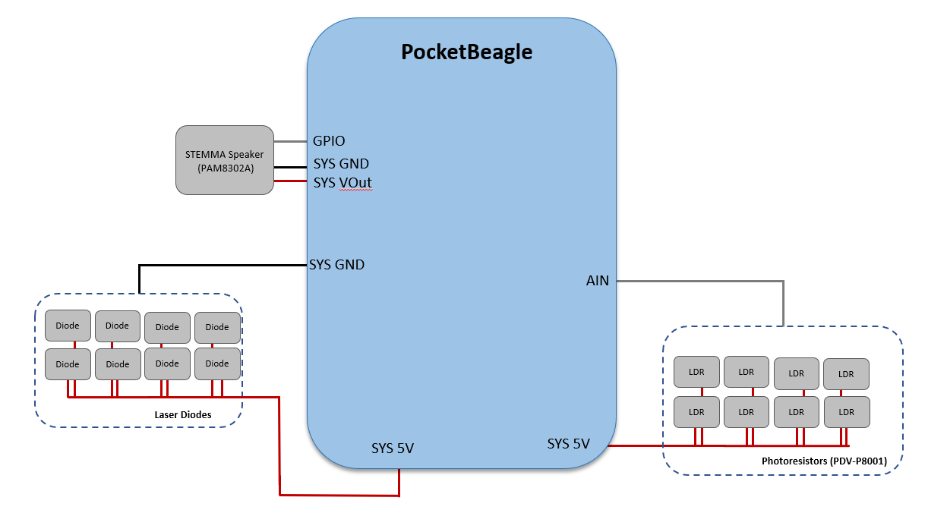
System Block Diagram
Note: 10 K resistors will be wired from the output of photoresistor to ground & input of pocketbeagle in parallel. Additionally, a voltage divider will be used to limit the voltage input for photoresistors.
Notes:
Check out the Zelda break candy dispenser on Hackster → look at library to generate musical tones
LED click screen (plugs right into inner rows on pocket beagle) → professor has 2 of them so you are more than welcome to do so
Add on/off switch
Add switch for two modes (maybe)
Maybe see if you can turn light off when you block light
Set two up to see how fast you can change tones
Cut down to like 8 tones (octave)
Try super bright LEDs and try to focus light with “pulled down housing”
Adafruit, sparkfun, or amazon
Add one with 8 dioes/resistors → then add stretch goals of 12
Introduce a transistor to add more current (max current to get out of pocket beagle is 5-6 mA)
ENGI301/project_1/docs

Slide 5
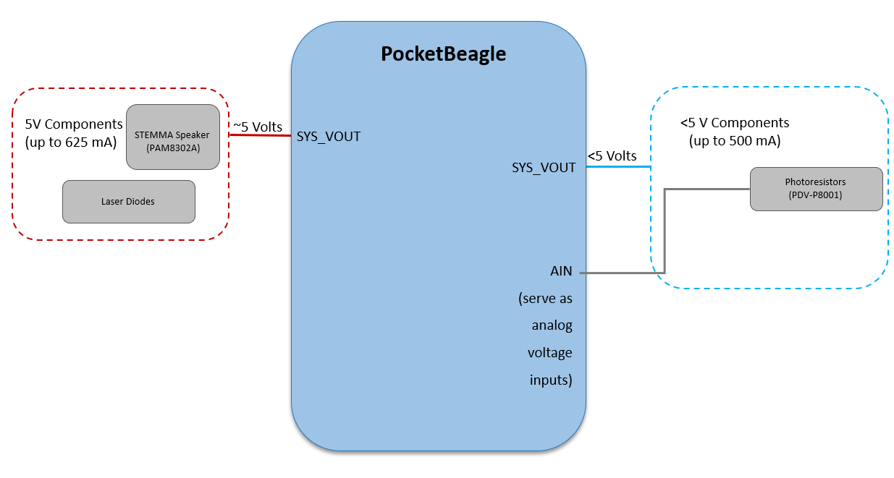
Power Block Diagram
Note: Will introduce a transistor to provide more current if necessary.
Notes:
- Look at voltage drops, and current limits of diodes (data sheet)

Slide 6
Components / Budget
` | Need to Buy* (Y/N) | Cost
BeagleBoard.org PocketBeagle | N
Adafruit STEMMA Speaker | Y | $5.95
Laser Diode (x8) | Y | ~$15
Photoresistor / LDR (x8) | N
Resistor 10k ohm (x8) | N
*If “N”, this means the component had been identified to exist in the OEDK.

