Slide 1
Differences in Usage Between Casual Riders and Membership Holders
Jason Heller
Last Updated: 8/30/22

Slide 2

About the Data
Results were extrapolated from Cyclistic’s datasets from August 2021 to July 2022.
Attributes of the data were split between membership holders and casual riders to compare how the two groups interact with the service differently.

Slide 3
Assessing the Data
There are some issues with the reliability of the data, such as missing data and changes in formatting over time.
The data is from a first-party source
The data is sufficient to do comparisons between membership holders and casual riders
The data is current at the time this case study was conducted
The data supplied was released under a license that allows for its use in this case study
The data is credible, and there are no signs of misrepresentation

Slide 4
Differences in Rider Volume

Slide 5
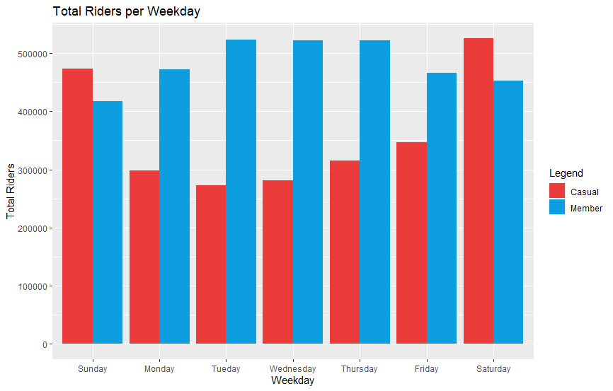
Total Riders Per Day for Each Rider Type
Members ride the most in the middle of the week (Tuesday to Thursday) whereas casual riders use the service mostly on the weekend
Casual ridership surpasses member ridership on weekends

Slide 6
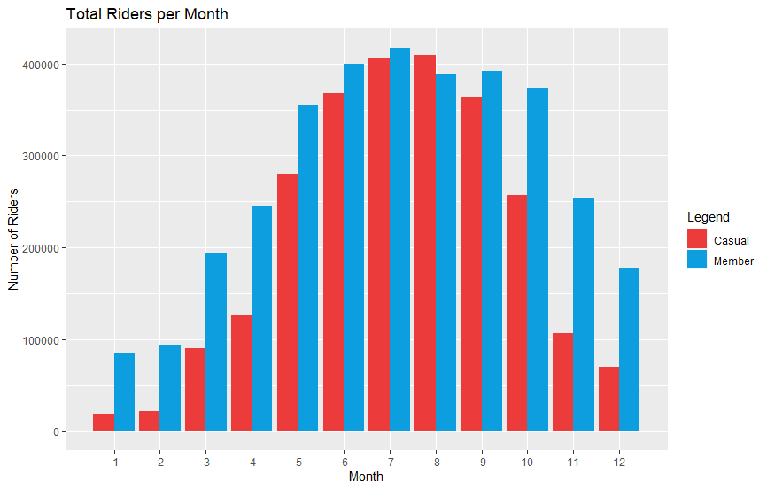
Looking at Demand on a Monthly Basis
Overall, the service sees the most traffic in the summer (May to September) and declines in the colder months
In the summer, member and casual ridership is similar, however members will ride more often in the winter compared to casual riders.

Slide 7
Differences in Ride Duration

Slide 8
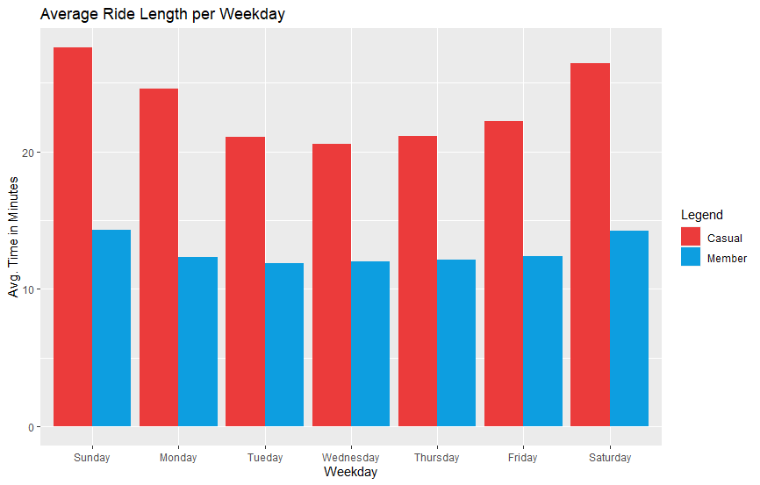
Average Ride Length per Day
Casual riders ride roughly twice as long compared to membership holders.
Ride lengths are longer on weekends for both groups.

Slide 9
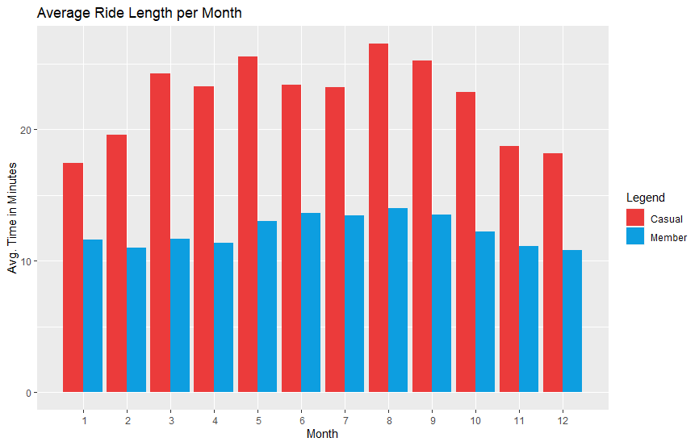
Average Ride Length per Month
Casual riders ride roughly twice as long compared to membership holders.
Ride lengths are longer on weekends for both groups.

